Slide 1


ED Pediatric performance snapshot
Connecticut
MedSChool Medical Center
Date
simulation: Feb 10, 2018

Slide 2
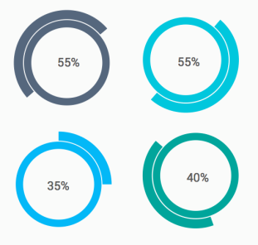

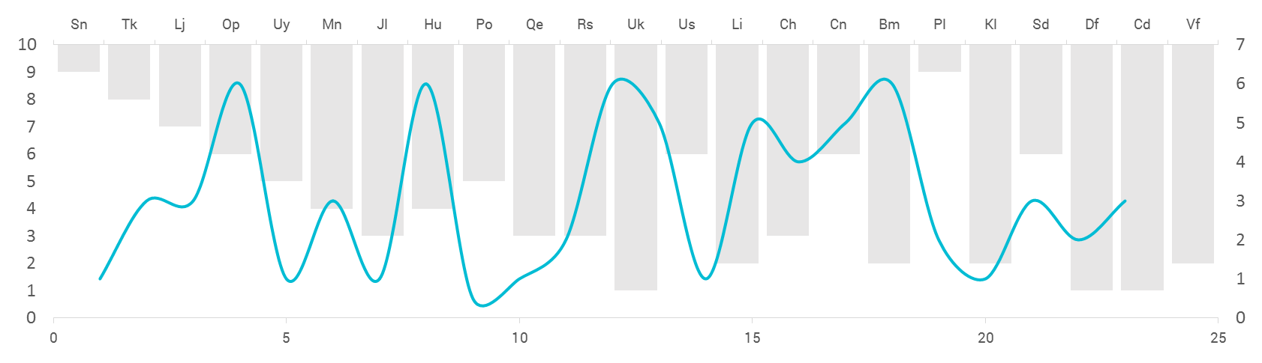
Data Collection
Methodology
In situ simulations were conducted in your ED bay.
Performance checklists were completed in person and via video review.
Data collected at your site were compared to other EDs.
Cases
Foreign body obstruction
Sepsis
Cardiac arrest
Seizure
Score Components
EMSC pediatric readiness score
Teamwork score
Case-performance scores
Teams
1-4 teams each comprised of 1-2 physicians, 3-5 nurses, and 2-3 nursing assistants or EMT personnel

Slide 3

Mission
ImPACTS aims to assess and improve the quality of care delivered to acutely ill and injured children

Slide 4
ImPACTS reach to date
33 EDs visited to date
Variable pediatric patient volume
8
Pediatric EDs
42,000
Pediatric patients annually
Pediatric EDs
55,000
total patients
25
General EDs
4,000
Pediatric patients annually
General EDs
44,000
total patients

Slide 5
What is the next step?
Prioritize Action Items
Set a Timeline
Improve Care
We want you to choose two action items from the next slide which in your opinion are the most important for your site to complete.
We want you to make these two action items your priority and we will support you to achieve them in coming two months.
Please feel free to contact us for any assistance or resources you might need for completing these actions.
We will follow up with you every 4 weeks to assist in your progress and support any roadblocks that you might face.

Slide 6

Contact Us
Patricia Padlipsky, MD, FAAP: patricia.padlipsky@gmail.com
Nancy McGrath, MN, RN, CPNP-AC/PC:
nmcg1@aol.com
Jumie Lee, MSN, RN, CPNP-AC/PC:
jumie1@yahoo.com
Marc Auerbach, MD, FAAP, MSc
Marc.auerbach@yale.edu

