Slide 1


ED Pediatric performance snapshot
Connecticut
MedSChool Medical Center
Date
simulation: Feb 10, 2018

Slide 2
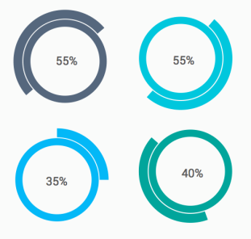

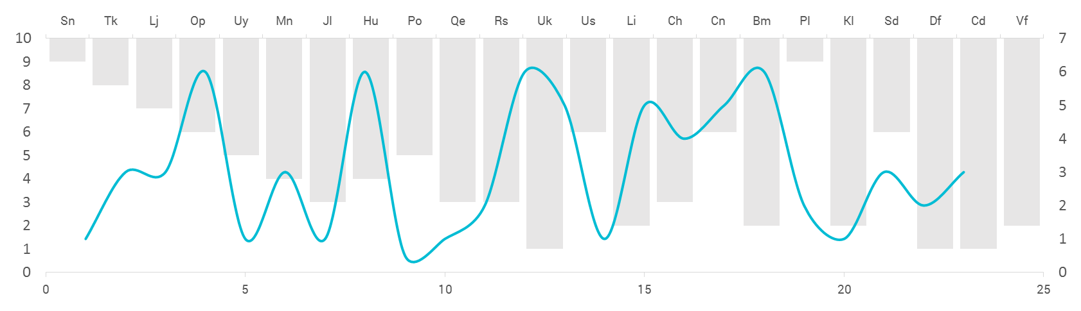
Data Collection
Methodology
In situ simulations were conducted in your ED bay.
Performance checklists were completed in person and via video review.
Data collected at your site were compared to other EDs.
Cases
Foreign body obstruction
Sepsis
Cardiac arrest
Seizure
Score Components
EMSC pediatric readiness score
Teamwork score
Case-performance scores
Teams
1-4 teams each comprised of 1-2 physicians, 3-5 nurses, and 2-3 nursing assistants or EMT personnel

Slide 3

Mission
ImPACTS aims to assess and improve the quality of care delivered to acutely ill and injured children

Slide 4
ImPACTS reach to date
33 EDs visited to date
Variable pediatric patient volume
8
Pediatric EDs
42,000
Pediatric patients annually
Pediatric EDs
55,000
total patients
25
General EDs
4,000
Pediatric patients annually
General EDs
44,000
total patients

Slide 5
In-situ Simulation based Case Performance

Slide 6
ED Pediatric Performance Snapshot
Case Performance | Foreign body
Case details
10-month old female, presents with chief complaint of stridor/drooling
Partial obstruction from Lego, inspiratory stridor, drooling, POX 100%
Complete obstruction at 3 min: stops crying, stops breathing, decreased POX
Improved POX/vitals when foreign body removed
Safety threats
Action items

Slide 7
ED Pediatric Performance Snapshot
Case Performance | Sepsis
Case details
Safety threats
10-month old female, presents with parent with vomiting/fever/lethargy
Mottled, cap refill 4 sec, tachycardia, normotensive, crying, CXR with pneumonia
Stops crying, more tachycardic, hypotensive, fluids improve HR
Fluids/pressors improve HR/BP
Action items

Slide 8
ED Pediatric Performance Snapshot
Case Performance | Seizure
Case details
Safety threats
10-month old female, presents with seizure after vomiting for days
Generalized seizure, no response to benzo, perioral cyanosis—dec with O₂
Glucose 40, seizure stops with dextrose
Post-seizure care, glucose infusion
Action items

Slide 9
ED Pediatric Performance Snapshot
Case Performance | Cardiac arrest
Case details
5-year old male, found in bathtub by parent pulseless/apneic
PEA requires 2 dose of Epi to convert Vfib
Vfib- convert sinus after Defib
Post resuscitation care
Safety threats
Action items

Slide 10
ED Pediatric Performance Snapshot
Overall Performance | Other Elements
Assessment

Slide 11
What is the next step?
Prioritize Action Items
Set a Timeline
Improve Care
We want you to choose two action items from the next slide which in your opinion are the most important for your site to complete.
We want you to make these two action items your priority and we will support you to achieve them in coming two months.
Please feel free to contact us for any assistance or resources you might need for completing these actions.
We will follow up with you every 4 weeks to assist in your progress and support any roadblocks that you might face.

Slide 12
Action Items Summary:
Choose ONE action item on which you will work for coming 6 months:

Slide 13
ED Pediatric Performance Snapshot
Appendix
Gap Analysis of Pediatric Readiness Assessment:
Physicians Nurses and Other health care providers who staff the ED
Have specific pediatric competency evaluations for physicians staffing the ED.
Guidelines QI/PI in the ED:
Collection and analysis of pediatric emergency data.
Guidelines for improving pediatric patient safety in the ED:
Written procedure in place to notify physicians when abnormal vital signs.
All children in ED are weighed in kilograms and/or weight is recorded in kilograms.
Guidelines for policies and procedures and protocols for the ED:
Immunization assessment and management of the under-immunized child
Assessment and Reassessment
Inter-facility guidelines.
Triage Policy
Child Death
Family Centered Care
Guidelines for equipment, supplies, and medications for the care of pediatric patients in the ED
Central Venous Catheter (any two sizes in range 4f-7f)
Nasopharyngeal Airways: infant and child size
LMA: size 1.5
Tracheostomy tubes: size 3.0 ,3.5, 4 mm
Link for EMSC Toolkit

Slide 14
ED Pediatric Performance Snapshot
Smart Aim Example
Rapid Fluid Infusion
To increase percentage of staff that can demonstrate delivery of 40-60 cc/kg in less than 10 minutes using push/pull by 25% within 6 months
Action Plan Example:
Administration and Infrastructure
Review institution policy/guidelines/training related to rapid fluid delivery in infants/children including scope of practice and determination of competency for push-pull.
Adapt policy/guidelines to ensure providers can use variety of methods for rapid fluid administration
Work with academic site and/or suppliers to ensure equipment is available in ED in area where children are cared for including (syringes 30 or 60 cc, three-way stop cock and tubing)
Stock push/pull kits for peds fluid delivery in appropriate areas (resusc cart, borsleow cart)
Develop a process for provider rapid fluid delivery training and competency assessment with push-pull technique
Get leadership approval on actions and activities to be implemented and resources needed
Training and Education
Identify potential trainers and conduct train-the-trainer sessions if needed
Identify initial target group of trainees and schedule training either one on one during shift or during competency/education day
Keep a record of all trainees who completed the training and are deemed competent
Click here to go back to previous slide

Slide 15
ED Pediatric Performance Snapshot
Smart Aim Examples
Weight Based Dosing
To increase the percentage of staff who demonstrate the ability to calculate appropriate weight based dosing of medications in less than two minutes using a standardized reference + local equipment/guidelines by 25% within 6 months.
Action Plan Example:
Administration and Infrastructure
Review institution policy/guidelines/training related to pediatric medication dosing and obtaining wt in kg
Work with local team/leadership to adapt policy/guidelines/training to ensure all patients have wt documented in kg (estimated or via bed scale)
Develop a process for standardization of a system/process to estimate weights and calculate dosing
Get leadership approval on actions and activities to be implemented and resources needed
Training and Education
Identify potential trainers and conduct train-the-trainer sessions if needed
Identify initial target group of trainees and schedule training either one on one during shift or during competency/education day
Keep a record of all trainees who completed the training and are deemed competent
Click here to go back to previous slide

Slide 16
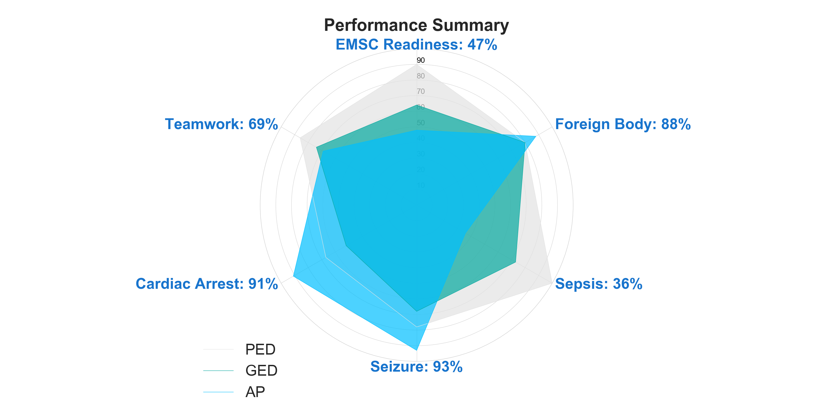

Slide 17
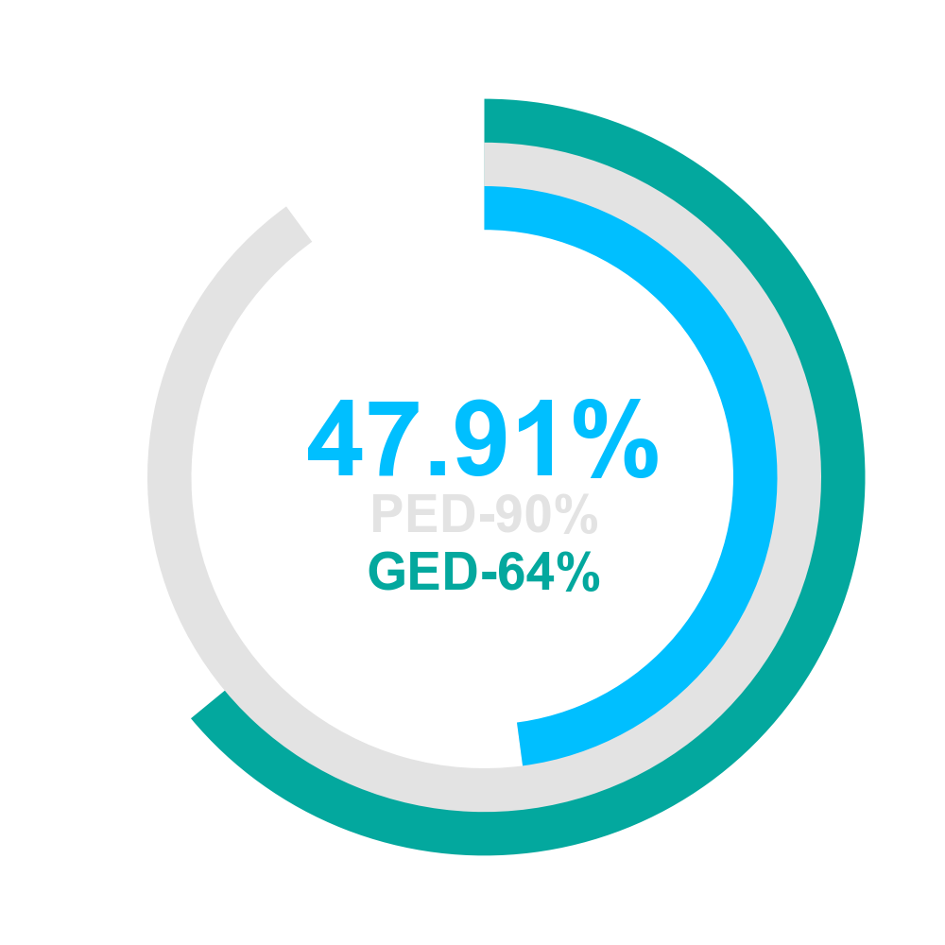
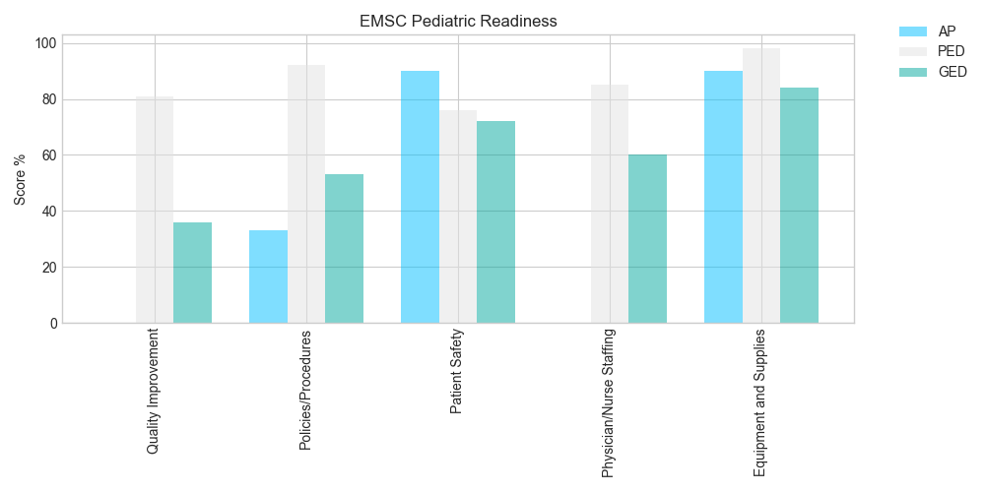

Slide 18
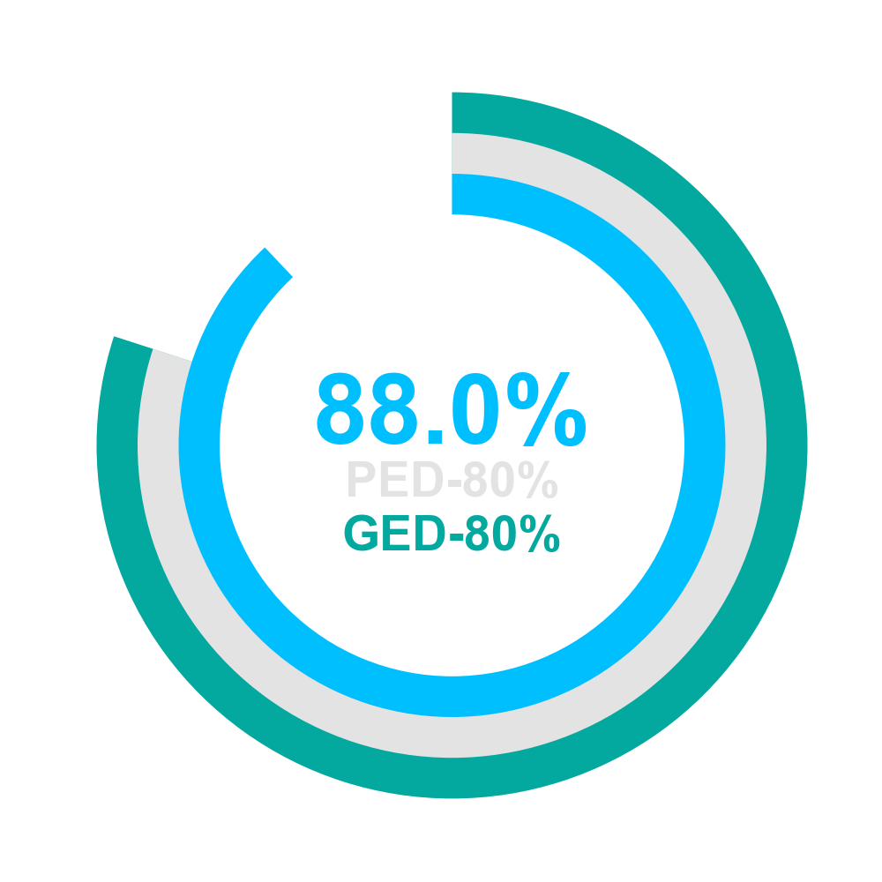
Foreign Body | Team 1 | Team 2
Airway assessed | Yes | Yes
Breathing assessed | Yes | Yes
McGill forceps used | No | Yes
Stridor verbalized | Yes | Yes

Slide 19
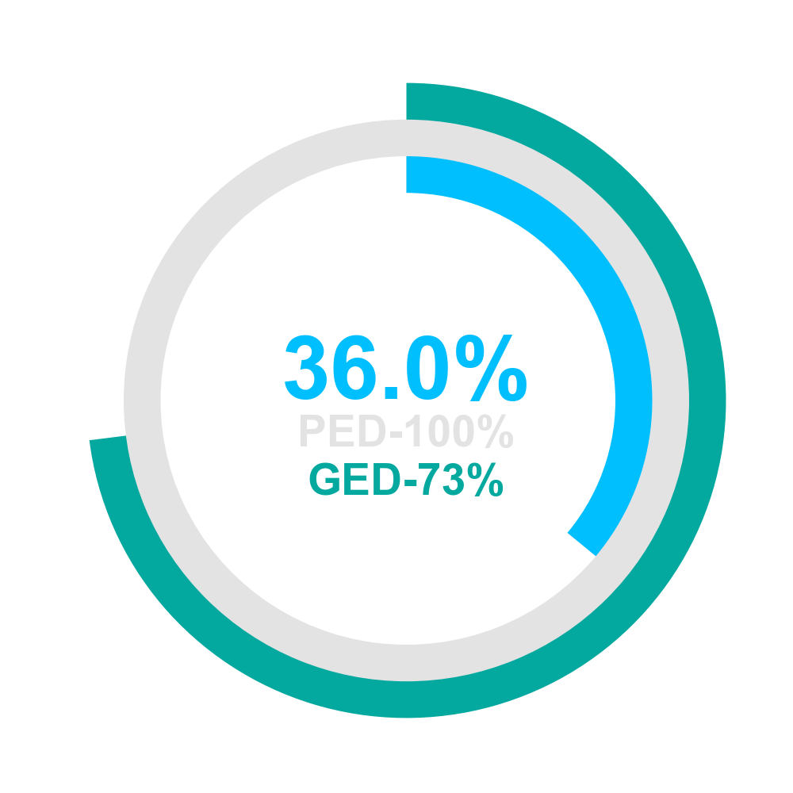
Sepsis | Team 1 | Team 2
60mL/kg given over 15min | No | Yes
Start 3rd vasopressor after 3rd bolus | No | No
Appropriate antibiotics given | No | No
Began high-flow O2 | No | No
Establish 1st IV/IO | Yes | Yes
Establish 2nd IV/IO | No | Yes
Push-pull techniques used | Yes | No

Slide 20
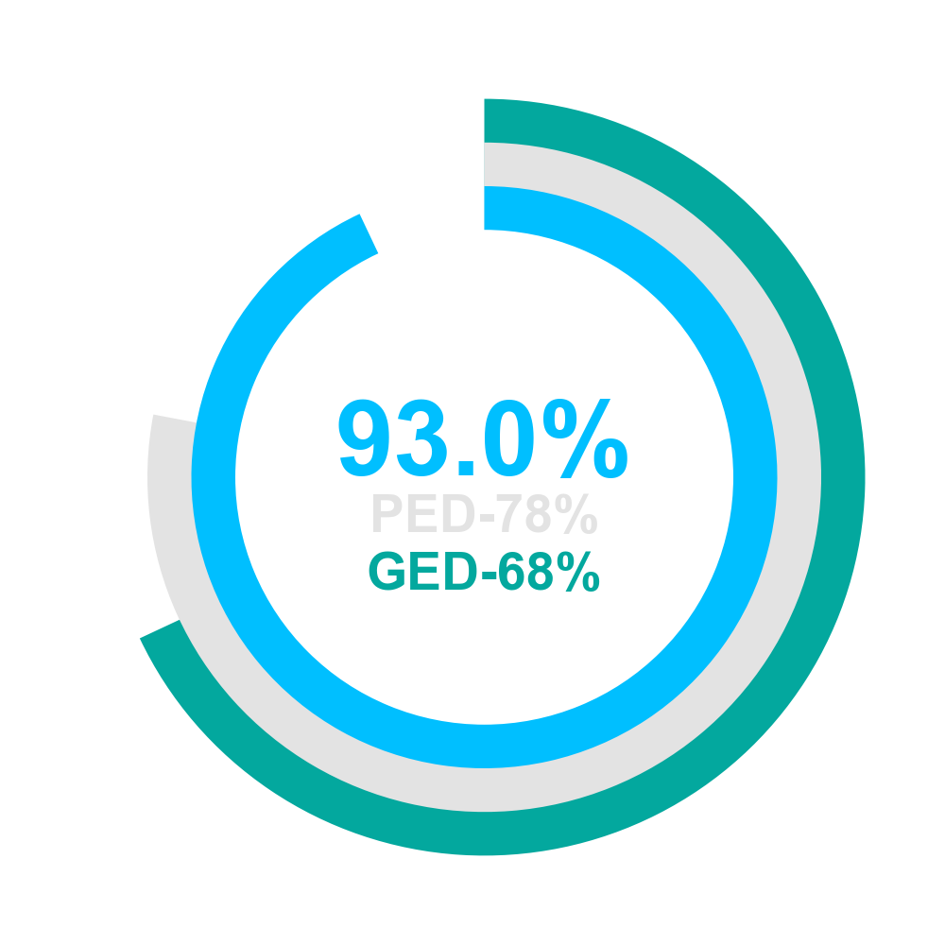
Seizure | Team 1 | Team 2
Maintenance glucose started | Yes | Yes
Correct glucose concentration | Yes | Yes
Bedside glucose checked | Yes | No
Placed on O2 | Yes | Yes
Correct Glucose dose | Yes | Yes
IV/IO placed | Yes | Yes
Respiratory depression recognised | Yes | Yes

Slide 21
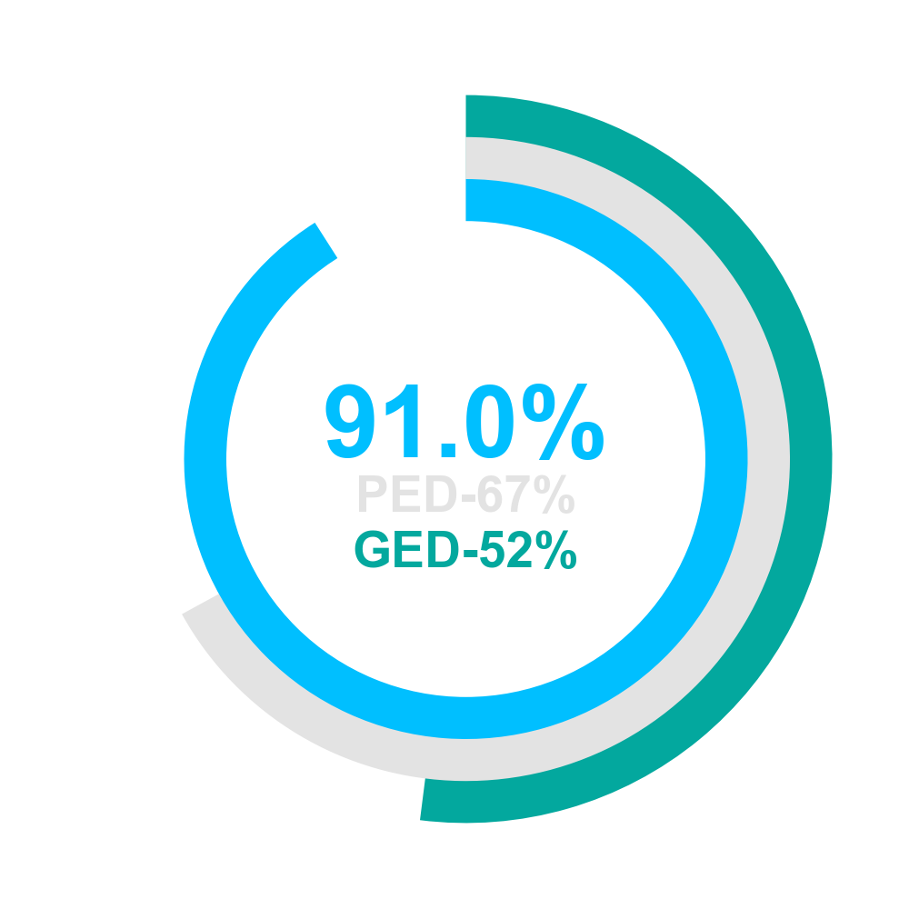
Cardiac arrest | Team 1 | Team 2
<10 sec stop/pause CPR preshock | Yes | Yes
ALL CPR cycles 120 | Yes | Yes
Adequate recoil | Yes | Yes
Backboard used | Yes | Yes
CPR resumed immediately after DEFIB cont 120sec | Yes | Yes
CPR started in <30 sec | Yes | Yes
Compression rate between 100-120/min | Yes | Yes
Continuous ETCO2 monitoring | Yes | No
Correct depth | Yes | Yes
Correct hand location | Yes | Yes
Intubation equipment | Yes | Yes
Defib safety: cleared people/O2 | Yes | Yes

Slide 22
Cardiac arrest | Team 1 | Team 2
Defibrillation dose 32-100J | Yes | Yes
1st dose of Epi in <5min | No | Yes
2nd dose of Epi in 2-3min after 1st | Yes | Yes
IV/IO placed | Yes | Yes
No interruptions > 10 seconds | No | Yes
PEA verbalized | Yes | Yes
Patient intubated pause <10sec | Yes | No
Pulse check < 120 sec into case | Yes | Yes
ROSC stated | Yes | Yes
Ventilation rate between 8-10/min | Yes | Yes
Ventricular fib verbalized | Yes | Yes

Slide 23
Other Elements | Score
Family Presence | 88.0
Proper weight assessed | 86.0
Teamwork Evaluation: CTS Tool | 69.0
Disposition | 100.0
Family centered care | 100.0

