Slide 1
Presenting Data
Charts and tables: which to use and how to use them effectively

Slide 2
When to use tables
Small data sets
Categorical data, e.g., a set of benchmarks
When data need to be accurate/precise

Slide 3
When Charts Are Good
Lots of data
Comparisons among multiple heuristics/algorithms
No need for precision
Interesting and compelling behavior and/or relationships
Important to show trends

Slide 4
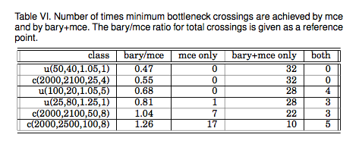
Table Example 1
Notes:
A reasonably good table. Data show, among other things, a clear relationship between the bary/mce ratio and the effectiveness of mce alone in solving the bottleneck crossings problem.

Slide 5
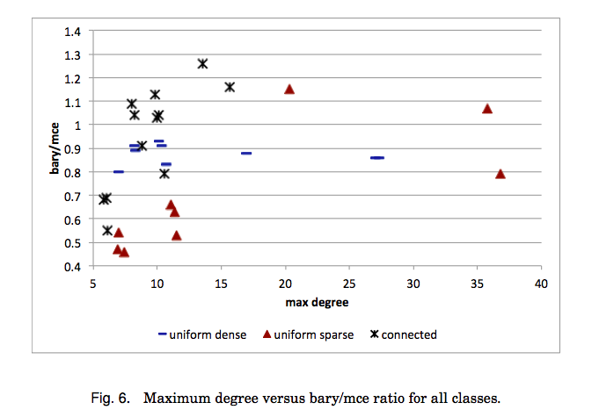
Chart Example 1
Notes:
Scatterplot is often a good way to illustrate relationships (correlations) between two quantities. It’s often ideal if the goal is to show a relationship between some measure of a problem instance and runtime or solution quality.

Slide 6
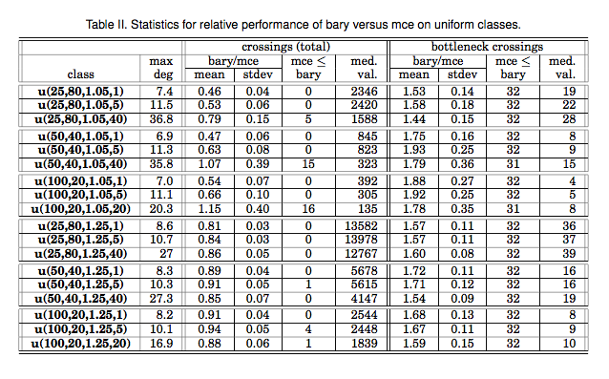
Table Example 2 - details for Chart 1
Notes:
Too much information. This table is not terribly useful, except to provide detailed numbers for the chart on the next page.

Slide 7
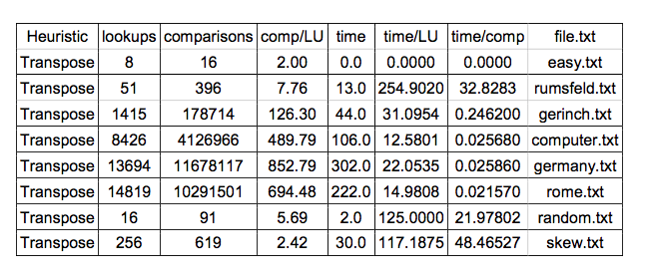
Table Example 3
Bad: numbers don’t line up; way to many decimal places
Notes:
Table is hard to read for several reasons:
there is no logic to the order of the rows
numbers are not lined up properly, hard to see how they relate
too much precision (4 decimal places is most likely noise)
not clear what the point is; table shows results for only one heuristic; need to consult separate tables for other heuristics

Slide 8
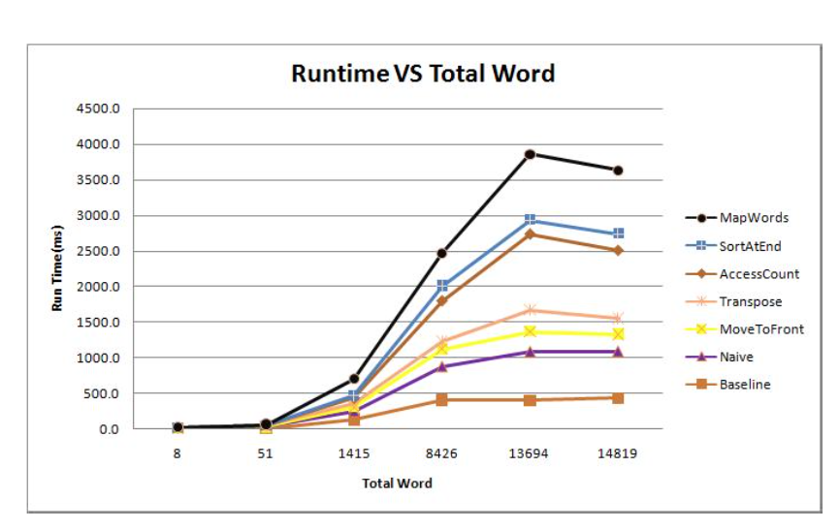
Chart Example 2
Notes:
Except for the fact that there’s no explanation for the decrease in runtime at the last data point on some of the lines, this is a pretty good chart:
it compares several heuristics
it’s easy to see both the comparative runtimes and the growth rate in runtime
data points are identified by both color and shape

Slide 9
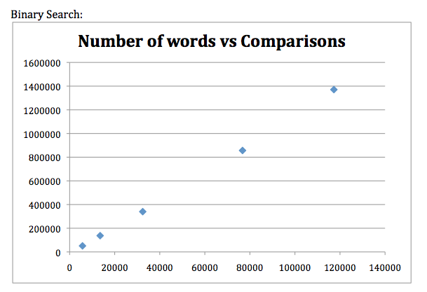
Chart Example 3
Bad: pretty useless - nothing is being compared
Notes:
Virtually no useful information that could not have been conveyed by a table. Some major shortcomings are:
too much white space
no comparison or interesting trends; might as well have shown a straight line
numbers have too many 0’s; could have expressed in increments of 1,000 or as powers of 2 (it appears, in fact, that each data point is double the previous)

Slide 10
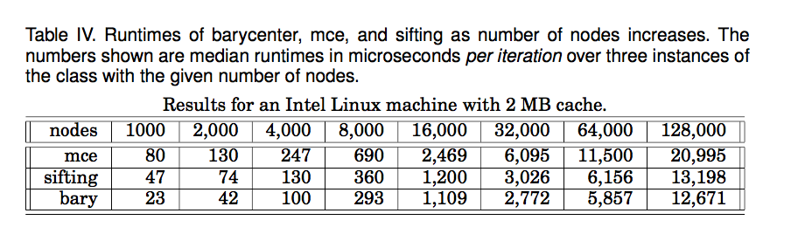
Table Example 4
Notes:
Pretty reasonable table. Doesn’t take the reader too long to see that the numbers roughly double as number of nodes doubles except for the big jump between 8,000 and 16,000 (could have said 8K and 16K to avoid the 0’s). A chart might be useful as well but not really necessary and the chart might have scaling issues. The jumps (actually there also a smaller one between 4k and 8k) were explained in terms of cache behavior.

Slide 11
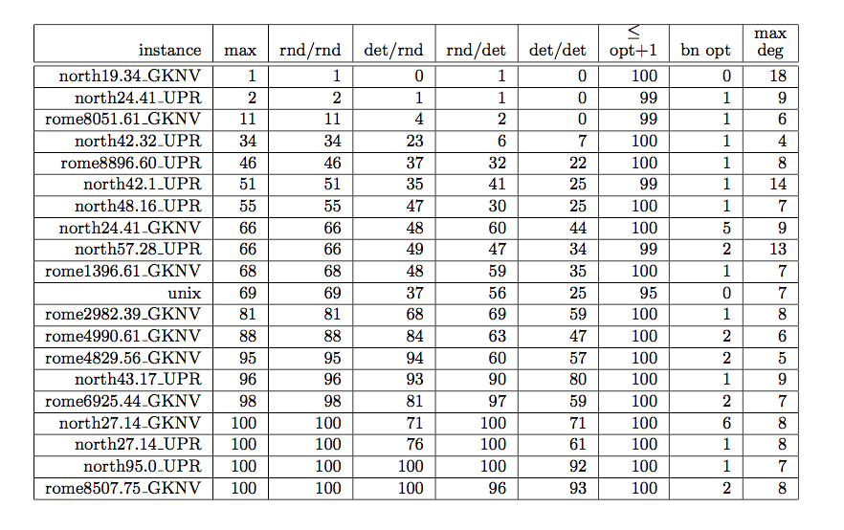
Table Example 5
TMI - hard to see relationships
Notes:
Too much information and not well organized. The text (not shown) does a reasonable job of explaining what’s going on. The numbers in the columns max through det/det represent number of runs out of 100 that each sequence of two heuristics achieved the optimum solution. The next column gives the number of times at least one combination came within one of optimum. The columns “bn opt” and “max deg” represent the value of the optimum solution and the maximum degree of the input graph, respectively (no discernable pattern, so not clear why this information is included).

Slide 12
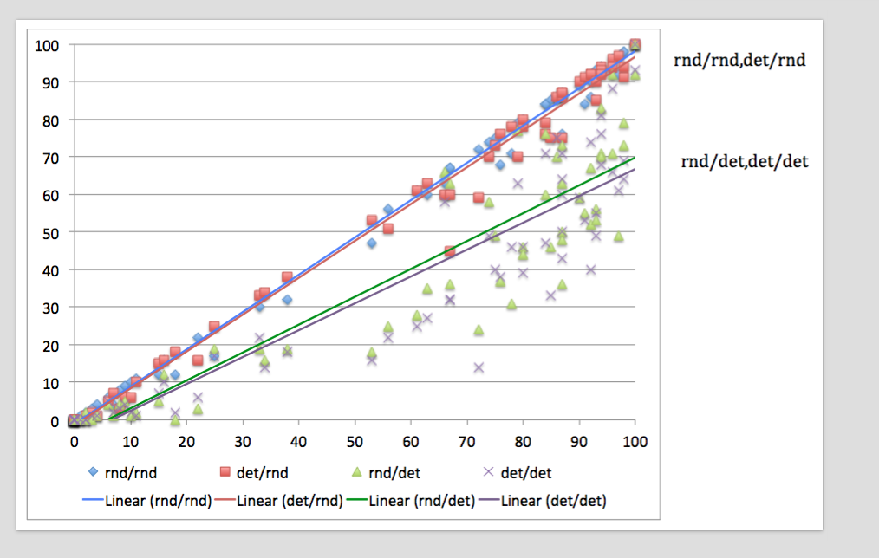
Chart Example 4 (based on Table Example 5)
chart is better in this case
Notes:
This chart summarizes the information on the previous page. The problem instances are sorted by number of times the optimum is achieved. The lines are least squares trend lines. The main point is that the combinations that randomize the second stage do better than those that don’t. And the latter have results all over the map while the former come pretty close to their trend lines.

Slide 13
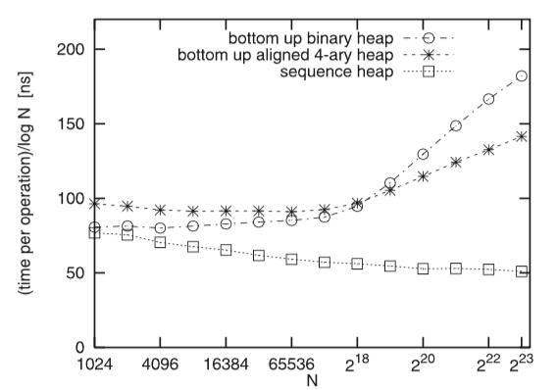
Chart Example 5
Nice: shows clear relationships among three types of heaps as n gets larger.
Potential improvement: use 2¹⁰, 2¹², etc. instead of 1024, 4096, etc.
Notes:
Note the division by log N here; this would mean that a heap with O(lg N) time per operation would have a horizontal line (modulo some lower order terms); so this chart is a nice illustration of the effectiveness of a sequence heap in relation to the others.

Slide 14
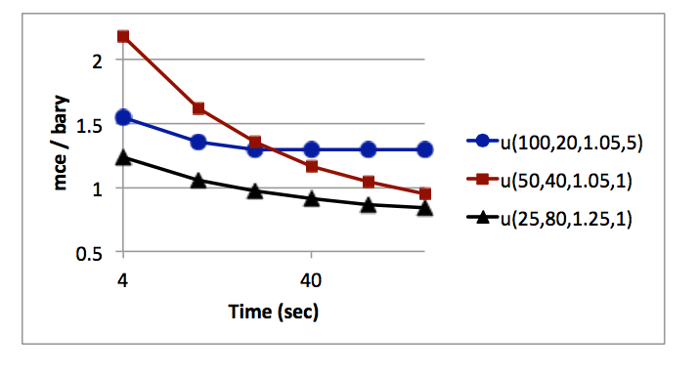
Chart Example 4
Notes:
The text (not shown) explains that this shows what happens to (relative) solution quality when the two heuristics are allowed more runtime. The main point is that the quality of mce improves at a faster rate than bary, up to a point. In one case (u(100,20,1.05,5)), however, it never gets as good as bary. Some experiments later in the paper show that bary followed by mce does much better on this instance.

Slide 15
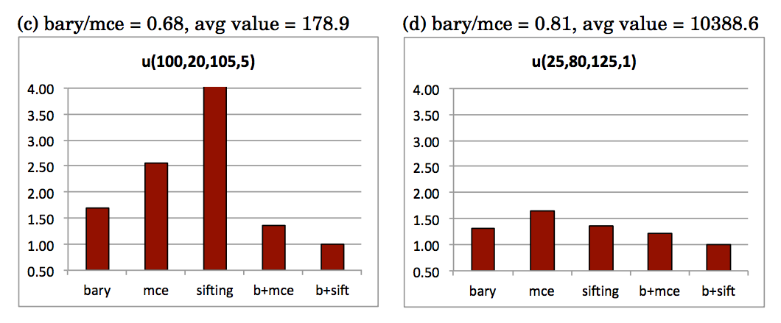
Chart Example 5
Shows ratio between each heuristic/combination with respect to best one.
These are two of six charts. The relevant measure is total number of crossings.
Notes:
A nice bar chart showing comparisons. There is a hidden scaling issue here – the chart on the right is more “compressed” simply because the numbers are larger.

Slide 16
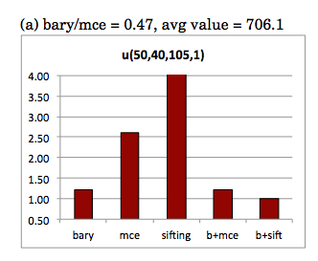
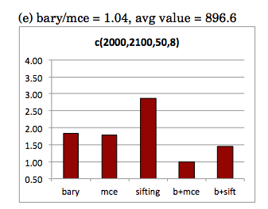
Chart Example 6
Notes:
No scaling issue here.

Slide 17
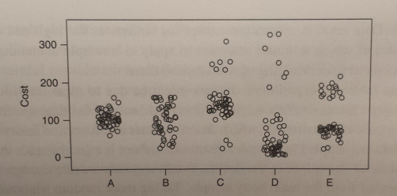
Chart Example 8 - Jitterplot
Good way to show results of multiple trials when variance is large
Notes:
Jitterplot from Cathy McGeogh’s textbook. Good way to show variation in results for each heuristic. This is a generic example.

Slide 18
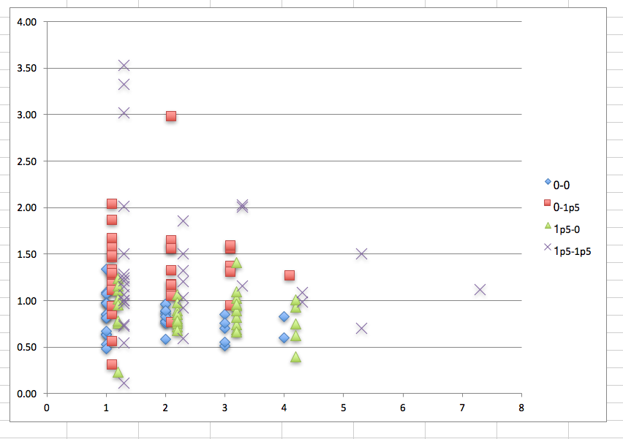
Another Jitterplot
Notes:
x-axis is number of pareto points, y-axis is mean sifting/mce for number of (bottleneck) crossings; categories have to do with parameters to random generator

Slide 19
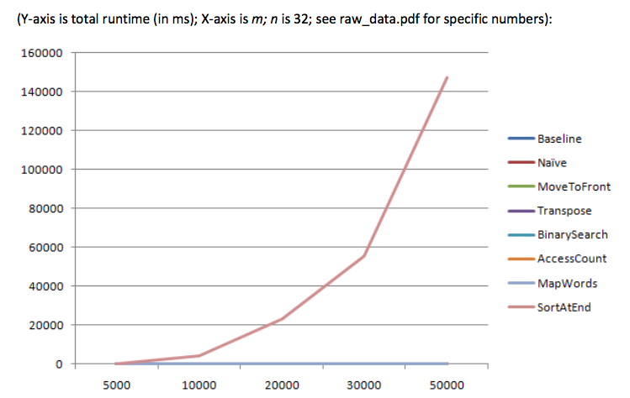
Chart Example 9
Lots of useless lines.
Might be better to do two separate plots.
one for slow and another for fast runtimes
Notes:
A scaling problem here: might be resolved by looking at runtime divided by n lg n or something like that. Or by omitting the baseline. In either case, it might make sense to either omit smaller values of n or do a logarithmic scale on the Y-axis or on both axes.

Slide 20
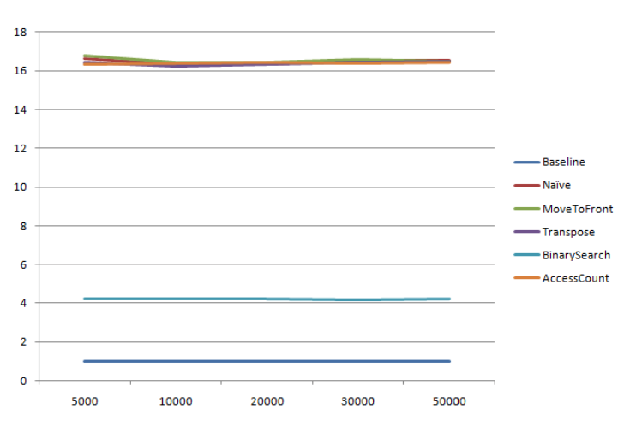
Chart Example 10
Similar problem.
Also uninteresting,
no growth shown
Notes:
Too many lines on top of each other. If you want to distinguish among similar heuristics, need a separate chart for each group. Otherwise pick a representative from each group and say that the others are roughly the same. A table might work equally well.

Slide 21
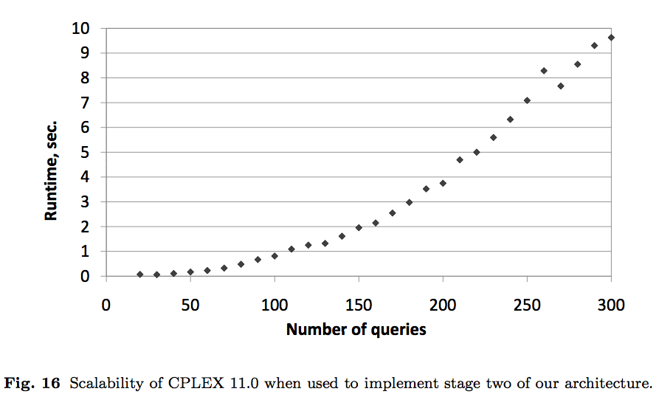
Chart Example 11
Nothing compared, weird jog in curve
would require explanation
Notes:
Very bad. No point since nothing is being compared. No explanation of the strange dip.

