Slide 1
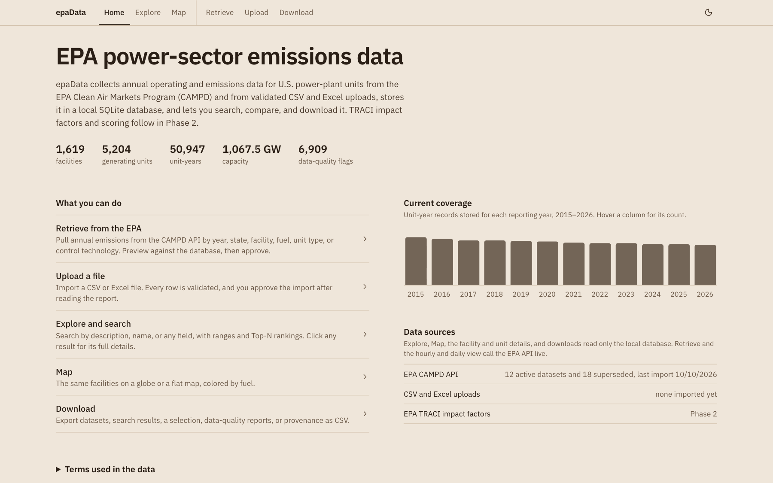
epaData
CS396 · Phase 1 · October 2026
Retrieving, validating, searching, and tracing EPA power-plant emissions data
RB
Raaj Banga
Backend lead
AB
Arnav Bawankule
Frontend lead
localhost:3000 · Next.js 16 · SQLite
Notes:
Slide 1. Title — Raaj + Arnav (0:15)
• Good afternoon. We are Raaj Banga and Arnav Bawankule.
– both stand; Raaj opens
• This is epaData, our Phase 1 project for CS396.
• It collects EPA power-plant emissions data, checks it, and stores it in SQLite.
– SQLite = a relational database kept in one file, with no separate database server
• You can then search, compare, and download that data.
– one-sentence pitch; don't elaborate yet
• Plan: about five minutes of design, seven of live demo, then challenges and who did what.

Slide 2
EPA emissions data is authoritative but hard to use
Why epaData
Hard to query. One API call per year, joins with facility data, thresholds applied by hand.
  “Kentucky coal units over 500,000 t CO₂ in 2025?”
Hard to trust. Spreadsheet extracts arrive unchecked.
  missing values · negatives · repeated unit-years
Hard to trace. Once sources mix, the origin of each figure is lost.
  which retrieval or file wrote this number?
Users: students, analysts, and reviewers who don't write SQL or API code.
1,619
5,204
facilities
generating units
50,947
6,909
unit-years · 2015–2026
audit flags raised
Committed database: 6 tables in one SQLite file, shipped with the repo
Notes:
Slide 2. EPA emissions data is authoritative but hard to use — Arnav (0:40)
• Power plants report their fuel use, generation, and emissions to the EPA.
– SO₂ = sulfur dioxide · NOₓ = nitrogen oxides · CO₂ = carbon dioxide
• The EPA publishes those reports through CAMPD and its CAM API.
– CAMPD = Clean Air Markets Program Data, the EPA's emissions data for power plants
– CAM API = CAMPD's web interface for downloading that data in code
• The data is authoritative, but a simple question is hard to answer.
– e.g. “Which Kentucky coal units emitted over 500,000 t of CO₂ in 2025?”
– needs the right endpoint, a join with facility data, and a hand-applied threshold
– and one API call per year for any history
• Spreadsheet extracts arrive with no easy way to check them.
– missing values · negative numbers · the same unit-year twice
– unit = one boiler or turbine inside a plant (a facility)
– unit-year = one unit's totals for one year; the main record in our database
• Once sources are mixed, nobody knows which file a number came from.
• epaData stores 1,619 facilities, 5,204 units, and 50,947 unit-years from 2015 to 2026.
– point at the figures under the home page title
– 6,909 audit flags = records our data-quality rules marked as questionable

Slide 3
One Next.js app, one SQLite file
System design · architecture
Browser · React 19
six pages · one detail + compare dialog · TanStack Query cache
Server-rendered first page, then typed tRPC calls.
One write path for API retrievals, uploads, and the CLI sync.
Pure logic in src/lib is unit-tested without a database.
  parser · record diff · CSV writer
Keys stay server-side. The browser never calls EPA or OpenRouter.
HTML
JSON
file / CSV
Next.js 16 server (Node.js)
Server render
page.tsx: URL → state
tRPC router
17 procedures · Zod
Route handlers
/api/upload · /api/export
Server modules
query builders (filters · ranking · paging) · CAMPD client · ingest.ts write path
Python 3
parse_import.py
Drizzle ORM
SQL builder · migrations
EPA CAM API
HTTPS + key
SQLite · db.sqlite
6 tables
OpenRouter
optional LLM
Notes:
Slide 3. One Next.js app, one SQLite file — Raaj (0:50)
• epaData is one Next.js application containing both the interface and the server.
– Next.js = a web framework that runs React pages and server code in one project
– React = the library that builds the interface from components
– one codebase, one process to run
• The first page arrives already rendered by the server, with its data filled in.
• After that, every search is a typed tRPC call.
– tRPC = typed remote procedure calls: the browser calls server functions, and both sides share the same types
– 17 procedures in total
• Every input is validated with Zod before it reaches the database.
– Zod = a library that checks data against a declared schema and rejects anything else
• Two plain HTTP routes handle file upload and CSV export.
• All logic sits in shared server modules.
– query builders · CAMPD client · one write path (ingest.ts) used by every import
• Every query goes through Drizzle ORM to one SQLite file.
– ORM = object-relational mapper: builds SQL from TypeScript code
– Drizzle = the ORM we use; it also runs the schema migrations
• Only two things leave the server process.
– uploaded files → a Python parser
– retrievals → the EPA CAM API
– optional: OpenRouter = a gateway to hosted large language models (LLMs); dashed because it is optional
• API keys stay on the server; the browser never calls the EPA or OpenRouter itself.

Slide 4
Two ways in, one write path, approval first
System design · data flow
EPA CAM API
/annual
Fetch & validate
Zod · dedupe pages
Compare
with stored records
new · changed · unchanged
User approves
Shared write path
upsert · derive rates · sanity audits · one transaction
preview
CSV / Excel
CAMPD layout
Python parser
map · validate · dedupe
saved on approval
import_issues
rejected · duplicate rows
SQLite
+ datasets row (provenance)
Local database
Live EPA API
Explore, Map, the detail dialog, compare, audit flags, and every download
Retrieve (preview + save) and the granular hourly-to-monthly time series
Notes:
Slide 4. Two ways in, one write path, approval first — Raaj (0:40)
• Data enters two ways: Retrieve and Upload.
– Retrieve calls the EPA CAM API
– Upload accepts CSV or Excel files in the CAMPD column layout
– a third path, the CLI (command-line) script sync:campd, skips the approval step
• Both paths validate every row first.
– API rows → Zod · files → the Python parser
– both drop repeated facility-unit-years (dedupe)
• Each incoming record is then compared with what the database already holds.
– result: new · changed · unchanged counts
– this is the DB-vs-API preview in demo step 3
• Nothing is written until the user approves.
• On approval, one shared write path saves everything in a single transaction.
– upsert = insert a record, or update it if it already exists
– computes heat rate (fuel energy per MWh generated) and CO₂ intensity (lb of CO₂ per MWh)
– runs the sanity audits and records a dataset row (one per retrieval or upload)
– transaction = all writes succeed together or none do
• Rejected and duplicate rows go to import_issues, so nothing is dropped silently.
• Everything you browse reads only the local database.
– only Retrieve and the granular time series call the API live
– point at the two source badges at the bottom

Slide 5
Six tables follow the shape of the data
System design · database
facilities
annual_records
datasets
Natural keys are enforced by the database.
  re-import = update, never a duplicate
NULL ≠ 0. Not reported is stored as missing.
Controls per year, as the spec requires.
  16,650 unit-years differ from today's
14 indexes match real queries.
  ranking: 9.5 s → 22 ms
1
N
N
1
id (EPA ORISPL)
name, state_code, county
latitude, longitude
owner_operator, region
id = unit + year
unit_internal_id → units
facility_id → facilities
dataset_id → datasets
year UNIQUE(unit, year)
co2/so2/nox_mass_tons NULL ok
heat_input, gross_load, hours
so2/nox/pm/hg_controls
id (UUID)
source API | CSV | EXCEL
query_params (JSON)
new / updated /
unchanged / dropped
1
N
1
N
N
units
import_issues
1
1
id (UUID)
facility_id → facilities
unit_id UNIQUE/facility
unit_type, primary_fuel
operating_status, MW
N
dataset_id → datasets
kind REJECTED|DUPLICATE
reason, raw_row (JSON)
data_audit_logs
annual_record_id → records
flag_type, severity
id primary key → foreign key, cascades on delete
Notes:
Slide 5. Six tables follow the shape of the data — Raaj (0:40)
• The schema follows the real hierarchy of the data.
– facility → units → one annual record per unit per year
– facilities.id is the EPA ORISPL code: the EPA's permanent plant ID, also used in URLs
• Two tables record provenance.
– provenance = where each record came from
– datasets: one row per retrieval or upload
– import_issues: every rejected or duplicate source row, kept verbatim
– the sixth table, data_audit_logs, holds the sanity flags
• An annual record is unique per unit and year.
– its id is built from that pair, so re-importing a year updates the row instead of duplicating it
– UNIQUE(unit_internal_id, year) is also the upsert target
• Metric columns may be NULL on purpose.
– NULL = no value: the source did not report one, which differs from a measured zero
• Controls and program codes are stored per year, as the spec asks.
• Indexes match the real query shapes.
– index = a sorted lookup structure that lets the database skip scanning whole tables
– adding (facility_id, year) took the per-state ranking from 9.5 s to 22 ms

Slide 6
Implementation choices and why
System design · choices
We chose
Instead of
Why
Next.js + tRPC + Drizzle
Flask + Jinja + SQLAlchemy
One typed codebase; Zod-validated inputs; same routes, templates, forms, ORM
SQLite, one file
A database server
Ships in the zip; window functions for ranking; reproducible
Python parser subprocess
JS CSV libraries
csv + openpyxl read CSV and Excel alike; returns a JSON report
Rule-based description parser
LLM only
Deterministic, offline, unit-tested; LLM only for leftover words
Preview, then save
Write on fetch
User sees new / changed first; one transaction per import
Notes:
Slide 6. Implementation choices and why — Raaj (0:40)
• The course suggests Flask; we used Next.js with tRPC and Drizzle.
– Flask = a Python web framework, usually paired with Jinja templates and the SQLAlchemy ORM
– ours covers the same objectives (routes, templates, forms, ORM) in one typed codebase
• SQLite in one file means the database ships with the submission.
– it also supports the window functions we use for ranking (slide 14)
• File parsing runs in Python.
– its csv and openpyxl (Excel reader) libraries treat CSV and Excel the same way
– returns a full validation report as JSON · Arnav's import feature
• Description search is rule-based first.
– works offline, gives the same answer every time, covered by unit tests
– a language model is only an optional fallback
• Retrieval previews before it saves.
– the user sees the differences first
– a failed fetch never leaves half a dataset behind

Slide 7
Ten steps, one story
Live demo
1
2
3
4
5
Home page
Upload a file
Retrieve (API)
Basic search
Multi-constraint
Interface · data source
Upload & import
EPA data retrieval
Basic search
Multi-constraint search
6
7
8
9
10
Description search
Ranking
Unit history
Compare
Download
Description search
Sorting / ranking
Detail page · history
Usability
Download
The thread: step 2's upload edits one Trimble County CO₂ value; step 3's Retrieve flags it as Changed against the EPA API and restores EPA's number.
Notes:
Slide 7. Ten steps, one story — Arnav (0:15)
• The demo has ten steps, each mapped to a rubric row.
– we alternate presenters by who built that part
– switch to the browser after this slide
• The steps tell one story.
– step 2's sample upload deliberately edits one Trimble County CO₂ value
– step 3's Retrieve catches that difference against the EPA API and restores EPA's number
– shows both data paths and the DB-vs-API comparison together
• Steps 4 and 9 can be cut if we run long.
– network down? see “If something goes wrong” at the end of slides-outline.md

Slide 8
Home page: what it is and where data comes from
Demo · step 1 of 10 · rubric 1 · 2
Plain introduction: purpose, sources, Phase 2 scope.
  CAMPD API + CSV / Excel uploads
  TRACI scoring comes in Phase 2
Coverage chart by year, 2015–2026.
  12 active datasets, 18 superseded (kept as history)
1,619 · 5,204 · 6,909 facilities, units, audit flags.
Every panel names its source.
  browse = local DB · Retrieve = live API
Notes:
Slide 8. Home page: what it is and where data comes from — Arnav (0:40)
• The intro paragraph says what epaData does and where its data comes from.
– sources: the EPA CAMPD API and CSV or Excel uploads
– TRACI = the EPA's method for turning emissions into environmental-impact scores; that is Phase 2
• The coverage chart shows unit-years per reporting year, 2015–2026.
– hover a column for its count
– data sources: “EPA CAMPD API: 12 active datasets and 18 superseded”
– superseded = an earlier retrieval whose records a re-sync replaced; kept as history
• The figures show 1,619 facilities, 5,204 units, 50,947 unit-years, and 6,909 data-quality flags.
• Everything you browse reads the local database; only Retrieve and the granular time series call the API live.
– say this verbatim: it is the rubric's “data source explanation”
– each panel is labelled with its source
• The navigation bar follows the workflow: look at the data (Explore, Map), then move it in and out (Retrieve, Upload, Download).
– “What you can do” lists the same functions · then click Upload in the navigation bar → step 2

Slide 9
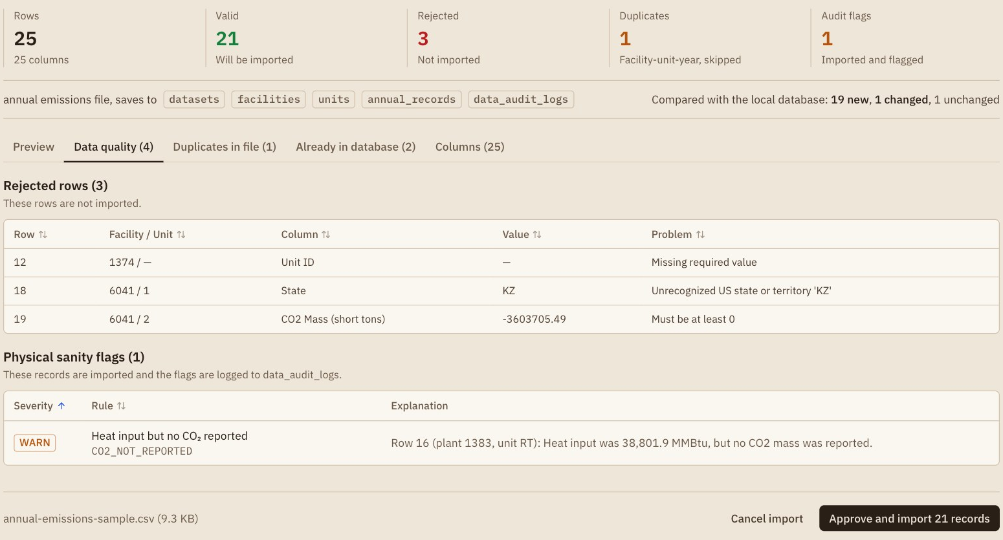
Upload: validate first, then import
Demo · step 2 of 10 · rubric 3
25 rows → 21 valid · 3 rejected · 1 duplicate · 1 flag.
Compared with the DB before saving.
  19 new · 1 changed · 1 unchanged
Every rejection has a reason.
  row 12 no unit ID · row 18 “KZ” · row 19 CO₂ < 0
Missing ≠ zero. Row 16 has heat input, no CO₂.
  stored as NULL, flagged CO2_NOT_REPORTED
Nothing dropped silently.
  Download rejected rows (4)
Notes:
Slide 9. Upload: validate first, then import — Arnav (1:30)
• Upload accepts CSV and Excel files up to 100 MB.
– click Upload in the navigation bar
– drag in samples/annual-emissions-sample.csv (already open in Finder)
• The Python parser maps CAMPD column headers to database columns.
– 5 columns stay unmapped: stack IDs, the operating-time count, and 3 rates epaData recomputes
– Columns tab, if anyone asks
• Summary: 25 rows, 21 valid, 3 rejected, 1 duplicate, 1 audit flag.
• Compared with the database: 19 new, 1 changed, 1 unchanged.
– Already in database (2): the two Trimble County 2023 rows; one “Will update co2MassTons”
• Each rejected row keeps its reason.
– row 12: no unit ID · row 18: state “KZ” · row 19: negative CO₂
– Duplicates in file (1): row 25 repeats row 4 (Ghent unit 1, 2014)
• Row 16 reported heat input but no CO₂, and that is real EPA data.
– Robert Reid unit RT: 38,801.9 MMBtu (million British thermal units of fuel energy)
– stored as “not reported” (NULL), not zero
– flagged CO2_NOT_REPORTED, severity WARN
• Approve and import the 21 records.
– click Approve and import 21 records
– “Import complete” shows the dataset and the archived file under uploads/
• Download the rejected rows: nothing is dropped silently.
– click Download rejected rows (4)
– 3 rejected + 1 duplicate + the flagged record, each with its original columns

Slide 10
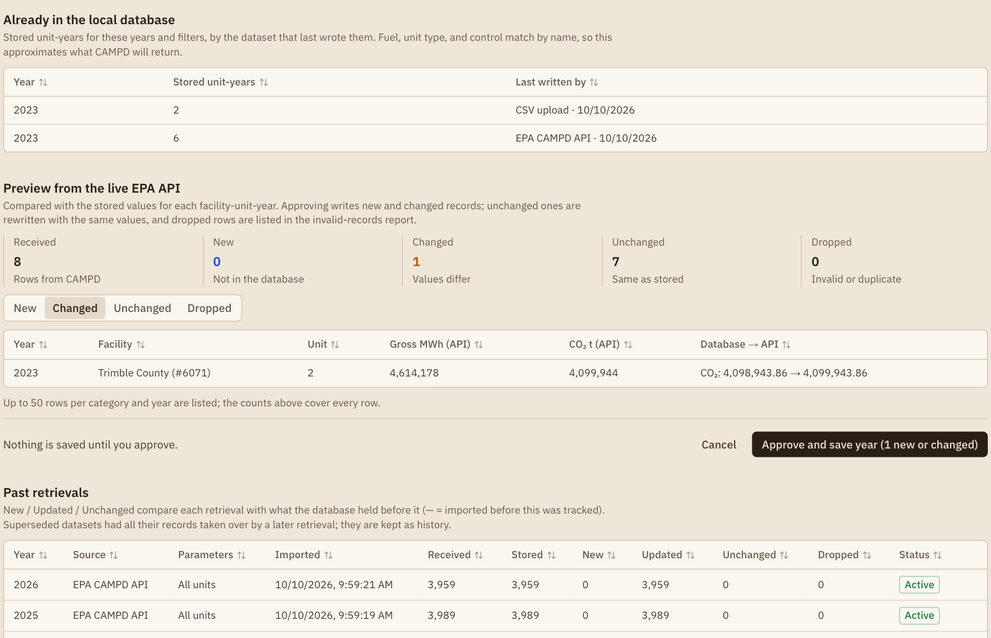
Retrieve: compare with the EPA API before saving
Demo · step 3 of 10 · rubric 2
Method on screen: EPA CAM API, /annual.
  key stays on the server
Already in the DB: 8 unit-years for 2023.
  2 from our upload · 6 from the API
Preview writes nothing.
  8 received · 0 new · 1 changed · 7 unchanged
Changed shows DB → API:
  Trimble 2 CO₂ 4,098,943.86 → 4,099,943.86
Approve → history row 0 / 1 / 7 / 0.
  new / updated / unchanged / dropped
Notes:
Slide 10. Retrieve: compare with the EPA API before saving — Raaj (1:15)
• Retrieve names its method: the EPA CAM API's apportioned annual emissions.
– apportioned = the EPA splits a shared stack's emissions across the units behind it
– the API key stays on the server
• Enter the parameters.
– State = KY · Facility IDs = 6071 (Trimble County) · From year = 2023 · To year = 2023
• “Already in the local database” fills in on its own: 8 unit-years for 2023.
– 2 written by the upload we just did · 6 by the EPA API
• Preview fetches from the API without writing anything.
– click Preview year from the EPA
– received 8 · new 0 · changed 1 · unchanged 7 · dropped 0
• The Changed tab shows the value our upload edited.
– Trimble County unit 2 CO₂: 4,098,943.863 → 4,099,943.863
– the API still has EPA's number: the punchline of the demo story
• Approve and save; the history gains a row.
– click Approve and save year (1 new or changed)
– status tiles: 0 new · 1 changed · 7 unchanged · 0 dropped
– Past retrievals gains the row, with the exact query parameters

Slide 11
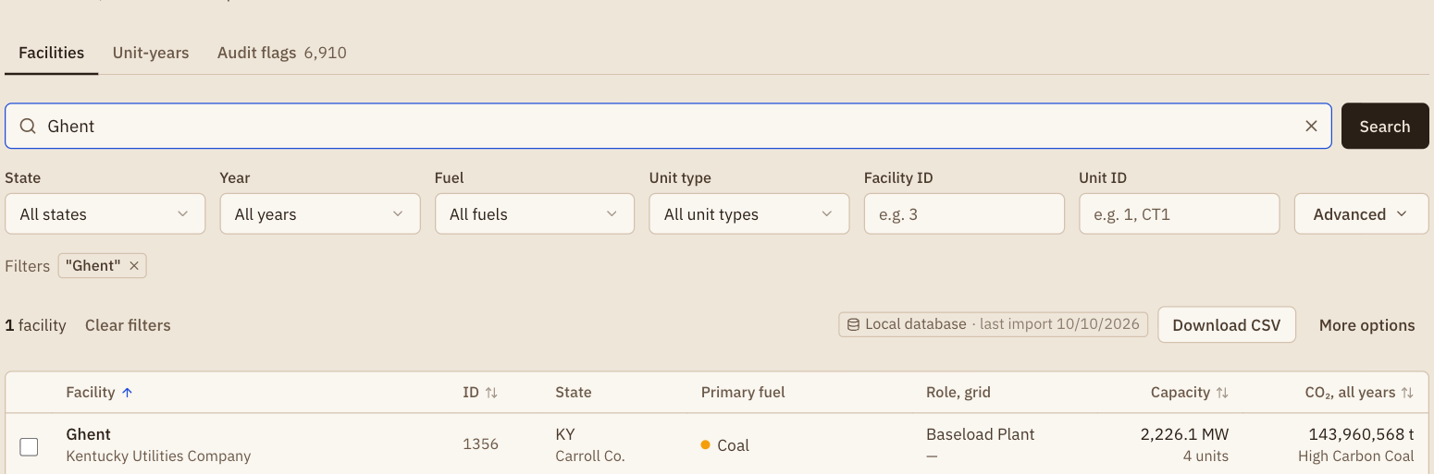
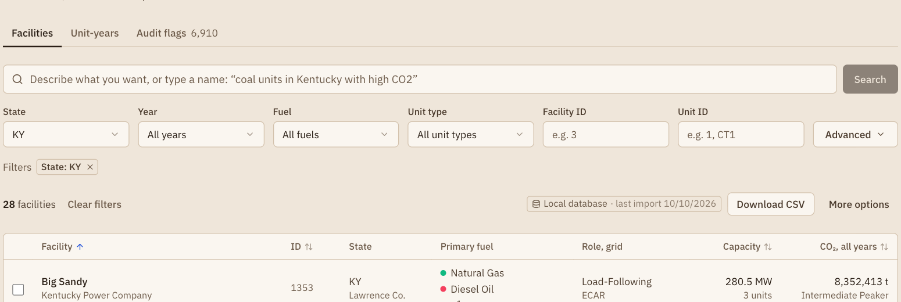
Basic search: name, filters, sort, page
Demo · step 4 of 10 · rubric 4
Type “Ghent” → 1 facility.
  one box for sentences and names
Basic fields filter: state, year, fuel, unit type, IDs.
  State = KY → 28 facilities
Sortable headers, server-side pages.
Count and page come from one query, so they always agree.
Notes:
Slide 11. Basic search: name, filters, sort, page — Arnav (0:30)
• Searching by name finds plants, operators, and counties.
– Explore · Facilities tab · type Ghent → Search → 1 facility
– the box takes names too: text with no filter words becomes a name search
• Dropdowns filter the list.
– clear the search (✕) · State = KY → 28 facilities
• Headers sort, and the footer pages through results.
– page size + go-to-page control
– optional step: cut if running long
• The server pages the results itself.
– one ranked subquery (a query nested inside another) gives both the page of rows and the total count, so they always agree

Slide 12
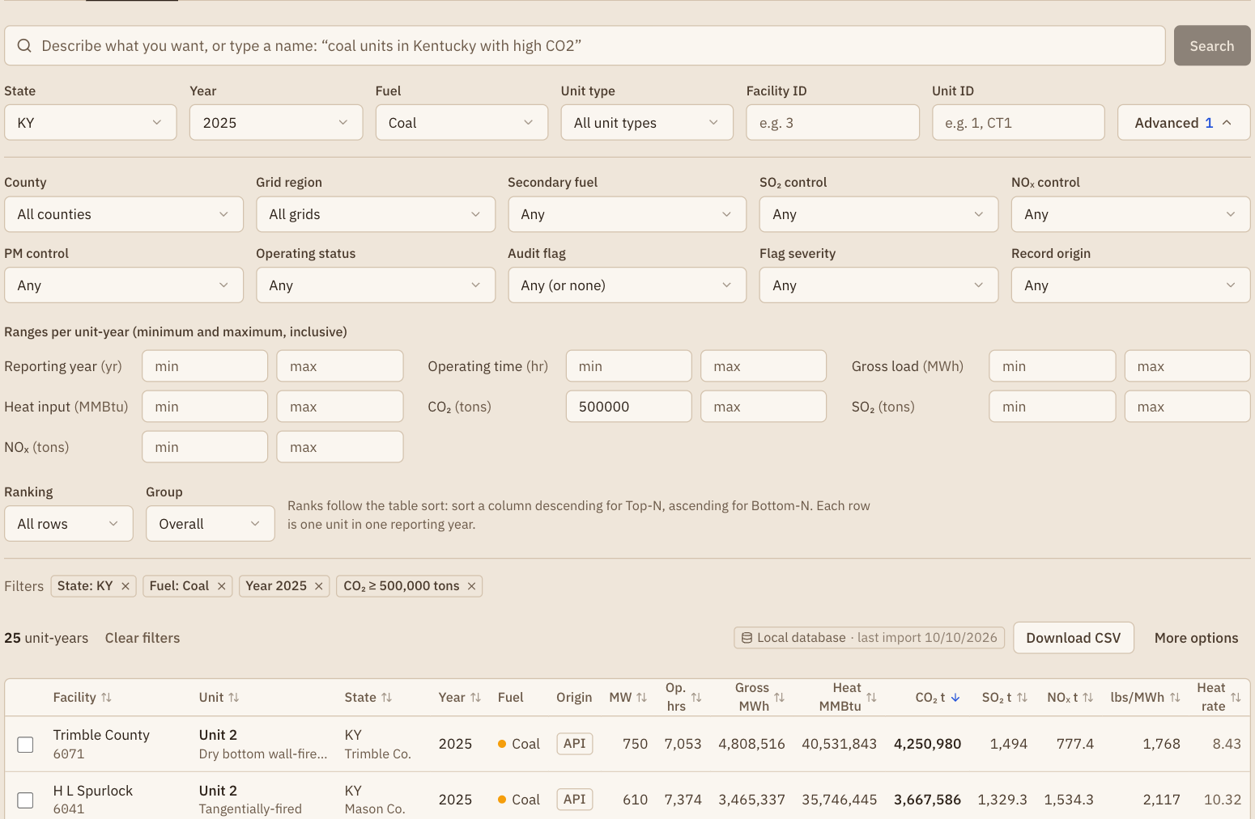
Multi-constraint search across three tables
Demo · step 5 of 10 · rubric 5
KY + Coal + 2025 + CO₂ ≥ 500,000 t → 25 unit-years.
  Facilities tab → 8 plants
Three levels, one query:
  facility (state) · unit (fuel) · unit-year (year, CO₂)
Shareable: the whole search lives in the URL.
/explore?tab=units
&stateCode=KY
&primaryFuel=Coal
&year=2025
&co2MassTonsMin=500000
Notes:
Slide 12. Multi-constraint search across three tables — Raaj (0:40)
• Set four filters on the Unit-years tab.
– Clear filters · Unit-years tab
– State = KY · Fuel = Coal · Year = 2025
– Advanced → CO₂ min = 500000
• Result: 25 unit-years.
– switch to Facilities: the same filters give 8 facilities
• The conditions sit on three tables, combined with AND.
– state → facility · fuel → unit · year and CO₂ → annual record
• The whole search lives in the URL.
– point at the address bar: /explore?tab=units&stateCode=KY&primaryFuel=Coal&year=2025&co2MassTonsMin=500000
– bookmark or share it; the CSV export parses the same URL
• Fuel and control filters match by substring.
– CAMPD stores combined values like “Coal, Pipeline Natural Gas”
– if asked

Slide 13
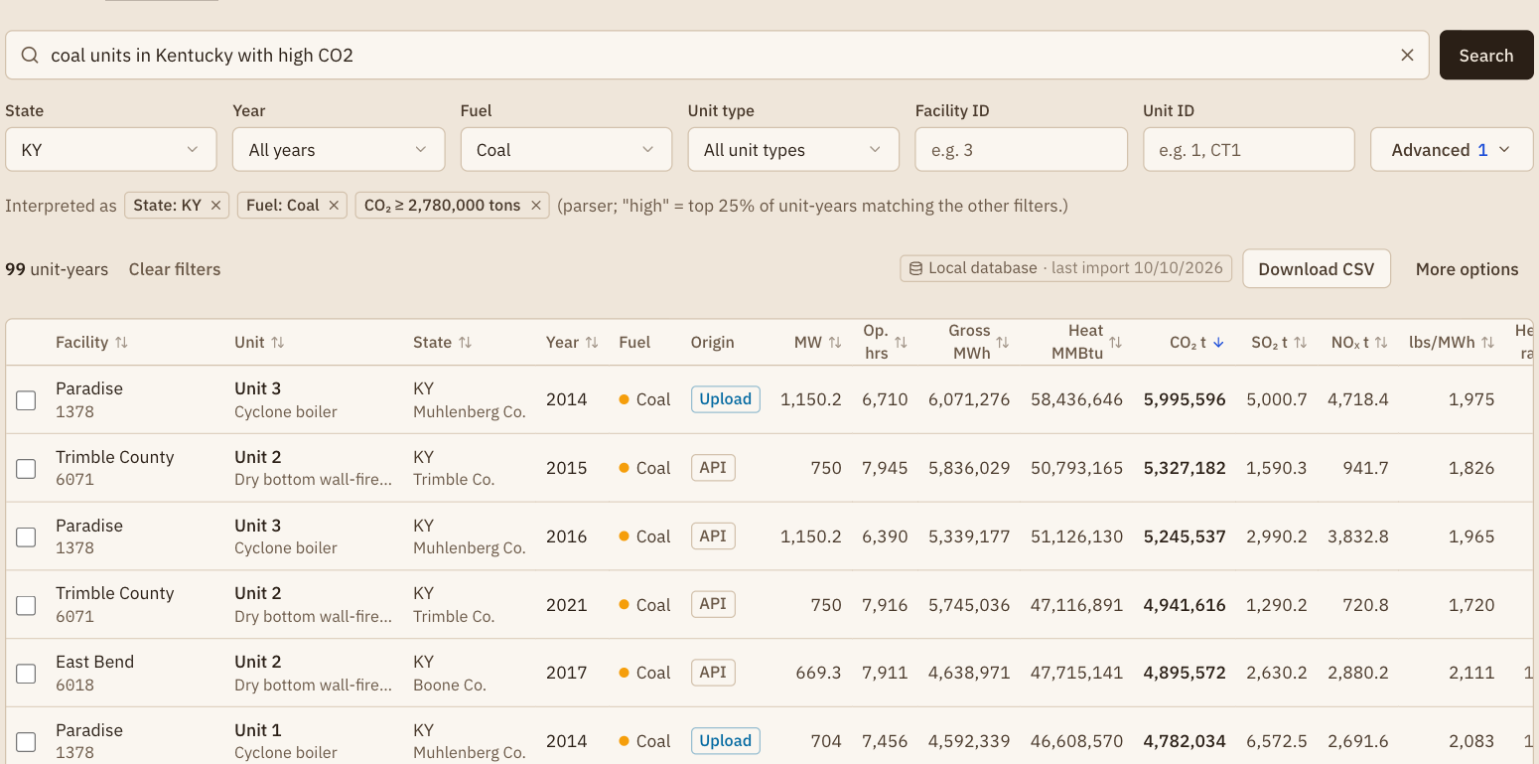
Description search: a sentence becomes filters
Demo · step 6 of 10 · rubric 6
“coal units in Kentucky with high CO2”
→ 99
Units
KY
Coal
CO₂ ≥ P75
Rule-based parser, no LLM needed.
  longest phrase wins · any word order · typo-tolerant
“High” = 75th percentile of the other filters.
  KY coal → CO₂ ≥ 2,780,000 t, sorted ↓
Chips are real filters: ✕ removes one.
Optional LLM fallback for leftover words only.
  validated against DB values · 8 s timeout
Notes:
Slide 13. Description search: a sentence becomes filters — Raaj (0:40)
• The same search box turns a sentence into filters.
– Clear filters · under the box, click Try “coal units in Kentucky with high CO2” → Search
• The sentence becomes “Interpreted as” chips: KY, Coal, and CO₂ ≥ 2,780,000.
– sorted by CO₂ · 99 unit-years
– “(parser; …)”: no language model was needed
– without the upload: 2,720,000 and 97
• “High” has no fixed number, so we use a percentile.
– 75th percentile (P75) = the value 75% of the matching unit-years fall below
– computed over the other filters only, here Kentucky coal
– the note under the chips states the rule
• The parser matches the longest known phrase at each position.
– parser = code that reads the sentence and maps words to filter values
– “natural gas” beats “gas” · word order doesn't matter
– tolerates one-letter typos (“Kentuky”) · reports what it didn't understand
• Every chip is an ordinary filter.
– click ✕ on Coal, then set Fuel back to Coal
– first row: Paradise unit 3 in 2014, from our upload

Slide 14
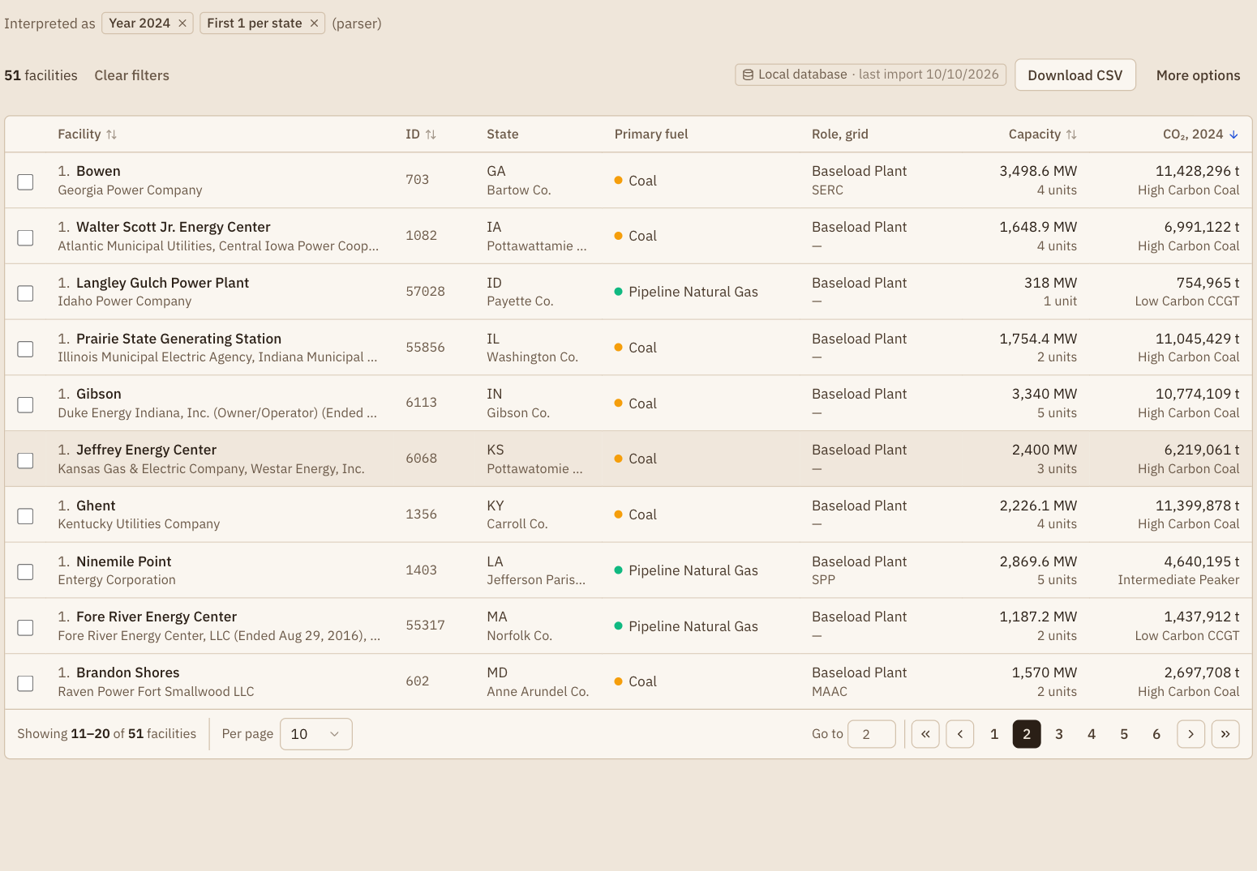
Ranking with one window function
Demo · step 7 of 10 · rubric 7
SELECT * FROM (
SELECT f.state_code, f.name, ar.co2_mass_tons,
ROW_NUMBER() OVER (
PARTITION BY f.state_code -- per state
ORDER BY ar.co2_mass_tons IS NULL,
ar.co2_mass_tons DESC, ar.id
) AS rank
FROM annual_records ar
JOIN units u ON ar.unit_internal_id = u.id
JOIN facilities f ON ar.facility_id = f.id
WHERE ar.year = 2024
) AS ranked
WHERE rank <= 1 -- top N
ORDER BY state_code;
“top CO2-emitting facility in each state in 2024”
  Ranking = First 1 · Group = Per state · Year 2024
51 facilities, one per state.
  page 2: Kentucky → Ghent
Simplified from rankedUnitYears(): page, count, and CSV share this subquery
Notes:
Slide 14. Ranking with one window function — Raaj (0:30)
• Ranking also works from a sentence.
– Clear filters · Facilities tab
– type: top CO2-emitting facility in each state in 2024 → Search
• Result: 51 facilities, one per state, sorted by CO₂.
– chips show what was set: Year 2024 · First 1 per state (Advanced has the same controls)
– Kentucky's row is Ghent (page 2 at 10 per page)
• In SQL this is one window function.
– window function = a calculation over a group of rows that keeps every row, unlike GROUP BY
– ROW_NUMBER() numbers the rows · PARTITION BY state restarts the numbering for each state
– keep rank 1 · point at PARTITION BY on the slide
• The page, count, and CSV export all come from this one subquery.
– missing values sort last

Slide 15
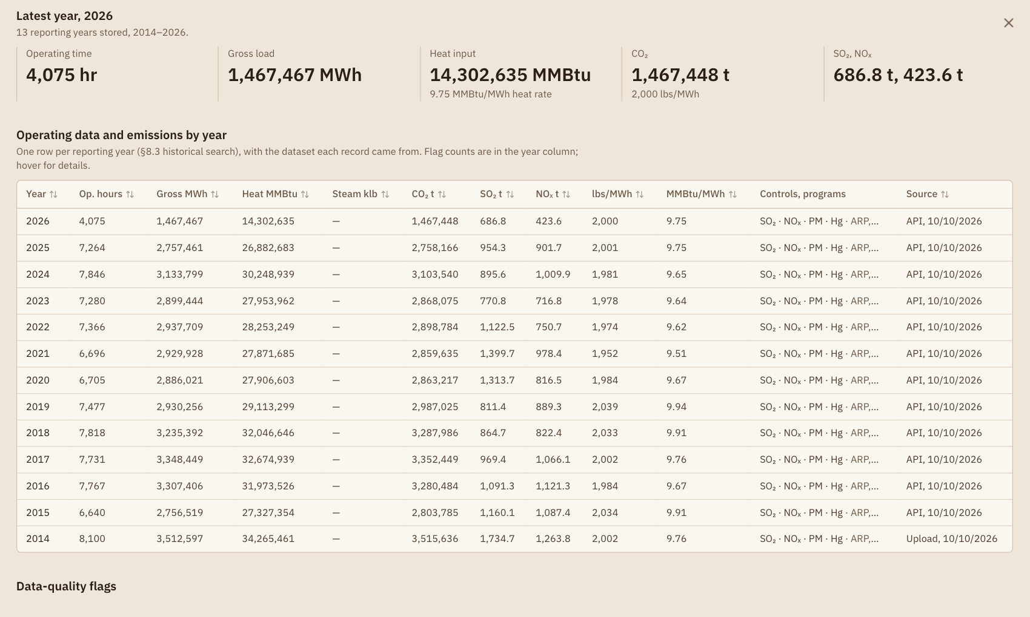
Unit detail: thirteen years of history
Demo · step 8 of 10 · rubric 7
Search “Ghent” on Unit-years → open unit 1.
Identification, fuel, and per-year controls.
13 reporting years, 2014–2026.
  2014 = our upload · 2015–2026 = CAMPD API
Audit flags listed at the bottom.
Notes:
Slide 15. Unit detail: thirteen years of history — Arnav (0:30)
• Open a unit to see its full history.
– Clear filters · Unit-years tab · type Ghent → Search · click a Ghent Unit 1 row
• The details dialog shows identification, fuel, and each year's controls and programs.
– its URL (?unit=…) reopens it on reload
– controls = pollution equipment, e.g. a scrubber for SO₂
• It lists 13 reporting years, 2014–2026.
– 2014 came from our upload · the rest from CAMPD API datasets
– covers the spec's “same unit, 2015–2025” history search
• Audit flags for the unit, if any, are listed at the bottom.

Slide 16
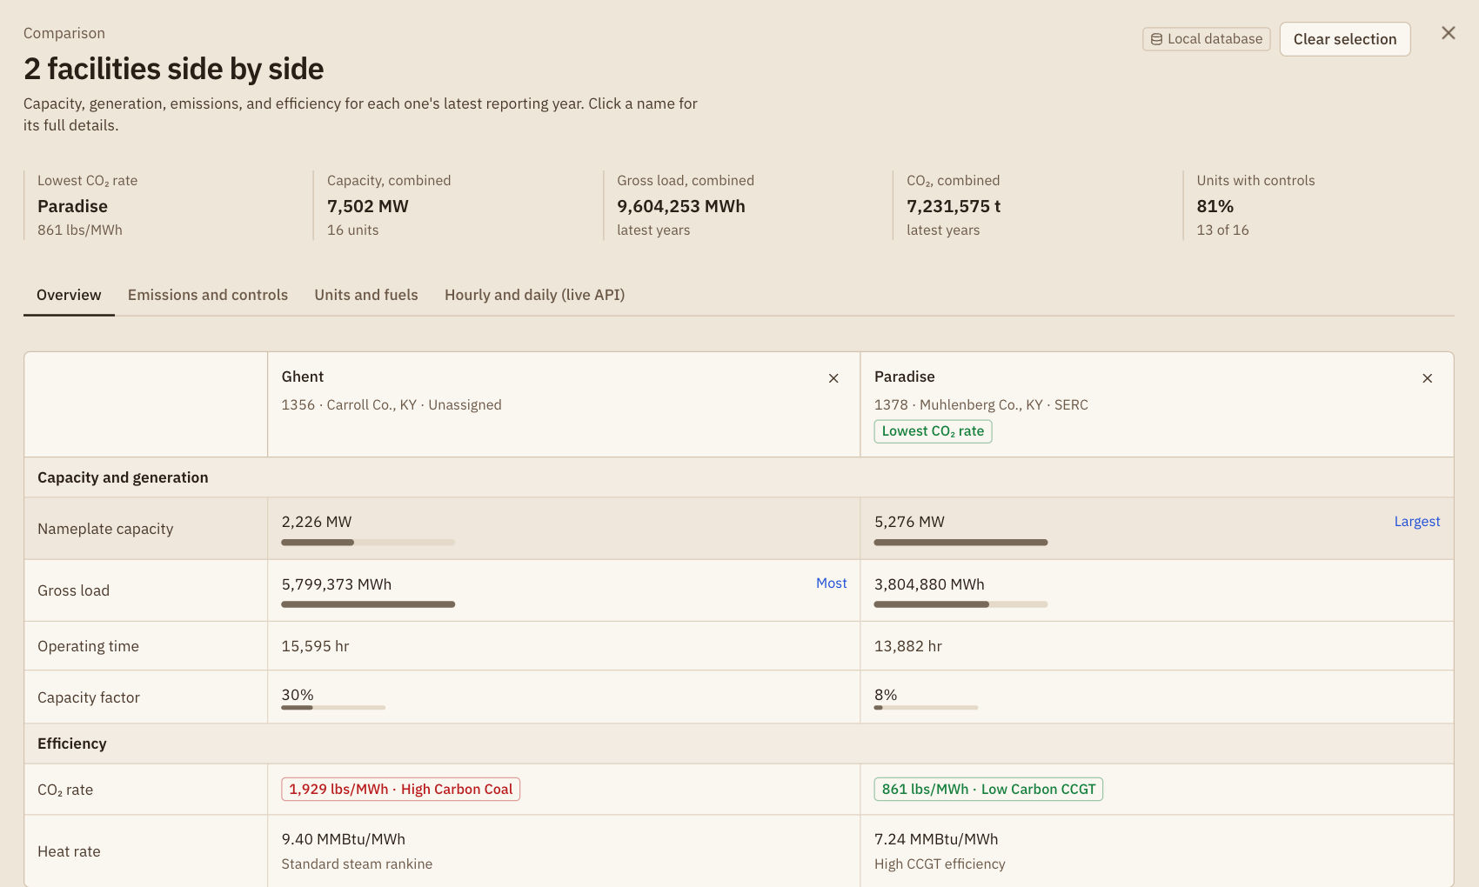
Compare plants side by side
Demo · step 9 of 10 · rubric 1
Tick Ghent + Paradise → Compare.
Side by side: capacity, generation, CO₂, intensity, controls.
Paradise is cleanest: 861 vs 1,929 lb/MWh.
  its current units burn gas
Up to 4 plants.
  a 5th: “Up to 4; remove one first”
Notes:
Slide 16. Compare plants side by side — Arnav (0:30)
• Pick plants to compare.
– Facilities · search Ghent → tick it · search Paradise → tick it
– click Compare in the dock
• Capacity, generation, CO₂, carbon intensity, and controls appear side by side.
• Paradise comes out cleanest.
– 861 vs 1,929 lb/MWh (pounds of CO₂ per megawatt-hour generated)
– its current units burn gas
• The limit is four plants.
– optional: tick 3 more → the dock says “Up to 4; remove one first”
– optional step: cut if running long

Slide 17
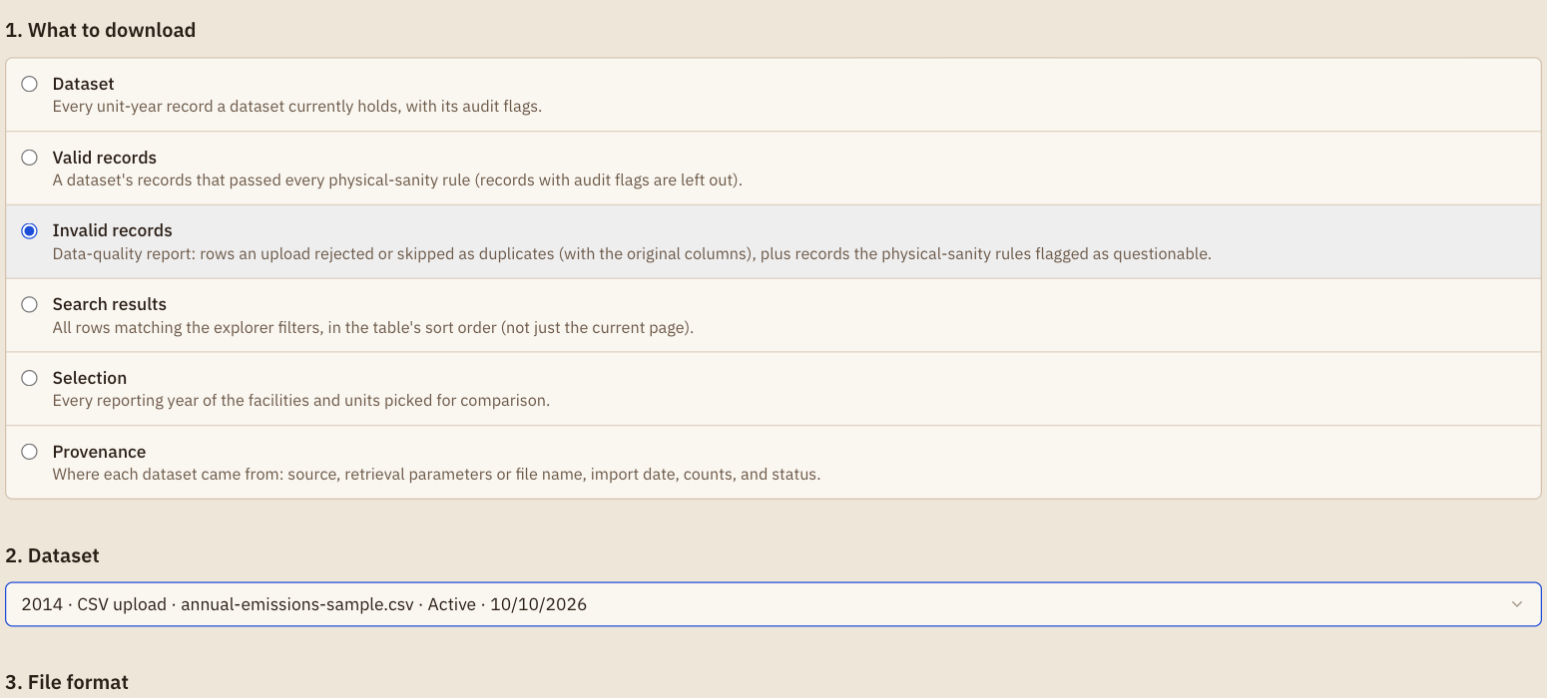
Download: every record traces to its source
Demo · step 10 of 10 · rubric 7
CSV by any result: every matching row, all pages.
Invalid records for the upload = the step 2 report.
Provenance: one row per dataset.
  source · date · query · new / updated / unchanged / dropped
Dataset
Valid records
Invalid records
Search results
Selection
Provenance
all records of one dataset
stored rows only
rejected + duplicate + flagged
same query as the table, all pages
your comparison picks
one row per dataset + diff counts
CSV per RFC 4180 · unit-year rows carry dataset_id, origin, dataset_imported_at
Notes:
Slide 17. Download: every record traces to its source — Raaj (0:45)
• Any result can be downloaded as CSV.
– e.g. rerun step 5's search → click Download CSV next to the result count
– every matching row, across all pages
• The Download page offers six types, in three numbered steps.
– More options next to Download CSV opens it with the current search
– complete dataset · valid records · invalid records · search results · selection · provenance
• Invalid records for the upload reproduce step 2's report.
– pick Invalid records · select the upload dataset (“… CSV upload …”; the latest dataset is now step 3's retrieval) · Download CSV
– rejected rows + the duplicate + the flagged record
• Provenance lists every dataset.
– Try “provenance of every dataset” · Download CSV
– source · date · query parameters · new / updated / unchanged / dropped counts
• Close with: every record traces to the retrieval or file that wrote it.
– stay on: Raaj presents the challenges next

Slide 18
Technical challenges
What we learned
Combined values
Missing ≠ zero
Superseded datasets
“Coal, Pipeline Natural Gas” broke equality filters.
DEFAULT 0 created 6,105 false errors.
Re-syncs left old datasets owning nothing.
Fix Split options · substring match
Fix Nullable metrics · WARN rule
Fix Keep and label as history
ORM-generated SQL
“IN” and “OR”
Query shape vs. index
An unqualified id bound to the wrong table.
State codes that are also English words.
Year-filtered ranking took 9.5 s.
Fix Qualify · read the SQL
Fix Codes count only in capitals
Fix (facility_id, year): 22 ms
Notes:
Slide 18. Technical challenges — Raaj (0:50)
• Combined values broke our filters.
– CAMPD lists “Coal”, but units hold “Coal, Pipeline Natural Gas”
– fix: split the options, match by substring
• Missing is not zero.
– the first schema stored blanks as 0 → 6,105 false errors
– fix: nullable metrics + a separate “not reported” warning
– lesson: model absence explicitly
• Re-syncs left old datasets owning nothing.
– deleting them would erase history
– fix: keep them, labelled superseded
• The ORM generated wrong SQL.
– an unqualified id bound to the wrong table
– fix: qualify it · lesson: read the SQL an ORM writes
• “IN” and “OR” are both state codes and English words.
– fix: two-letter codes count only in capitals
• One query shape was slow.
– year-filtered rankings took up to 10 s
– fix: an index on (facility_id, year) → 22 ms

Slide 19
Who built what
Team
RB
Raaj Banga
Backend lead
AB
Arnav Bawankule
Frontend lead
Schema, 7 migrations, 14 indexes
CAMPD client: preview, diff, granular series
Shared write path · audits · provenance
Search backend · description search · CSV export
Explore page, map / globe, detail + compare dialog
Tests, README, report
CSV + Excel import feature
Python parser: column mapping and validation
Data-quality report: rejected and duplicate rows
Upload endpoint + page with preview / approve
First import tests
Shared API contracts · integration testing · sample data · documentation · this presentation
Notes:
Slide 19. Who built what — Arnav (0:30)
• Raaj led the backend.
– schema, migrations, indexes
– CAMPD client with preview and diff
– shared write path, audits, provenance
– search backend incl. description search · CSV export
– also most of the Explore page, map, detail dialog, pages, tests, README, report
• Arnav led the frontend and built the CSV and Excel import.
– Python parser and validation
– data-quality report
– upload endpoint and page with preview and approval
• We shared the API contracts, integration testing, sample data, and documentation.
– each of us presented the parts we built

Slide 20
Questions?
Thank you
What's next
Reproduce
Phase 2: evaluation
TRACI factors, indicators, and weighted scoring on top of the stored unit-years
$ npm install
$ python3 -m venv .venv
$ .venv/bin/pip install \
-r requirements.txt
$ cp .env.example .env
$ npm run db:migrate
$ npm run dev
Record history
Keep overwritten values in a history table instead of last-writer-wins
Shared deployment
Hosted libSQL with user accounts for upload and retrieval
Full steps, env vars, and expected counts in README.md · sample upload in samples/
Notes:
Slide 20. Questions? — Raaj + Arnav (0:10)
• Phase 2 builds on this foundation.
– TRACI factors · environmental indicators from the stored records · a weighted scoring model
– the same ranked queries and CSV path will serve the indicators
• Everything is reproducible from the README.
– install, migrate, run · committed database and sample files included
• Thank you; we are happy to take questions.
– likely: why Next.js not Flask (slide 6) · LLM safety (slide 13) · missing vs zero (slide 18)

