Slide 1
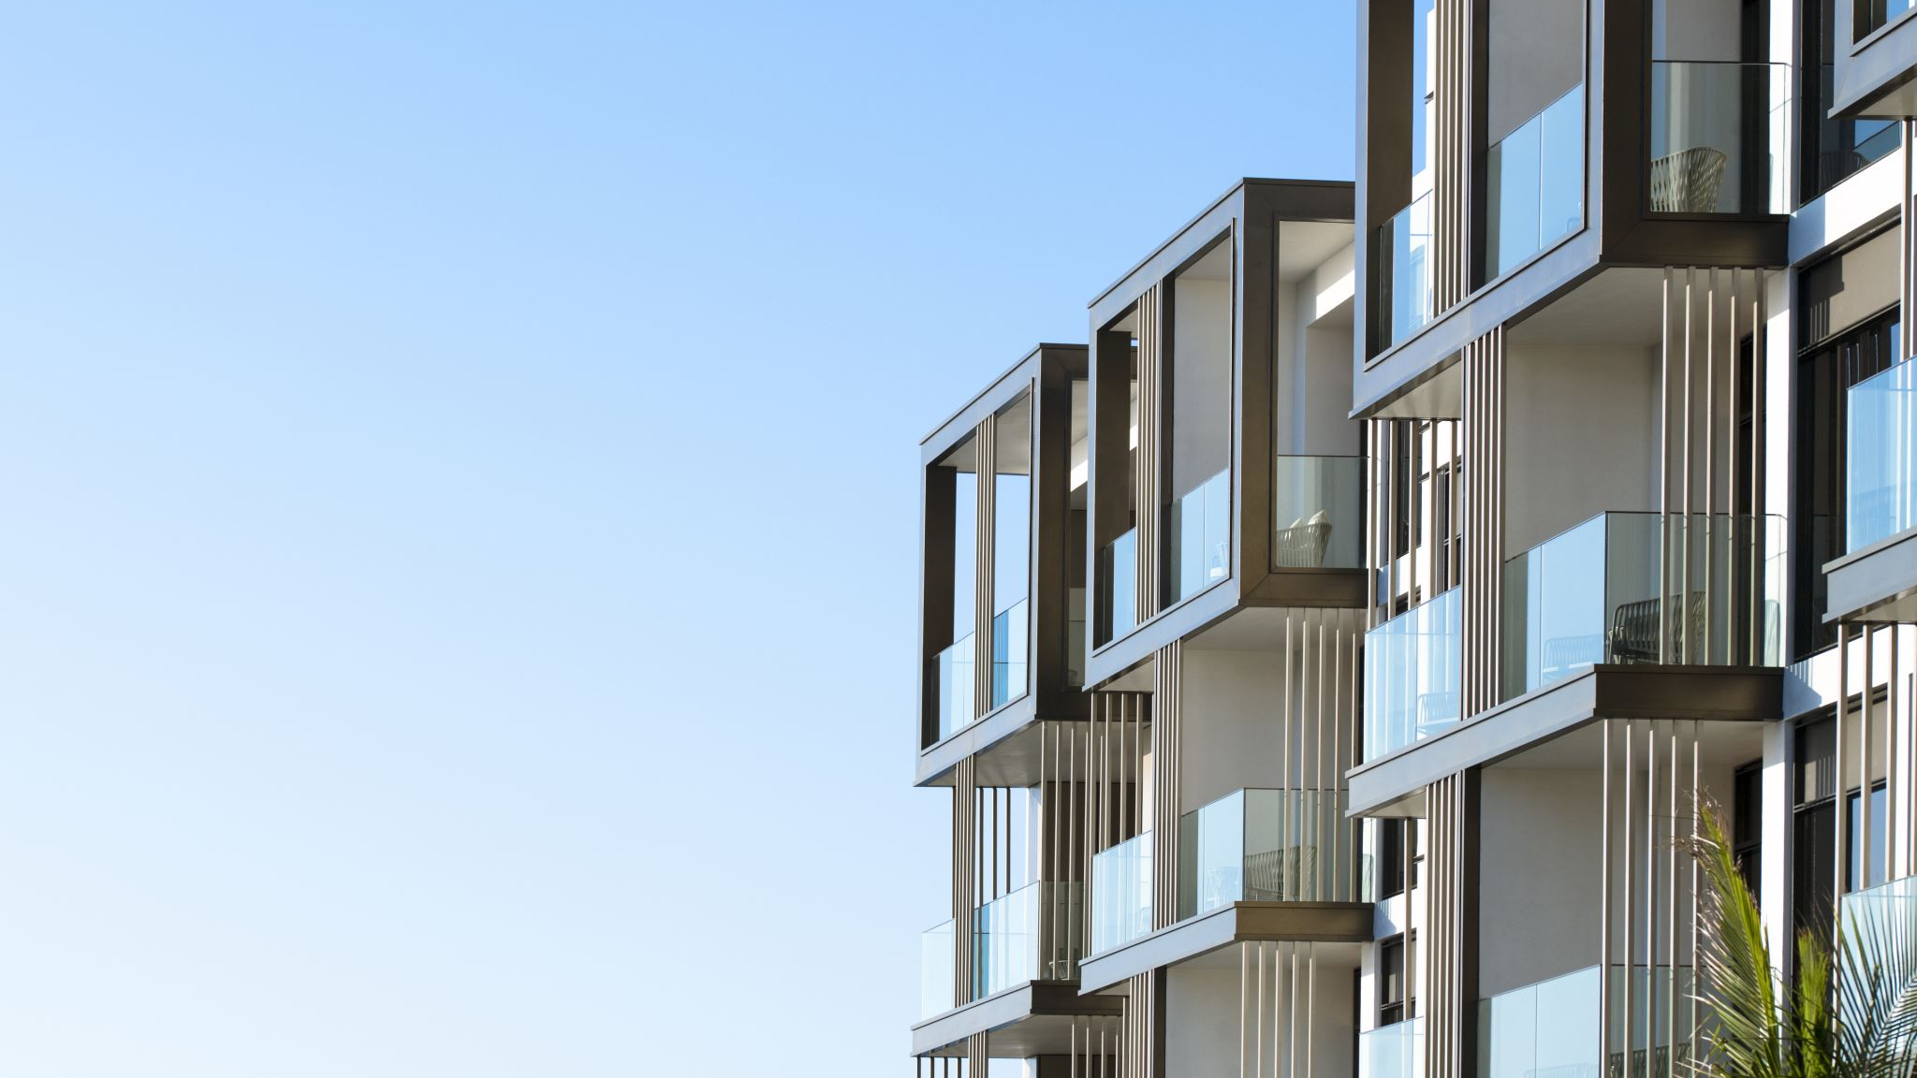
EIS: South St. Petersburg Community Redevelopment Area Property Value Analysis
Group 6
Raajitha Sai Bondada
Ranjith Babu Vennam
Kusuma Yalamarthi
Shree Vaishnavi Reddy Bhoomi Reddy
Vasudeva Reddy Bolleddula

Slide 2
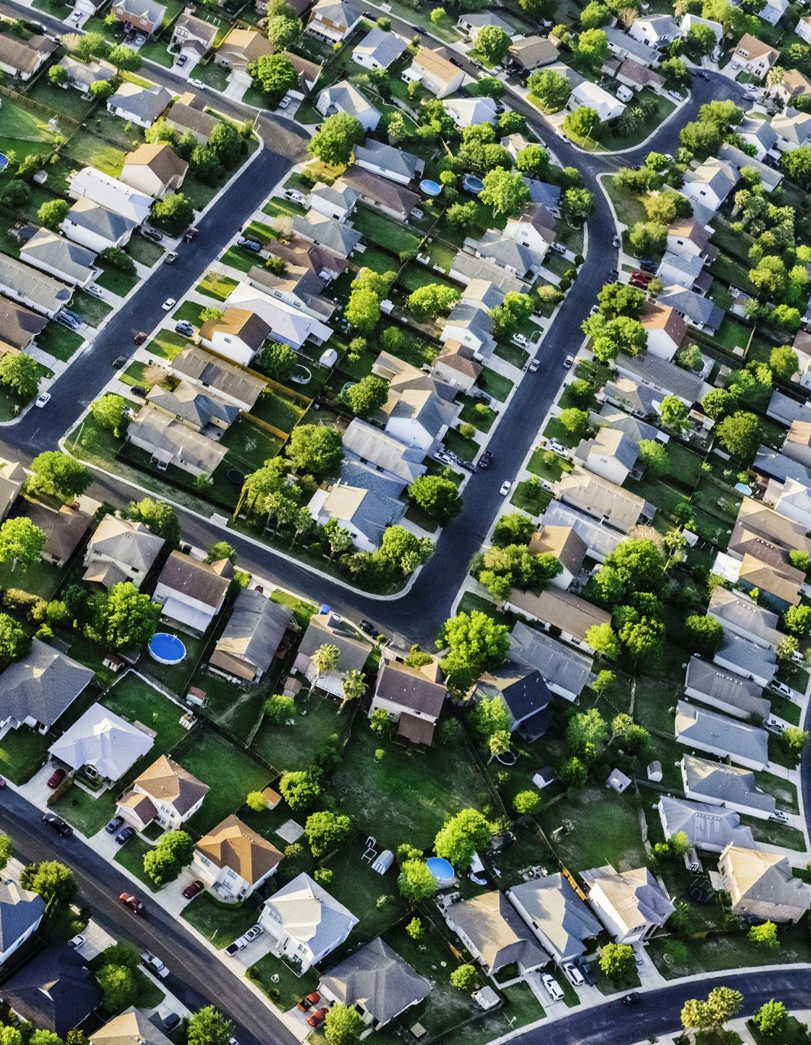
Understanding Property Values near 5th Avenue South
Objective: To conduct an in-depth analysis of property values in areas north and south of 5th Avenue South.
Scope: Analysis spans data from 2015 and 2022, focusing on all properties & non-residential and mixed-use properties.
Purpose: To provide stakeholders with insights into property value dynamics for informed decision-making on revenue taxes, urban planning, and investment.

Slide 3
Methodology Overview
Data Description
Property datasets for 2015 and 2022.
Includes neighborhood boundaries, coordinates, and property categorizations.
Classification of properties by use (residential, non-residential, mixed-use).
Data Cleaning
Identification and handling of null values.
Standardization of property use definitions.
Merging datasets based on common identifiers.
Data Segmentation
Division based on location relative to 5th Avenue South.
Further segmentation into all properties, non-residential, and mixed-use properties.
Research Questions Alignment
Precise segmentation for targeted analysis.
Focus on how property values relate to location.

Slide 4

Methodology Details & Visualizations
Data Analysis
Utilization of Tableau for interactive visualizations.
Detailed perspective on property value trends.
Developing Visualizations
Property Value Trends: Bar charts for average and median taxable values, distinguishing by property use and location.
Growth Rate Calculations: Bar charts illustrating growth rates from 2015 to 2022, differentiated by location.
Validation and Quality Assurance
Thorough review process by all team members.
Identification and correction of errors to ensure reliability and trustworthiness.

Slide 5
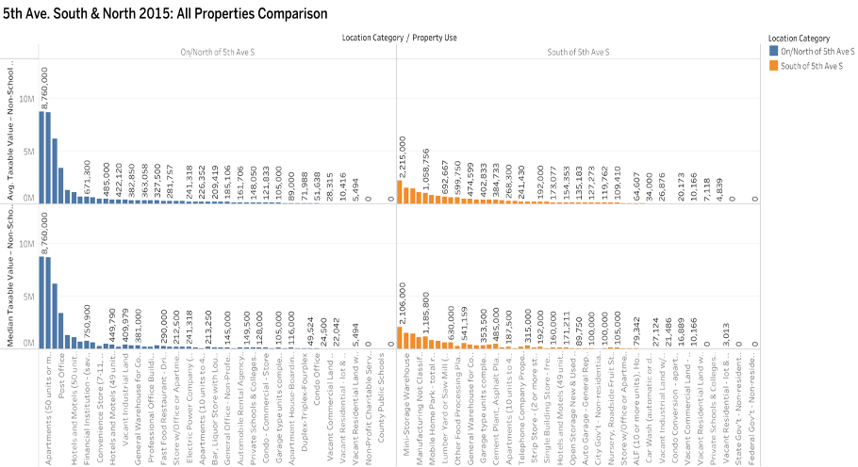
Calculate the mean and median property values in 2015 for properties on/north of 5th Avenue South compared to properties south of 5th Avenue South for:
a. For all properties:
The mean and median property values for properties north of 5th Avenue South in St. Petersburg for 2015 are higher than those south of it, with the highest values in apartments with 50+ units versus mini-storage warehouses.

Slide 6
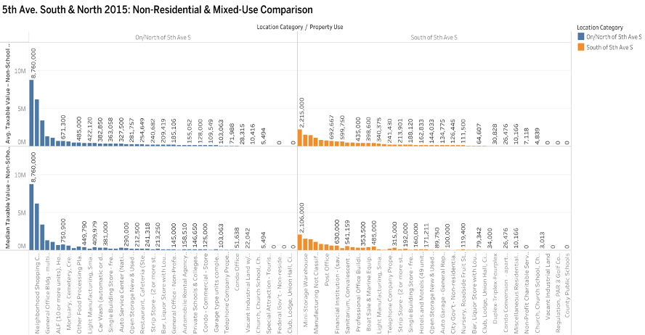
b. For non-residential and mixed-use properties:
Non-residential and mixed-use property values north of 5th Avenue South in St. Petersburg are notably higher, with "neighborhood shopping complexes" reaching 8.7 million, in contrast to properties south of 5th Avenue South where "mini-storage warehouses" top at 2,215,000.

Slide 7
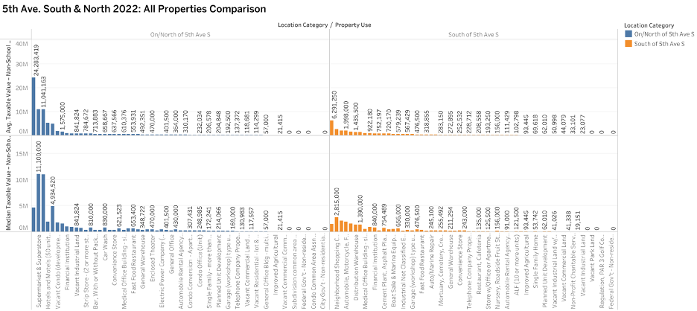
Calculate the mean and median property values in 2022 for properties on/north of 5th Avenue South compared to properties south of 5th Avenue South for:​
a. For all properties​:
In 2022, properties on/north of 5th Avenue South in St. Petersburg had significantly higher average and median values compared to those on the south, with supermarkets and superstores averaging 24 million and mediating 11 million respectively, while properties south of 5th Avenue South had neighborhood shopping centers averaging 6 million and mediating 2 million.

Slide 8
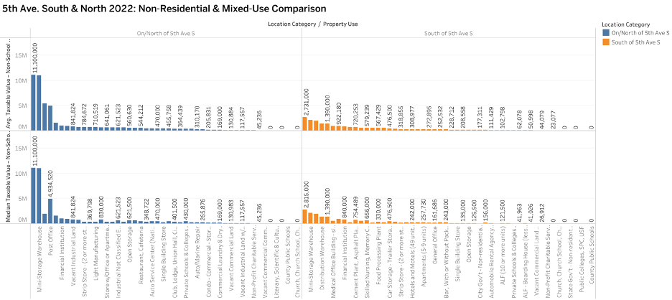
b. For non-residential and mixed-use properties​:
The image compares non-residential and mixed-use properties in 2022, showing higher average and median values north of 5th Avenue South (around 11 million for mini-storage warehouses) compared to properties south of it (2.73 million for mini-storage warehouses).

Slide 9
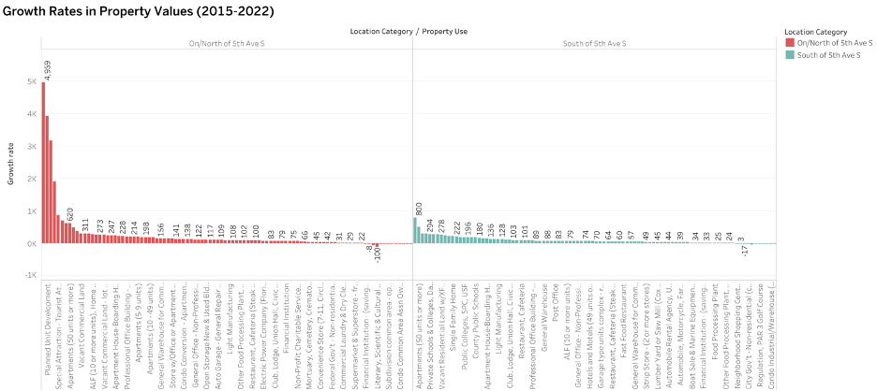
Calculate and show the growth rates (%) in property values for properties north/on 5th Avenue South compared to those properties south of 5th Avenue South between 2015 and 2022 for:
a. For all properties:
The graph shows how property values changed from 2015 to 2022. For properties north of 5th Avenue South, "Manufacturing not classified" had the biggest drop, while "General office-non-professional" had the largest increase. In contrast, for properties south of 5th Avenue South, "mini-storage warehouses" saw the highest growth rate.

Slide 10
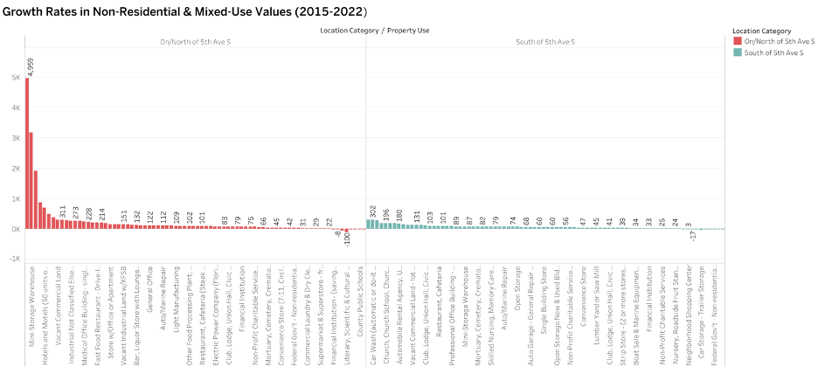
b. For non-residential and mixed-use properties​​:
​​
From 2015 to 2022, the chart indicates that "General office-non-professional" properties had the highest increase on north of 5th Avenue South , while "Manufacturing not classified" properties saw the biggest decrease; whereas south of 5th Avenue South, "Car storage-trailer storage" decreased the most, and "Mini-storage warehouses" increased the most.

Slide 11

Conclusion
First Research Question: Comparative Property Values in 2015
Properties on/north of 5th Ave South had higher average and median taxable values compared to those south of it.
Apartments, offices, and hotels were the most valuable property types in both areas.
Second Research Question: Trends in Property Value Growth (2022)
Significant growth observed on/north of 5th Ave S, with some property types experiencing over 1000% growth.
South of 5th Ave S also showed growth, albeit at a more moderate rate.
Third Research Question: Differential Growth Trends by Property Type
Non-residential and mixed-use properties, especially on/north of 5th Ave S, exhibited the most significant growth rates.
This suggests a thriving business environment and potential shift towards mixed-use development trends.

Slide 12
Future Directions
Further analysis needed to explore socio-economic reasons behind property value differences and growth trends.
Consideration of population changes, city policies, and market conditions.
Assessment of the impact of zoning laws, infrastructure projects, and investment patterns.
Importance of evaluating the sustainability of growth for long-term urban planning and community welfare.

Slide 13

Thank You

