Slide 1
What is AngularJS Benefits of AngularJS A Simple Angular Example

Slide 2
What is AngularJS
AngularJS is JavaScript framework that helps build web applications .
Google has developed and donated to open source community .
Basically it is used for Single web Page application and line of business applications .
Many companies are using Angular today.
www.madewithangular.com: that has list of websites build with AngularJS.

Slide 3
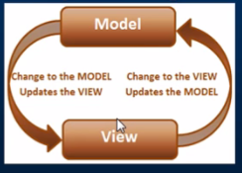
Benefits of AngularJS
In market we already have several JavaScript frameworks ?
Why Angular ?
-Dependency Injection
-Two Way Data-Binding
-Testing
Angular is designed with testing in mind right from the start.
-Model View Controller
In an Angular it very easy to develop clean MVC applications . MVC connections are managed by container .

Slide 4
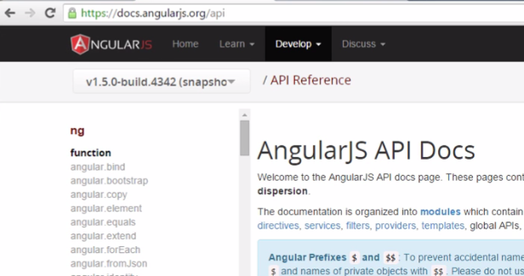
Many more benefits like Directives, Filters etc…
Controlling behaviour of DOM elements through Directives.
To Build applications in Angular we need only one file to Import i.e. angular.js from angularjs.org

Slide 5
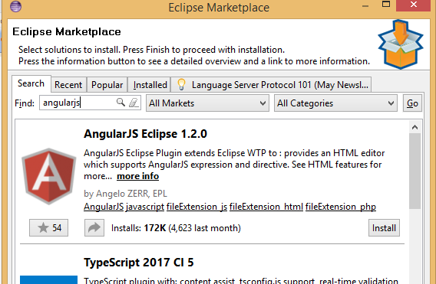
Environment setup
Eclipse Market place in your Eclipse IDE and search for angular in search area.

Slide 6
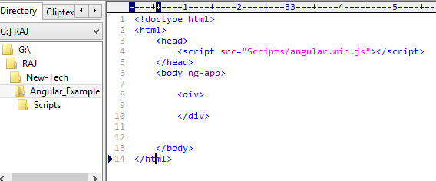
Another way to do practices code is to create folder and place .html and angular.min.js and run in browser directly .
Through one more way without downloading .js instead directly call file from website and place in script section in HTML.

Slide 7
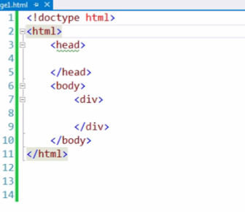
How to Setup workspace for Angular
It is simple JavaScript setup, you have to put all imports in script folder .

Slide 8
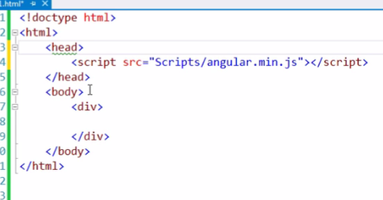
First step to work with angular is to add Angular reference
to the HTML code like this.
Added Angular JS ref through .js in script section.

Slide 9
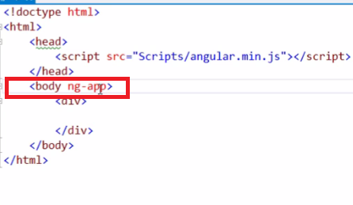
Second step to include “ng-app” attribute somewhere in HTML code as per application requirements.
Now i’m going to include this with in body element .
What is ng-app in angular ? , it is Directives
We have many such directives in angular API ref page.
“ng-app” is starting point for angularJS applications.

Slide 10
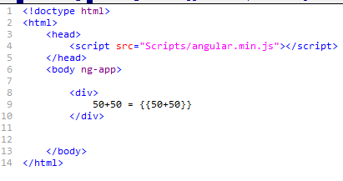
Angular framework will first check for this ng-app directive somewhere in HTML page . If ng-app directive is found then angular Bootstrap itself and start managing section where ng-app is written.
So in our example we have written ng-app in body section, everything within the body section will be managed by Angular.
Lets have example

Slide 11
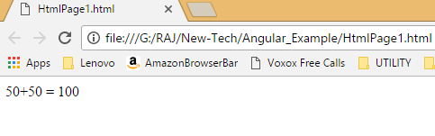
After running in chrome , page will have result like this
{{ }} written in HTML : in angular term it is call as Binding Expression .
At present ng-app is with body element, now we will move it …..

Slide 12
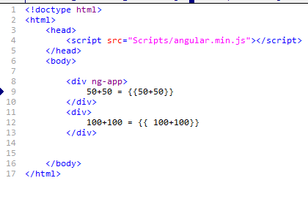
Now we will add another div element under same body scope
If we run this change in browser than what will be output ?

Slide 13
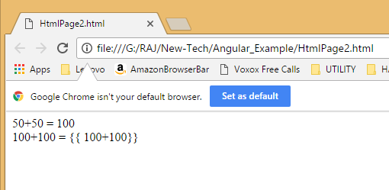
Output is :
Why because angular ng-app scope, means angular is going to manage only div elements in which ng-app is written .

Slide 14
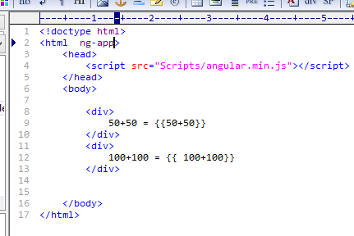
Lets see what will happen if we move ng-app at HTML tag level . Like ….

Slide 15
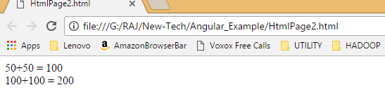
ng scope will cover at all HTML level
Angular is going to responsible for all the child elements with in HTML tag.

Slide 16
<!doctype html>
<html ng-app>
<head>
<script src="Scripts/angular.min.js"></script>
</head>
<body>
<div>
{{1==2}}
</div>
<div>
100+100 = {{ 100+100}} </div>
</body>
</html>

Slide 17
And in case of
----
<div>
{{1==1}}
</div>
-----
We can also use plain old java scripts object in angular expression
<!doctype html>
<html ng-app>
<head>
<script src="Scripts/angular.min.js"></script>
</head>
<body>
<div>
{{ {name: 'Cognizant', add: 'Pune'}.name }}
</div>
</body>
</html>

Slide 18
We can also use Array
<!doctype html>
<html ng-app>
<head>
<script src="Scripts/angular.min.js"></script>
</head>
<body>
<div>
{{ ['Cognizant', 'Infy', 'TCS'][2] }}
</div>
</body>
</html>

Slide 19
PART- 2: Modules and Controllers
-What is modules in angular and how to create module ?
-What is Controllers and how to create controller ?
-How to register Controller with the Module ?
-How to use the module that we have created to bootstrap the angular application.

Slide 20
What is a module in Angular ?
A: Module is container for different parts of your application i.e. controllers, services, directives, filters etc …
You can think of a module as a Main() method in other types of applications . For example core java has main method on it. Dot net console application has main method as entry point to the applications .
Responsibility of the Main method is to bind together different parts of application.
So modules are the angular applications equivalent of the main Method.

Slide 21
How to create a module ?
It is very straightforward , Use the angular object’s module() method to create module.
var myApp = angular.module(“myModule”, []);
angular Object is provided my angular framework
Module method has two parameters one is the name of the module and another is empty array the dependencies of the module .
Like module can depend upon other module

Slide 22
Currently created module is not depended on any external module, so passing empty array .
What is controller in angular ?
In angular a controller is a JavaScript constrictor function .
Job of controller is to build a module for the view to display
How to create a controller in angular ?
Create a JavaScript constructor function , so notice here
var myController = function ($scope) {
$scope.message = “Hello All” ;
}

Slide 23
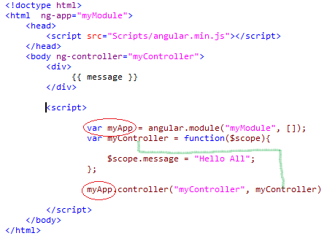
Now Binding controller with module and displaying variable in Views.

Slide 24
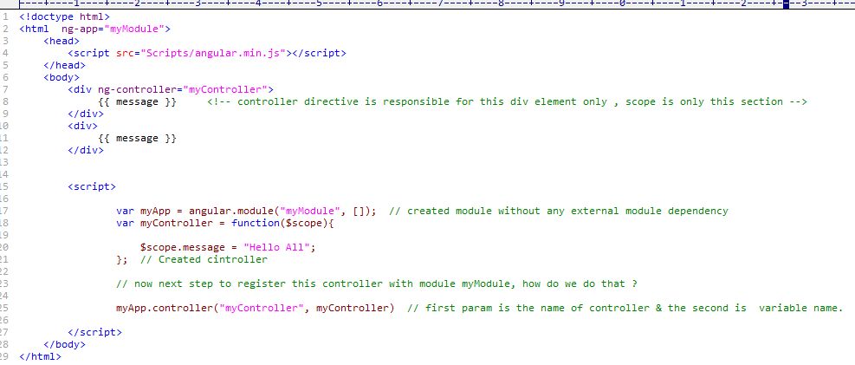
example for view controller and model

Slide 25
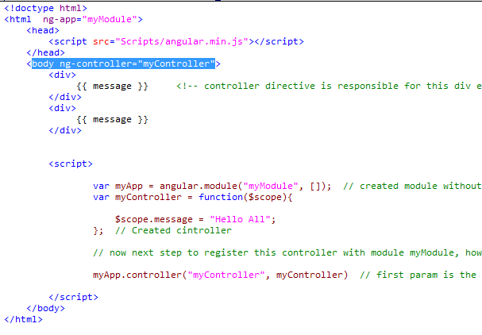
Lets move controller location to html body tag

