Slide 1
Complex object creation in controller and binding with scope object .
var employee = { firstName : "Martin", lastName : "Oderskey", gender : "Male“
};
Now we will put this lines in controller function ….

Slide 2
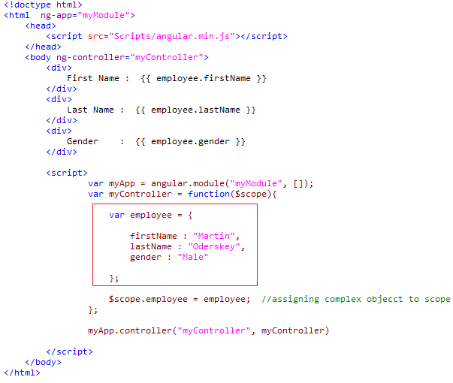
Here it is !!!

Slide 3
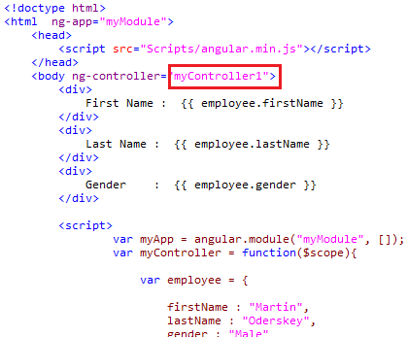
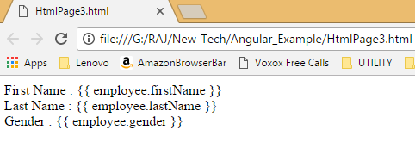
How to check error in Angular
Lets change controller name in view page in previous example
Like in case of myController we will have myController1
------------------------------------------------

Slide 4
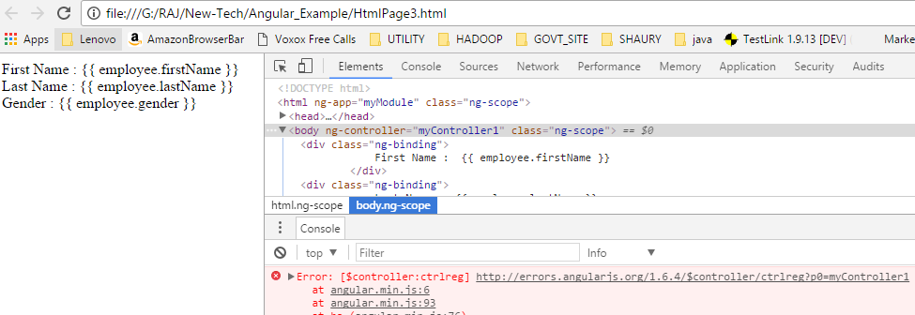
As angular and Chrome is part of Google, so Chrome has excellent acceptability for Angular . I’m using chrome for checking error in angular ..
Press F12 key in chrome ……

Slide 5
but mentioned error is not readable ?
As I have used compressed/minified version of angularJS library
Like in a code you are able to see it
angular.min.js , instead we can use full version (angular.js) & lets see error again…..

Slide 6
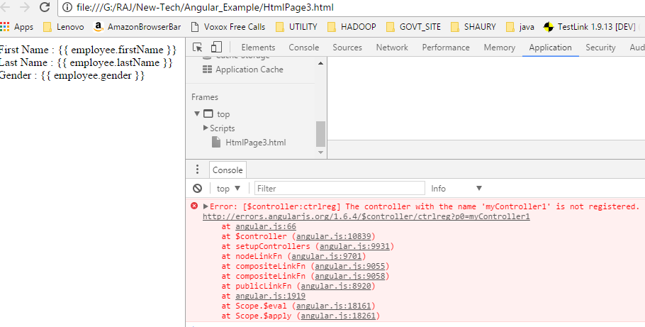

Slide 7
What happens if the controller name is misspelled ?
When the controller name is misspelled, 2 things happen
-An error is raised. To see error, use browser developer tools.
--The binding expressions in the view that are in scope of the controller will not be evaluated .

Slide 8
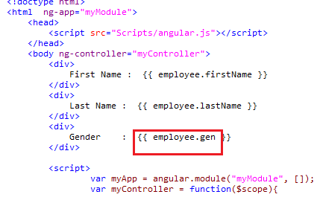
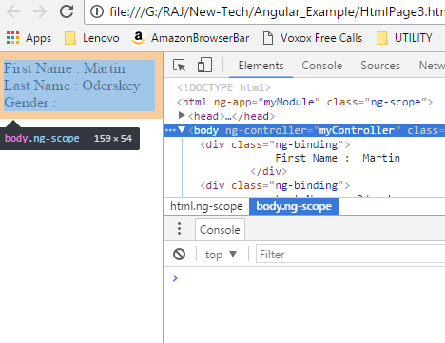
Let suppose missed property name in binding expression
Load in browser and F12 key

Slide 9
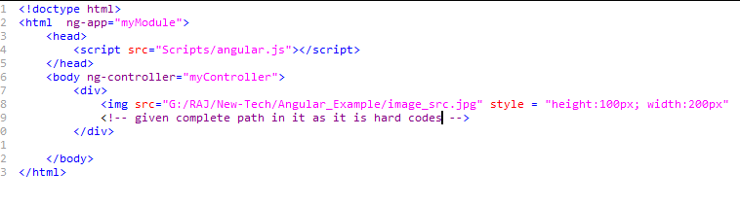
What happens if a property name in the binding expression is misspelled ?
Angular will not report any error, it will simply return null Or undefined .
ng-src directives :

Slide 10
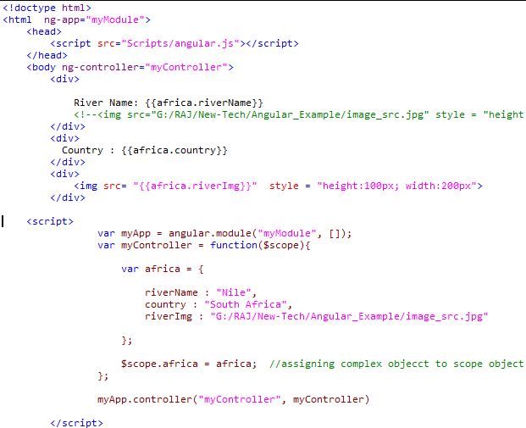
Now if we use ng-src in it

Slide 11
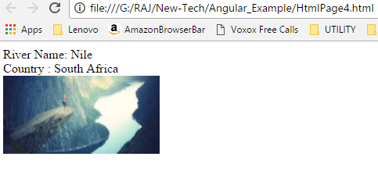
After loading browser …..

Slide 12
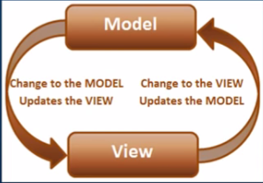
Two way data binding in AngularJS.
keeps the model and the view in sync at all times, that is a change in the model updates the view and the change in view updates the model.
Lets check in code….

Slide 13
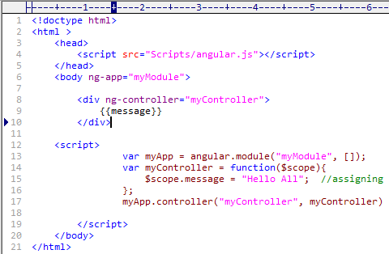
Code block
Binding expression updates the view when the model changes {{ message }} , but what, if we want other way around means View changes then model to be updated automatically.

Slide 14
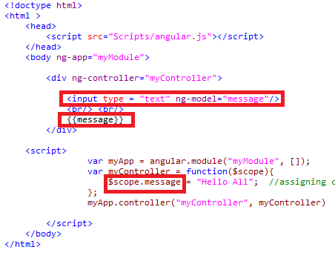

Slide 15
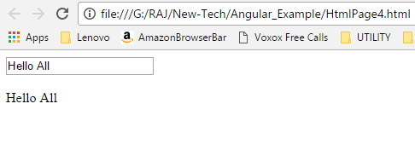
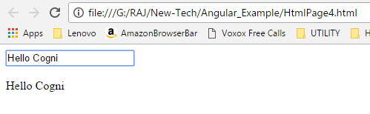
When you load the browser …
----------------------------
Typing in text are and it changing in model

Slide 16
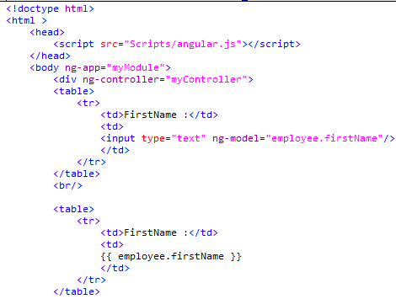
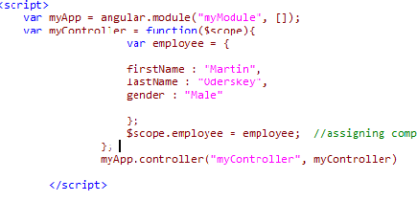
ng-model directive can be used with
input
select
textarea
----------------------
Next Q : Can we have Complex Object for ng-model ?

Slide 17
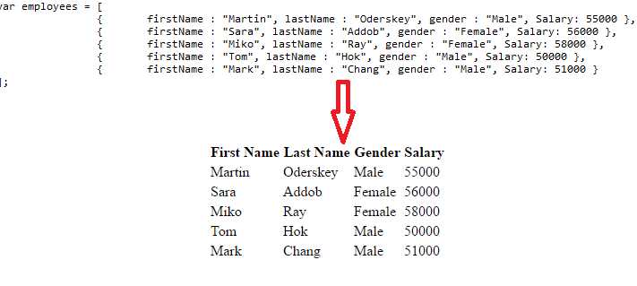
ng-repeat Directive in angular
This is similar as “for each” loop in programming languages .

Slide 18
<body ng-app="myModule">
<div ng-controller="myController">
<table>
<thead>
<tr>
<th>First Name </th>
<th>Last Name </th>
<th>Gender </th>
<th>Salary </th>
</tr>
</thead>
<tbody>
<tr ng-repeat="employee in employees">
<td>{{ employee.firstName }}</td>
<td>{{ employee.lastName }}</td>
<td>{{ employee.gender }}</td>
<td>{{ employee.Salary }}</td>
</tr>
</tbody>
</table>

Slide 19
and script model is
<script>
var myApp = angular.module("myModule", []);
var myController = function($scope){
var employees = [
{{ firstName : "Martin", lastName : "Oderskey", gender : "Male", Salary: 55000 }},
{{ firstName : "Sara", lastName : "Addob", gender : "Female", Salary: 56000 }},
{{ firstName : "Miko", lastName : "Ray", gender : "Female", Salary: 58000 }},
{{ firstName : "Tom", lastName : "Hok", gender : "Male", Salary: 50000 }},
{{ firstName : "Mark", lastName : "Chang", gender : "Male", Salary: 51000 }}
];
$scope.employees = employees;
};
myApp.controller("myController", myController)
</script>

Slide 20
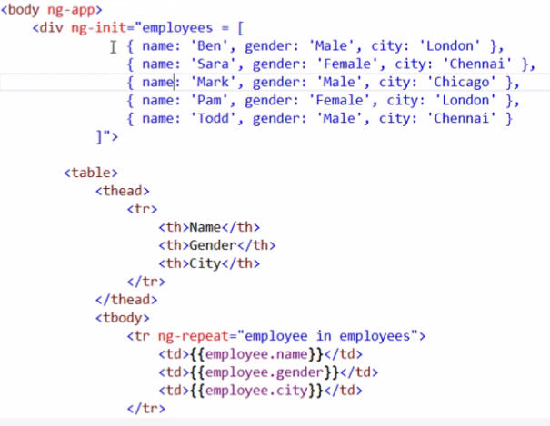
ng-init Directive

Slide 21
The ng-init directive allows evaluate expression in the current scope
In real world application you should use controller instead of ng-init to initialize values of scope

