Slide 1
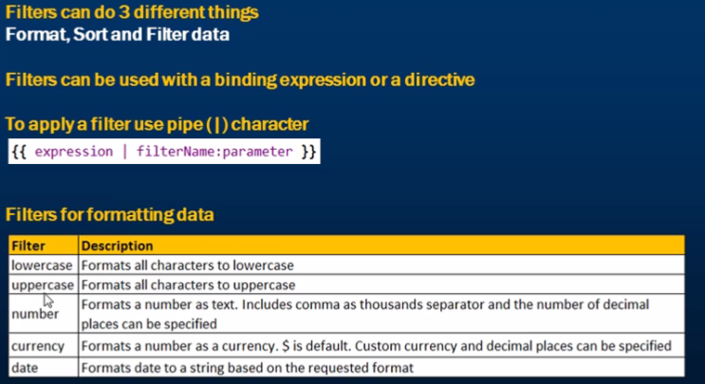
Filter in Angular

Slide 2
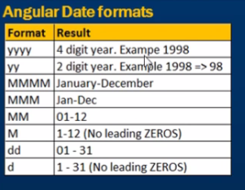
Date Formats in Angular
Another Filter :
limitTo filter – Can be used to limit the number of rows or characters in a String.
{{ expresion | limitTo : limit : begin }}
limit (mandate) and begin(optional) are two parameters.

Slide 3
Example : Angular Filter
Name | DOB | Gender | Salary (Number filter) | Salary (Currency Filter)
Martin | 21/11/1980 | Male | 55,000.79 | 55,000.79
Miko | 05/05/1970 | Female | 68,000.00 | 68,000.00
Tom | 15/08/1974 | Male | 57,000.00 | 57,000.00

Slide 4
Scope is a special javascript object which plays the role of joining controller with the views.
Scope contains the model data. In controllers, model data is accessed via $scope object.
$scope.message
$scope.type

Slide 5
Service in Angular
A service in Angular is simply an object that provide some sort of service that can be reused within an angular application
Why do we need services
Services encapsulate reusable logic that does belong anywhere else (i.e. Directives, Filters, View, Models & Controllers )
What are the benefits of using services
Reusability , Dependency Injection and Testability

Slide 6
Some of Inbuilt services
AngularJS provides many inbuilt services for example, $http:, $route, $location etc.
Use the $location service in a controller:
The $location service has methods which return information about the location of the current web page
var myApp = angular.module(“myModule”, []); app.controller(“myController”, function($scope, $location) { $scope.myUrl = $location.absUrl(); });

Slide 7
use the $http service in a controller
var myApp = angular.module('myModule', []);
myApp.controller('myController', function($scope, $http)
{ $http.get("https://www.w3schools.com/angular
/customers.php").then(function(response)
{
$scope.myData = response.data.records;
}, function myError(response)
{
$scope.myData = response.statusText;
});
});

Slide 8
Use $timeout service in a controller
<script>
var myApp = angular.module("myModule", []);
myApp.controller("myController", function($scope, $timeout)
{
$scope.myHeader = "Hello All!";
$timeout(function ()
{
$scope.myHeader = "It's time out ?";
}, 2000);
});
</script>

Slide 9
Use $internal service in a controller
var myApp = angular.module("myModule", []);
myApp.controller("myController", function($scope, $interval) {
$scope.theTime = new Date().toLocaleTimeString();
$interval(function () {
$scope.theTime = new Date().toLocaleTimeString();
}, 1000);
});

Slide 10
Create Your Own Service
var app = angular.module('myModule', []);
app.service('sum', function() {
this.mySum = function (x) {
return x+x ;
}
});
app.controller('myController', function($scope, sum) {
$scope.custSum = sum.mySum(10);
});

Slide 11
AngularJS Service vs Factory
AngularJS services as already seen earlier are singleton objects. These objects are application wide. Thus a service object once created can be used within any other services or controllers etc.
We saw there are two ways (actually four [value,provider], but for sake of simplicity lets focus on 2 ways that are widely used ) of defining an angularjs service. Using module.factory and module.service.
Function Signature for both
module.service( 'serviceName', function );
module.factory( 'factoryName', function );

Slide 12
When declaring serviceName as an injectable argument you will be provided with an instance of the function.
When declaring factoryName as an injectable argument you will be provided with the value that is returned by invoking the function reference passed to module.factory.

Slide 13
module.service('MyService', function() {
this.method1 = function()
{
//.. logic
}
this.method2 = function()
{
//.. logic
}
});
module.factory('MyService', function() {
var factory = {};
factory.method1 = function()
{
//.. logic
}
factory.method2 = function()
{
//.. Logic
} return factory;
});

