Slide 1

For Further Questions?
WWW.ETHANS.CO.IN

Slide 2
Splunk Components
Splunk Components and basic architecture
Cluster components and architecture
Different Splunk Packages

Slide 3
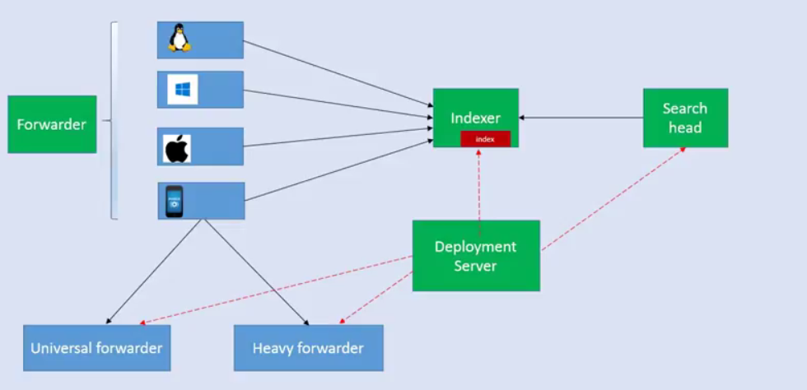
Splunk Components and basic architecture

Slide 4
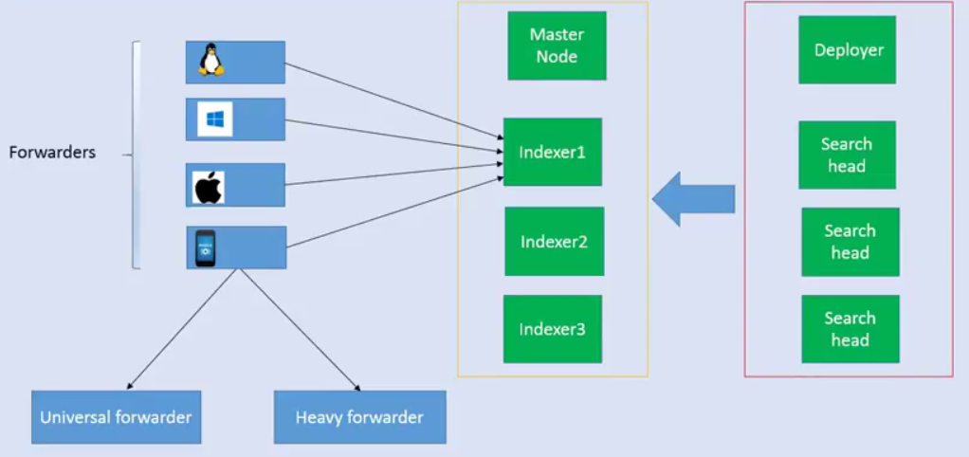
Cluster Components and basic architecture

Slide 5
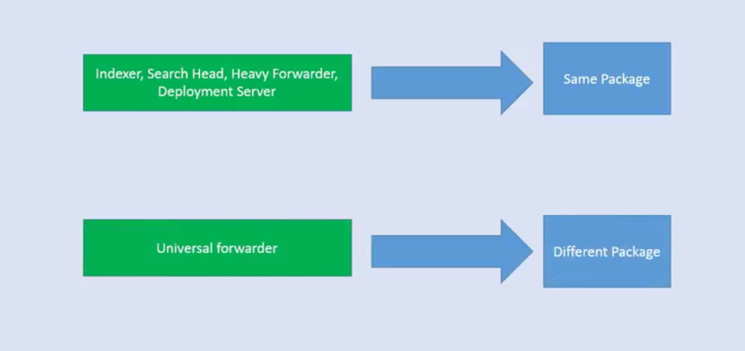
Different Splunk Packages

Slide 6
Monitoring
The importance of monitoring cannot be overstated and it is seen as one of the core elements of a DevOps approach to a system.
Monitoring takes many shapes; however, it's common to stop once you've added state monitoring, such as Is the database up? or
Is the site responding?.
These are indeed critical things to monitor, but they don't cover important questions such as
How fast am I responding to requests? And How many things have I done?.
This is where a time series database can be a valuable addition to the monitoring and information stack that you have to hand not handle.

Slide 7
Time Series DB
A time series database is a storage technique that is designed to be fast at both storing and retrieving points of data.
For instance, you can measure CPU usage in percentiles from one second to the next or alternatively measure the number of times a particular
service call has been made.
Once you have a different series, you can start to use this data for correlation.
In the above example, we can overlay the CPU statistics across the service call information and start noting where the CPU spikes
correlate with the service calls.
This starts to form the basis for an Application Performance Monitoring (APM) solution; thus allowing you to drill into the detail of where your platform is spending time and where improvements can be made

Slide 8
Ansible
Simple to Start
Scales up on demand
Automating remote system provisioning and applications deployment.
No agents are required to install on remote systems
We can use existing SSHd on remote systems
Native OpenSSH can be used for remote communication on control machine
Parallel by default

Slide 9
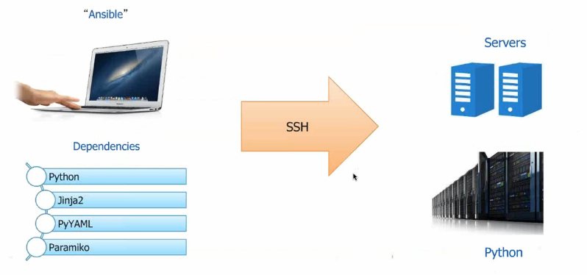
Ansible

Slide 10
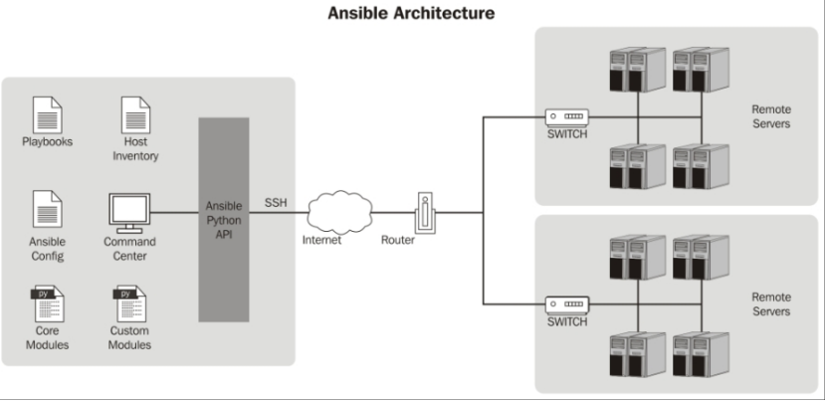
Ansible Architecture
Parallel SSH & Local execution

Slide 11
Installing Ansible on CentOS
We need to install the Extra Packages for Enterprise Linux (EPEL) repository before we install Ansible. You can install it with the following command:
sudo yum -y install https://dl.fedoraproject.org/pub/epel/epel-release-latest-7.noarch.rpm
Install Ansible using the following command:
sudo yum install ansible
You can test if Ansible is installed correctly using the version switch, as shown in the following example:
ansible --version

Slide 12
Configuring Ansible
An Ansible configuration file uses an INI format to store its configuration data
While running an ansible command, the command looks for its configuration file in predefined order, as follows
ANSIBLE_CONFIG – Firstly ansible command checks the environment variable which points to the configuration file.
./ansible_cfg – Secondly it checks for file in current directory
~/.ansible.cfg – Thirdly it checks the file in the user’s home directory
/etc/ansible/ansible.cfg – Lastly it checks the file that is automatically generated when installing Ansible via a package manager

Slide 13
Ansible Terminology
Term | Meaning
Inventory | A List of hosts , groups and variables
Modules | Actually do the work
Tasks | Invokes a module to do the work
Plays | Loops overs list of tasks mapped to list of hosts
Playbooks | A collection of plays
Handler | Same as task but will run when called by another task
Roles | Organizing Tasks and encapsulating data needed to accomplish those Tasks

Slide 14
Creating Ansible Inventory
Every action you take with Ansible is applied to an item in your inventory
The inventory file is formatted as an ini file and is essentially a simple text file that can store your catalog.
By Default ansible inventory is located at /etc/ansible/hosts
E.g.

Slide 15
Installing packages with Ansible
ansible localhost -m ping
ansible all --ask-pass -m raw -a 'yum -y install python-simplejson‘
Ansible to update all the packages on your RHEL-based servers:
ansible all -m yum -a "name=* state=latest" --ask-pass
http://docs.ansible.com/ansible/yum_module.html
http://docs.ansible.com/apt_module.html

Slide 16
Restarting services using Ansible
ansible all -m service -a "name=mariadb state=restarted" --ask-pass
ansible mysql -m service -a "name=mysql state=stopped"“--ask-pass
ansible mysql -m service -a "name=mysql state=started"“--ask-pass

Slide 17
Executing commands with Ansible
Sometimes, you need to be able to run actual shell commands on a range of servers.
An excellent example will be to reboot some nodes.
This is not something that you would put into your automation stack,
But at the same time, it is something you would like to be able to leverage your automation tool to do.
Ansible enables you to do this by sending arbitrary commands to a collection of servers.
ansible all -a "reboot -now"
ansible all -a "uptime" --ask-pass
ansible all -m user -a "name=mk shell=/bin/bash groups=wheel password=pass@123" --ask-pass

Slide 18
Installing Nginx using Ansible
<html>
<body>
<h1>Ansible Demo</h1>
<p>{{MyMessage}}</p>
</body>
</html>

Slide 19
Installing Nginx using Ansible via Playbook
- hosts: all
vars:
- MyMessage: "Welcome to Ansible world!"
- DBMessage: "Hello from MongoDB"
tasks:
- name: NGINX | Installing NGINX repo rpm
yum: name=http://nginx.org/packages/centos/7/noarch/RPMS/nginx-release-centos-7-0.el7.ngx.noarch.rpm
- name: NGINX | Installing NGINX
yum: name=nginx state=latest
- name: NGINX | Starting NGINX
service: name=nginx state=started
- name: index.html copy
template: src=index.html.j2 dest=/usr/share/nginx/html/index.html

Slide 20
Handler
A Handler is exactly the same as a Task, but it will run when called by another Task
A Handler will take an action when called by an event it listens for

Slide 21
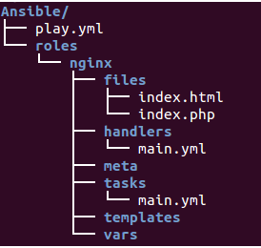
Role
We can use two techniques for reusing a set of tasks: includes and roles
Roles are good for organizing Tasks and encapsulating data needed to accomplish those Tasks.

Slide 22
Role
Files – It contains files needs to be transferred
Handlers – We can segregate all the handlers required in playbook
Meta – This directory contain files that establish roles dependencies
Templates – Files that uses variables
Tasks – It contains all the tasks that is normally in the playbook
Vars – Variables for the roles can be specified in this directory and used in your configuration files

Slide 23
Application Server Role using Tomcat
This recipe will demonstrate using Ansible to install and configure a Java application server.

Slide 24
Reference Ansible
Sample Ansible Playbooks
https://github.com/johanan/Dockerized-Wordpress-the-Correct-way
https://github.com/Einsteinish/Ansible-Playbooks-Samples
http://software.danielwatrous.com/install-and-configure-a-multi-node-hadoop-cluster-using-ansible/
https://github.com/dwatrous/hadoop-multi-server-ansible
https://www.youtube.com/watch?v=oqQHF1nz7BE

