Slide 1

For Further Questions?
WWW.ETHANS.CO.IN

Slide 2
What is Cloud Computing
Wikipedia defines cloud computing as:
"Cloud computing is internet-based computing in which large groups of remote servers are networked to allow the centralized data storage, and online access to computer services or resources.“
The National Institute of Standards and Technology (NIST) gives the following definition of cloud computing:
"Cloud computing is a model for enabling convenient, on-demand network access to a shared pool of configurable computing resources (e.g., networks, servers, storage, applications, and services) that can be rapidly provisioned and released with minimal management effort or service provider interaction."

Slide 3
What is Cloud Computing
Users should be able to provision and release resources on-demand
The resources can be scaled up or down automatically, depending on the load
The provisioned resources should be accessible over a network
Cloud service providers should enable a pay-as-you-go model, where customers are charged based on the type and quantum of resources they consume

Slide 4
Cloud Service Models
Infrastructure as a Service (IaaS) provides users the capability to provision processing, storage, and network resources on demand.
In Platform as a Service(PaaS), the service provider makes certain core components, such as databases, queues, workflow engines, e-mails, and so on, which are available as services to the customer. The customer then leverages these components for building their own applications.
In the Software as a Service(SaaS) model, typically, third-party providers using a subscription model provide end-user applications to their customers.
Example Iaas ,PaaS & Saas

Slide 5
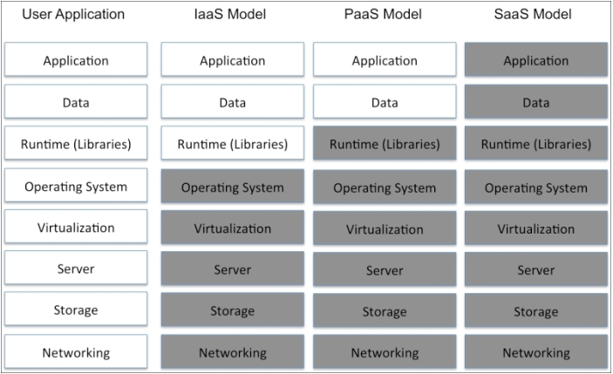
Cloud Service Models

Slide 6
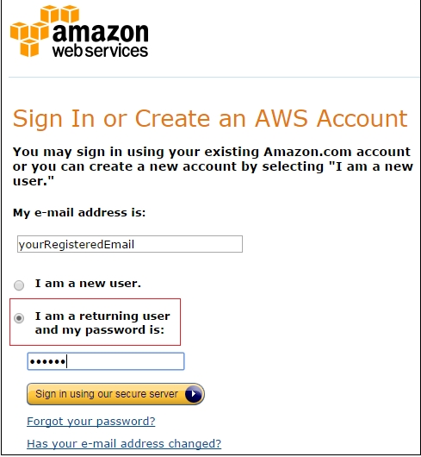
Setting up AWS Account
Point your browser to http://aws.amazon.com/ and click on Create a Free Account.

Slide 7
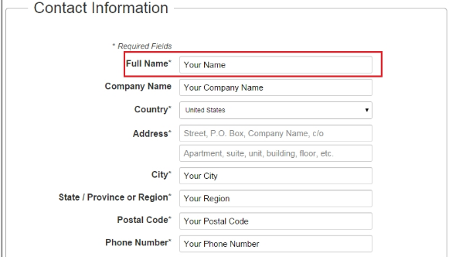
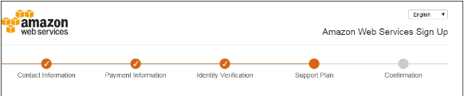
Setting up AWS Account

Slide 8
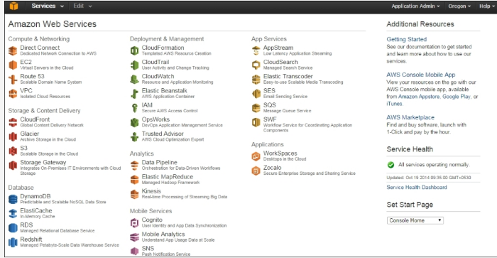
AWS Management Console

Slide 9
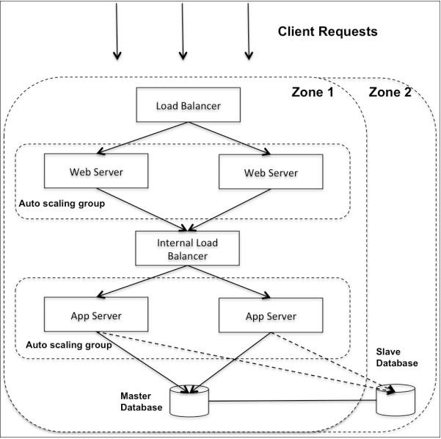
Designing Cloud Applications
Multi-tier Architecture

Slide 10
AWS Components
Amazon Elastic Compute Cloud (EC2) :Amazon EC2 is a web service that provides compute capacity in the AWS cloud.
Amazon Elastic Block Storage (EBS):Amazon EBS is highly available and durable persistent block level storage volumes for use with Amazon EC2 instances.
Elastic IP addresses allow you to allocate a static IP address, and programmatically assign it to an instance.
Amazon CloudWatch: We can enable monitoring on EC2 instance using it.
We can also distribute incoming traffic by using the Elastic Load Balancer (ELB) service.
We can create auto scaling groups using the auto scaling feature to automatically scale your capacity based on CloudWatch.

Slide 11
AWS Components
Amazon S3: Amazon S3 is a highly durable and distributed data store.
Amazon Glacier: Amazon Glacier is low-cost storage service that is typically used for archiving and backups.
Amazon RDS: It provides an easy way to setup, operate, and scale a relational database in the cloud. Database options available from AWS include MySQL, Oracle, SQL Server, PostgreSQL, and Amazon Aurora (in preview at this time)
Amazon DynamoDB : It is a NoSQL database service offered by AWS. It supports both document and key-value pairs, data models, and has a flexible schema.
Amazon ElastiCache: f your application is read-intensive, then you can use the AWS ElastiCache service to significantly boost the performance of your applications. ElastiCache supports Memcached and Redis in-memory caching solutions.

Slide 12
AWS Components
Amazon Simple Queue Service (Amazon SQS) is a reliable, highly-scalable, hosted, and distributed queue for storing messages as they travel between computers and application components.
Amazon Virtual Private Cloud (Amazon VPC) allows you to extend your corporate network into a private cloud contained within AWS. Amazon VPC uses the IPSec tunnel mode that enables you to create a secure connection between a gateway in your data center and a gateway in AWS.
Amazon Route 53 is a highly-scalable DNS service that allows you to manage your DNS records by creating a hosted zone for every domain you would like to manage.
AWS Identity and Access Management (IAM) enables you to you to control access to AWS services and resources.
Amazon CloudWatch is a monitoring service for your AWS resources. It enables you to retrieve monitoring data, set alarms, troubleshoot problems, and take actions based on the issues arising in your cloud environment.

Slide 13
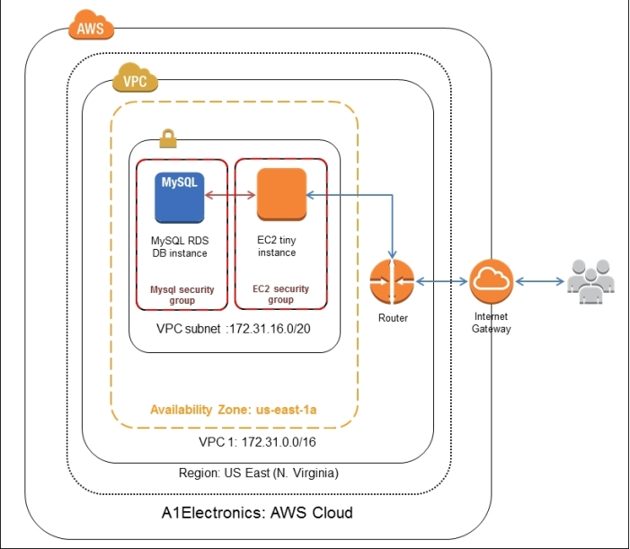
Setting up AWS Infrastructure

Slide 14
Setting up AWS Infrastructure
Region: AWS services are hosted in multiple locations around the word and these are known as regions. The regions are connected through the public internet.
Availability Zone: Availability zones (AZ) can be treated as traditional data centers within a region. AZs in the same region are designed to provide infrastructure redundancy in the event of a catastrophic outage, such as earthquakes, snowstorms, Godzilla attacks, and so on. The number of AZs in a region is region specific. In our example, we select the us-east-1a AZ.
EC2 Instance: This is a virtual server on which you run your applications. These come in various flavors to meet your computing demand. A high compute EC2 instance also has high network I/O memory associated with it. You cannot have a low compute EC2 instance with high memory and network I/O. EC2 instances have fixed CPU to memory ratios. It is best to select a micro instance for development, since it is free. More on EC2 instance types is available athttp://aws.amazon.com/ec2/instance-types/.

Slide 15
Setting up AWS Infrastructure
Security Groups: A security group acts as a virtual firewall for your instance to control inbound and outbound traffic. The security group can be configured by a set of rules for inbound and outbound traffic. The rules define the network protocol, port, and source and destination IP address ranges to accept or send your data to.
Virtual Private Cloud (VPC): VPC lets you provision a private, isolated section of the AWS cloud where you can launch AWS resources in a virtual network, using custom-defined IP address ranges. It is like your own private data centre.
Subnets: Subnets are logical segments of a VPC's address range that allow you to designate to a group of your resources based on security and operational needs
Router: Each VPC comes with a default router in order to communicate with resources outside the VPC. For example, connecting to a database server in other VPCs.

Slide 16
Setting up AWS Infrastructure
From the EC2 dashboard, click on Security Groups from the navigation pane and then on theCreate Security Group button.
Create a security group for EC2 instances to allow the following
Web traffic from any IP address on port 8080 (default Tomcat server port)
SSH traffic for remote login from any IP address
ICMP traffic to ping the EC2 instance from a public Internet

Slide 17
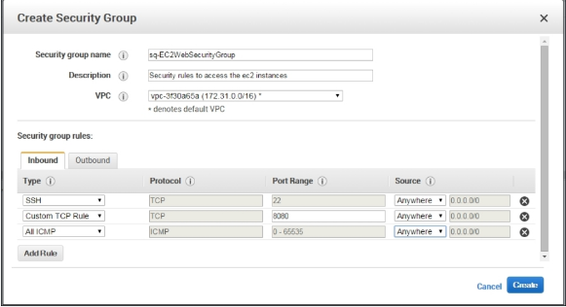
Setting up AWS Infrastructure

Slide 18
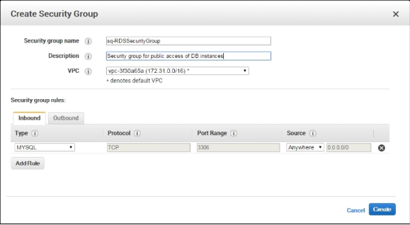
Setting up AWS Infrastructure
Create a security group for MySQL RDS instances to allow access from the Internet.

Slide 19
Setting up AWS Infrastructure
Creating EC2 instance key pairs
From the EC2 dashboard, click on Key Pairs from the navigation pane and then on the Create Key Pair button.
Enter e2accesskey when prompted with a dialog box asking to enter the key pair name. This key pair name will be used while configuring the EC2 instances.
Note - Make sure you select the correct AWS region from the EC2 dashboard to create the keys because key pairs can't be shared across regions
As soon as you create the key pair, your private key will be immediately downloaded to your computer. Secure this private key. This private key file can be only downloaded once during the creation of the keys. You cannot change access keys in your EC2 instances once they have been assigned.

Slide 20
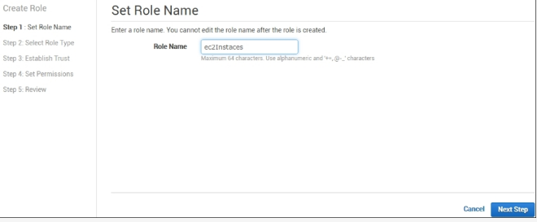
Setting up AWS Infrastructure
Creating Roles
From the IAM dashboard, click on Roles in the navigation pane and then on the Create New Role button
Create a role named ec2Instance for our EC2 instances that have access to all the AWS provided services, as shown in the following screenshot:

Slide 21
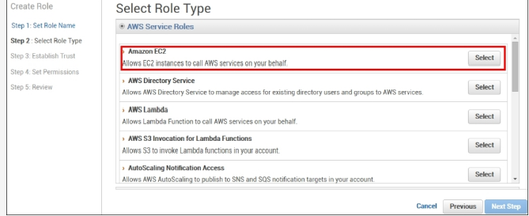
Setting up AWS Infrastructure

Slide 22
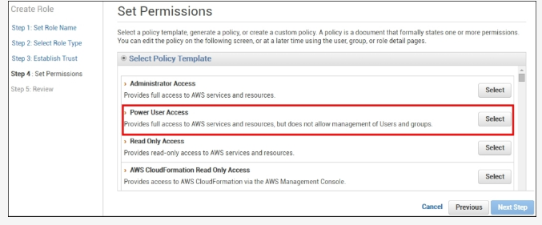
Setting up AWS Infrastructure

Slide 23
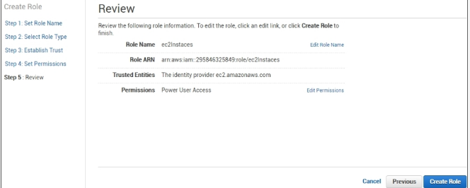
Setting up AWS Infrastructure

Slide 24
Setting up AWS Infrastructure
Creating EC2 Instance
From the EC2 dashboard, click on Instances in the navigation pane and on the Launch instance. This will start a process of provisioning an EC2 instance.
The next step is to choose an operating system for the EC2 instance; this is done by choosing the correct Amazon Machine Image (AMI) as per our requirements. Select theUbuntu Server 14.04 LTS (HVM) SSD Volume Type AMI, as shown in the following screenshot:

Slide 25
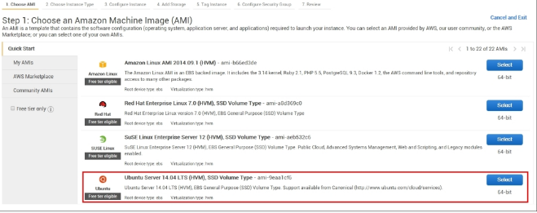
Setting up AWS Infrastructure

Slide 26
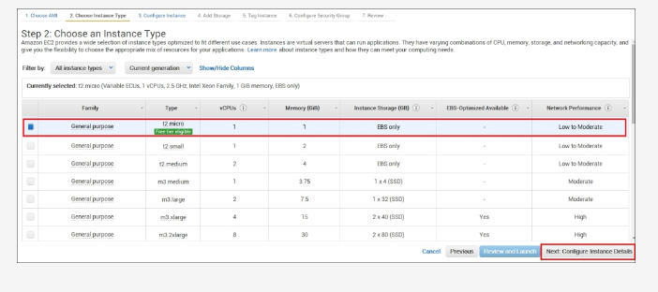
Setting up AWS Infrastructure

Slide 27
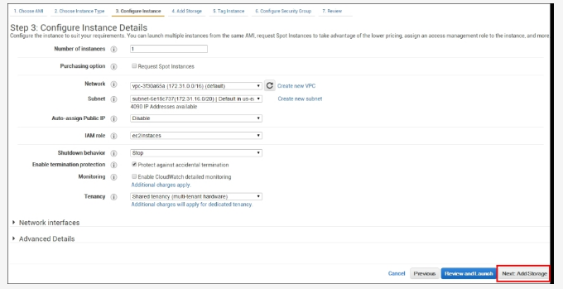
Setting up AWS Infrastructure

Slide 28
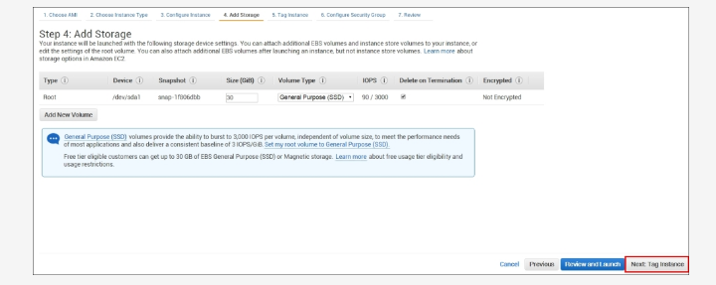
Setting up AWS Infrastructure

Slide 29
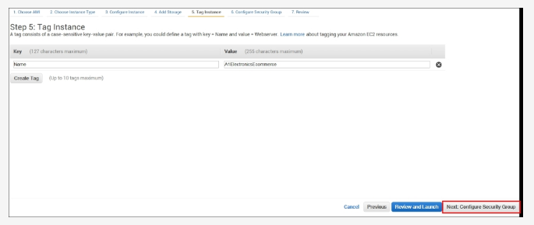
Setting up AWS Infrastructure

Slide 30
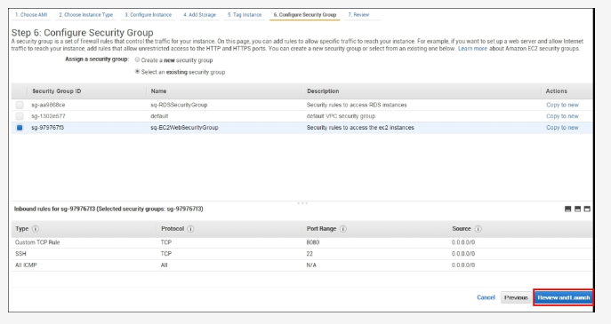
Setting up AWS Infrastructure

Slide 31
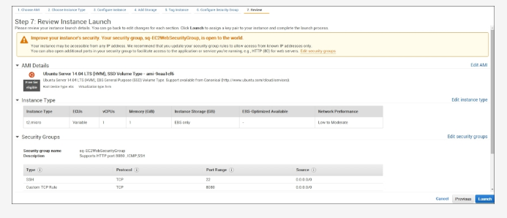
Setting up AWS Infrastructure

Slide 32
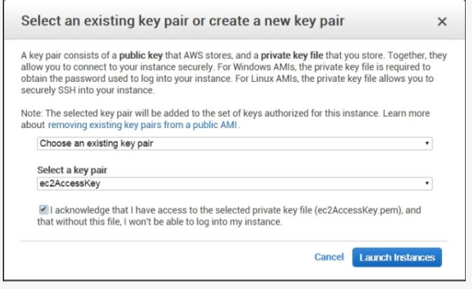
Setting up AWS Infrastructure

Slide 33
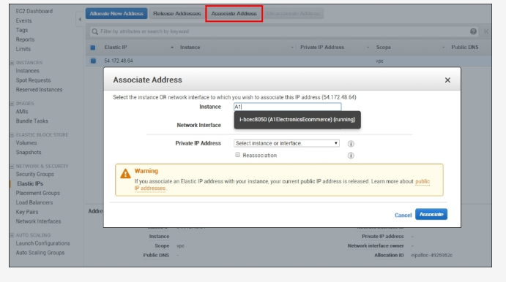
Setting up AWS Infrastructure
Assigning Elastic IP

Slide 34
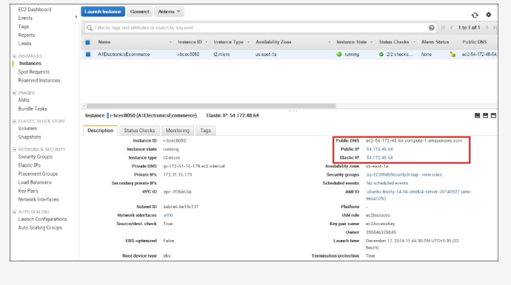
Setting up AWS Infrastructure

Slide 35
