Slide 1
Rust’s Memory Model
David Atkinson, Sherry Nguyen, and Rami AlQunaibit
Notes:
Hi, I’m Sherry, and this video was created by David Atkinson, Rami AlQunaibit, and me, about Rust’s memory model.

Slide 2
Have you ever had memory errors?
“I call it my billion-dollar mistake. It was the invention of the null reference in 1965. … My goal was to ensure that all use of references should be absolutely safe, with checking performed automatically by the compiler. But I couldn't resist the temptation to put in a null reference, simply because it was so easy to implement. This has led to innumerable errors, vulnerabilities, and system crashes, which have probably caused a billion dollars of pain and damage in the last forty years.
-- Tony Hoare, Turing Award Winner
Notes:
Have you ever had memory errors? Segmentation faults? Memory leaks? Dereferenced a null pointer?
These are big problems, and while languages have made a lot of progress on this front since Algol, there’s still room for improvement. We want to talk about a language, Rust, that thinks it has something to offer here.

Slide 3

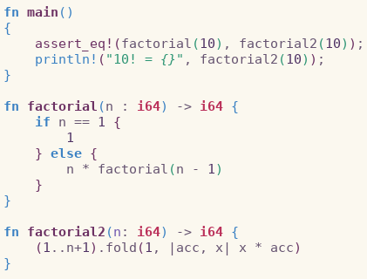
What is Rust?
Initially created in 2006 by Graydon Hoare, and now sponsored by Mozilla.
Open source, MIT license
Designed for similar use cases to C++
Notes:
Rust is a systems programming language sponsored by Mozilla Research, which describes it as a "safe, concurrent, practical language," supporting functional and imperative-procedural paradigms. Rust is syntactically similar to C++, but its designers intend it to provide better memory safety while still maintaining performance.
Rust won first place for "most loved programming language" in the Stack Overflow Developer Survey three years in a row 2016, 2017 and 2018.
As you can see in the code sample, Rust has C-like syntax, along with some features that will be familiar to Scala programmers, such as type annotations, anonymous and higher-order functions, and compile time macros.
Rust is a big language, with many features, but today, we’re going to focus specifically on Rust’s approach to memory management, which is arguably its biggest draw.

Slide 4
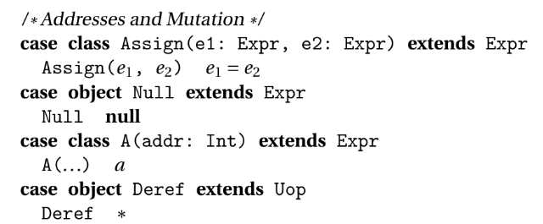
Memory Model: How does Javascripty do it?
Notes:
Before we dive in to Rust’s memory model, let’s take a look at Javascripty’s. Javascripty is a simple language, but it does have a pretty rudimentary system of memory addressing, dereferencing, and mutation. As we’ll see, this basic framework is similar to Rust’s approach. However, Rust is much more restrictive.
Javascripty also distinguishes between parameters that are called by value, and those that are called by reference. Again, Rust’s approach is similar, but with added safety rules.
One significant difference is that, with a cast, we can assign a Null value to Javascripty objects. In the main Rust language though, this is impossible. Instead, Rust encourages an approach that’s similar to Scala’s, in which the possibility of not having a value is expressed directly through the type system.

Slide 5
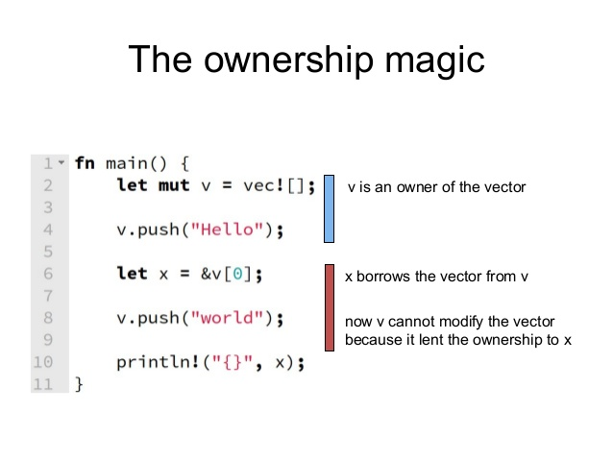

The Memory Model: How ?
Ownership:
Notes:
Rust’s memory model is driven by different requirements than Javascripty’s. Rust would like to have both: the safety and ease of garbarge collected languages like Java and Scala, AND the control and predictability of the manual memory management provided by languages like C and C++. The way it does so is the ownership model.
With the ownership model, each memory value has a single owner, usually the variable that was initially assigned to. For example, in the figure on the right, on line 2, “v” is the owner of a heap--allocated vector.
In Rust, when one variable is assigned to another, the ownership of the relevant memory value is “moved.” Accessing the first variable is now an error! You can see this in the figure on the left. First, we initialize “a” with a string value. But, when we assign “a” to “b” on line 2, “a” becomes uninitialized. Its value has moved. Importantly, since this is the default behavior, moves are cheap--internally, nothing on the heap actually changes, just the internal pointers.
In the next few slides we’ll talk about some other ways Rust makes it easier to actually write useful programs.
---
On the JVM, any unreferenced objects should get garbage collected - and your last reference to the new object disappears as soon as the object goes out of scope. This is where Rust out shines Javasripty.
In Rust, there are very clear rules about which piece of code owns a resource. In the simplest case, it’s the block of code that created the object representing the resource. At the end of the block the object is destroyed and the resource is released.
+ Moving: The process of transferring ownership is also called moving, because resource is moved from the old location (say, a local variable) to the new location (a function argument). For speed purposes only the reference changes.
+ Copy: A move is just a copy where the compiler disallows using it afterward. That's the only thing this modifies, it's not more or less expensive.

Slide 6
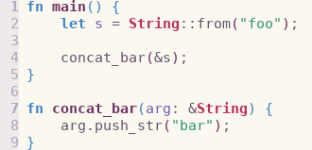
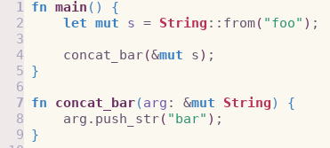
How ?
2. References:
Notes:
Rust has a notion of references, like C, C++, Javascripty, and so on. Unlike those languages, Rust has two types of references: shared, and mutable. If you’re familiar with the classic Readers/Writers concurrency model, this will be familiar: Rust lets you have multiple shared references, but only if there are no mutable references to the object. You can use a mutable reference to modify an object, but not a shared reference.
So, in the screenshots, the left code segment will produce an error. We’re trying to modify the string we’ve passed in to “concat_bar”. But we’re using a shared reference. Changing everything to be mutable will fix things.
----
In the simplest case references behave “just like” moving ownership back and forth without doing it explicitly.
+ It allows us to have multiple references to a resource while still adhering to the “single owner, single place of responsibility” concept.
+ References are similar to pointers in C.
+ A reference is an object too. Mutable references are moved, immutable ones are copied. When a reference is dropped, the borrow ends (subject to the lifetime rules, see the next section).
+ Multiple shared references can exist at a time, but only one mutable reference.
+ When there’s a shared reference to an object, it can’t be modified.
The values pointed to by references aren’t dropped when references go out of scope

Slide 7
How ?
3. Lifetimes:
How Rust implements safety guarantees.
Every resource has a lifetime
A resource must be “alive” for it to be borrowed
Notes:
In a nutshell, lifetimes are the way the compiler ensures that every reference is a good one. In Rust, every variable has a lifetime. To use a reference to a variable, that variable has to be “alive.” One of the technical advances offered by Rust is compile time verification of references. This is a little abstract, so here’s example to illustrate how it all works in practice.

Slide 8
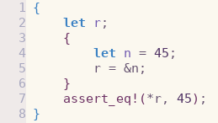
Quick Example
Notes:
This code will actually not compile, as I’ll explain in a minute.
The first thing to note is that scope is the key to understanding lifetimes. Like Scala, Rust is lexically scoped. So from this code segment, we can determine the values that each variable has, and when it has them.
So what’s happening here? First, we declare a variable “r”. Then, in another block, we declare a variable “n”, before setting “r” equal to a shared reference to “n”. Finally, we check if the dereferenced “r” equals the original value of “n”, 45.
The problem here is that “r” is in scope from lines 2-7, and “n” is in scope from lines 4-5. So the lifetime of the reference “&n” both shouldn’t exceed the bounds of lines 4-5 AND needs to extend to line 7, where it’s used.
Since there’s no way to satisfy those requirements, Rust gives us a helpful error message:

Slide 9
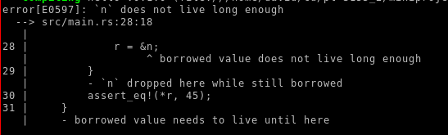
What Happens?
Notes:
“‘n’ does not live long enough”
It’s worth noting here that this is happening at compile time. In Javascripty for example, the equivalent program would create a totally valid parse tree. To realize that our reference actually points to nothing useful, we’d have to wait until runtime. This makes sense for Javascripty, since its interpreted, and because the kind of static analyses that Rust uses to determine lifetimes is way too complicated for an undergraduate class. But in Rust, it’s nice to know that a whole class of errors just isn’t possible, as long as your code compiles.

Slide 10
Other Things to Look Into
Copy traits
The Arc and Box types
Unsafe code (the Rustonomicon)
Notes:
We’ve only talked about the very basics here. Rust has a ton of other features just related to memory management, that are all worth checking out.
We’ve listed some especially important ones here. Not all assignments in Rust actually transfer ownership, for example. If you’re interested in that, the Copy trait is worth reading about.
Also, some parts of Rust are sort of garbage collected … ish. For example, the Arc type stands for “automatic reference counting”. It lets you create the same kind of program structure as you might get in C, with big webs of references, all managed by Rust.
Finally, we’ve been talking about safe Rust code. If you’re an advanced user, Rust lets you do all the unsafe things that you can do in C (and Javascripty). Searching for “the Rustonomicon” will tell you how.

Slide 11
Sources
Programming Rust by Jim Blandy and Jason Orendorff
Understanding Rust Ownership by Sergey Bugaev (https://medium.com/@bugaevc/understanding-rust-ownership-borrowing-lifetimes-ff9ee9f79a9c)
https://doc.rust-lang.org/book/second-edition

