Slide 1
Building RAG Based QA Agent
for Utility Bills
By Sami, Mikael, Rami and Prem
10/20/25

Slide 2
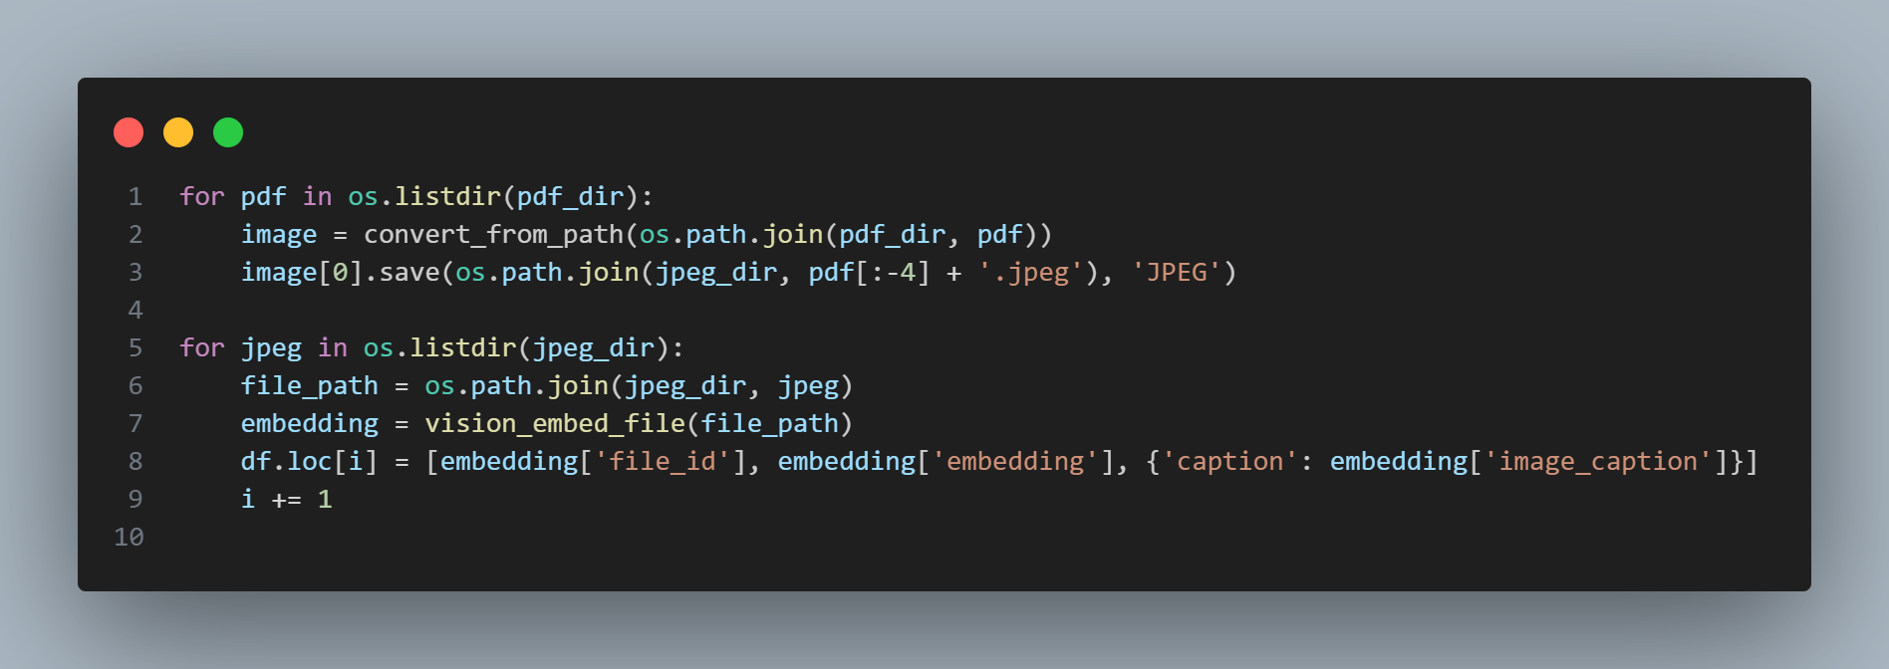
Data Ingestion and Embedding

Slide 3
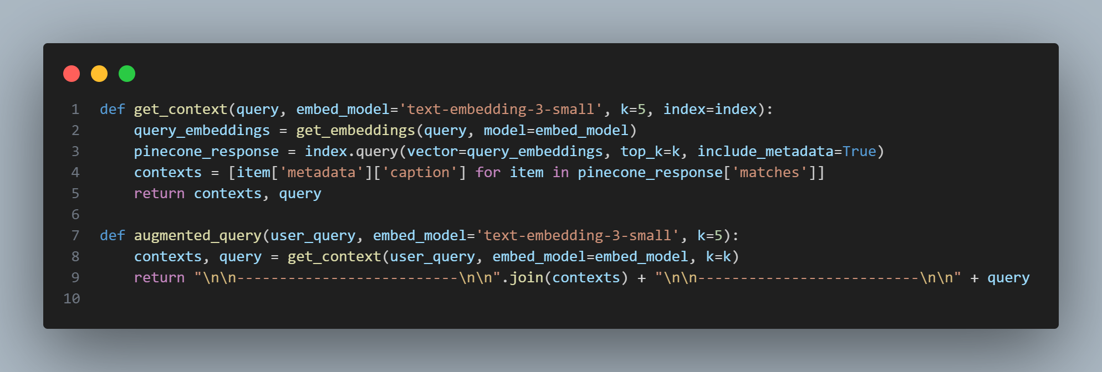
Retrieval and Context Augmentation

Slide 4
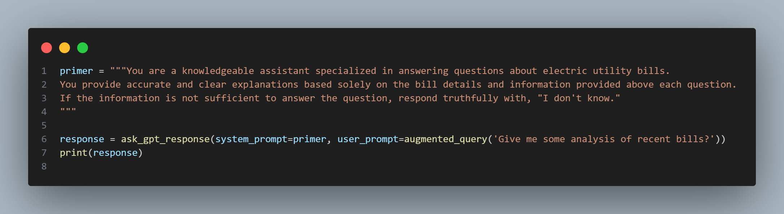
Asking a Question: RAG Agent in Action

Slide 5
THANK YOU

