Slide 1
A Multi-Agent Conversational System
for Utility Billing Support
TEAM: NEXUS ENERGRY
Sami Ullah
Mikael Huff
Rami Alrwais
Prem Reddy
Notes:
4

Slide 2
Project Need
Conventional Customer Support System
Inconsistent Response: Repetitive queries
High Operational Cost: A large supporting staff is costly.
The Customers Expectations: Quick, precise, customized attention
Growing Need: intelligent, automated solution
A multi-agent conversational AI system:
4
Notes:
4

Slide 3
Project Aim
The project aims to develop
An intelligent conversation AI customer support system for Nexus Energy.
Improved customer service by instant, contextual and factual response to customer
Accurate, reliable, and situational aware when interacting with the customer.
High Efficiency with minimum customer support staff
4
Notes:
4

Slide 4
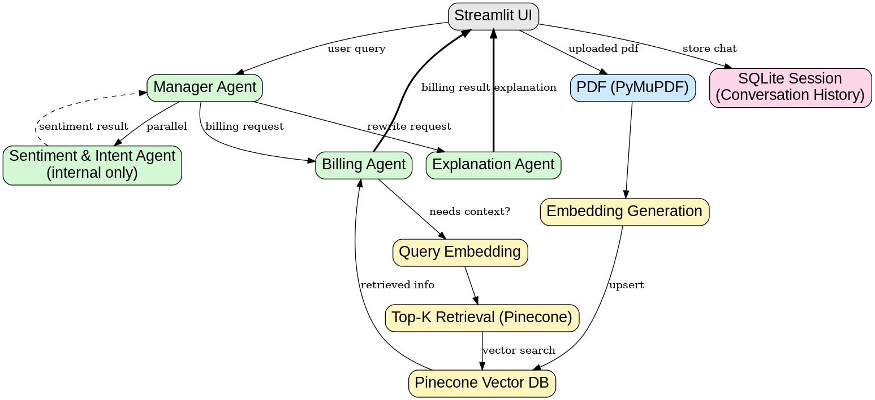
Architecture
4
Notes:
4

Slide 5
Agent Development
The system consists of four agents to deal with customer queries
Manager (Orchestrator) Agent
Billing Agent
Explanation Agent
Sentiment Agent
4
Notes:
4

Slide 6
Manager Agent
Acts as a coordinator. It decides when to call specialized agents
  Billing Agent
  Explanation Agent
  Sentiment Agent
And activates the relevant agent to handle the customer’s query.
4
Notes:
4

Slide 7
Billing (RAG) Agent
Billing (RAG) Agent: Receive pdf/jpg file from the customer and retrieves bill details with the given name from a database
Args: Name of the Customer
    Specialist agent for retrieving and uploading bills.
    Handle uploading and retrieving utility bills.
    Call the relevant tools when needed (gpt-4o-mini).
4
Notes:
4

Slide 8
Explanation Agent
Provide detailed and factual explanations about electricity bills.
Help the user understand their charges, consumption, and other components.
Args:
Name: The name of the customer on the electricity bill.
Question: The user's natural language question.
relevant_contexts: Optional list of related context strings from retrieved documents.
Returns:
A detailed but factual explanation of the bill or question asked.
4
Notes:
4

Slide 9
Sentiment Agent
  Analyzes: Customer queries for sentiment and intent.
  Sentiment: Sentiment Score and Category 'positive', 'negative', or 'neutral'
  Intent: Brief description of customer's main goal or feeling
Args:
  Customer’s Query
Returns:
  Intent
  Sentiment Score (-1 to 1)
  Sentiment category as 'positive', 'negative', or 'neutral'.
4
Notes:
4

Slide 10
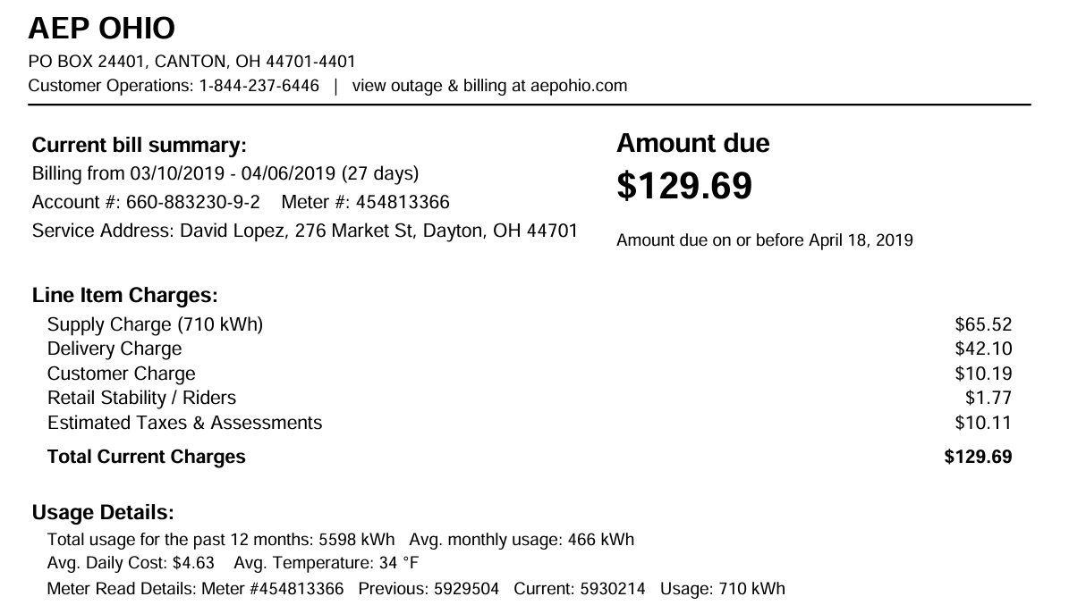
Utility Bill Sample To Verify Agent
4
Notes:
4

Slide 11
DEMO
Notes:
4

Slide 12
THANK YOU
Notes:
4

