Slide 1
Building RAG Based QA Agent
for Utility Bills
By Sami, Mikael, Rami and Prem
10/20/25

Slide 2
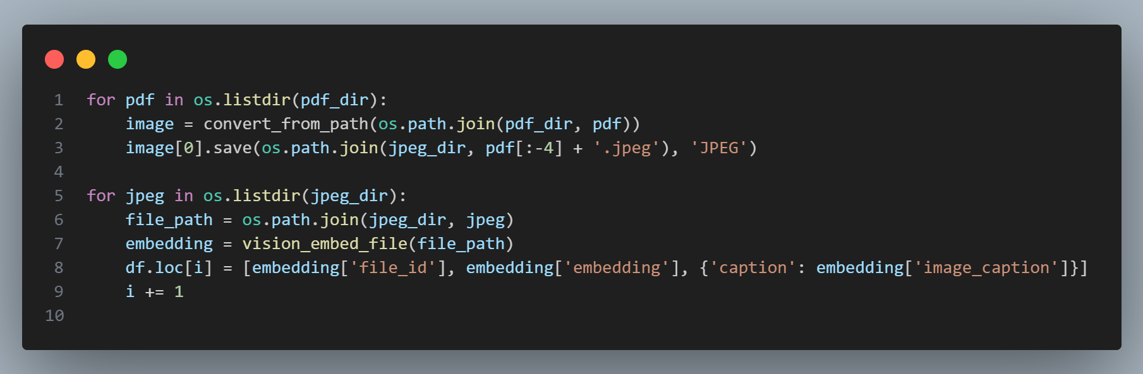
Data Ingestion and Embedding
PDFs are converted to images and embedded as semantic vectors for efficient retrieval.

Slide 3
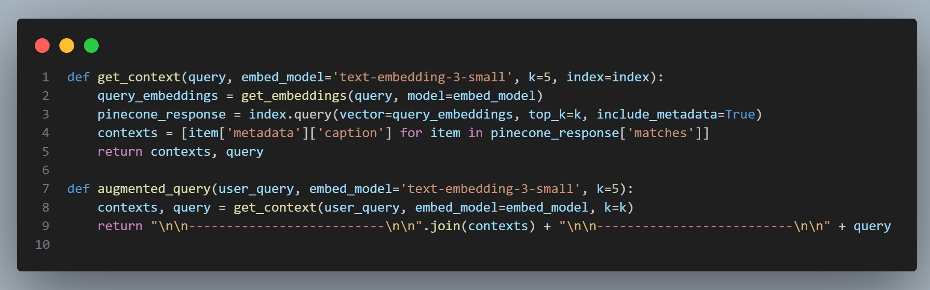
Retrieval and Context Augmentation
User queries are matched to relevant bill captions using semantic search, then combined for context-rich prompts.

Slide 4
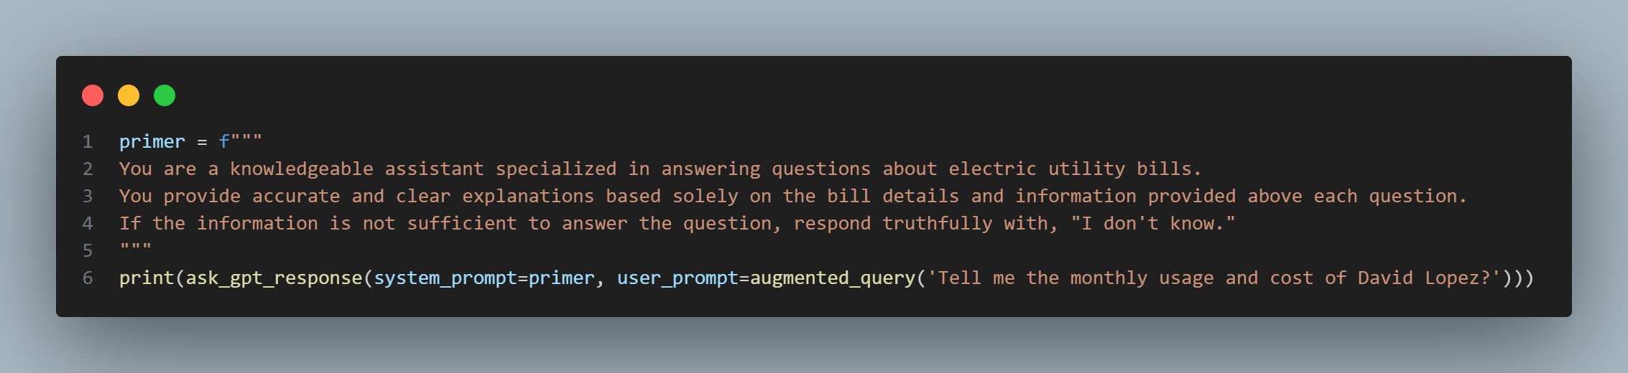
Asking a Question: RAG Agent in Action
According to the AEP Ohio bill for **David Lopez**:
- **Monthly usage:** 710 kWh
- **Total cost (amount due):** $129.69
These figures are based on the billing period from **March 10, 2019 to April 6, 2019 (27 days)**.

Slide 5
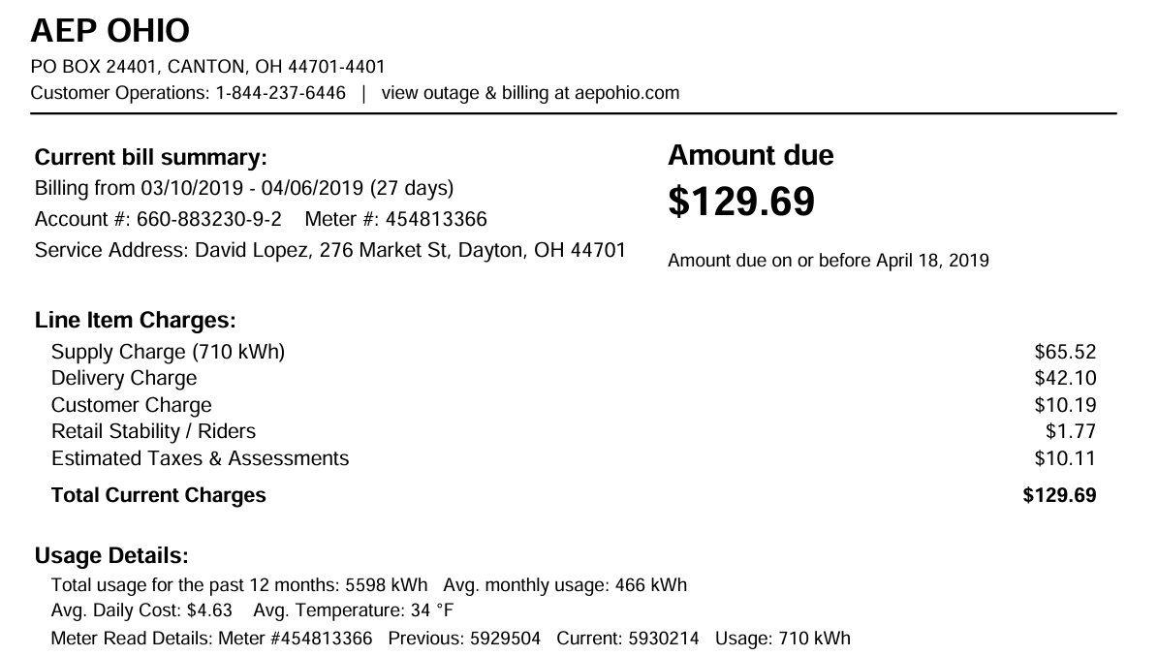
Utility Bill Sample To Verify Agent

Slide 6
THANK YOU

