Slide 1

Optimizing Peer Referrals for Public Awareness using Contextual Bandits
Ramaravind Kommiya Mothilal
Microsoft Research India
t-rakom@microsoft.com
Amulya Yadav
University of Southern California
amulyaya@usc.edu
Amit Sharma
Microsoft Research India
amshar@microsoft.com
(Special Thanks to Bill Thies and Devansh Mehta)

Slide 2


Public Awareness for Social Welfare Projects
Necessary first step in social welfare projects: raising awareness
Timely dissemination of critical information to relevant communities
Notes:
In some projects, the goal is to promote beneficial practices such as regular washing of hands..
For others, goal is to draw people’s attention to available interventions such as vaccinations or beneficial public campaigns
While not sufficient for behavioral change per se, delivering right information in a timely fashion in critical in many situations

Slide 3


Public Awareness in Low-Resource Communities
Design Challenges in Manual Outreach
Labor intensive
Scale up
Notes:
Further, designing public awareness initiatives is more challenging in low-resource communities especially if the outreach is manual mainly because
They are very labour intensive, which means more cost
scaling up with limited resources is also very difficult

Slide 4
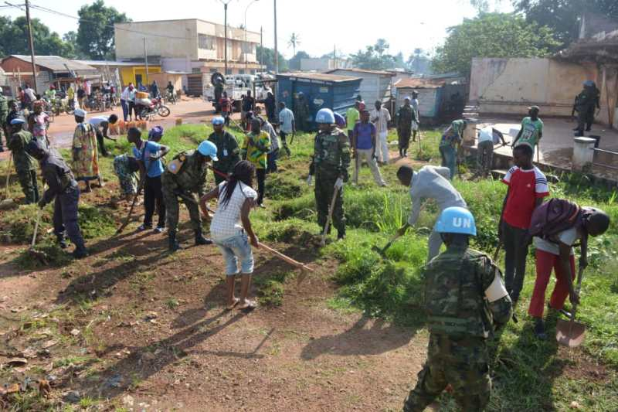
Public Awareness in Low-Resource Communities
Design Challenges in Manual Outreach
Labor intensive
Scale up
Notes:
TODO: change the pic
Further, designing public awareness campaigns is more challenging in low-resource communities especially if the outreach is manual mainly because
They are very labour intensive, which means more cost
scaling up with limited resources is also very difficult

Slide 5
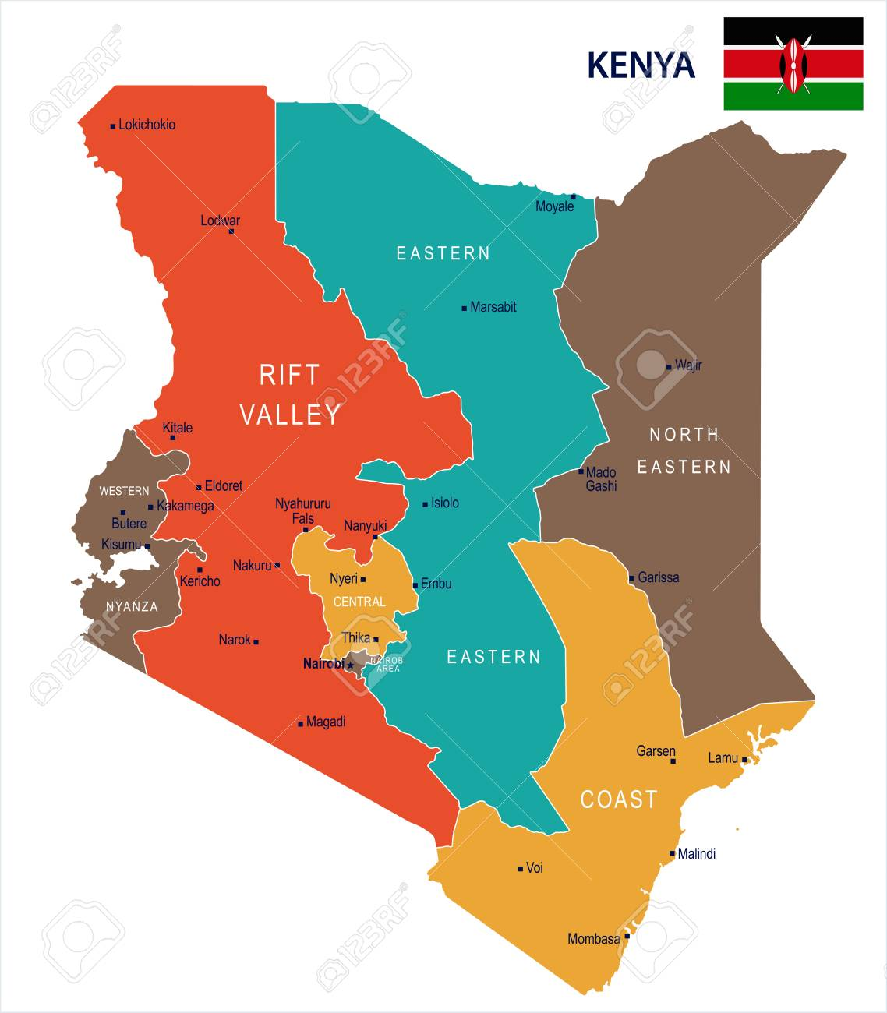

Public Awareness in Low-Resource Communities
From Manual Outreach to Phone-based Solutions
M-SIMU: To improve immunization uptakes in western Kenya
Gibson, Dustin G., et al. "Mobile phone-delivered reminders and incentives to improve childhood immunisation coverage and timeliness in Kenya (M-SIMU): a cluster randomised controlled trial." The Lancet Global Health 5.4 (2017): e428-e438.
Notes:
The Mobile Solutions for Immunization (M-SIMU) cluster-randomised controlled trial aimed to assess whether SMS reminders, either with or without mobile money incentives, could improve the proportion of children fully immunised by their first birthday

Slide 6
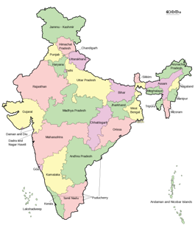


Public Awareness in Low-Resource Communities
From Manual Outreach to Phone-based Solutions
Learn2Earn: To spread land rights awareness in central India
Saiganesh Swaminathan, Bill Thies, Amit Sharma, Devansh Mehta, Alok Sharma. “Learn2Earn: Enabling Mass Awareness through Financial Incentives.” In Proc. of ICTD 2019, Jan 2019.
Notes:
Users call an Interactive Voice Response (IVR) system, listen to a brief audio tutorial, and
take a multiple-choice quiz to check their understanding. People who pass the quiz receive a mobile top-up (about
USD 0.14) and

Slide 7
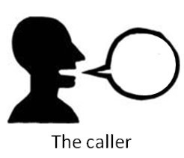

Public Awareness in Low-Resource Communities
From Manual Outreach to Phone-based Solutions
Reach a larger audience
Peer-to-peer referral systems
Avoids knowing
all phone numbers
beforehand
Incentive (mobile top-up)
Notes:
Many of these phone-based solutions also have a referring option where users have the opportunity to earn additional credits by referring others to the system
To reach large audiences
Avoid knowing all ph nos beforehand

Slide 8
Peer Referrals for Public Awareness
Problems with
Fixed Incentive structure
A
B
C
Social Network
Oracle
Effort put to refer
Arrow length α effort
Response to Incentives
responds equally
Best Option: Choose at random
Best Option: Choose A and C
Notes:
Most programs follow fixed incentive structure
However,

Slide 9
Peer Referrals for Public Awareness
Problems with
Fixed Incentive structure
A
B
C
Social Network:
Past works (Tong et al. 2017, Yadav et al. 2016, Zhuang et al. 2013) assumes some information about the underlying social network
People’s response to incentives:
Past works (Lobel et al. 2016, Singer 2012) assumes step-function as a proxy for response to incentives
Social Network
Oracle
B
C
Effort put to refer
Arrow length α effort
Response to Incentives
responds equally
Best Option for Larger Networks:
Pay more to people like B and C and very less to people like A
Best Option: Choose B and C

Slide 10
Peer Referrals for Public Awareness
Practical Considerations:
Variable Incentive
Confusing
Complex project management
Changing frequency of payment α Changing incentives
Offer to Pay first
sets expectations motivates referral
Pay incentives only to the referrer
Notes:
Further, we also consider some practical constraints that are not discussed very much in the past works…
Additional constraints – lessoin from real world deployments

Slide 11
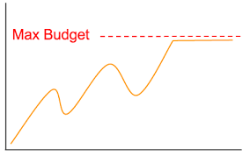
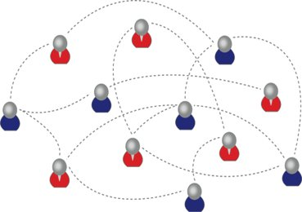
Optimizing Peer Referrals for Public Awareness
Goal: To design an optimal “offer to pay” strategy to maximize reach of a particular message given…
Unknown people’s effort put to refer and response to incentives
Unknown social network
Fixed budget

Slide 12
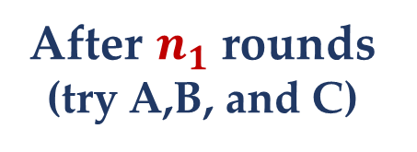
Optimizing Peer Referrals for Public Awareness
How to design an optimal “offer to pay” strategy given the constraints?
A
After $n_{1}$ rounds (try A,B, and C)
Best Policy:
Incentivize B and C
Why not use the best-known option?
B
C
Exploitation
Arrow length α effort put to refer
Respond equally to incentives

Slide 13
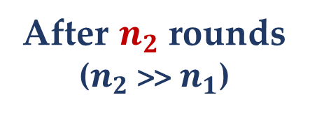
Optimizing Peer Referrals for Public Awareness
How to design an optimal “offer to pay” strategy given the constraints?
A
After $n_{1}$ rounds (try A,B, and C)
Best Policy:
Incentivize B and C
Why not explore to gather enough information to make better decisions?
B
C
After $n_{2}$ rounds ($n_{2}$ >> $n_{1}$)
Reach more people in the network
Exploration and Exploitation
Arrow length α effort put to refer
Respond equally to incentives

Slide 14
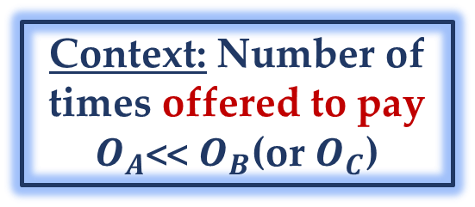
Optimizing Peer Referrals for Public Awareness
How to design an optimal “offer to pay” strategy given the constraints?
Exploration and Exploitation
with Context
A
After $n_{1}$ rounds (try A,B, and C)
Best Policy:
Incentivize B and C
Choosing
best policy
Why not explore to gather enough information to make better decisions?
Context: Number of times offered to pay
$O_{A}$<< $O_{B}$(or $O_{C}$)
B
C
After $n_{2}$ rounds ($n_{2}$ >> $n_{1}$)
Reach more people in the network
Number of successful referrals
Exploration and Exploitation
Arrow length α effort put to refer
Respond equally to incentives

Slide 15
Optimizing Peer Referrals for Public Awareness
How to design an optimal “offer to pay” strategy given the constraints?
Exploration and Exploitation with Context
Multi-Arm Contextual Bandits
(Kocsis and Szepesvári, 2006; Chu et al., 2011; Agarwal et al., 2014 …)
CoBBI (Contextual Bandit Based Incentives):
Incentives: P1: $10 P2: $0
Policy: To offer (P1) or to not offer (P2) to pay
Referrals based on people’s effort put to refer and response to incentives
Context:
No. of times Offered to Pay
Reward: based on successful referrals

Slide 16
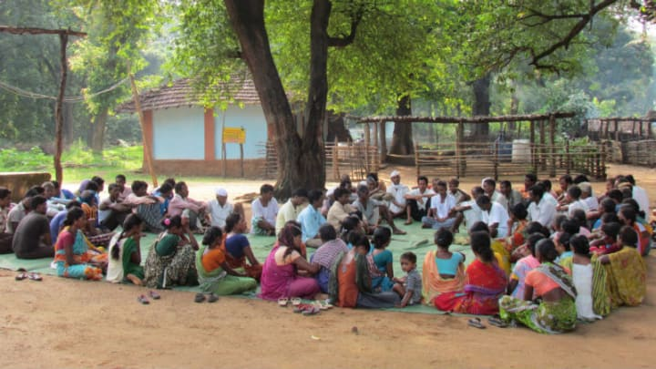
Evaluating Contextual Bandit Based Incentives (CoBBI)
Ideal setting: Randomized Controlled Trials
Complications: non-trivial due to spill-over effects
So, Simulations on known real-world data as a proxy on which our referrals program can occur
Against a wide range of Configurations
Learn2Earn data
Users: 3116 Referrals: 2826
True social network of farmer’s community
Notes:
We repurpose this referral network as a proxy for a new underlying, unobserved social network over which a different referral program can occur
To partially control for the spillover, one could run different policies at different times on the same community (which may have exposure bias), or
run different policies in different communities at the same time (which may have selection bias).

Slide 17
Evaluating Contextual Bandit Based Incentives (CoBBI)
Configuration 1: People’s effort put to refer
Constant-Prob: Constant effort by everyone
Random-Prob: Effort is random
Friends-Prob: Effort α No. of friends
A
B
C
A
A
B
C
B
C
Notes:
Constant-Prob: Each person is assumed to exert the same effort to spread a given message
Random-Prob: Influence probabilities of individuals are chosen uniformly at random.
Friends-Prob: Influence probability is a monotonically increasing function of the number of friends of an individual

Slide 18


Evaluating Contextual Bandit Based Incentives (CoBBI)
Configuration 2: People’s response to incentives
Increasing: Incentives motivate
to refer
Decreasing: Incentives discourage
to refer
Idiosyncratic: Response
unpredictable
☺
☹
Notes:
Increasing: Whenever an incentive is offered, the influence probability increases
Decreasing: Whenever an incentive is offered, the influence probability decreases. Ex: altruistic scenarios
Idiosyncratic: People’s behavior is unpredictable
For ex, in an altruistic setting such as referral program for a medically effective drug, people may be unwilling to refer their friends without any monetary incentive.
However, being offered money might decrease the chances of referral, i.e, they might not want their friends to know that they are being paid or referring.

Slide 19
Evaluating Contextual Bandit Based Incentives (CoBBI)
Configuration 3: Referral Policies
NoPay
AlwaysPay
RandomPay
Pay>=5
Pay<=5
PayMultipleOf5
PayFriendsLen
AlwaysPay
Incentives: P1: $10 P2: $0
RandomPay
Baseline Policy: To offer (P1) or to not offer (P2) to pay
Referrals
AlwaysPay:
Always Offer to pay an incentive for a referral
RandomPay:
Offer to pay individuals who are randomly selected according to some probability
Notes:
Most of the current referral policies don’t have a feedback loop becoz they don’t know or assume anything about or explore the social network not people responses to incentives.

Slide 20
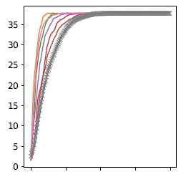
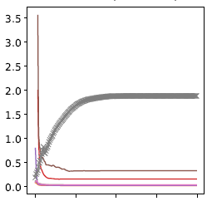

Simulation Results
CoBBI obtains highest efficiency
Further, CoBBI adapts based on people’s response to incentives
No of rounds (time) vs Evaluation metrics
Configuration:
Effort put to refer: constant
Response to incentives: increasing
% of People Influenced per Offer to Pay
% of People Influenced
Results:
CoBBI matches the maximum no. of people reached by any of the baseline policies
For 1 Offer to Pay, CoBBI influences 4 times more people than best baselines
0
50
100
150
200
0
50
100
150
200

Slide 21
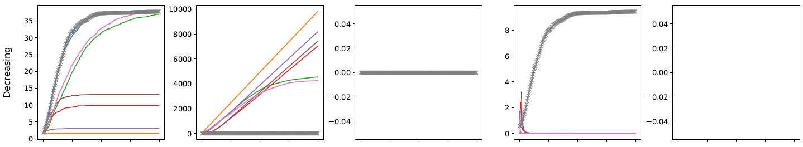
Simulation Results
CoBBI obtains highest efficiency
Further, CoBBI adapts based on people’s response to incentives
No of rounds (time) vs Evaluation metrics
Configuration:
Effort put to refer: constant
Response to incentives: decreasing
% of People Influenced per Offer to Pay
% of People Influenced
Results:
CoBBI outperforms all baselines that pay
RandomPay and PayFriendsLen also reach max people
But CoBBI is 9 times efficient
0
50
100
150
200
0
50
100
150
200

Slide 22
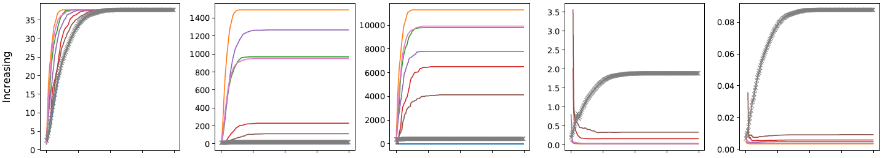
Simulation results
CoBBI obtains highest efficiency:
social influence model: Constant-Prob, people’s response function: Increasing
matches the maximum no. of nodes reached by any of the baseline policies
No. of incentive offers is 6 times lower compared to best baseline
Incentive amount paid is 10 times lower
OfferToPayEfficiency is 4 times higher than best baselines
PaymentEfficiency is 8 times higher
Notes:
1. matches the maximum no. of nodes reached by any of the baseline policies, but at a very low cost
Animate graphs and explain separately

Slide 23
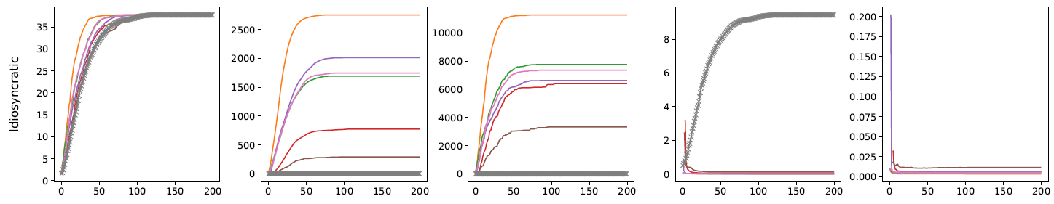
Simulation results
CoBBI adapts based on people’s response functions:
social influence model: Constant-Prob,
people’s response function: Decreasing
social influence model: Constant-Prob,
people’s response function: Idiosyncratic
Outperforms all baselines that pay
RandomPay and PayFriendsLen also reach max nodes
But CoBBI is 9 times efficient
CoBBI is 10 times more efficient than best baselines
Notes:
Example of decrreasing

Slide 24
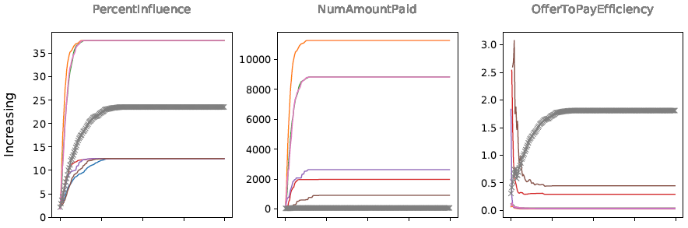
Simulation results
CoBBI can be too conservative for some setting
social influence model: Friends-Prob,
people’s response function: Increasing
86% only one friend in the network,
Hence, the influence probability is low (P=0.01) for most people
CoBBI reached only two-thirds reached by AlwaysPay, RandomPay and PayFriendsLen
Efficiency of CoBBI is 1.5-4 times higher
Notes:
most (86%) of the people have only one friend in the network, hence the influence probability is low (P=0.01) for most people, and only a few outliers have high probability (0.2)

Slide 25
Summary and Future Work
What?
Optimizing Peer Referrals for Public Awareness
How?
Contextual Bandit Based Incentives (CoBBI)
Results?
Efficiency of CoBBI >> wide range of baselines
More stateful response functions
Evaluate algorithmic guarantees
Field experiments with referral programs
Future Work?
Notes:
First, we assumed that a person’s response to incentives depends only on the most recent incentive offer which ignores the effect of past incentives
Second, properties of successive referrals depend upon each other and thus the referral contexts received by CoBBI are not i.i.d., thereby violating the conditions for algorithmic guarantees for contextual bandits
Considering more stateful response functions and algorithms, and doing field experiments with referral programs will be useful future work

