Slide 1

Capstone Project
Finding a New York City Neighborhood similar to DC Shaw

Slide 2
Problem
Sophie was just offered her dream job in New York City and is due to start next month. She's excited to start her new job but feels very sad to leave her Shaw neighborhood she loves so much.
As she's planning her move and looking for a new place to call home in NYC, we are going to use the new skills we learned in this class to help her choose a neighborhood that is the most similar to her beloved Shaw.

Slide 3
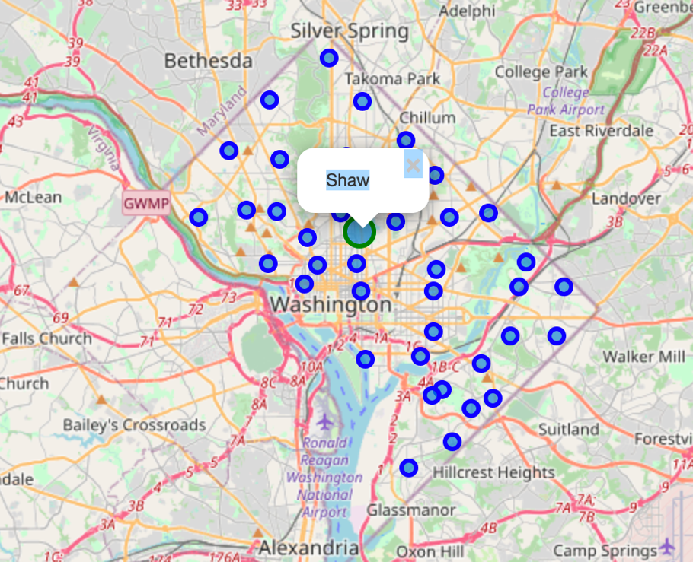
The Shaw Neighborhood
Shaw is a central neighborhood in the Northwest quadrant of Washington, D.C., United States. Shaw and the U Street Corridor historically have been the city's black social, cultural, and economic hub

Slide 4
Methodology
Establish the profile the of the Shaw neighborhood using the Foursquare venues data
Use the Foursquare tool explore function to get the most common venue categories in the Shaw Neighborhood
Calculate the frequency of each category and the per capita frequency for better comparison.
Run a K-means clustering algorithm on a population comprised of Shaw and New York City neighborhood using the per capita number of selected categories as features
The Neighborhood in the cluster containing Shaw are candidates for our recommendation.

Slide 5
Data
Foursquare API to explore DC’s Shaw and New York city neighborhood and identify the venue categories in each neighborhood.
The Shaw neighborhood demographic and crime data is extracted from several tables in https://opendata.dc.gov/
The New York city neighborhood demographic and crime data is extracted from several tables in https://opendata.cityofnewyork.us/
The selected features selected are the per capita count of the following categories:
RESTAURANT
BAR
THEATER / SHOW
GYM / SPORT
SPECIALTY STORE / SERVICE

Slide 6
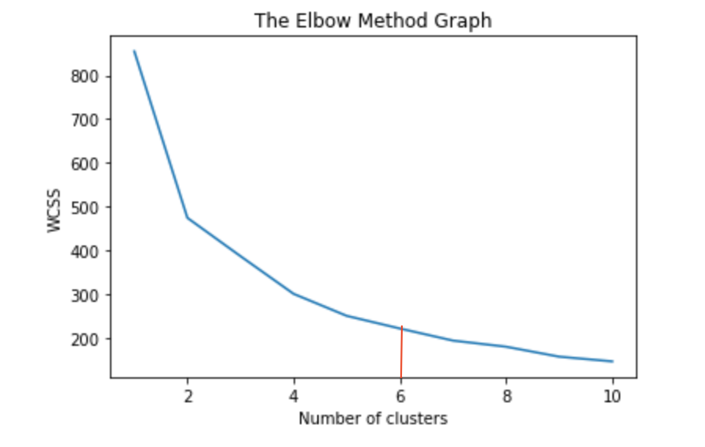

Cluster Analysis
We use the Elbow method to determine the optimal number of clusters. In this method, the sum of distances of observations from their cluster centroids, called Within-Cluster-Sum-of-Squares (WCSS). This is computed as
We decide on 6 clusters

Slide 7
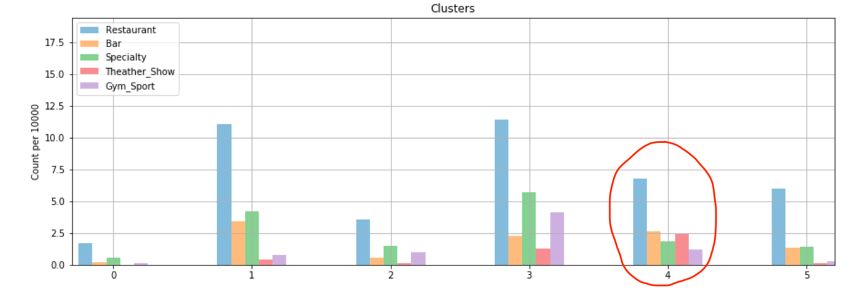
Cluster Analysis
The cluster analysis shows neighborhood groupings based on different value ranges of our selected venue categories.
Based on those values, we can characterize the different clusters

Slide 8
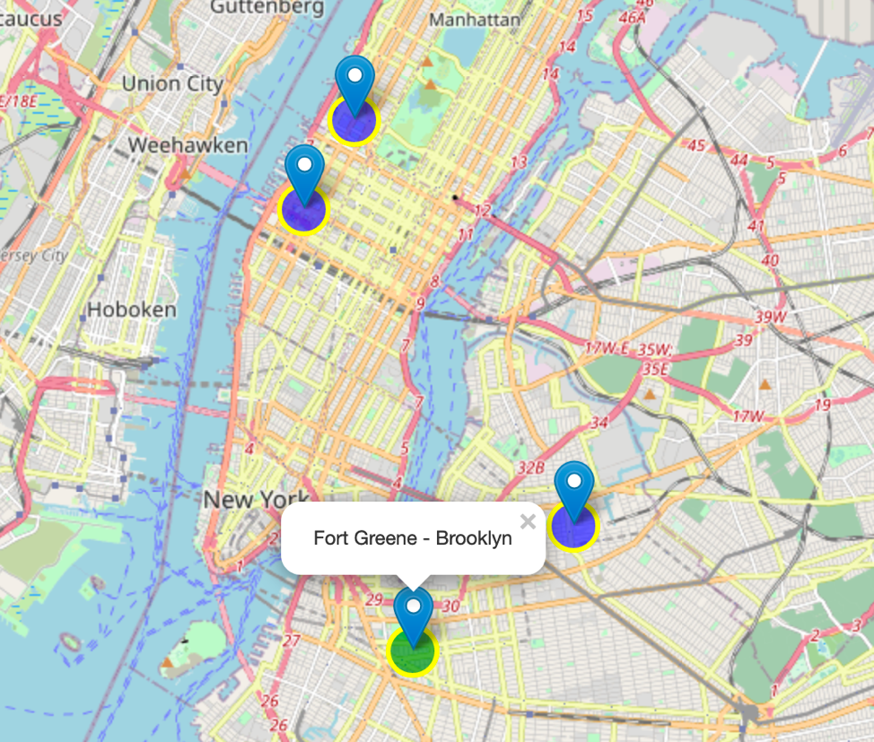
Results and Recommendation
The Shaw neighborhood is assigned to cluster number 4
From this cluster, we select the neighborhood the highest venue concentration for most categories and the lower crime rate.
Our recommendation is for Sophie to relocate to the neighborhood of Fort Greene – Brooklyn.

