Slide 1
Analysis of Diamond Data Set
Geeta Sowmya Chethi
Ayushi Daksh
Ram Kashyap Cherukumilli Shivani Bethi

Slide 2
Objective
Dataset
Variable | Variable Description | Variable Type | Range of values
price | In US dollars | Numeric | 326-18,823
carat | Weight of diamond | Numeric | 0.2-5.01
cut | Quality of cut | Ordered Factor | Fair,Good,Very Good,Premium,Idea
color | Color of Diamond | Ordered Factor | J,I,H,G,F,E,D
clarity | How Clear the diamond is | Ordered Factor | I1, SI2, SI1, VS2, VS1, VVS2, VVS1, IF
x | Length in mm | Numeric | 0-10.74
y | Width in mm | Numeric | 0-58.9
Z | Depth in mm | Numeric | 0–31.8
depth | Total Depth percentage = z / mean(x, y) = 2 * z / (x + y) | Numeric | 43-79
table | width of top of diamond relative to widest point (43–95) | Numeric | 43–95
Predict the Price of Diamond based on the features of the diamond.
Confirm most important features that determine the Price of the Diamond.
This Dataset has 6 numeric features carat, x, y, z depth, table.
Three ordered factors cut, color, clarity.
54000 records in the dataset.

Slide 3
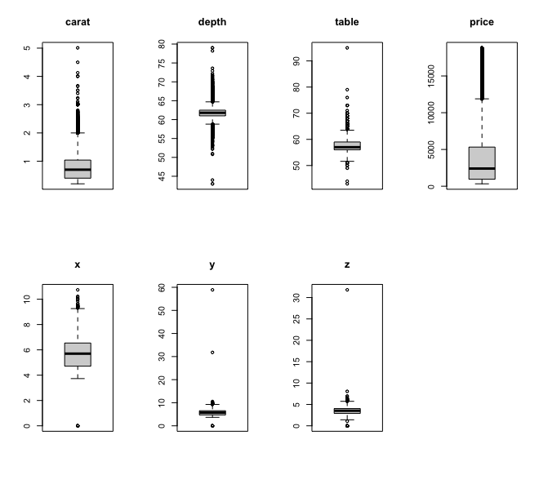
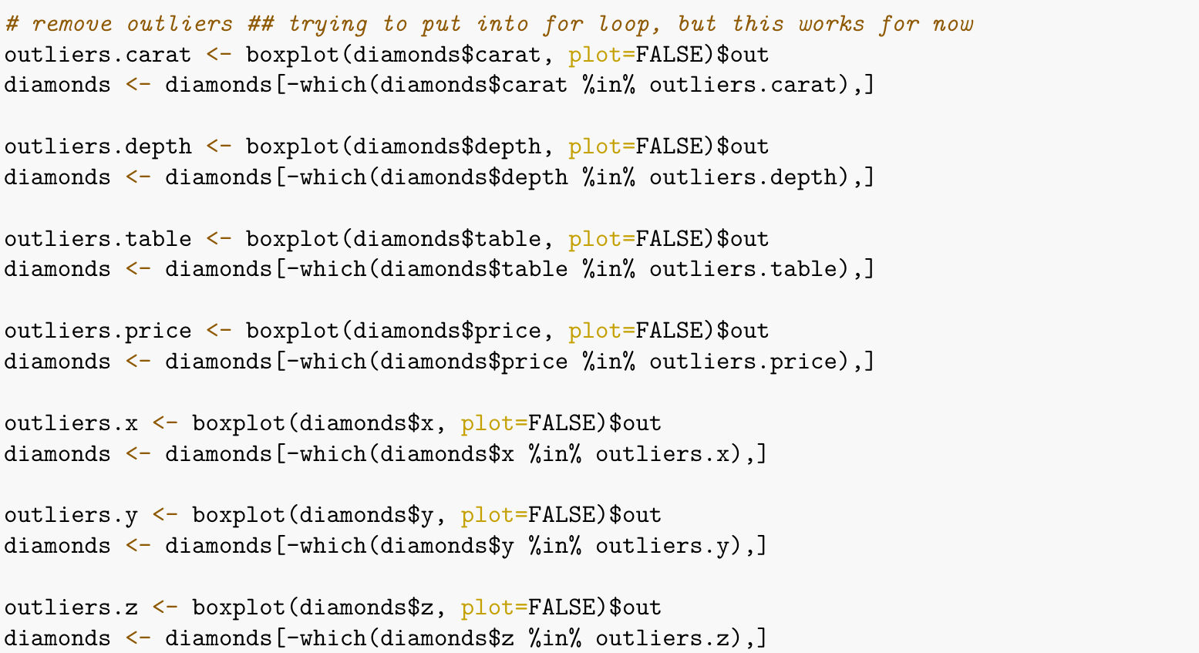
Outlier Detection
Boxplots
Plots of all the numerics features in order to check for the outliers.
Removal of outliers from the numerical columns.

Slide 4
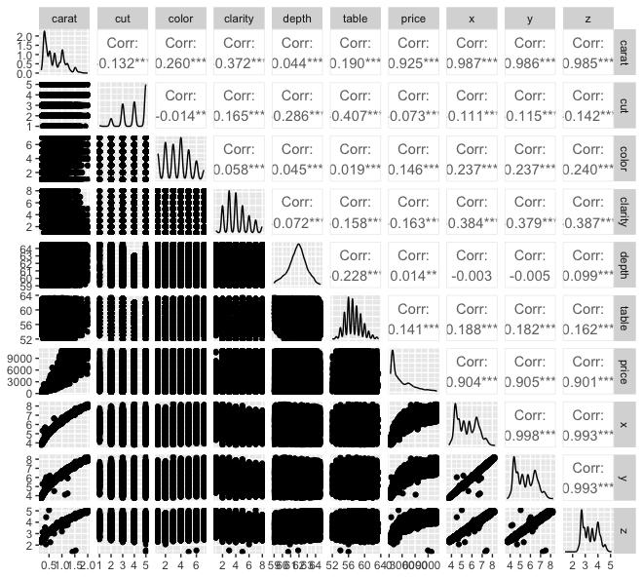
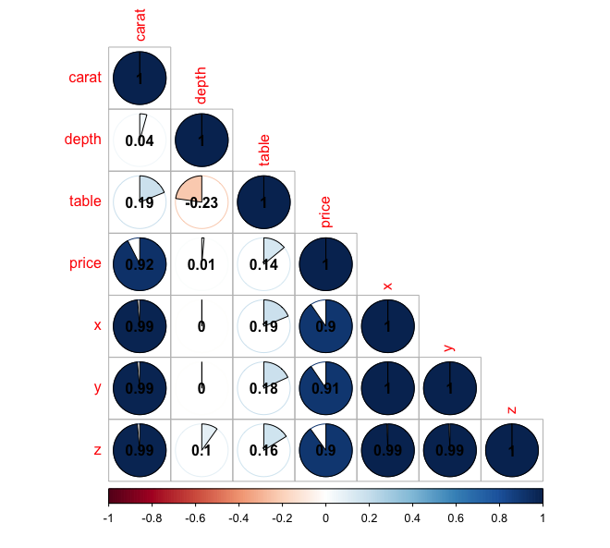
Pairwise Association
From both the plots it is evident that Price is highly correlated to carat
Carat is highly correlated to x, y, z predictors

Slide 5
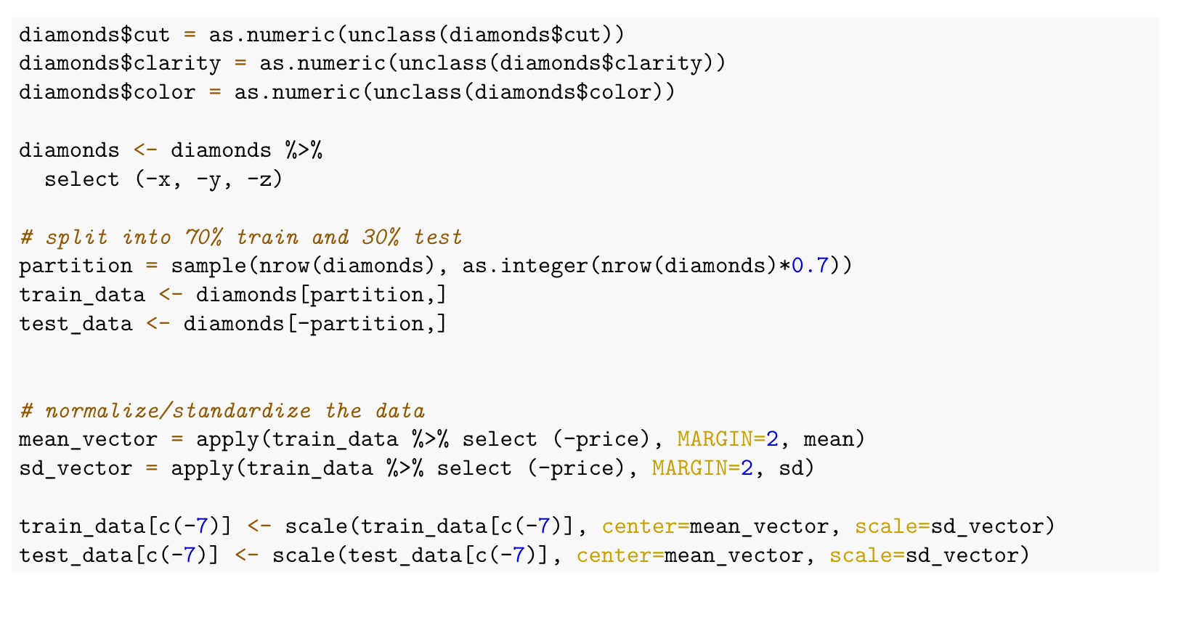
Data Splitting and Encoding
Removed predictors based on EDA
Encoded values for categorical variables
Split the dataset into Train - 70% Test - 30%
Normalization of data

Slide 6
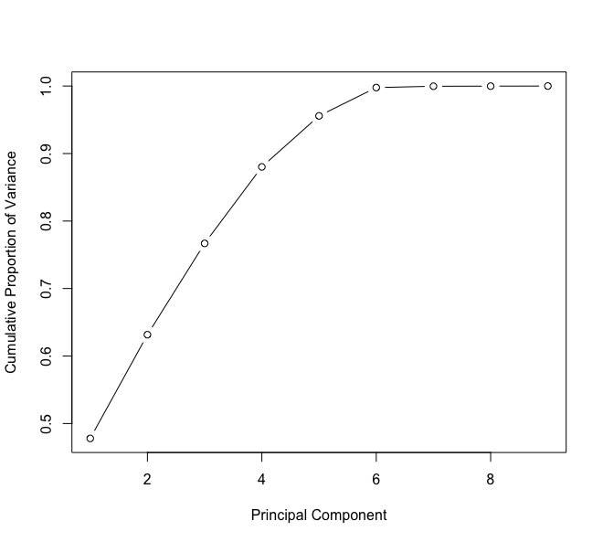
Principle Component Analysis(PCA)
Scree plot
To decide on the most important features Principal component Analysis is uses as it reduces dimensions
From scree plot6 principal components are required to explain maximum variance of dataset
Built statistical models on first 6 principal components

Slide 7
Regression Models
LINEAR REGRESSION:
Making a linear model with a minimum sum of squared residuals/error (SSE) is the aim of linear regression.
Linear Regression , Y = aX +b , where ,y is the response variable x is the predictor variable. a and b are constants which are called the coefficients.
Using R's lm() utilities, construct a relationship model.
Find the model's coefficients, then use them to construct the mathematical equation.
To find out the average prediction error, get a summary of the relationship model. known as residuals as well.

Slide 8
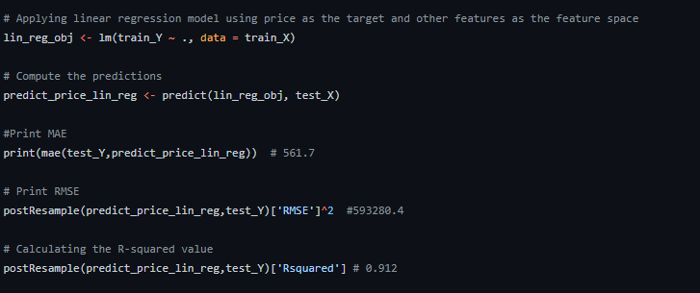
Code snippet(Linear Regression)

Slide 9
Random Forest Regression
Random Forest is an ensemble of decision trees i.e. numerous trees are ordered in a certain “random” fashion so as to form a random forest.
Every tree in RF is generated from a distinct sample of rows at each node , a distinct sample of features is being selected for splitting.
The average of these predictions are then used to produce a single result.
The “averaging” aspect makes a RF better than single decision tree, hence it improves its accuracy and reduces overfitting.
The Random Forest Regressor is unable of identifying patterns that would allow it to extrapolate values outside of the training set.
The regressor makes the assumption that in this situation, the prediction will be close to the highest value in the training set.

Slide 10
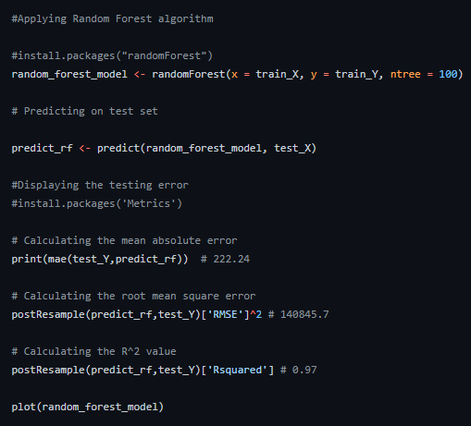
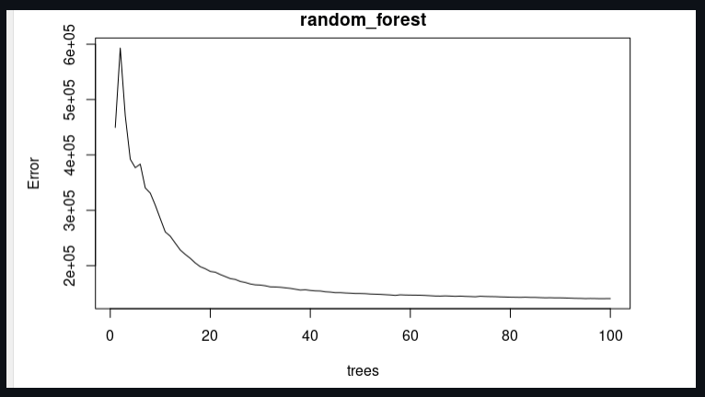
Random Forest implementation

Slide 11
Results on test data set
The training and testing dataset has been split in 70:30 ratio.
So as to judge the model’s performance we have considered three metrics.(MAE, RMSE,R-squared value)
The mean absolute error refers to the magnitude of difference between the prediction of an observation and the true value of that observation.
RMSE shows how far predictions fall from measured true values using Euclidean distance.
R-squared represents the fraction of variance of the actual value of the response variable captured by the regression model rather than the MSE which captures the residual error.

Slide 12
Bootstrap approach for estimating coefficients
Bootstrap is a method of random sampling with replacement.
It is a simple yet powerful approach for checking the stability of regression coefficients.
Bootstrap samples the data with replacement and estimate the coefficients to decipher how extreme would it be.
It takes the observations and resamples with replacement for some amount of trials and then runs the regression model and saves the coefficients.
The average of these coefficients is taken and then compared with other models that we have previously obtained.
Bootstrap is helpful when we have doubts about the distribution of the data arrived from, or want to check the stability of the coefficients.

Slide 13
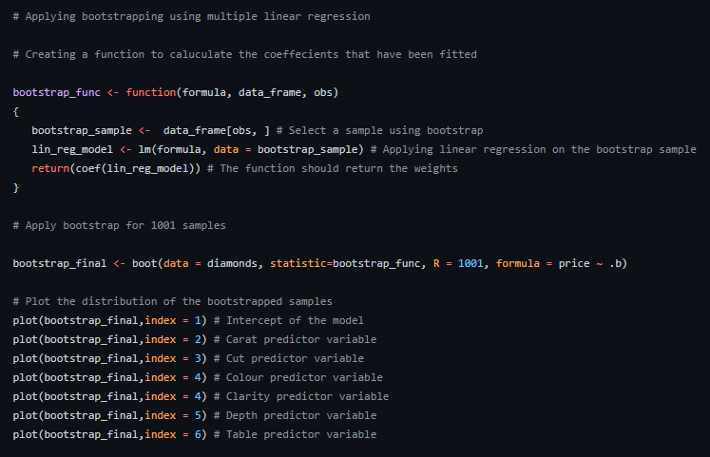
Bootstrapping using linear regression

