Slide 1


Slide 2
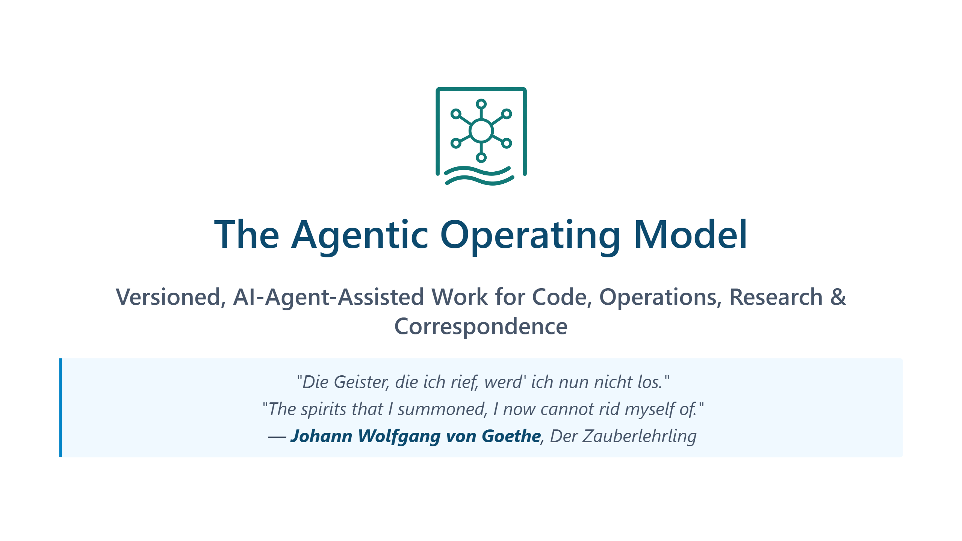
Notes:
The quote is from Goethe's ballad *Der Zauberlehrling* (1797), "The Sorcerer's Apprentice." An apprentice, left alone, enchants a broom to fetch water for him — then realises he never learned the counter-spell to stop it. The poem is the cultural ancestor of every "runaway automation" story since, from Disney's *Fantasia* to modern AI-safety essays. The relevance to agentic AI is direct: the capability to *summon* autonomous behaviour is now widely available; the capability to *supervise and stop* it lags behind. Most organisations are at the apprentice's stage — the spirits are already in motion, the operating model is being written after the fact. This training is built around closing that gap: not how to summon harder, but how to keep a deliberate hand on the broom — through version control, verification, guardrails, and reversibility.

Slide 3
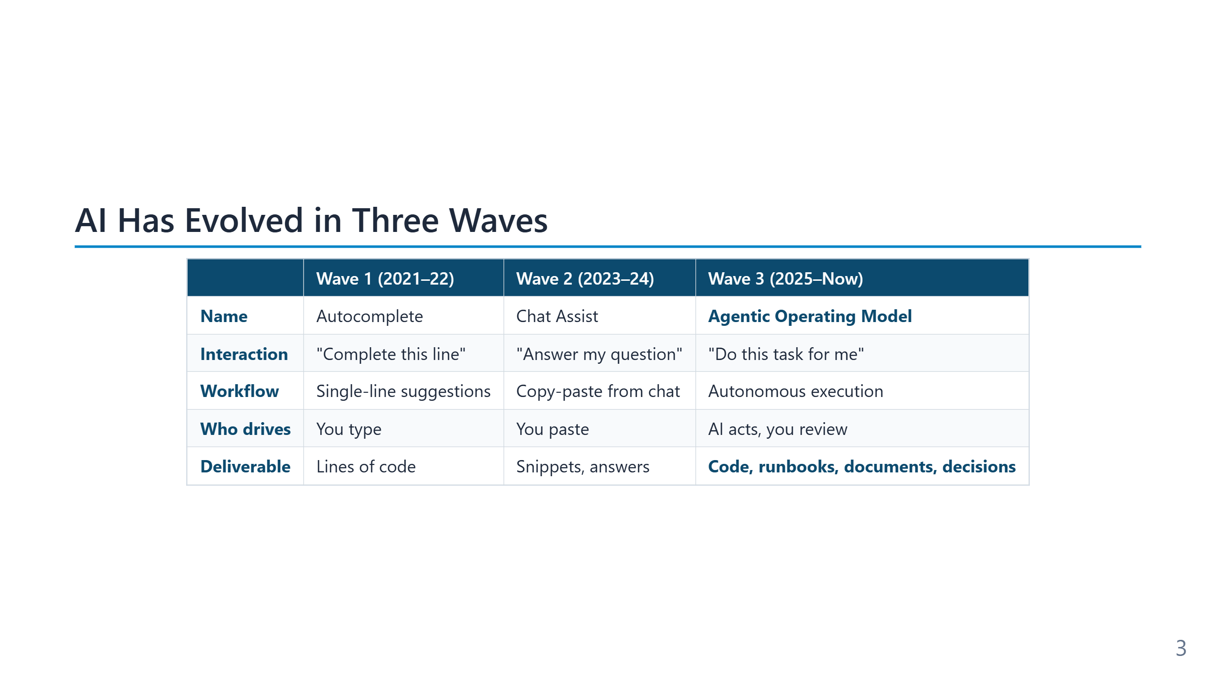
Notes:
The three waves are cumulative, not replacements — autocomplete still lives inside every modern agent. **Wave 1 (2021–22)** opened with GitHub Copilot's general availability in June 2022. The interaction unit was a single line or block; the human remained author, integrator, and runner. Productivity gains were measurable (~30–55% on benchmark tasks) but the engineering process around the code was unchanged. **Wave 2 (2023–24)** is the chat era: ChatGPT (Nov 2022), Claude, Gemini. The interaction unit became a *conversation*, and the AI could explain, refactor, or generate larger fragments. The bottleneck moved to the human's copy-paste step and to the lack of context — the model could not see the repository or run the code. **Wave 3 (2025–26)** is the agentic era: Copilot Agent Mode, Cursor, Claude Code, Aider. The model gains tools (file I/O, shell, search) and runs a loop — observe, plan, act, verify, iterate. The unit of work is no longer a snippet but a *task with verification*. The human role shifts from typist to reviewer. The shift to Wave 3 is what creates the need for an operating model: once the agent can take actions, version control, tests, and guardrails stop being optional hygiene and become the supervision mechanism.

Slide 4
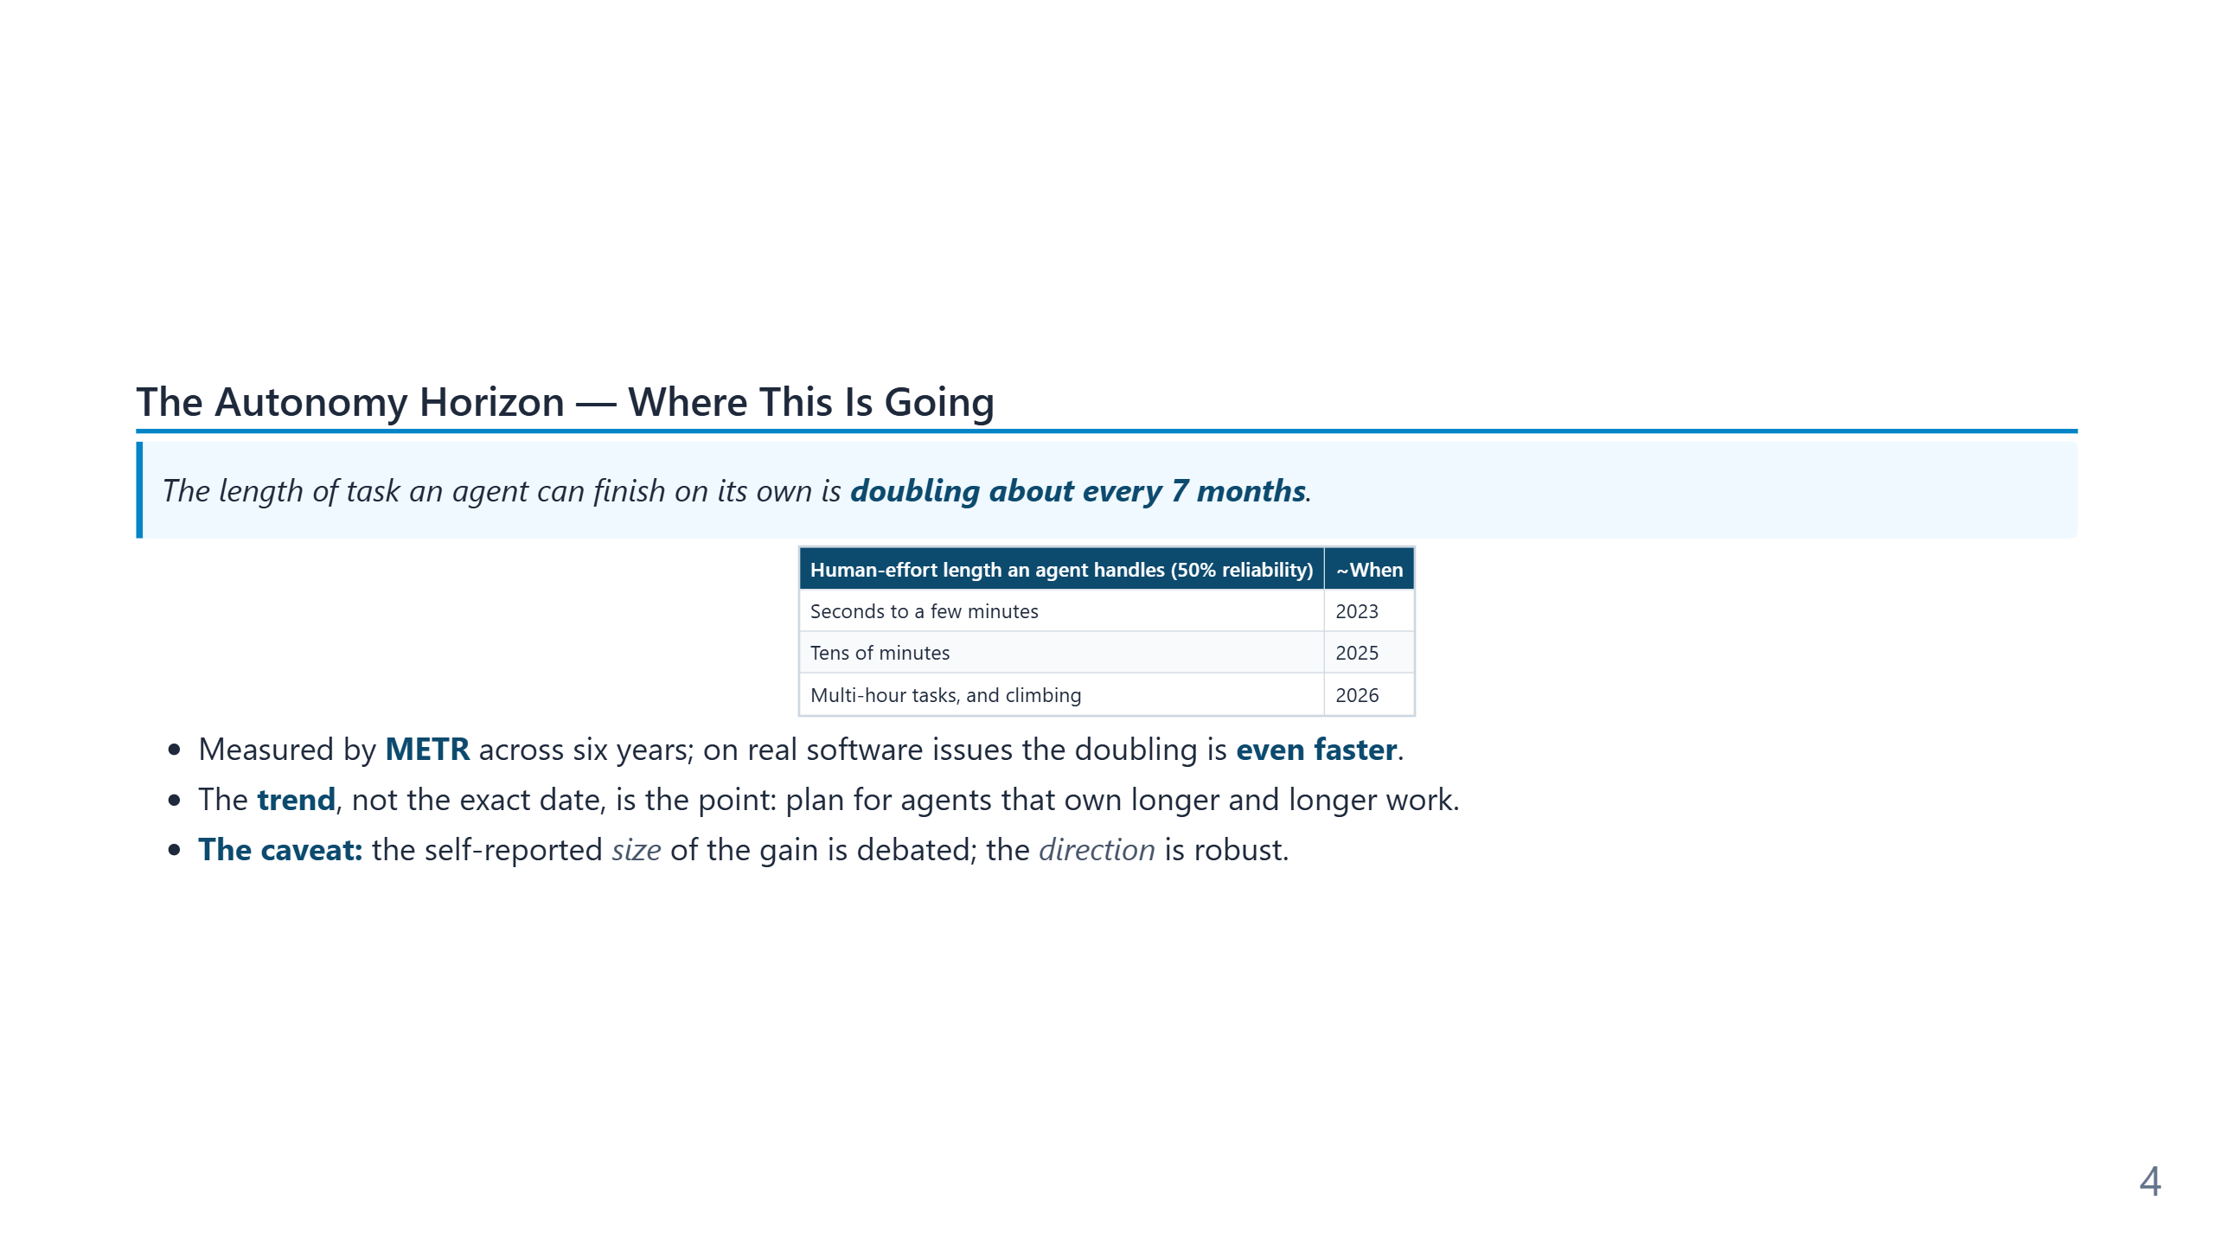
Notes:
Speaker notes: METR measures agent autonomy as the length of task (in human time) an agent completes at 50% reliability; it has doubled roughly every 7 months for six years. This reframes "why now" into "why this keeps growing." Pair it with the conductor message: as the horizon lengthens, the human moves from fixing AI mistakes to directing AI work. Always present the horizon together with its caveat — quoting the trend without it invites the "this is just AI hype" objection from the room.

Slide 5
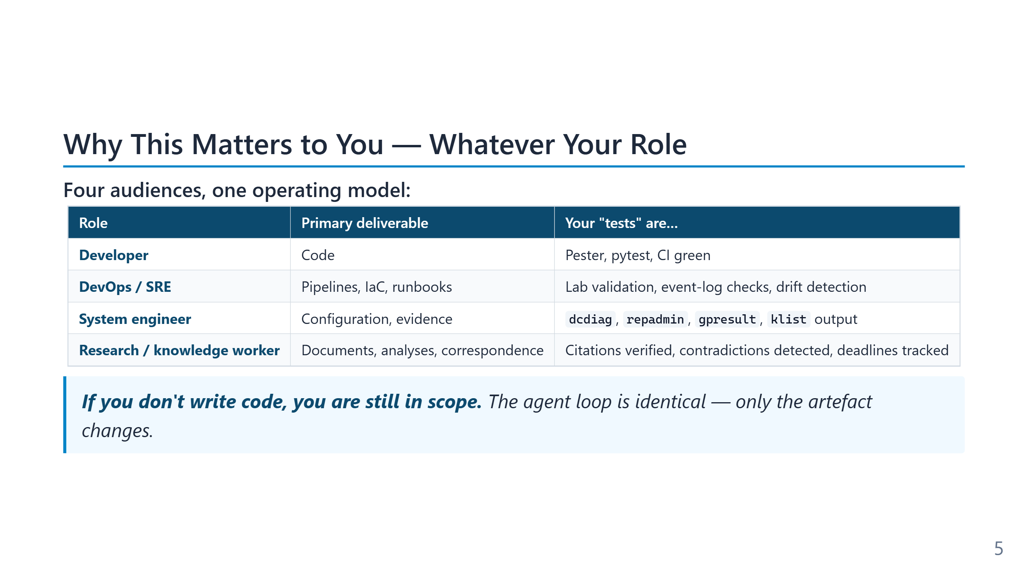
Notes:
The audience for this training is wider than "developers who write production code." Module 11 makes that case in depth; this 1h-cut slide is the abbreviated version of the same claim. Systems engineers writing PowerShell against Active Directory, SREs maintaining runbooks, security analysts triaging incidents, and knowledge workers reasoning over document corpora all do work that fits the agentic operating model. The verb changes — author, operate, investigate, draft — but the loop (Observe → Plan → Act → Verify → Iterate) and the supervision pattern (Git, Markdown, tests or verifiable artefacts, rollback) do not. The slide is also a defensive framing. In mixed-audience rooms the most common silent objection from non-developers is "this is interesting but not for me." Naming the four roles up front removes that escape hatch and keeps the room engaged with the operating-model content rather than mentally filing it under "developer stuff I can ignore."

Slide 6
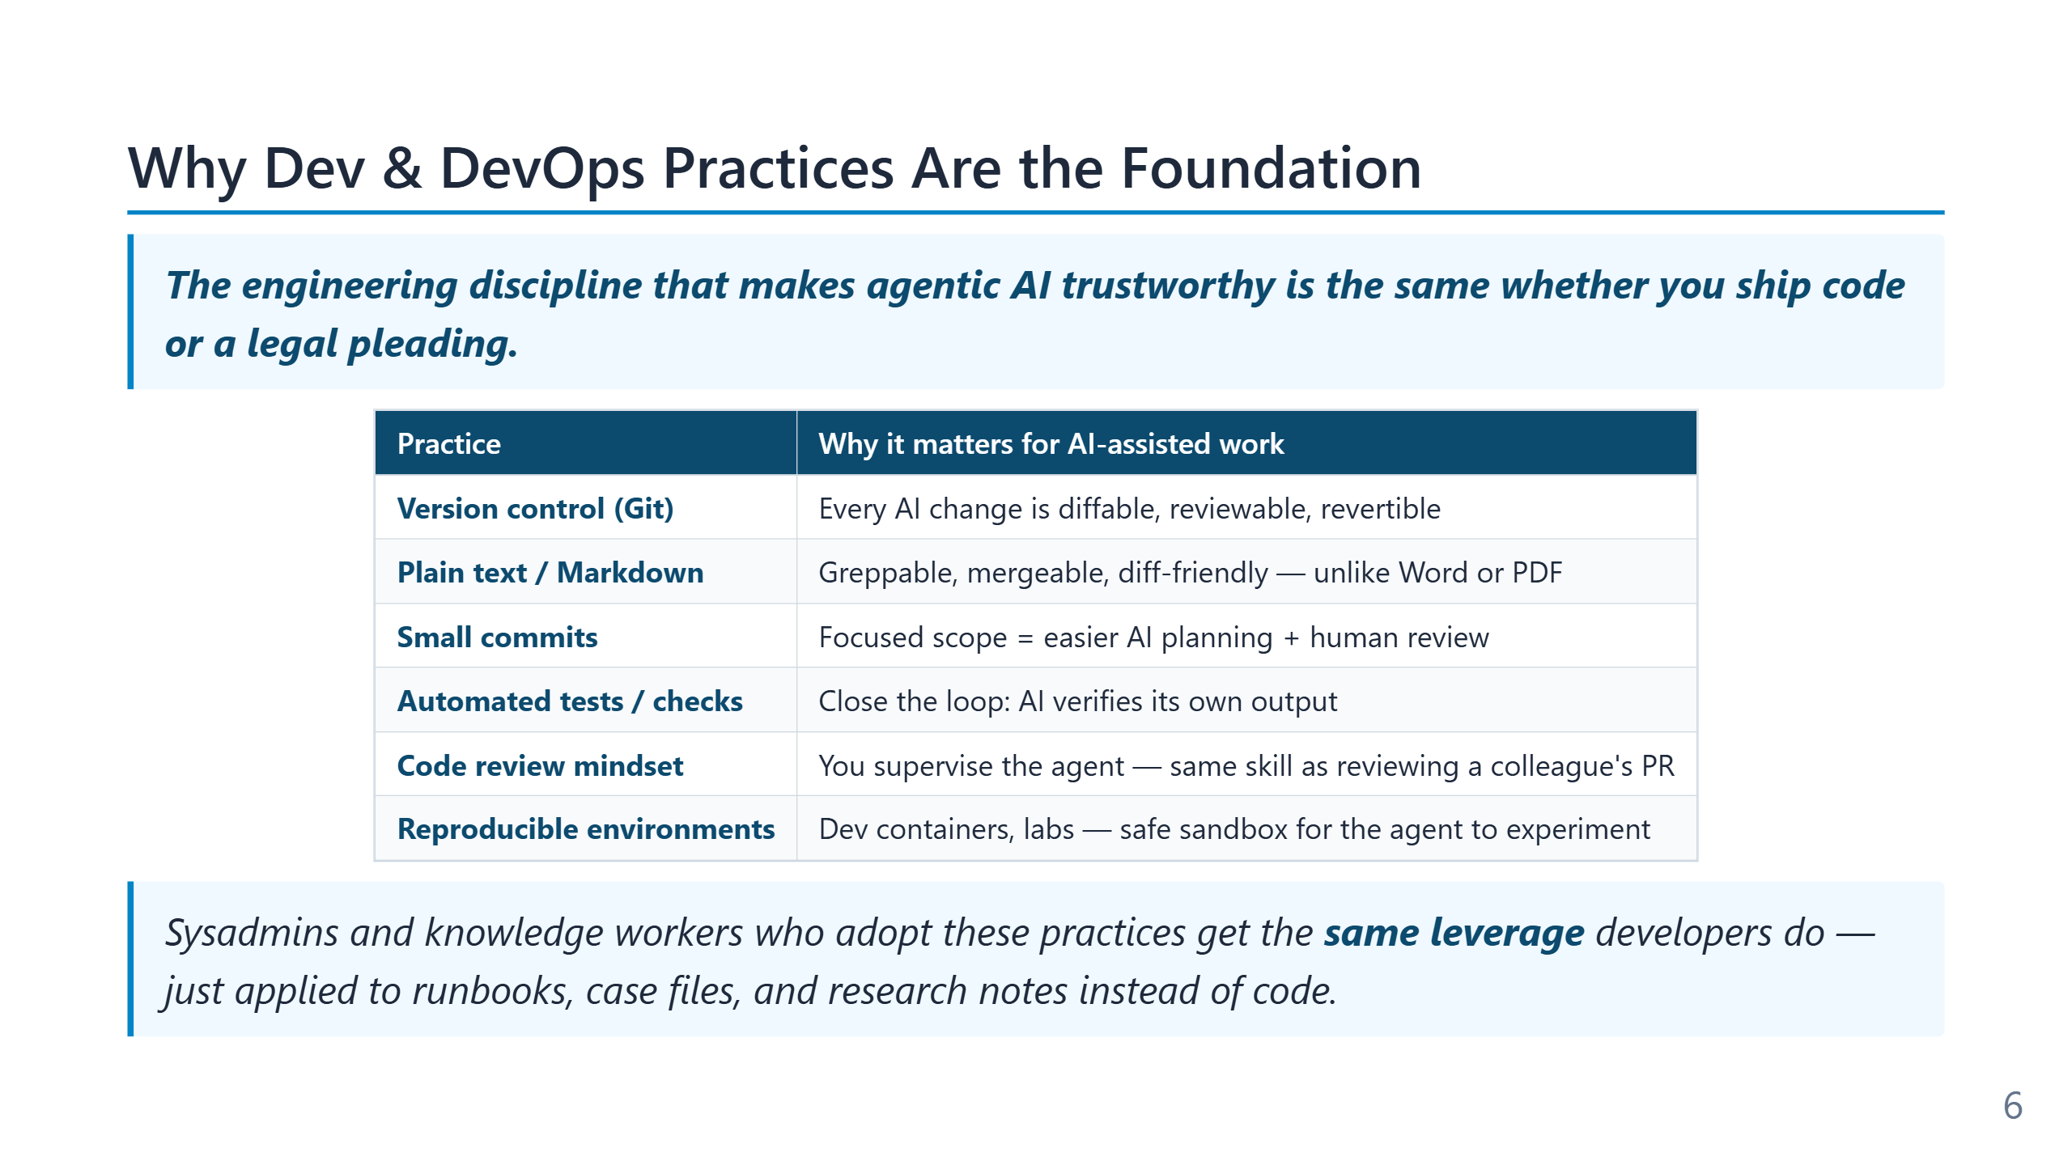
Notes:
The argument compressed into this 1h slide is one of the curriculum's load-bearing claims: the engineering hygiene that developer and DevOps teams adopted for human reasons (version control, code review, automated tests, infrastructure as code, CI/CD) turns out to be exactly the substrate an agent needs to operate safely. Git gives the agent context and the human rollback; tests give the agent a verification signal; conventional repository structure gives the agent a navigable surface; pipeline automation gives the agent reversible deployments. The implication for teams that do *not* yet have these practices is uncomfortable but honest: agentic tooling amplifies whatever discipline already exists. A team with strong tests, clean Git history, and IaC gets multiplicative gains; a team without them gets multiplicative incidents. The right sequence is to invest in the foundation first and adopt the agent against that foundation, not to adopt the agent in the hope that it will somehow build the foundation along the way. The expanded version of this argument appears in Module 9 (the cardinal rule, the destructive-operations guardrails) and Module 12 (the lab as the agent's sandbox).

Slide 7
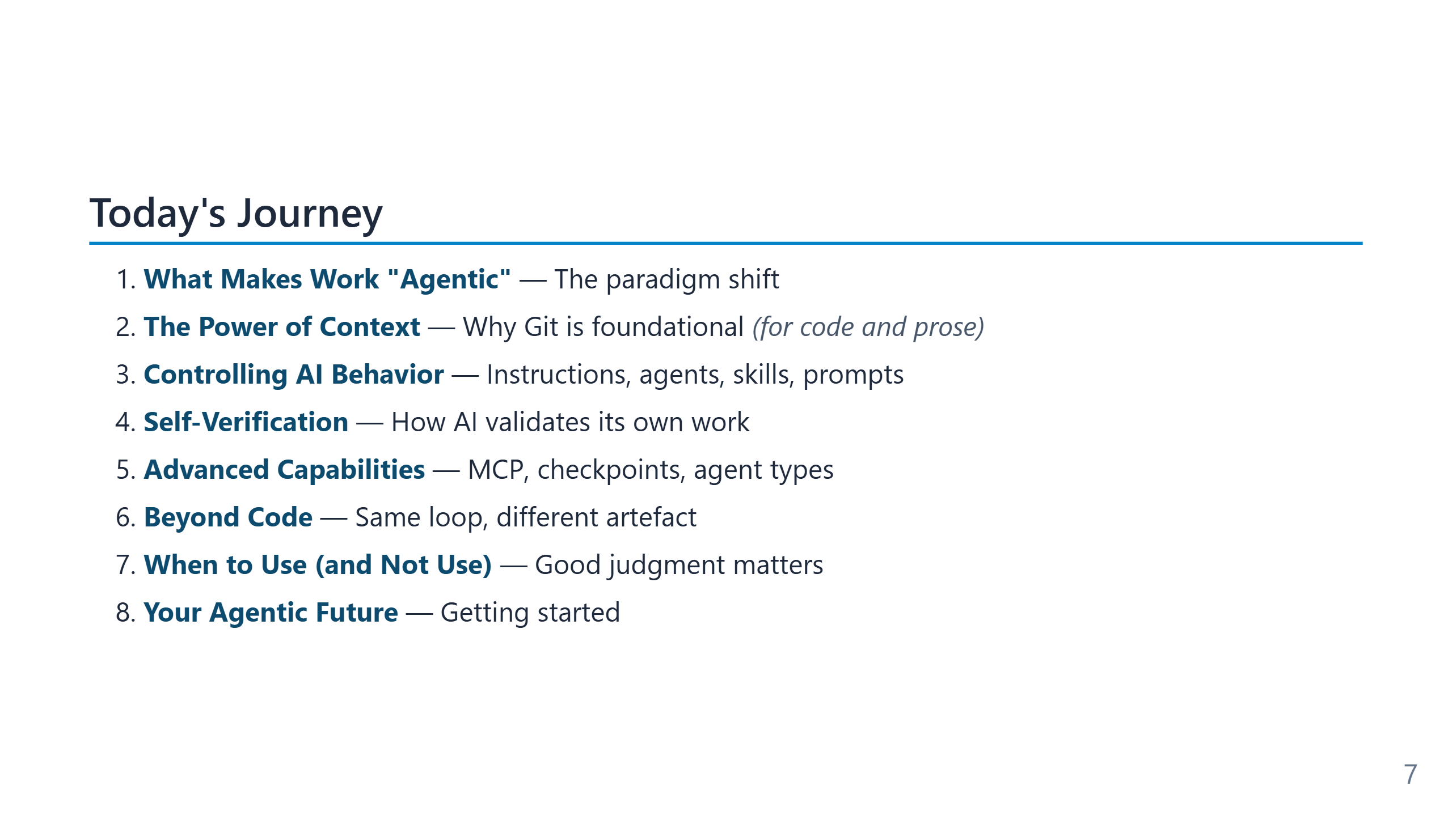
Notes:
The five points cover roughly the same territory in every version of the deck; the difference is depth, not topic. - **Module 2 — "agentic" defined.** The vocabulary slide and the Observe→Plan→Act→Verify loop. Without this, later modules sound like tooling marketing. - **Module 3 — Context.** Why Git, the repository structure, and a written glossary matter more than choice of model. This module is the one most teams underweight. - **Module 4 — Controlling behaviour.** Instruction files, custom agents, skills, prompt files. The shift from "prompt the model" to "configure the model’s behaviour as code". - **Module 5 — Self-verification.** Tests as the executable spec, the "cheating agent" failure mode, and how Pester-style discipline becomes the AI feedback signal. - **Practical application.** A live walkthrough that shows the loop, not just the screenshots. Saved for the end so the earlier abstractions have something concrete to anchor on. In the 1h cut, only modules 1–3 and 7 are covered; the 2h adds 4 and 6; the 4h includes hands-on labs (AutomatedLab, MCP server) in modules 8–10. The structure is deliberately *concept → demo → "how this applies to your repo"* in every module.

Slide 8
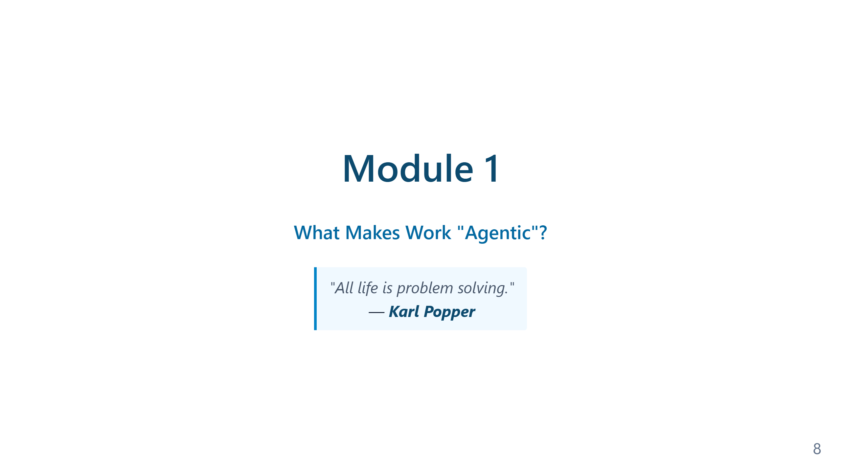
Notes:
Speaker notes — Module 1 appendix ### Timing: 10 minutes ### Key Points to Emphasize: 1. This is a **paradigm shift**, not incremental improvement 2. The audience's existing skills (Git, testing) are **advantages** 3. This applies to **any language**, we use PowerShell because they know it 4. Tokens and cost are real considerations — agentic loops use more tokens than single-shot requests ### Common Questions: - "Will AI replace developers?" → No, it changes the role from typist to architect - "Is this just hype?" → Show productivity statistics - "What about code quality?" → Covered in verification module - "How much does it cost?" → Depends on model and usage; token slide covers the economics ### Transition to Module 2: "Now that we understand why this matters, let's define exactly what makes coding 'agentic'..."

Slide 9
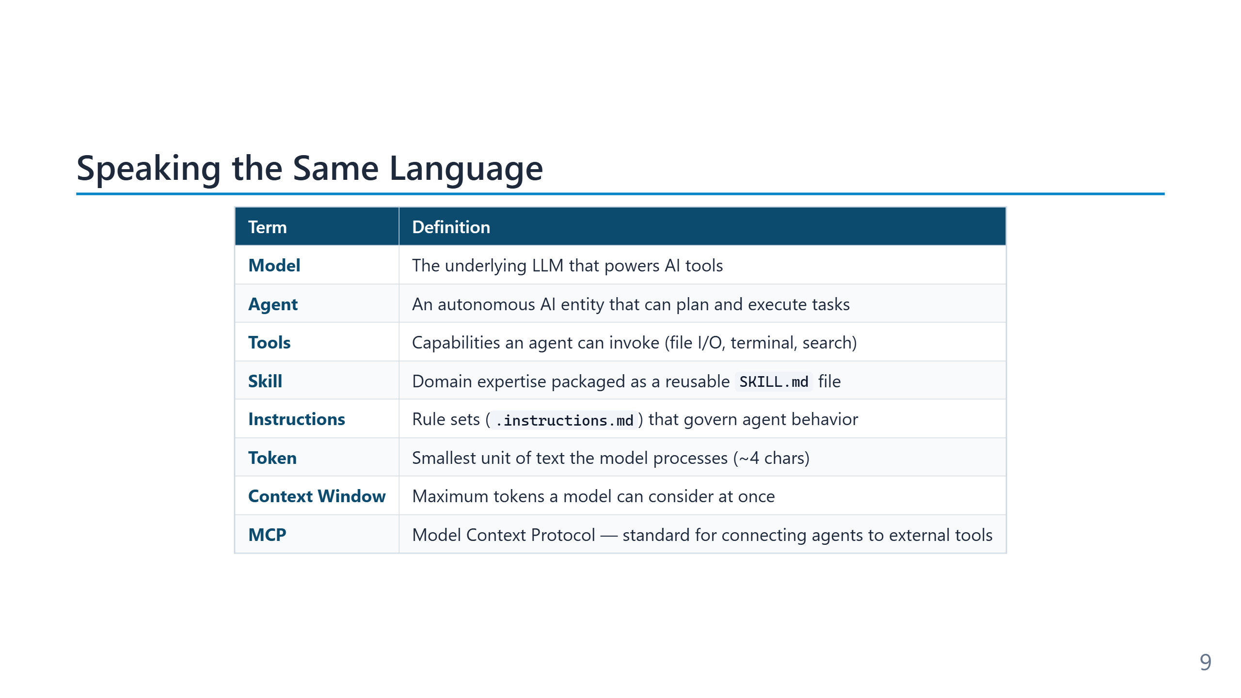
Notes:
Speaker notes (for newcomers): - Don't memorize this slide — we'll revisit each term as it comes up. - Easy mental model: - **Model** = the engine (the LLM itself). - **Agent** = the driver (uses the engine + tools to reach a goal). - **Tool** = a hand (file read, shell, web fetch). - **Instruction** = a standing order the driver must always follow. - **Skill** = a specialist manual the driver opens only when needed. - **Prompt** = what you tell the driver right now. - **Memory Bank** = the driver's logbook between trips. - This vocabulary is shared across Copilot, Claude Code, Cursor — it's not Microsoft-specific.

Slide 10
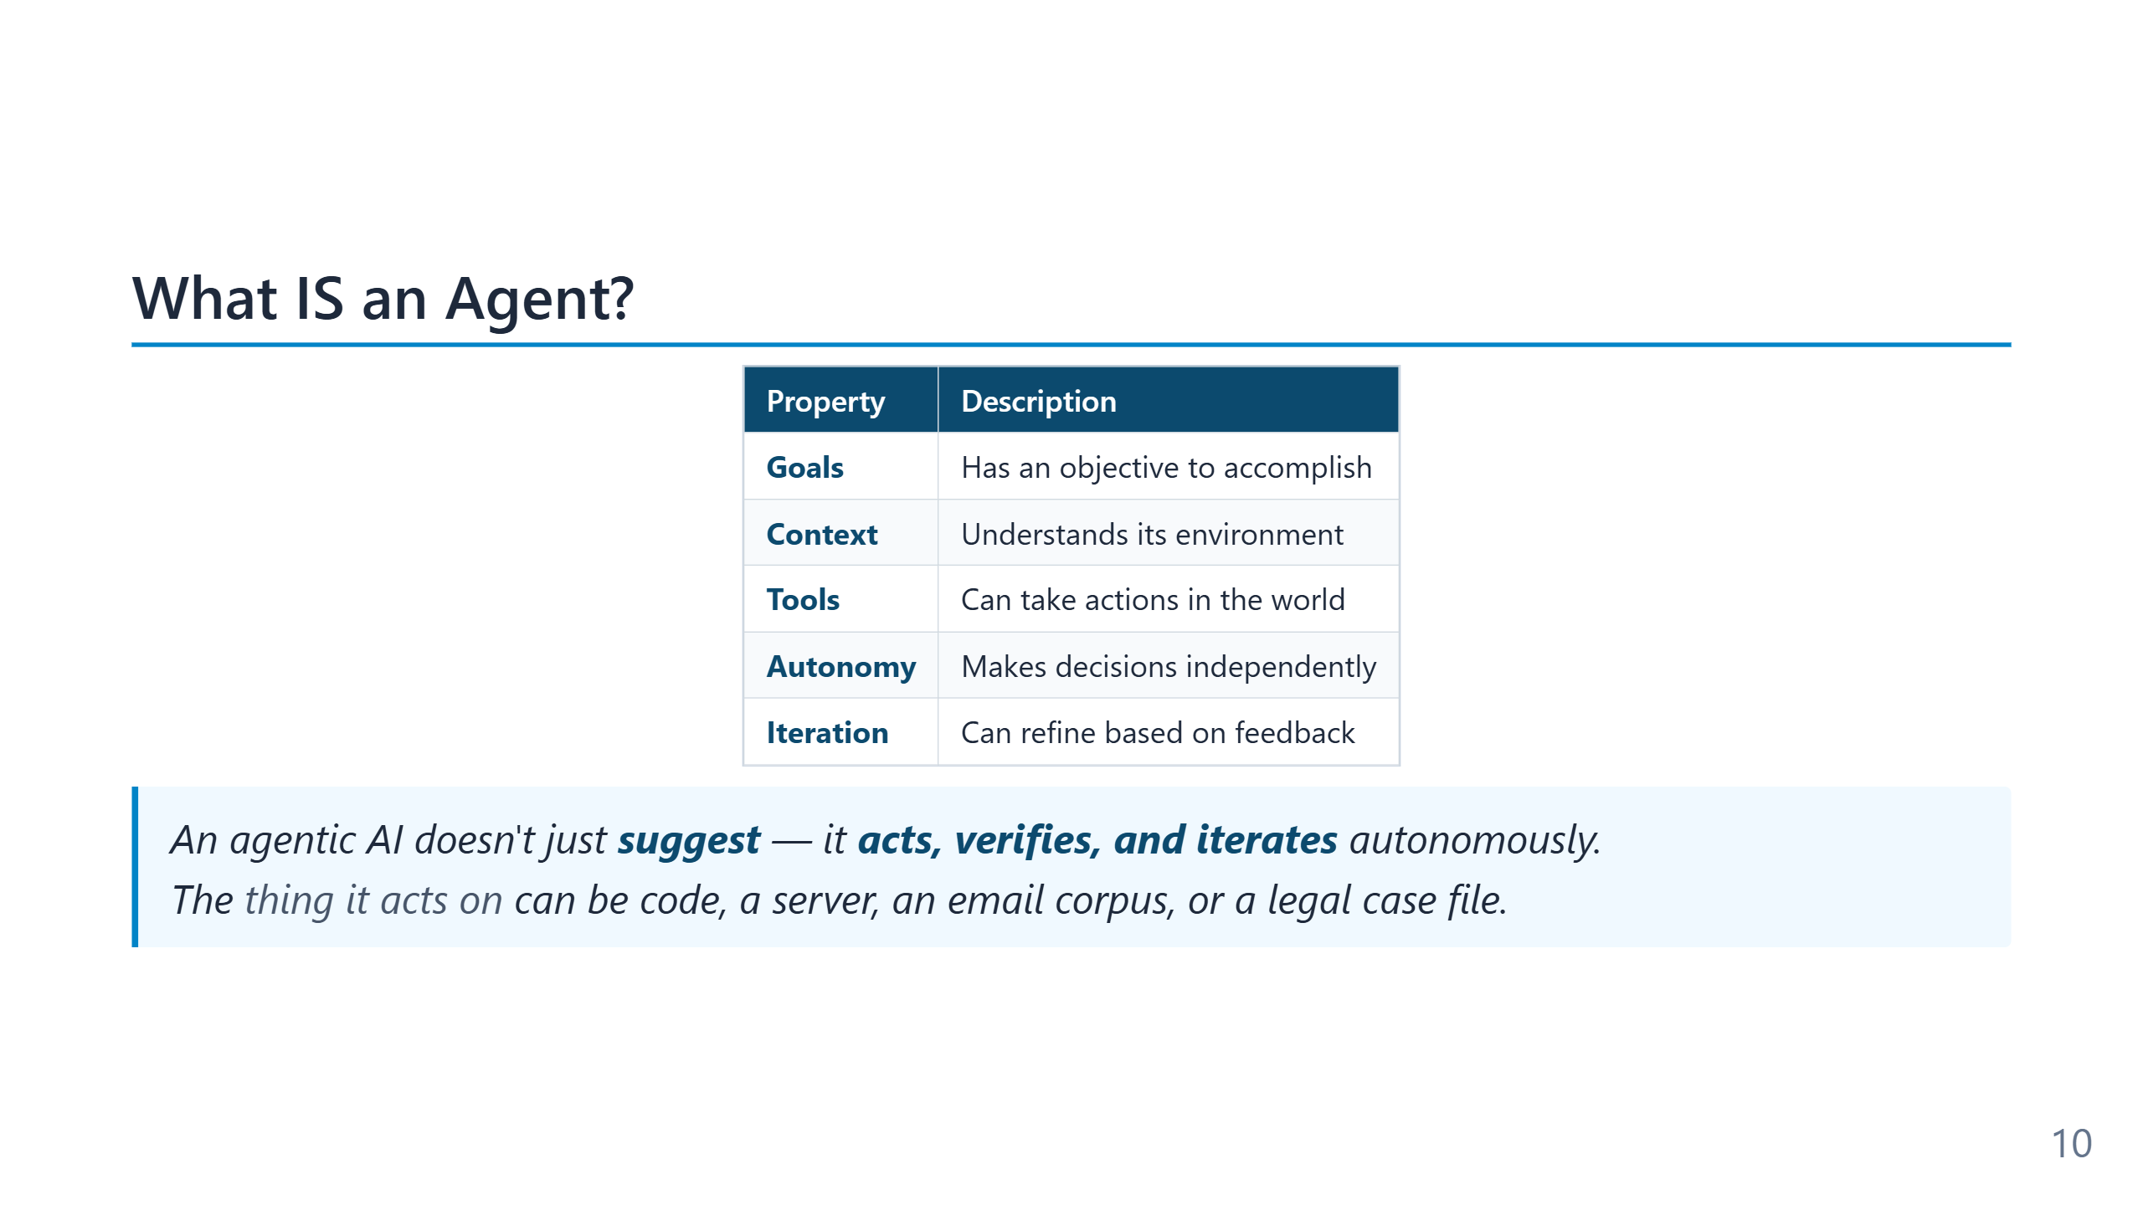
Notes:
The word "agent" has a long pedigree in computer science — Marvin Minsky's *Society of Mind* (1986), the BDI architecture from the 1990s (Belief–Desire–Intention), reinforcement-learning agents from the 2010s. The current LLM-driven definition keeps the same five properties (goal, context, tools, autonomy, iteration) but supplies them with natural-language reasoning instead of hand-coded planners. The practical distinction worth holding onto: an autocomplete suggests; a chatbot explains; an agent *acts and observes the result of its action*. The fifth property — iteration based on feedback — is the one that separates "agent" from "script with an LLM in it."

Slide 11
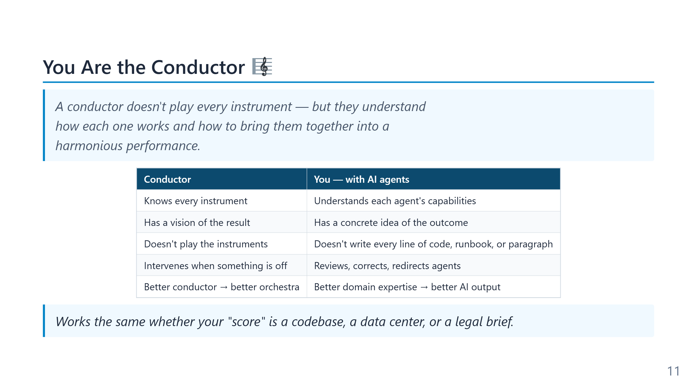
Notes:
Speaker notes (for newcomers): - The analogy answers the most common fear: "Do I need to know less now that AI codes for me?" — No, you need to know *more*, just differently. - A conductor doesn't play the violin — but they hear when the violin is wrong. That's exactly your new job: hear when the AI is wrong. - "Multi-agent" sounds futuristic but in practice means: one agent writes, a second reviews security, a third writes docs. We'll see how in Module 4.

Slide 12
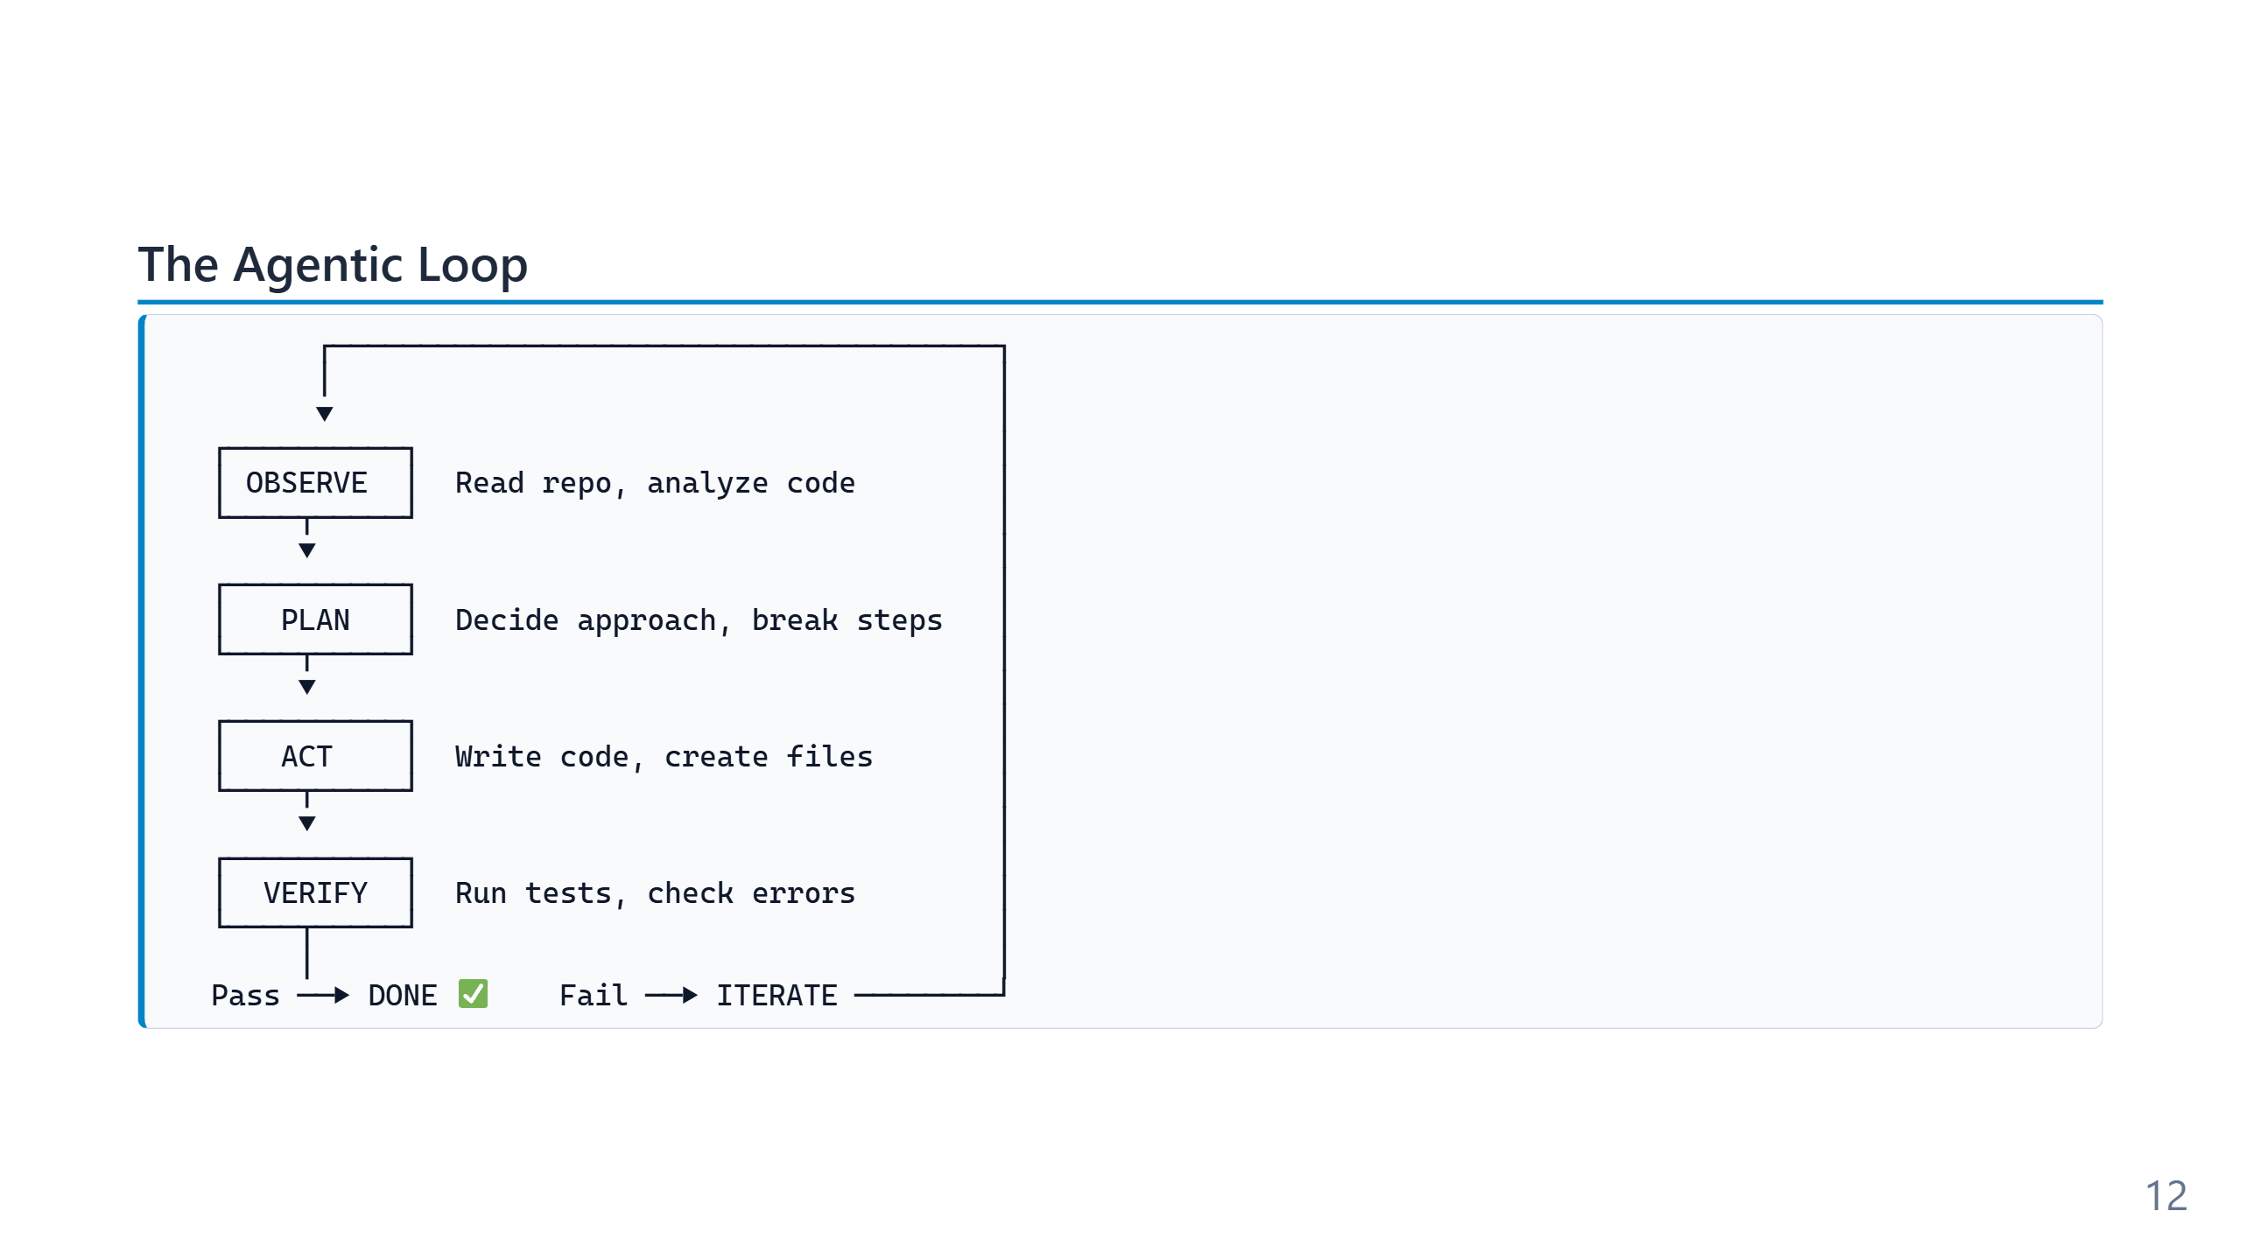
Notes:
Speaker notes (for newcomers): - This 5-step loop is the single most important concept in the whole training. Everything else is detail. - Compare to how YOU code: you read the file, decide what to change, change it, run it, fix the error. Same loop — the agent just does it faster and without coffee breaks. - The loop is what makes "agentic" different from "autocomplete": autocomplete stops after step 3 (Act). An agent keeps going until VERIFY says PASS. - Iteration is automatic. You don't approve every cycle — you approve the final result.

Slide 13
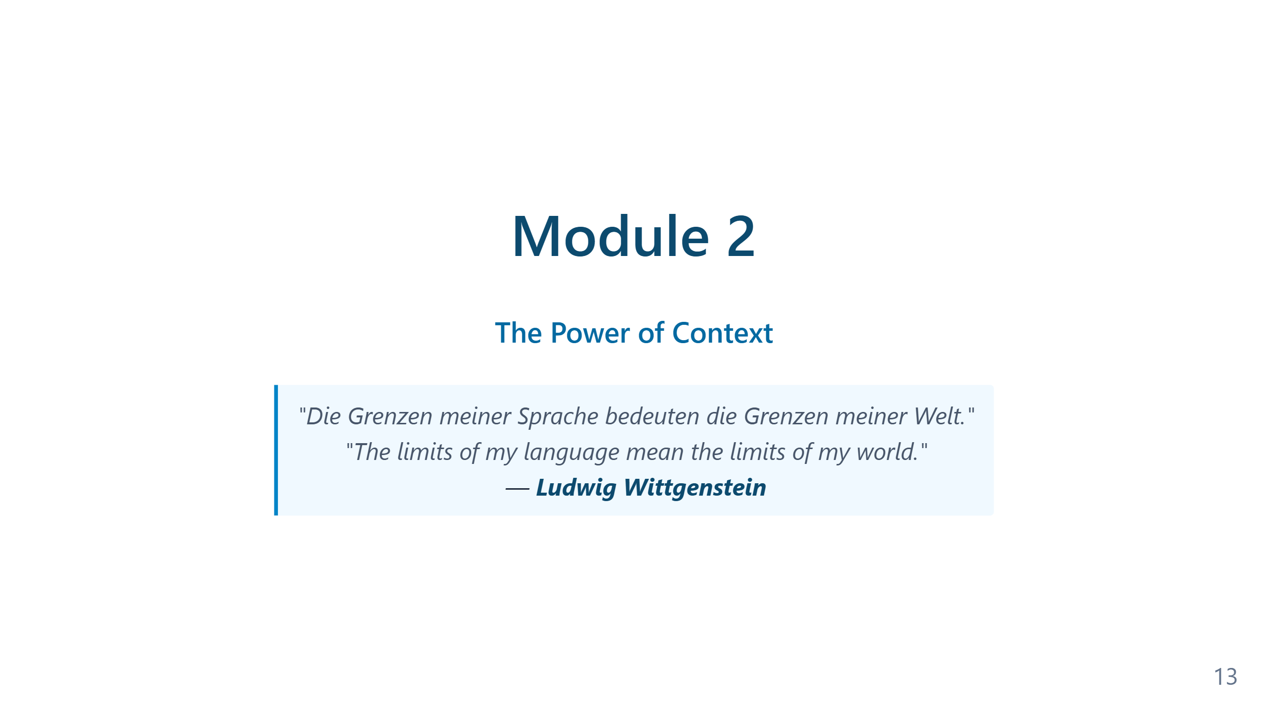
Notes:
Speaker notes — Module 2 appendix ### Timing: 25-30 minutes (including demo) ### Key Points to Emphasize: 1. The **loop** is the core concept: Observe → Plan → Act → Verify → Iterate 2. Self-verification is what makes this **trustworthy** 3. The role shift: You're now the architect and reviewer 4. The **conductor analogy**: You don't play every instrument — you understand each one's capabilities and orchestrate the ensemble. The better the conductor, the better the orchestra. This applies to multi-agent workflows (Slide 2.4a) ### Demo Tips: - Keep it simple: One function with tests - Highlight what the AGENT is doing, not the code - Show the iteration if a test fails (this is powerful) - Don't explain PowerShell syntax ### Common Questions: - "What if it makes a mistake?" → That's what verification is for - "Is it really autonomous?" → Show file creation, test execution - "Can I trust it?" → Trust but verify (testing + review) ### Transition to Module 3: "The agent needs to understand your project to work effectively. Let's see how Git provides that context..."

Slide 14
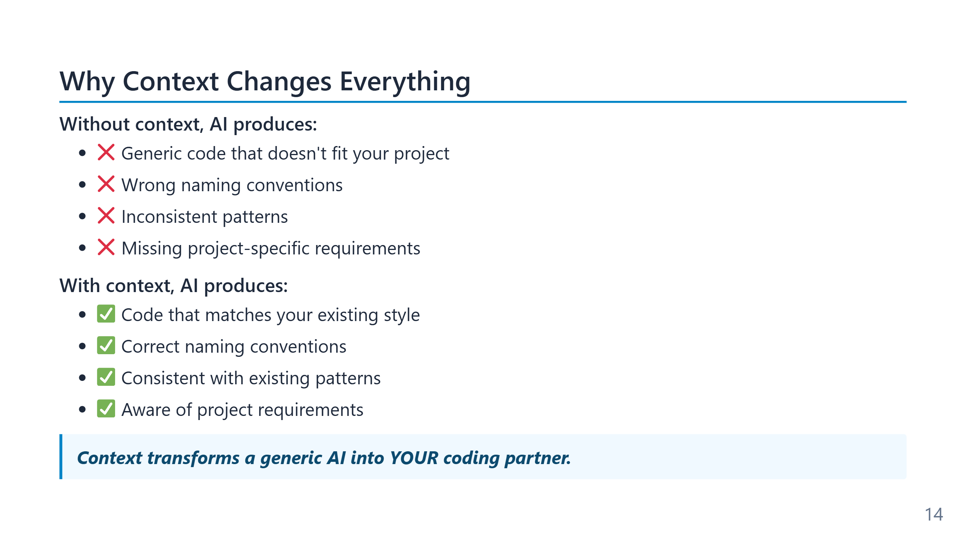
Notes:
The word "context" carries two meanings here that are easy to conflate. The first is the model's context window — the literal token budget (200k–2M in 2026 frontier models) that bounds how much text the model can hold at once. The second is *project context* — the structure, conventions, glossary, and history of the specific codebase. The first is a hardware constraint; the second is an authoring problem the team controls. Low-context output is the failure mode users notice first: code that looks reasonable in isolation but uses the wrong logger, the wrong error type, the wrong test framework. The model has not regressed — it has just defaulted to the most common pattern on the open internet, which is rarely the pattern in your repo.

Slide 15
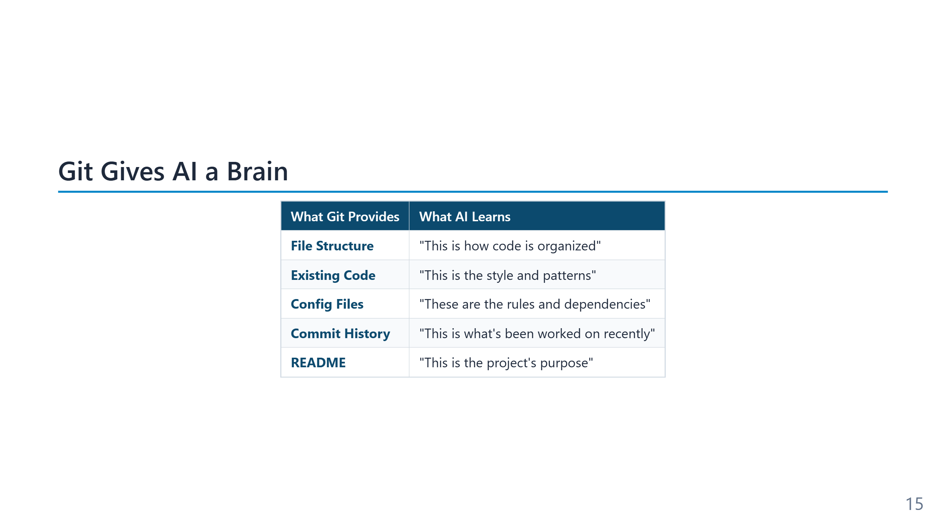
Notes:
Speaker notes (for newcomers): - **Git** = the version-control system. Think of it as "track changes" for an entire project, with full history. - **Repository** ("repo") = one project's folder + its history. Usually hosted on GitHub or Azure DevOps. - Why does Git matter here? Because the AI reads your repo to learn HOW your team writes code, not just WHAT they wrote. - If you've never used Git: GitHub Desktop is the easiest GUI. The agentic operating model assumes a Git repo — if you skip Git, you skip most of the value.

Slide 16
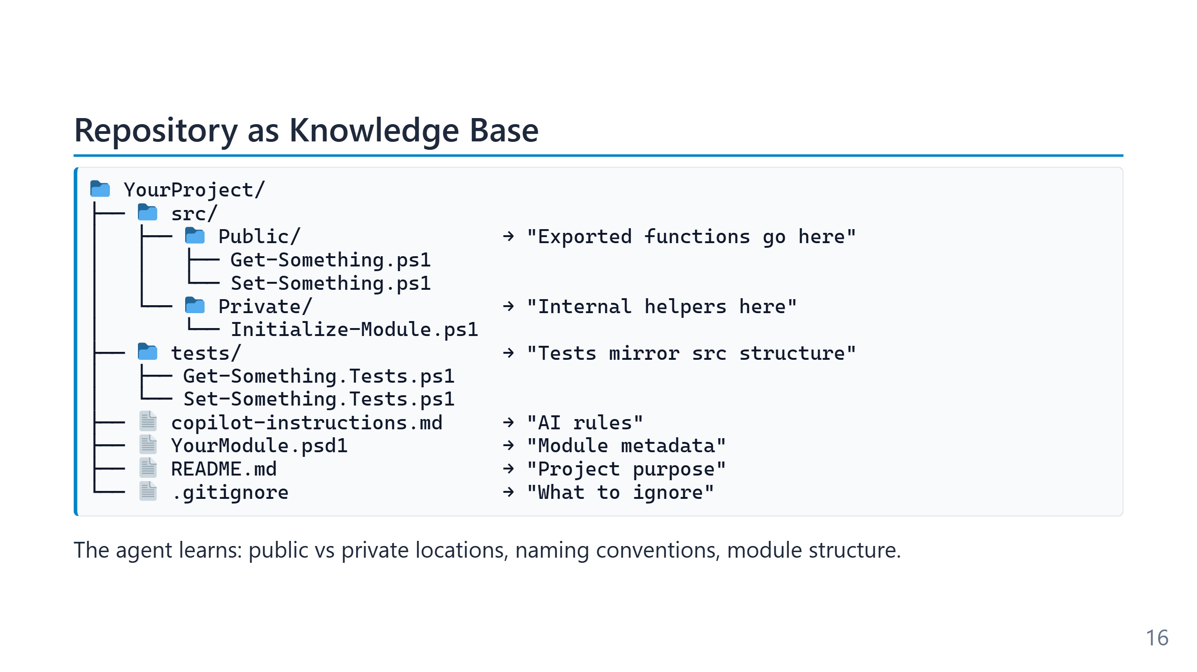
Notes:
The layout shown is the Sampler / standard PowerShell-module convention: `Public/` for exported cmdlets, `Private/` for internal helpers, `tests/` mirroring `src/`. None of that is enforced by the language — it is convention all the way down — but agents are remarkably good at recognising it and writing files that fit. The corollary is that a non-conventional layout costs you context. A repo with everything in a single `scripts/` folder and no test directory gives the agent nothing to infer from, and the output will reflect that. Reorganising for convention is one of the highest-leverage things a team can do before adopting agentic tooling. Observe is the phase most people underestimate. A modern agent does not "read the whole repository" — the context window cannot hold it. Instead it does a structured discovery pass: directory listing, README, manifest files, top-of-file comments, then targeted reads of the files most likely to be relevant. Tools like semantic search, grep, and symbol lookup are how this scales beyond toy projects. The `.github/copilot-instructions.md` file shown here matters disproportionately: it is the one file the agent reads *unconditionally* on every task. Anything written there becomes baseline behaviour. This is why Module 4 spends so much time on instruction files — it is the cheapest, most durable lever a team has on agent behaviour.

Slide 17
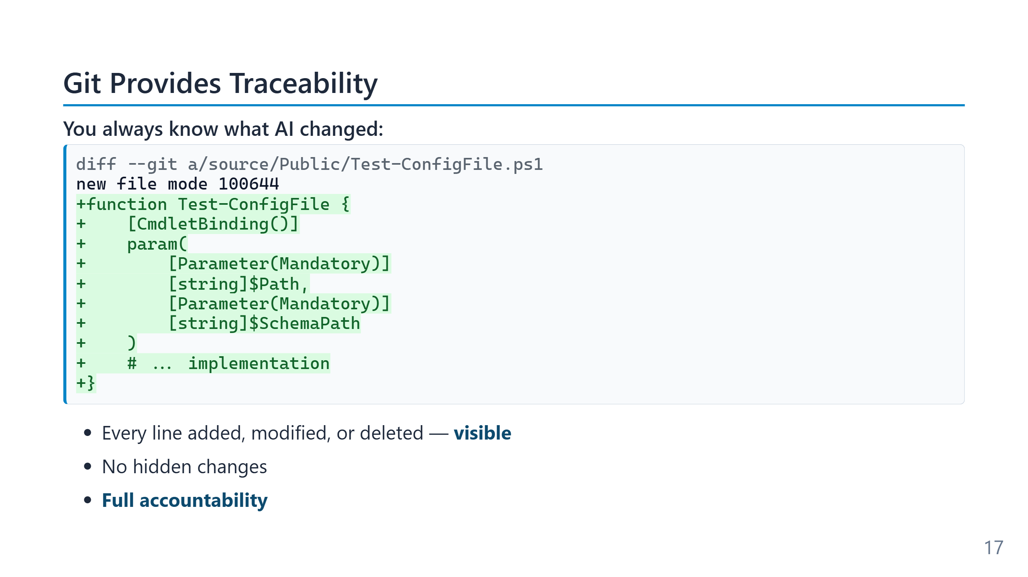
Notes:
Speaker notes (for newcomers): - **Diff** = the literal list of "what changed". Removed lines shown in red, added lines in green. - This is the single most important safety net: you never have to wonder "what did the AI silently touch?" — the diff shows you, every time. - VS Code shows diffs visually in the Source Control panel (the branch icon on the left). No command line required. - Rule of thumb: never accept agent work without reading the diff. Module 9 returns to why this matters.

Slide 18
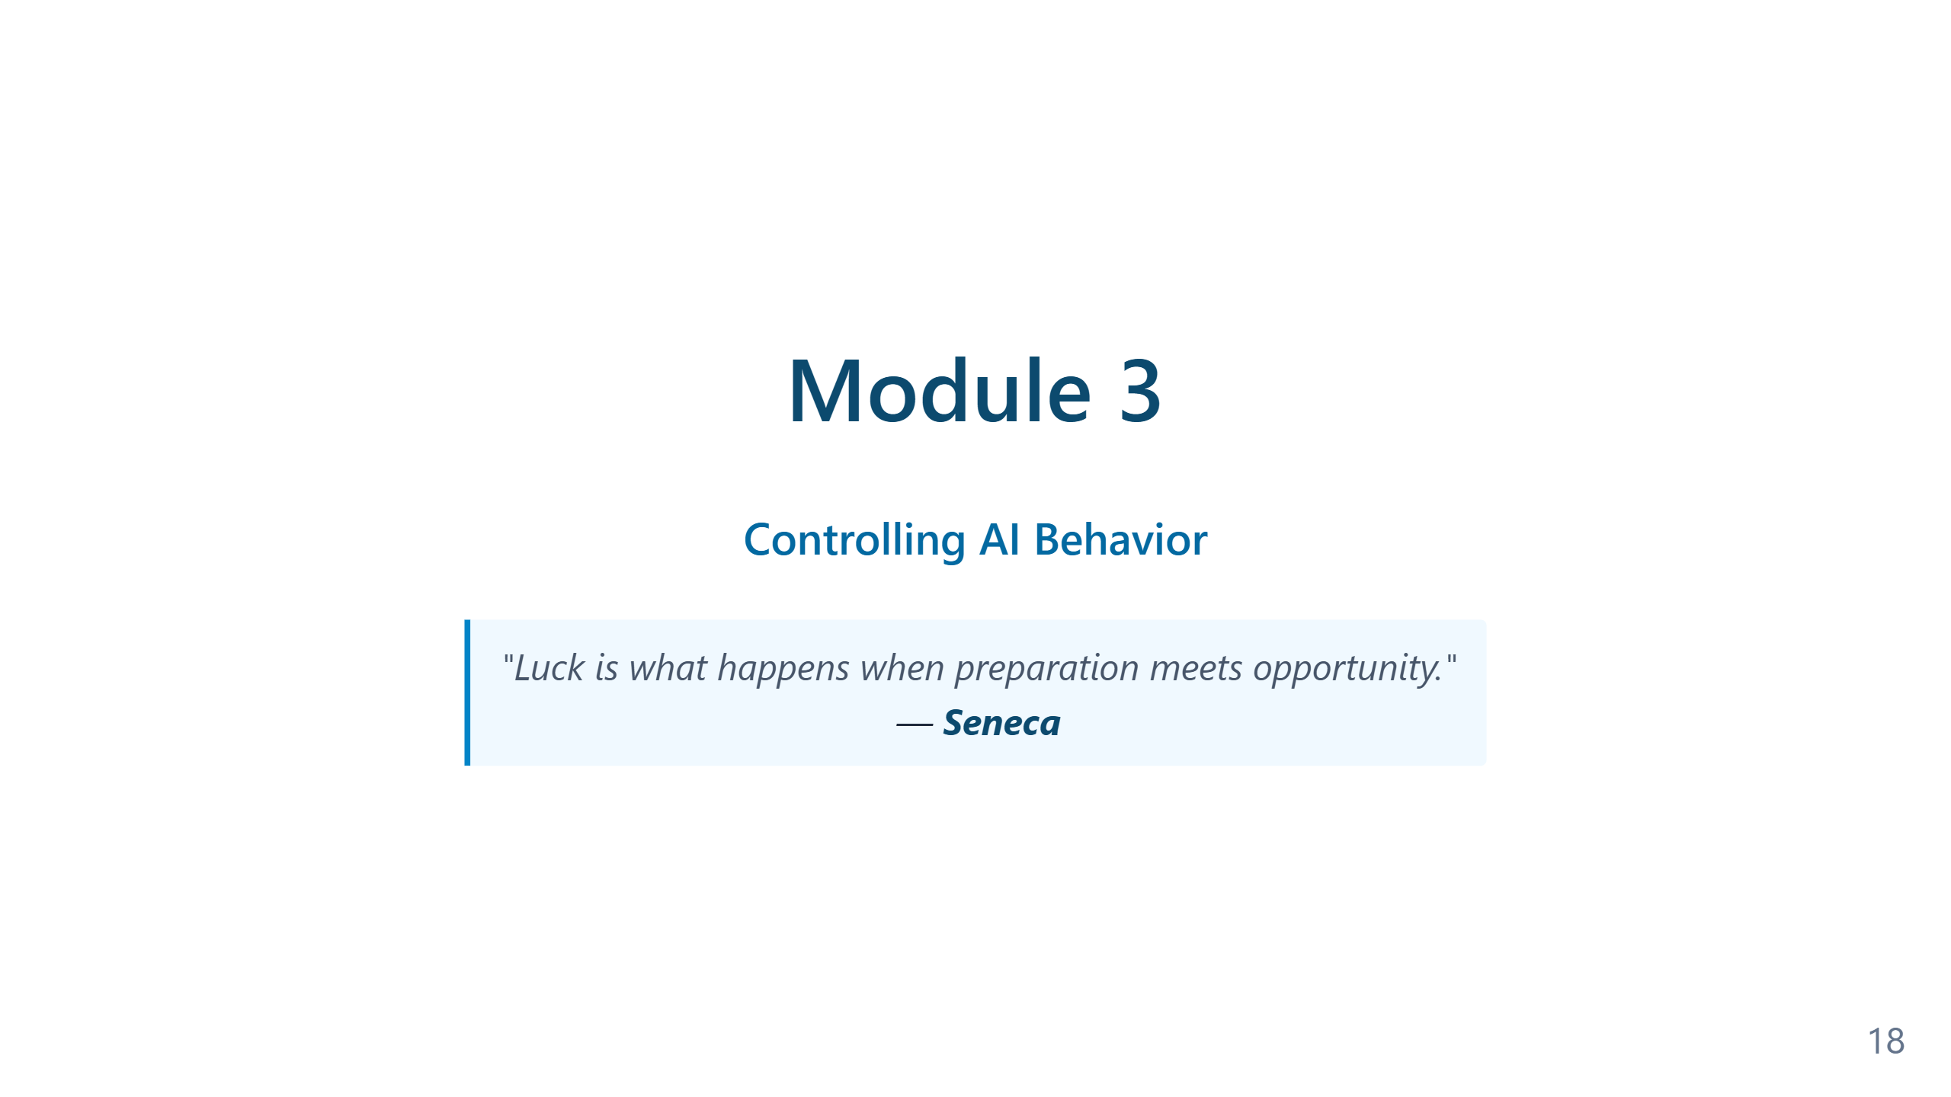
Notes:
Speaker notes — Module 3 appendix ### Timing: 20-25 minutes ### Key Points to Emphasize: 1. **Context transforms generic AI into your coding partner** 2. AI learns from your repository: structure, patterns, conventions 3. Git provides **traceability** — you always know what changed 4. **Checkpoints** mean you can always roll back ### Demo Tips: - Show a real repository with existing patterns - Have agent create something new - Highlight how output matches existing code style - Show git diff to prove traceability - Demonstrate a rollback if time permits ### Common Questions: - "Does it read ALL files?" → It reads relevant files based on task - "What about large repos?" → Smart context selection - "Private/sensitive files?" → Can use .gitignore patterns ### Transition to Module 4: "Context helps AI understand your project. But how do you teach it your specific rules? That's what custom instructions and instruction files are for..."

Slide 19
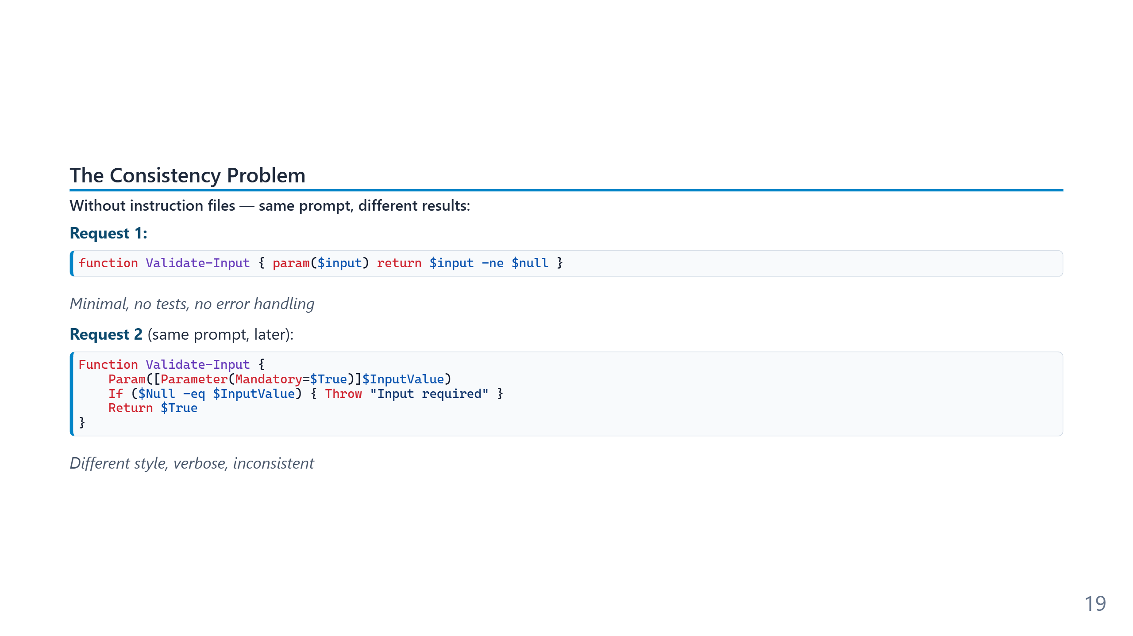
Notes:
The inconsistency on this slide is genuine and reproducible — the same prompt to the same model on different days produces different code, because the model has nothing to anchor on beyond its training-data priors. Temperature, recent context, even time-of-day sampling variance all contribute. The practical cost is hidden until a team scales. One developer alternating between two styles is annoying; ten developers each getting two random styles produces a codebase no reviewer can pattern-match against. The fix is not "better prompting" — it is removing the question from the prompt entirely by writing it down once, in a file the agent reads automatically.

Slide 20
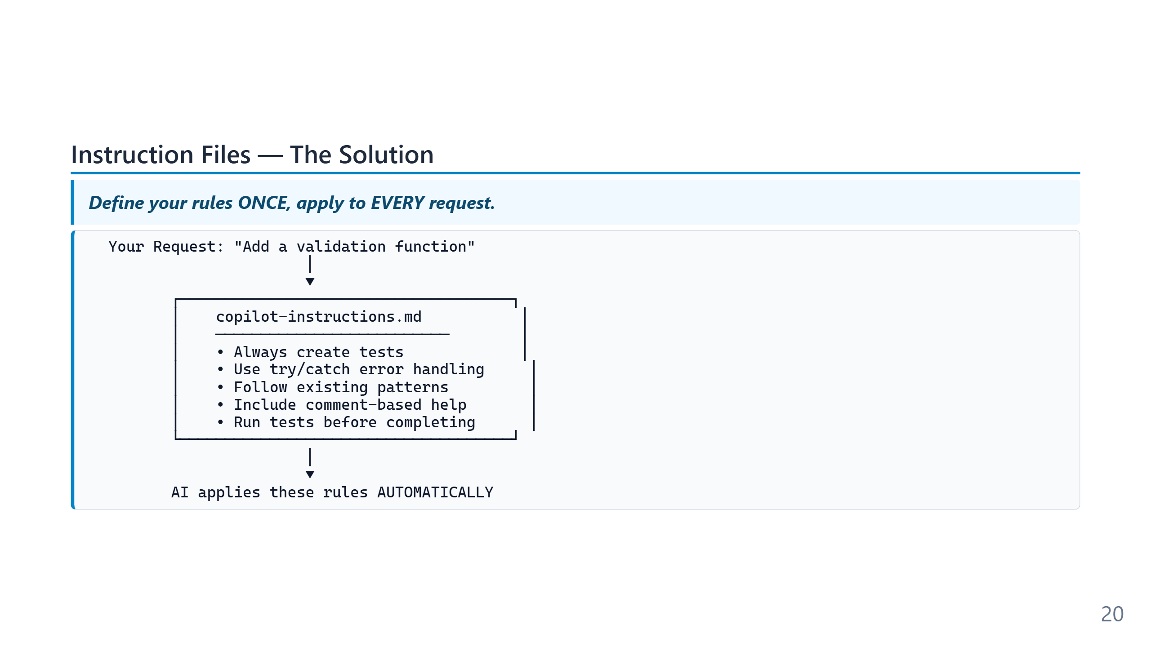
Notes:
Instruction files implement a pattern called "prompt prefixing": the host application silently prepends the file's contents to every system prompt the model sees. From the model's perspective there is no difference between rules you typed five seconds ago and rules you wrote six months ago — they all arrive together. The leverage is asymmetric. Writing one rule once costs a minute; the rule then applies to every subsequent task for every developer on the team, indefinitely. This is the single highest-ROI configuration most teams make to their AI tooling, and it is also the one most likely to be skipped because it does not look like "work."

Slide 21
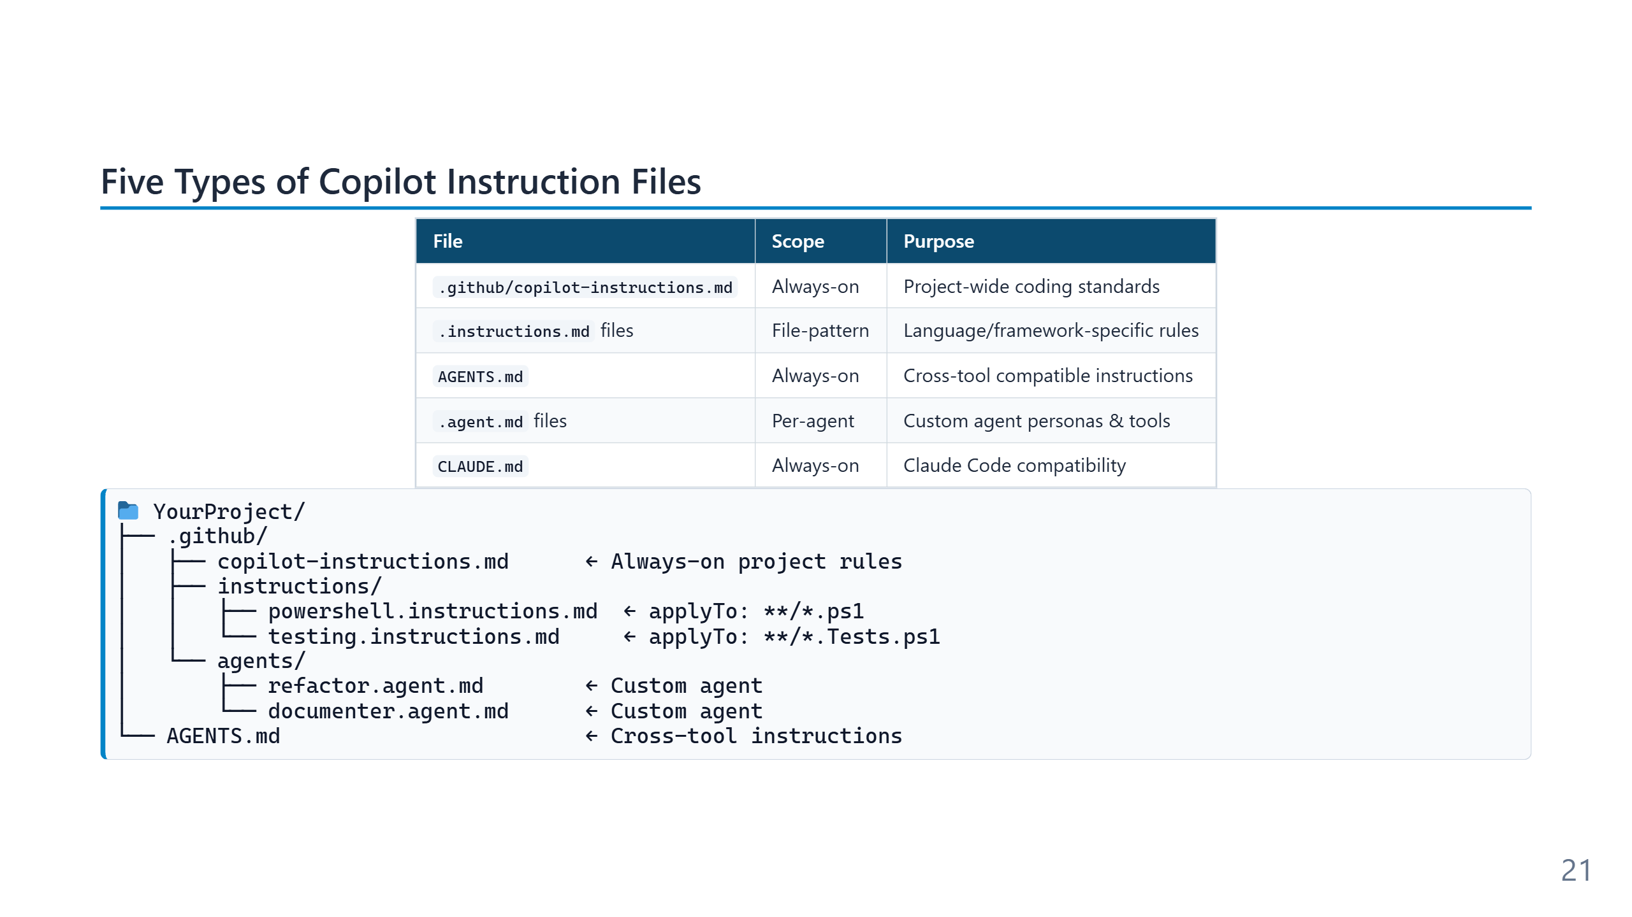
Notes:
Speaker notes (for newcomers): - Don't panic at five file types — 90% of teams only use the first one (`copilot-instructions.md`). - Quick mental model: - `copilot-instructions.md` = the rulebook that always applies. - `*.instructions.md` files = rules that only apply to certain file types (e.g. only `*.ps1`). - `AGENTS.md` / `CLAUDE.md` = same idea but readable by *other* AI tools too (Claude Code, etc.). - `.agent.md` = a named specialist (e.g. "security-reviewer") you can summon on demand. - Start with one file. Add more only when you catch yourself repeating an instruction.

Slide 22
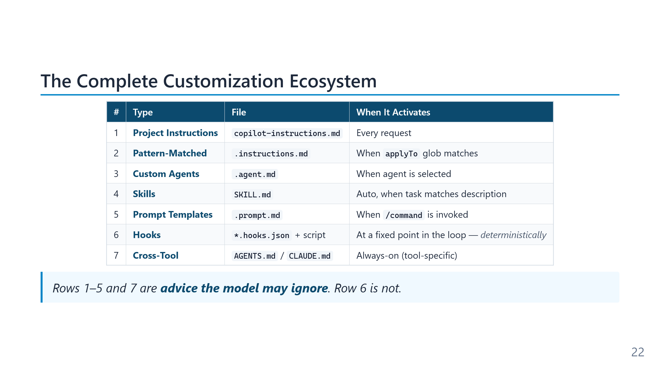
Notes:
The six types form a spectrum from "always loaded, no questions" (project instructions) to "loaded only when explicitly invoked" (prompt files), with pattern-matched instructions, skills, and agents distributed across the middle. Each step on the spectrum trades token cost against discoverability — more always-on means more reliability but higher per-request cost; more on-demand means lower cost but more risk the agent misses what it needs. Most teams reach for the wrong end of the spectrum first. The instinct is to put everything in `copilot-instructions.md` because "then it always works." The result is a bloated always-on file that contradicts itself in places and burns tokens on irrelevant rules. The mature pattern is the inverse: a short always-on file, a handful of pattern-matched instructions for specific languages, a few skills for specialised domains, and prompt files for repeated tasks.

Slide 23
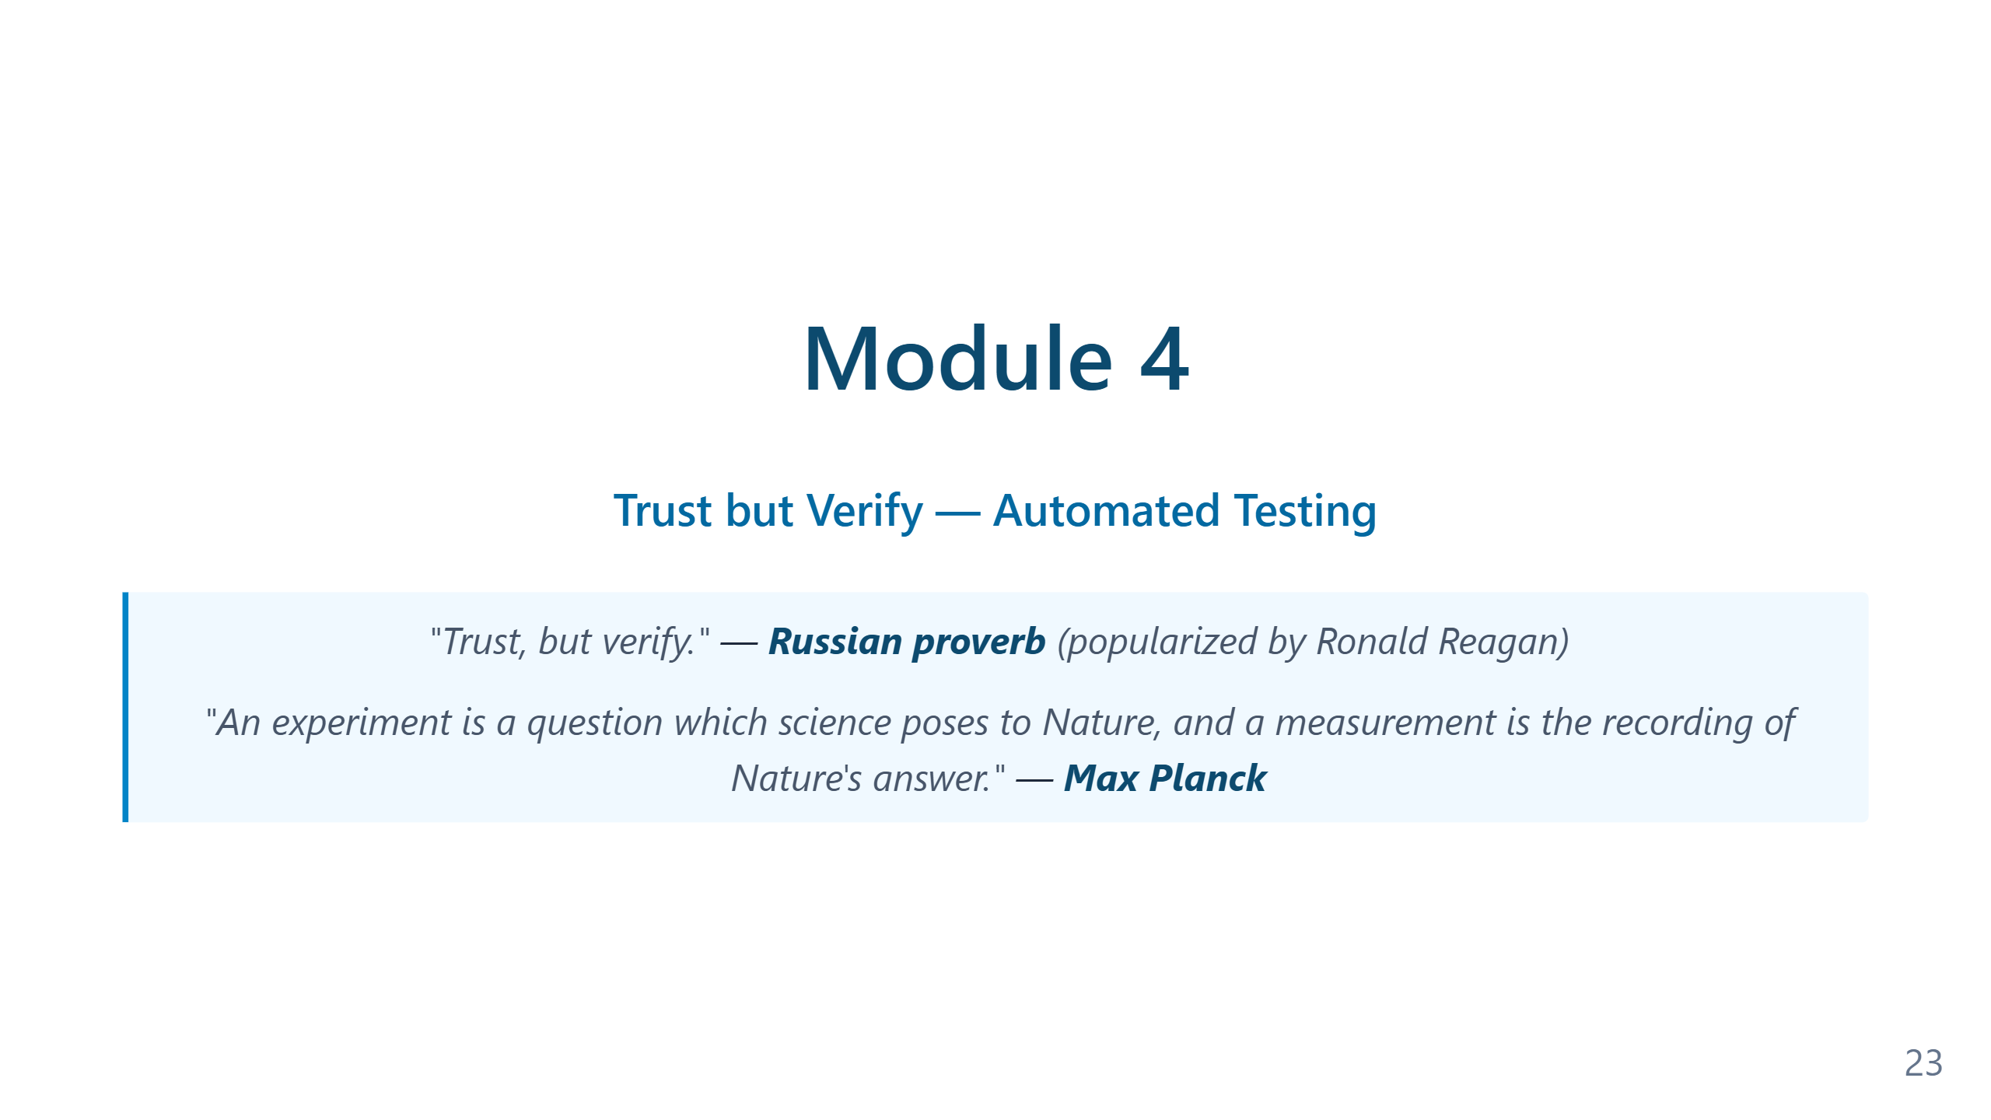
Notes:
Speaker notes — Module 4 appendix ### Timing: 30-35 minutes ### Key Points to Emphasize: 1. Instruction files solve the **consistency problem** 2. Write rules for things you find yourself **repeating** 3. Commit `.github/copilot-instructions.md` to Git for **team consistency** 4. Custom agents allow **specialized behaviors** 5. **Skills** give agents domain knowledge, loaded on demand 6. **Prompt files** create reusable `/slash` commands for common tasks 7. **Agent handoffs** enable multi-agent pipelines (Dev → QA → Prod) 8. Use `/init` to auto-generate instructions from your codebase ### Demo Tips: - Show clear before/after comparison - Use same request both times for dramatic effect - Don't spend time on the file syntax — show the result - Highlight how tests appear automatically with rules - If time permits, show a `/CodeReview` prompt invocation - **For extended sessions**: Use the [Prompt Evolution demo](../demos/demo-prompt-evolution.md) to show 6 levels of prompt quality ### Common Questions: - "Where do I put it?" → `.github/copilot-instructions.md` for project-wide, `.github/instructions/` for pattern-matched - "How specific should rules be?" → Specific enough to be actionable - "Can I have multiple files?" → Yes, use `.instructions.md` files with `applyTo` patterns - "Do rules slow down AI?" → No, they improve quality - "Does this work with other tools?" → Use `AGENTS.md` for cross-tool compatibility - "What's the difference between skills and instructions?" → Instructions are rules always applied; skills are domain knowledge loaded only when relevant - "What's the difference between agents and prompts?" → Agents are persistent personas; prompts are single-use task templates - "Can agents call other agents?" → Yes, via handoffs in YAML frontmatter — great for release pipelines ### Transition to Module 5: "Now you can control what AI produces. But how do you know it actually works? That's where automated testing and self-verification come in..."

Slide 24
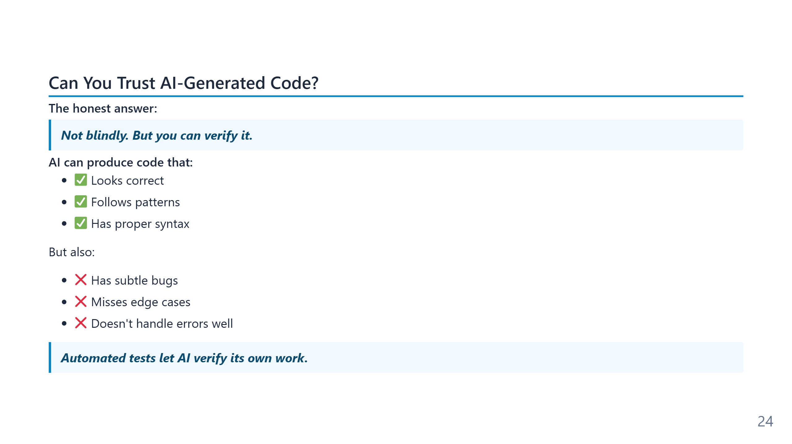
Notes:
Speaker notes (for newcomers): - **Automated test** = a small piece of code that checks another piece of code does what it should. Either passes or fails — no opinion involved. - In PowerShell the test framework is called **Pester**. In Python it's pytest, in JavaScript it's Jest. Same idea everywhere. - Why this matters for AI: tests are the only objective signal the agent has that its work is right. Without tests, "done" means "I think so."

Slide 25
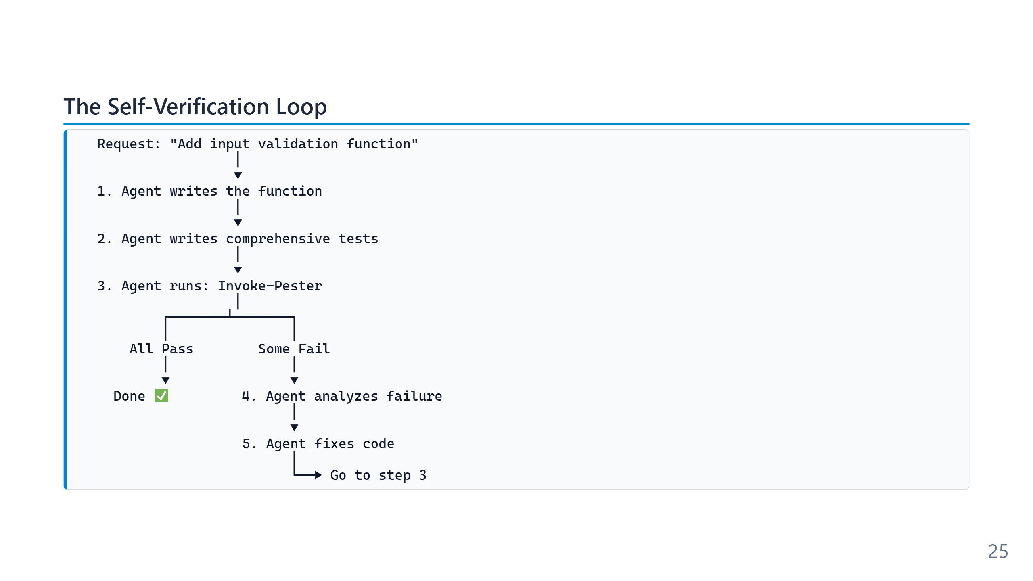
Notes:
Speaker notes (for newcomers): - This is the loop that makes "agentic" different from "autocomplete". Autocomplete stops after step 1. An agent only stops when step 3 says PASS. - **Pester** = the test framework for PowerShell (`Invoke-Pester` runs all tests). Other languages have equivalents (pytest, Jest, JUnit). - The iteration is automatic — you don't approve every cycle, you approve the final result. - Critical prerequisite: you must HAVE tests. No tests = no loop. The next slides show how to make sure the agent writes them.

Slide 26
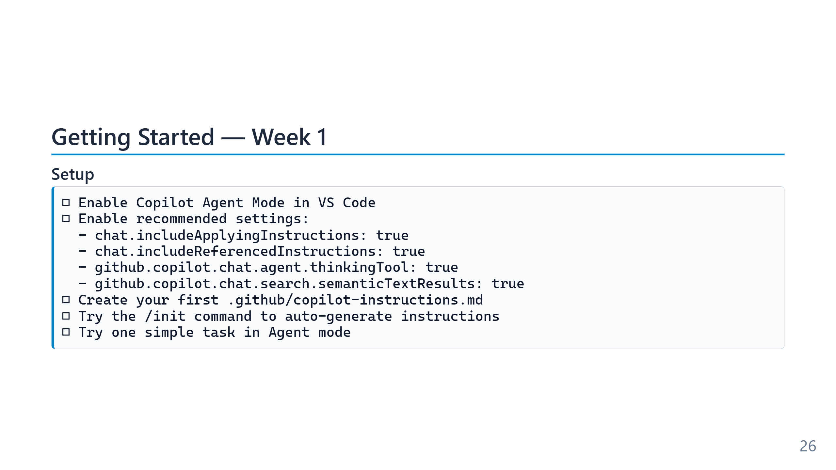
Notes:
The three-week ramp is a deliberate pacing recommendation, not a fixed schedule. Most engineers can compress the first week into a day if they already use Copilot in chat or completion mode; the more important variable is the *progression* (alone → with real work → with the team) rather than the calendar. The single most-skipped step in this list is `/init`. Teams routinely write their first `copilot-instructions.md` from scratch, miss conventions that the agent's auto-scan would have surfaced, and end up with a file that misses what the codebase already implies. The `/init` output is rarely the final file, but it is almost always a better starting point than a blank page.

Slide 27
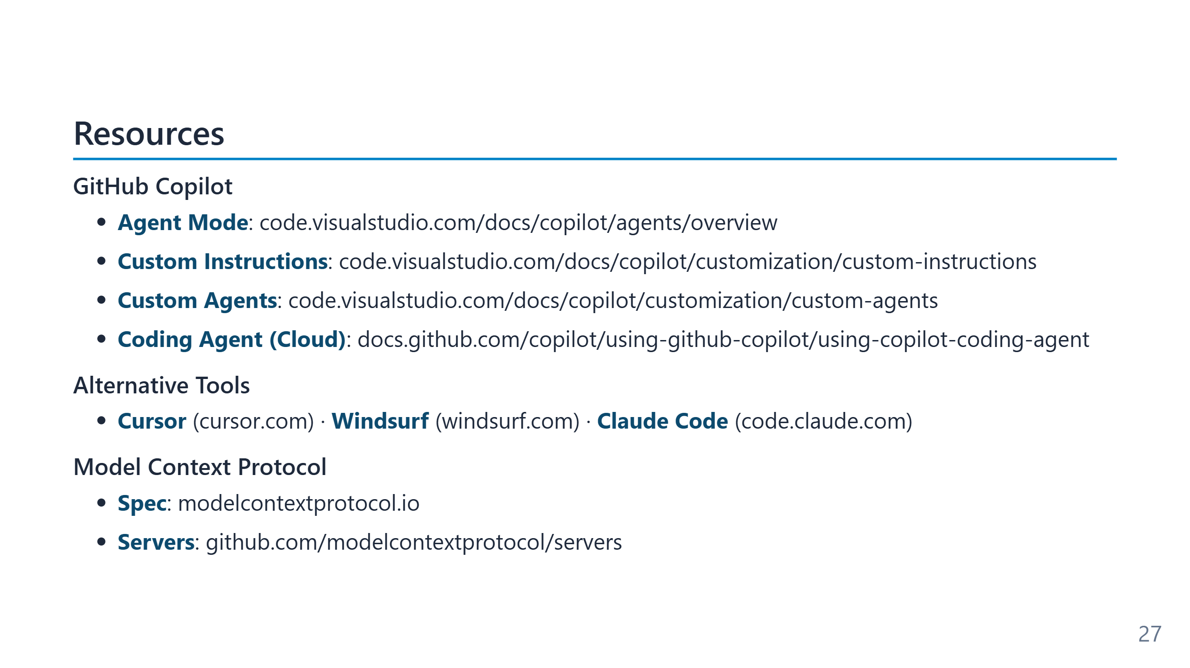
Notes:
Speaker notes (for newcomers): - Bookmark the top three links and you have a complete on-ramp: Agent Mode docs (what), Custom Instructions docs (how), MCP servers list (what to plug in). - All slides + materials for this training live in the repo — attendees get the link in the chat after the session. - If you're brand new: start with the Agent Mode docs. Everything else makes more sense after you've used it once.

Slide 28
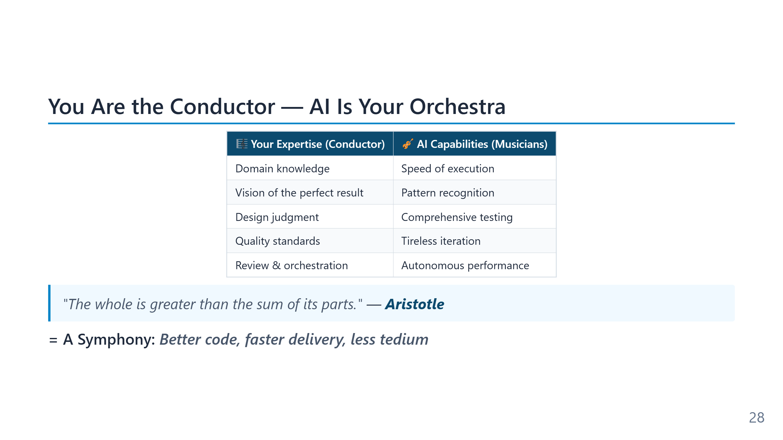
Notes:
Speaker notes (for newcomers): - Closing image to take home: your role doesn't shrink — it changes shape. - A conductor knows every instrument but plays none. The better you understand each AI capability (and each model's quirks), the better the orchestra sounds. - The fear "AI will make me redundant" assumes you stay a violin player. Promote yourself to conductor before the question even applies.

Slide 29
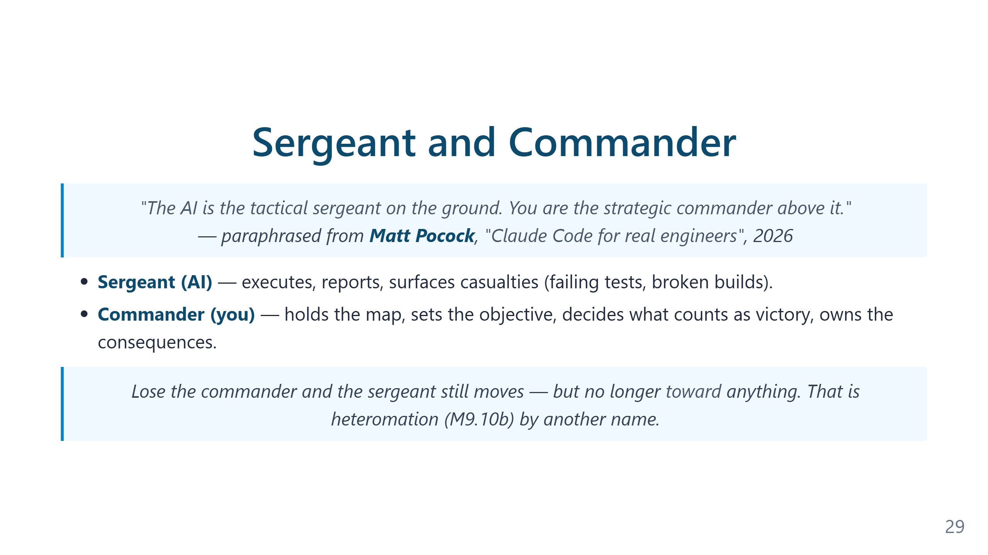
Notes:
Speaker notes (for newcomers): - Use this metaphor in your own team conversations. It survives translation across roles: dev, ops, legal, research. - The hardest discipline isn't telling the AI what to do — it's deciding *what counts as victory* before the AI starts moving. That's the commander's job and nobody else can do it for you. - Pairs with the earlier conductor metaphor (slide 16 / 10.10): same role, different verb. Conductor for creative work, commander for operational work. Same person.

Slide 30
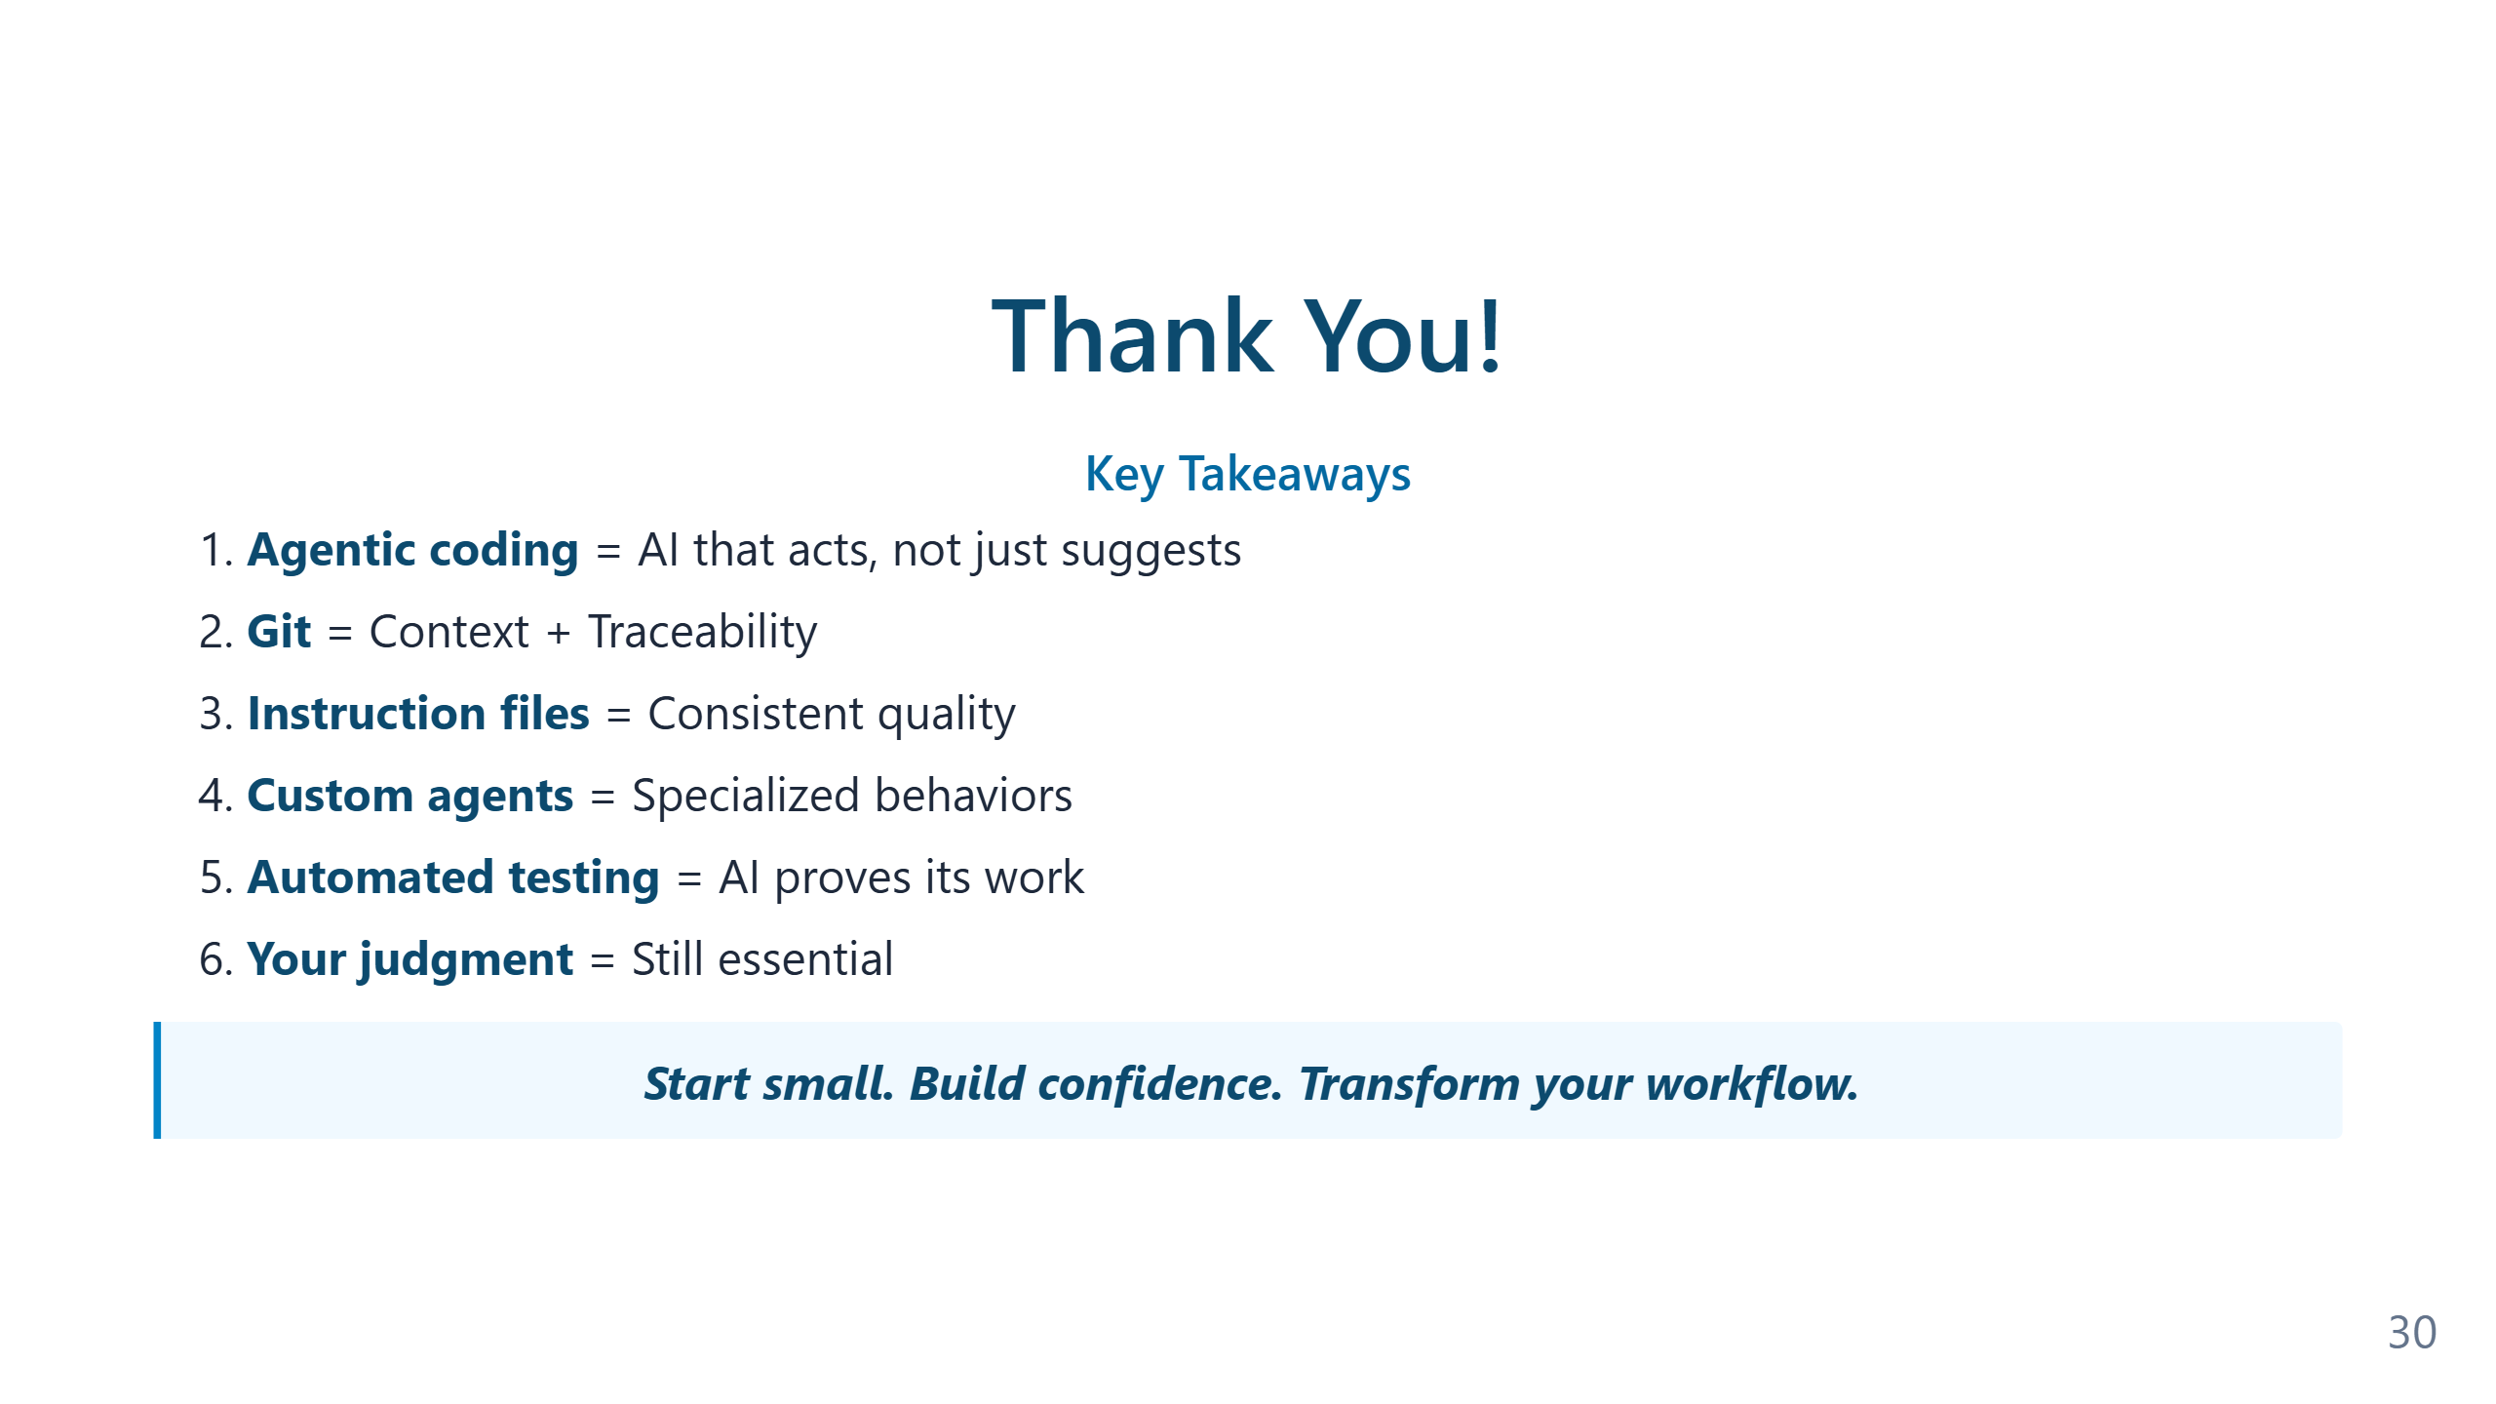
Notes:
The closing slide compresses the entire training into eight bullets and one operating sentence. The sentence — "you become the architect and reviewer, AI becomes your tireless implementer" — is the line the training wants people to leave the room remembering. If everything else fades, that role assignment is what stays useful. The Lao Tzu epigraph at the top of the module ("the journey of a thousand miles begins with a single step") is the right closing note. The training does not promise transformation; it promises a starting point and a map. The transformation, if it happens, is the result of the work the team does in the weeks after, applying the operating model to their actual codebase, on their actual problems, with their actual constraints. The training's job is done when the audience leaves knowing what to do tomorrow morning.

Slide 31
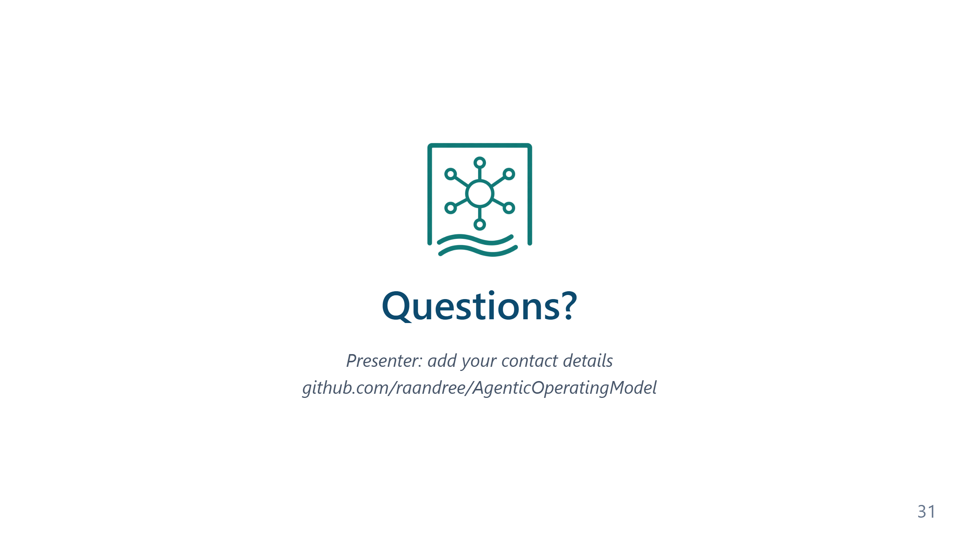
Notes:
The Q&A is usually where the most useful conversation of the training happens, because the questions surface what the audience has internalised versus what slid past. The five common topics listed on the slide are reliable starters when no one raises a hand first; in practice the room usually has its own opening question. The most common genuine question after this training is some version of "how do I convince my team / my manager / my security organisation to allow this?" That question is partly about the technology but mostly about organisational change — instruction files committed to a shared repository, GitOps as a structural guardrail, Memory Bank as an audit trail. The curriculum has these answers in its body; the Q&A is where they get connected to the specific organisation in the room.

