Slide 1
WorkshopPLUS – Windows PowerShell: Tool Building

Slide 2
Disclaimer

Slide 3
Instructor Introduction
Name
Specialty
Experience

Slide 4
Attendee Introductions
Name
Job/Team/Specialty
Time Zone

Slide 5

Objectives
After completing this WorkshopPLUS, you will be able to:
Create advanced functions
Create Classes in PowerShell
Work with the debugger
Work with code in GIT repositories
Create GUI based PowerShell code

Slide 6
Modules
Knowledge Refresh
Developing Advanced Functions
Mastering Parameters
Classes
Error Handling
Debugging
Git Introduction
Git Intermediate
Runspaces
Create a GUI in PowerShell

Slide 7
Agenda Day 1
Knowledge Refresh
Script Basics, Flow Control and Functions
Object Models and Regular Expressions
Advanced Functions
Basic functions and parameters
CmdletBinding attribute and properties
Returning Objects and pipeline
Dynamic parameters
Mastering Parameters
Attributes and special parameters
Validation and risk mitigation
Comment-based help
OutputType()
Classes
What is a class
Work with Methods and advanced object features

Slide 8
Agenda Day 2
Error Handling
Introduction
Streams and Write-Host
Working with the ErrorRecord Object
Terminating and Non-Terminating Errors
Try-Catch
Debugging
Introduction and Basics
Console and ISE debugging
Advanced Debugging
Git Introduction
DevOps and Git
Source Control and Changes
Git Repository
Git Intermediate
Push and Pull
Branch/Merging

Slide 9
Agenda Day 3
Runspaces
Overview and Commands
Classes and Methods
Creation and Initialization
Invoke and Remoting
Debugging and Pools
Create a GUI in PowerShell
The presentation Framework
Visual Studio
Graphical User Interface and GUI Design
Code behind a Form and Advanced Techniques

Slide 10
Get Ready to Participate
Close email and Update Status
Open Group Chat
Prepare to be Called on

Slide 11


Getting the most from this class
Annotation tools
Emoticons
Voice discussions
…but stay engaged.
Stay muted…

Slide 12

Virtual Training Tour of your virtual classroom

Slide 13
Connect to Lab environment
Prerequisites and Overview
Using the desktop version of IE go to
https://aka.ms/premiereducation
Sign in with your Microsoft account
Live ID or Azure ID
If you do not have one, then create it here:
http://live.com
Training Key
WorkshopPLUS -> My Training (Select at the top)
Select Redeem Training Key
Enter Training Key

Slide 14
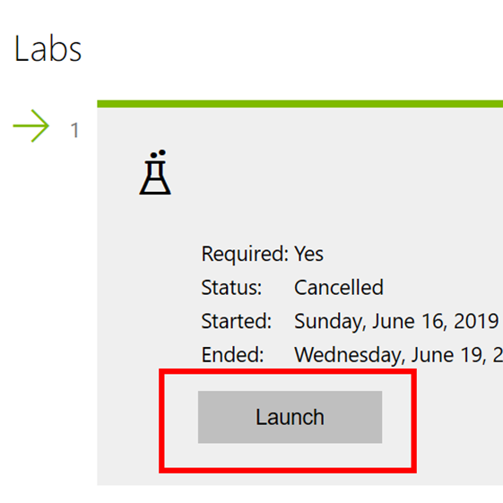
Launch the Lab
In the Labs section, click Launch

Slide 15
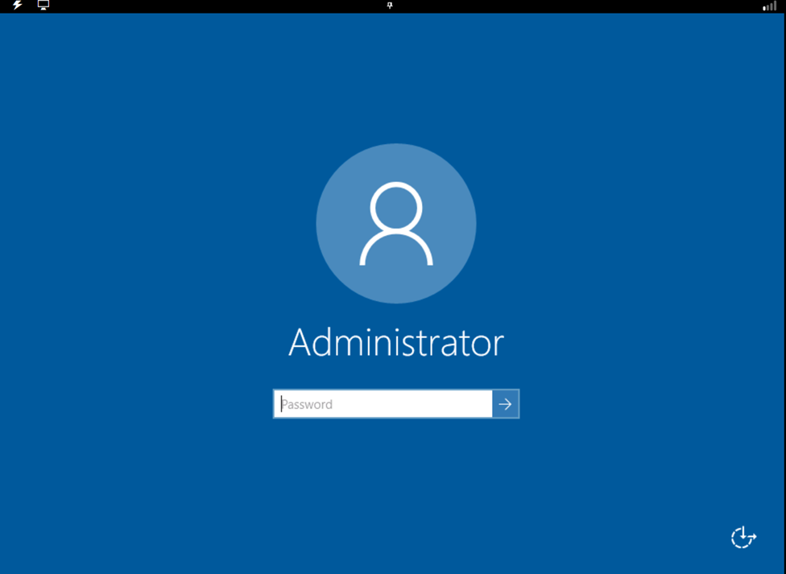
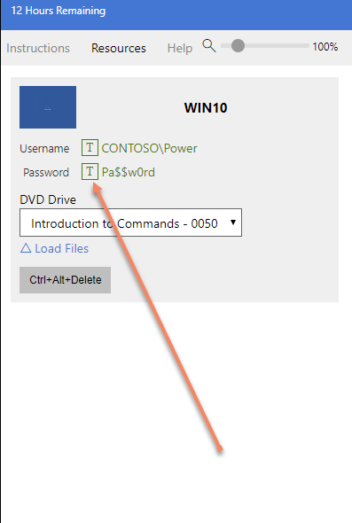
Lab environment LOD
Logon to the virtual machine using the provided password and username on the Resource tab.

Slide 16
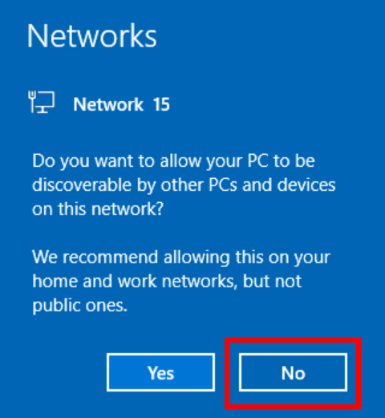
Lab environment LOD Network Settings
Select Yes or No to allow the server to be discoverable.
It doesn’t matter in this training environment.

Slide 17
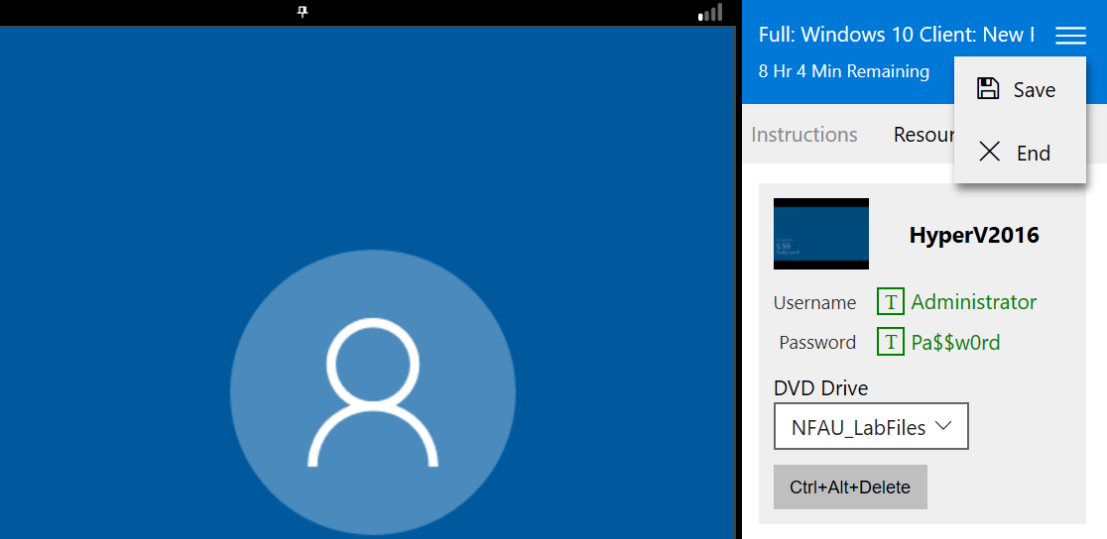
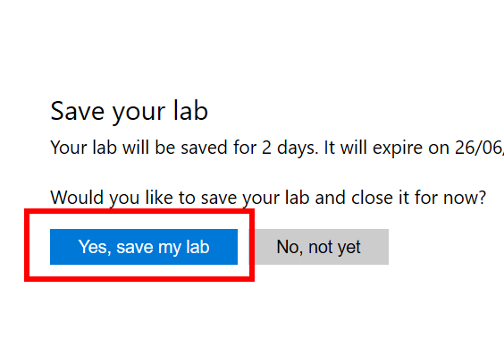
LOD Lab Time Remaining
Ensure you select Save before leaving the LOD environment. This pauses the time remaining to complete the Labs.

Slide 18
Microsoft

