Slide 1
Debugging
Module 6
Notes:
Version: 12/10/2019 17:20:30

Slide 2
Disclaimer

Slide 3
Learnings covered in this Unit
Debugging Introduction
Debugging Basics
Debugging PowerShell Console
Debugging PowerShell ISE
Debugging Advanced
Debugging Other commands

Slide 4
Debugging Introduction

Slide 5
Debugging Overview
What is debugging?
Process that allows you to examine your code while it’s running
How does it help?
Enables you to identify errors and correct them during execution
To which code does it apply?
Debugging works with commands, expressions, functions, workflows and scripts

Slide 6
Debugging Features
Available in console and ISE (starting PowerShell 5 also support for remote debugging in ISE)
$PSDebugContext to determine if we are debugging
$DebugPreference influences debugging behavior
-Debug common parameter to influence $DebugPreference
Cmdlets include:
Breakpoint
Call stack
Debug
Trace
StrictMode

Slide 7
Breakpoints – automatic variables
Determine whether we are debugging or not (e.g. from an automation perspective)
When debugging commences the current scope doesn’t change
Example: if debugging starts within a function it remains in the function
PS C:\> if($PSDebugContext) { Write-Output "Currently debugging" } else { Write-Output "Not debugging" }

Slide 8
Breakpoints – automatic variables
PS C:\> Function Bits { >> Get-Service -Name Bits >> } PS C:\> Set-PSBreakpoint -Command Get-Service PS C:\> Bits Entering debug mode. Use h or ? for help. PS C:\>> $PSDebugContext InvocationInfo Breakpoints -------------- ----------- System.Management.Automation.InvocationInfo {Command breakpoint on ‘Get-Service’}

Slide 9
$DebugPreference
Valid Values
Automatic Variable
Debug information is not displayed by default
To display debug information:
Change $DebugPreference
Use -Debug common parameter
SilentlyContinue
(Default)
Inquire
Continue
Displays debug message and continues with execution
Displays debug message and prompts user to continue (default behavior)
Displays debug message and stops execution
Writes error to console
Debug message is not displayed, and execution continues without interruption
Stop

Slide 10
Debug common parameter
PS C:\> Function Bits {
>> [Cmdletbinding()]Param()
>> $Service = Get-Service -Name Bits
>> $Service
>> Write-Debug "Debug enabled: status is $($Service.Status)"
>> }
PS C:\> Bits
Status Name DisplayName
------ ---- -----------
Running Bits Background Intelligent Transfer Ser...

Slide 11
Debug common parameter
PS C:\> Bits –Debug
Status Name DisplayName
------ ---- -----------
Running Bits Background Intelligent Transfer Ser...
DEBUG: Debug enabled: the status of service BITS is Running
Confirm
Continue with this operation?
[Y] Yes [A] Yes to All [H] Halt Command [S] Suspend [?] Help (default is "Y"):
Custom Debug Message

Slide 12

Demonstration
Debugging introduction

Slide 13

Questions?

Slide 14
Debugging Basics

Slide 15
Breakpoints
A designated spot in a script where you pause the operation to examine the current state of the variables and the environment in which your script is running From How to Debug Scripts in Windows PowerShell ISE
The prompt will change and is now prefixed with "[DBG]:"

Slide 16
Breakpoints
While in the debugger environment you can:
You can set breakpoints at:
Examine a variable
Query the runtime state
Test conditions
Variables (Read / Write / ReadWrite)
Commands (cmdlet, function or workflow)
Line and column numbers
Notes:
Set-PSPreakPoint –Variable DebugPreference -Mode ReadWrite # -Mode can also be Read or Write determines when the debugger is triggered (so whenever a variable is accessed for read and/or write).

Slide 17
Breakpoints
Breakpoints for variables have the limitations:
Does not work with $_
Does not work with $input
Does not work with $Args
Does not work with $PSBoundParameters
Does not work with $MyInvocation

Slide 18
How to set Breakpoints
The Windows PowerShell ISE includes menu items that map to some of these cmdlets.
Description | Command
Gets breakpoints in current session | Get-PSBreakpoint
Sets breakpoints on lines, variables, or commands | Set-PSBreakpoint
Turns off breakpoints in current session | Disable-PSBreakpoint
Re-enables breakpoints in current session | Enable-PSBreakpoint
Deletes breakpoints from current session | Remove-PSBreakpoint

Slide 19
Demonstration
Debugging basics

Slide 20
Questions?

Slide 21
Debugging PowerShell ISE

Slide 22
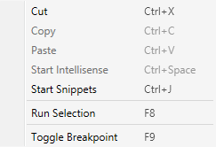
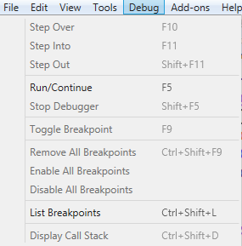
ISE Breakpoints
Set a breakpoint (scripts must be saved):
Debug menu
Right-click line Toggle breakpoint
Press F9
List/Remove/Enable/Disable breakpoints:
Debug menu
Ctrl+Shift+L/Ctrl+Shift+F9

Slide 23
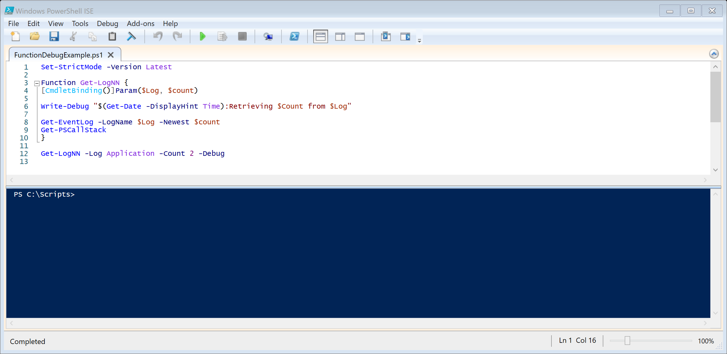
ISE Breakpoints
Consider the following script (must be saved before a breakpoint can be set)
Notes:
Reminder: please demo this script instead of just showing it

Slide 24
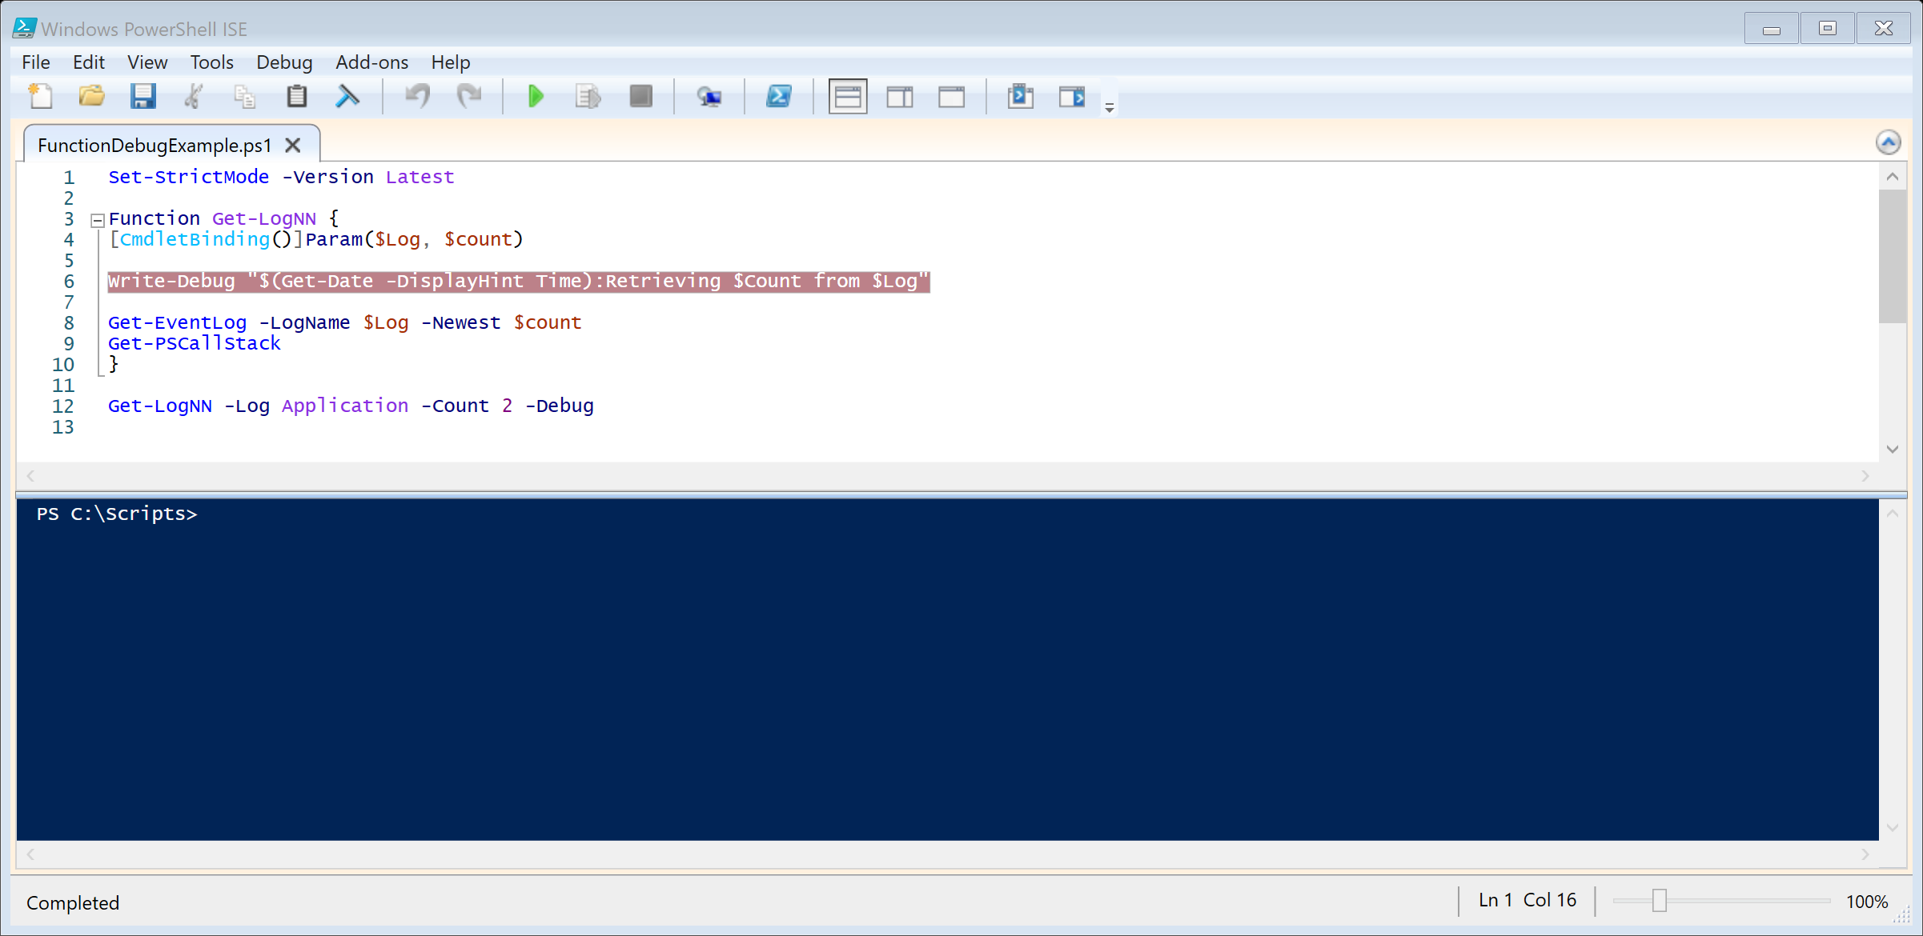
ISE Breakpoints
Breakpoint set using F9 or the Toggle Breakpoint from the Debug menu
Enabled breakpoints highlighted in red
Notes:
Reminder: please demo this script instead of just showing it

Slide 25
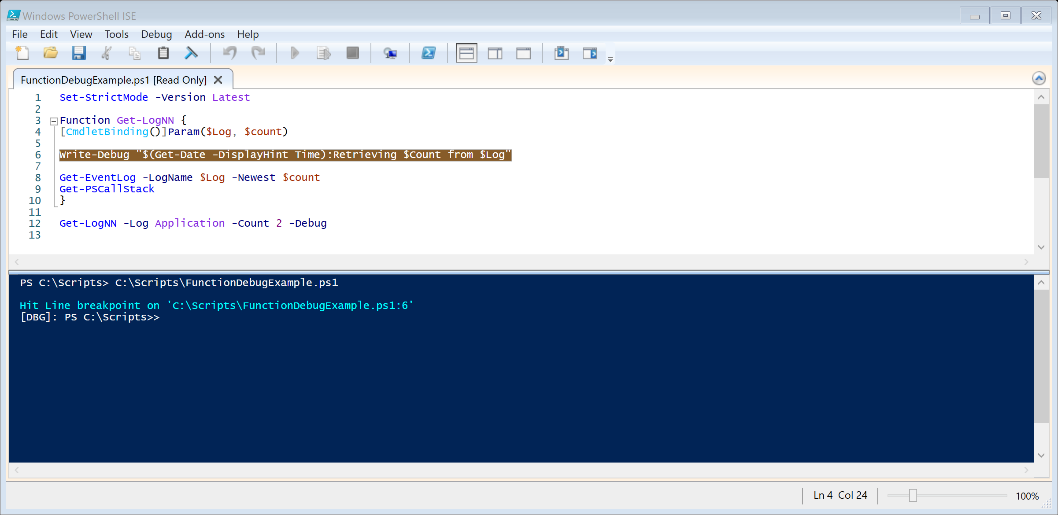
ISE Breakpoints
Breakpoint is highlighted in yellow when reached during execution
Highlighted in yellow
Notes:
Reminder: please demo this script instead of just showing it

Slide 26
ISE Debugger Commands
Debugging task | Description | Shortcut
Step Into | Runs current statement and stops at next one; Steps into function or script if next statement is function or script call | F11
Step Over | Runs current statement and stops at next one; Executes function or script if next statement is function or script call but doesn’t step into | F10
Step Out | Steps out of current function and goes up one level if current function is nested; If in main body executes until end or next breakpoint | SHIFT+F11
Continue | Continues to the end or next breakpoint Function and invocations are executed but not stepped through | F5
Stop | Stops the debugger and resumes normal operation | SHIFT+F5
Notes:
Reference: https://docs.microsoft.com/en-us/powershell/scripting/components/ise/how-to-debug-scripts-in-windows-powershell-ise?view=powershell-5.1

Slide 27
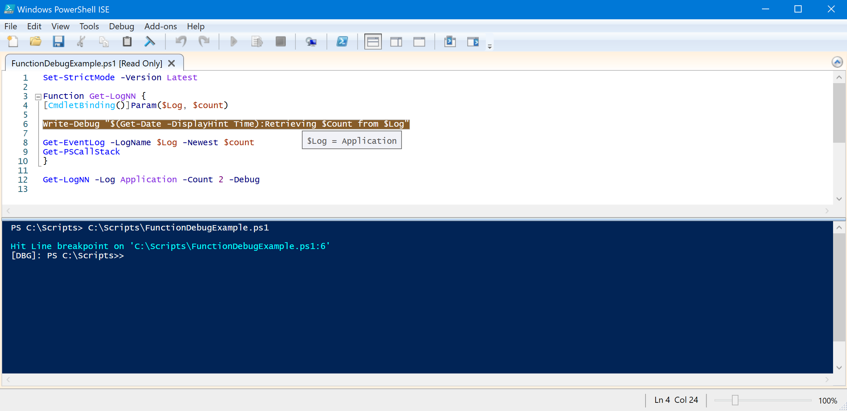
ISE Breakpoints – Variables
Breakpoint
Hover over variable to see its value
Does not work for:
$_
$input
$PSBoundParameters
$Args
$MyInvocation
Notes:
Reference:
https://docs.microsoft.com/en-us/powershell/module/microsoft.powershell.core/about/about_automatic_variables?view=powershell-5.1

Slide 28
Demonstration
Debugging with PowerShell ISE

Slide 29
Questions?

Slide 30
Debugging PowerShell Console

Slide 31
Command-Line Debugging
Full debugging experience in the PowerShell console
Enables you to debug a script at runtime when the ISE is not available for use
PS C:\> Set-PSBreakPoint -Script .\ScriptHelpExample.ps1 -Variable log -Mode Read
ID Script Line Command Variable Action
-- ------ ---- ------- -------- ------
7 ScriptHelpExample.ps1 log
PS C:\> .\ScriptHelpExample.ps1 -log system -numberofevents 2
Hit Variable breakpoint on 'C:\ScriptHelpExample.ps1:$log' (Read access)
[DBG]: PS C:\>>

Slide 32
Debugger Commands
[DBG]: PS C:\Scripts>> ?
s, stepInto Single step (step into functions, scripts, etc.)
v, stepOver Step to next statement (step over functions, scripts, etc.)
o, stepOut Step out of the current function, script, etc.
c, continue Continue operation
q, quit Stop operation and exit the debugger
k, Get-PSCallStack Display call stack
l, list List source code for the current script.
Use "list" to start from the current line, "list <m>"
to start from line <m>, and "list <m> <n>" to list <n>
lines starting from line <m>
<enter> Repeat last command if it was stepInto, stepOver or list
?, h displays this help message.
Notes:
Step Into
Executes current statement then stops at next statement. If current statement is a function or script, debugger steps into it, otherwise it stops at next statement.
Step Over
Executes current statement then stops at next statement. If current statement is a function or script debugger executes whole function or script and stops at next statement after function call.
Step Out
Steps out of current function and up one level if function is nested. If in main body, script is executed to end, or to next breakpoint. Skipped statements are executed, but not stepped through.
Continue
Continues execution to end, or to next breakpoint. Skipped functions and invocations are executed, but not stepped through.
Get-PSCallStack
By using the Get-PSCallStack, you can view the function or procedure calls that are currently on the stack. The Call Stack shows the order in which methods and functions are getting called. The call stack is a good way to examine and understand the execution flow.

Slide 33
Debugging Functions
function Test-DebugFunction {
begin {
Write-Host "Begin"
}
process {
Write-Host "Process"
}
end {
Write-Host "End"
}
}
Begin, Process, and End blocks
Break at each section
PS C:\> Set-PSBreakpoint -Command Test-DebugFunction
PS C:\> Test-DebugFunction
Hit Command breakpoint on 'Test-DebugFunction' Stopped at: begin {
[DBG]: PS C:\>>

Slide 34
Demonstration
Debugging with PowerShell Console

Slide 35
Questions?

Slide 36
Debugging Advanced

Slide 37



Debugging Remote Scripts
Enter-PSSession
Debug with breakpoints
If script hits breakpoint, client starts debugger
If disconnected session is at breakpoint, Enter-PSSession starts debugger when reconnecting

Slide 38
Debugging remote scripts
Debugging remote scripts is only possible from the PowerShell console starting PowerShell 5 also support for remote debugging in ISE
Remote debugging will prefix the prompt with "[REMOTE_HOSTNAME]: [DBG]:"
Typical steps to initiate remote debugging:
Enter-PSSession to connect to remote host
Set-PSBreakPoint –Script <script_to_debug> -Line 1
Allows exit the remote host (e.g. Exit-PSSession) to make sure you don’t leave any remote sessions open

Slide 39
Example: Debugging remote script
PS C:\> Enter-PSSession -ComputerName DC
[DC]: PS C:\> Set-PSBreakpoint -Script .\ScriptExample.ps1 -Line 1
ID Script Line Command Variable Action
-- ------ ---- ------- -------- ------
0 ScriptExample.ps1 1
[DC]: PS C:\> .\ScriptExample.ps1
Entering debug mode. Use h or ? for help.
Hit Line breakpoint on 'C:\ScriptExample.ps1:1'
At C:\ScriptEx.ps1:14 char:5
+ Get-EventLog -LogName $Log -Newest $Count
[DC]: [DBG]: PS C:\>>

Slide 40
Debugging remote scripts with ISE
Typical steps to initiate remote debugging in ISE:
Start the PowerShell ISE
Select File → New Remote PowerShell Tab (shortcut use CTRL+Shift+R)
Provide remote computer and username to connect
Provide password to complete the connection
PSEdit <script file> to open script file
Use F9 to toggle breakpoints
Run the script to start debugging

Slide 41
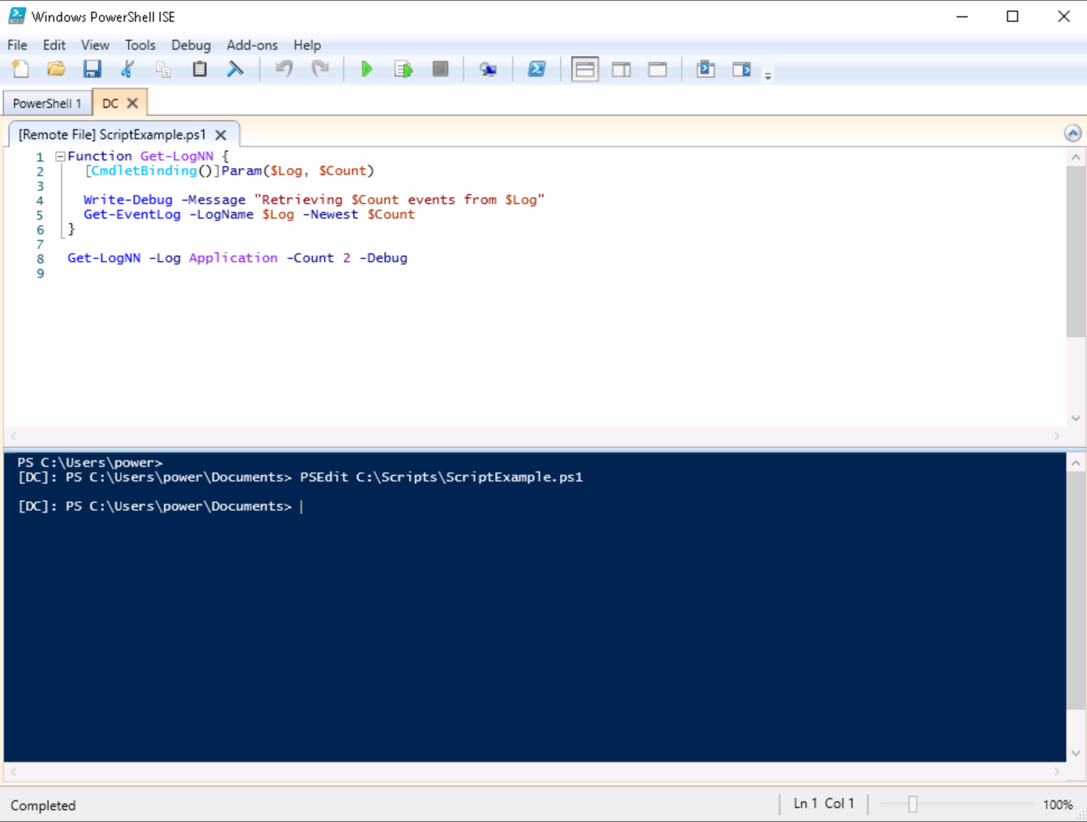
Debugging remote scripts with ISE

Slide 42
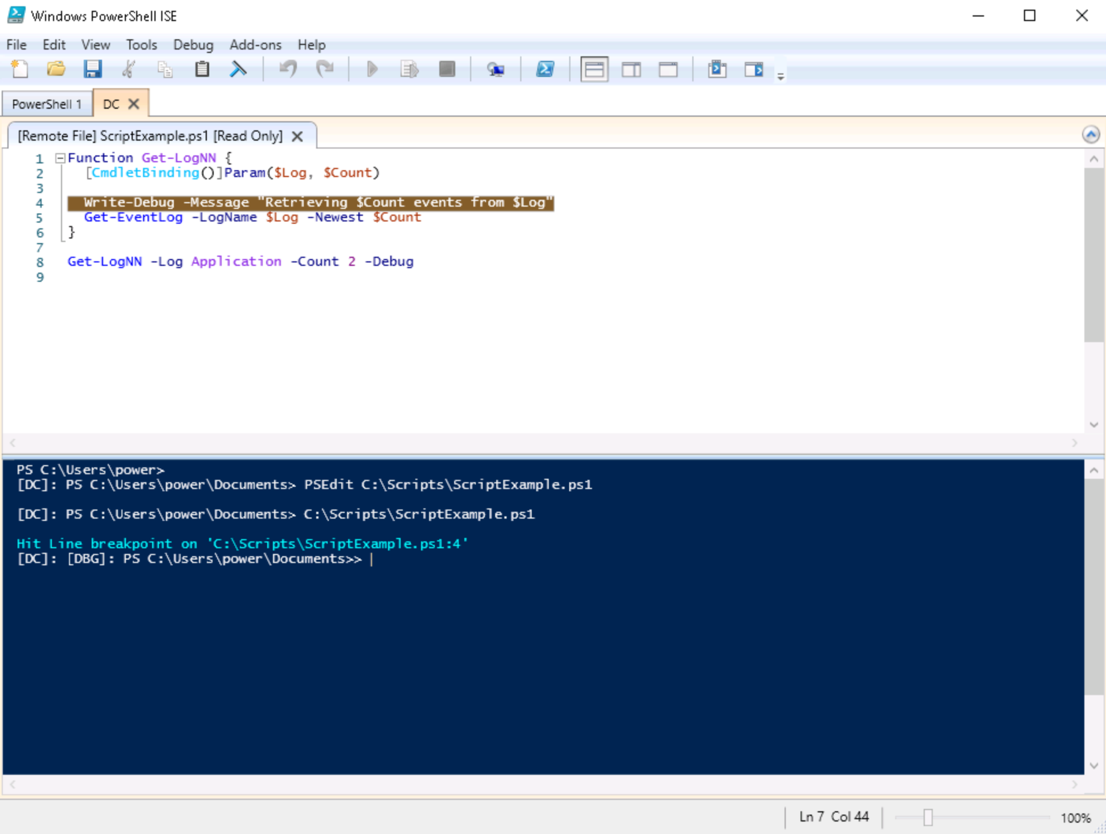
Debugging remote scripts with ISE

Slide 43
Debugging and scopes
Scope: Area (“territory”) that a given object is visible or available
PowerShell protects access to: variables, aliases, functions, and PSDrives by limiting the lifetime and visibility (or scope) where they can be read/changed
Created when starting a command shell, script, or function
Cleaned when script or function finishes
Defines separate items in memory (e.g. variables)
Avoids naming collisions of items across different scopes
Notes:
Scope determines lifetime & visibility of variables, aliases, functions, and PSDrives

Slide 44
Debugging and scopes
Four scopes available:
Global (Powershell session)
Local (Default)
Script
Private
Notes:
Instructor: Allowing you the flexibility to hide some of these slides, depending on your delivery. You can either use the overview of the 4 scopes, and/or present the verbiage to go along with them, or jump to the demo slides.
########
Scope determines lifetime & visibility of: variables, aliases, functions, and PSDrives

Slide 45
Debugging and scopes
Whenever you enter the debug environment, you remain in the same scope
The following example shows same scope although entered the debug environment
PS C:\> $DebugExample = "Test"
PS C:\> Set-PSBreakpoint -Script C:\Scripts\DebugExample.ps1 –Line 1
ID Script Line Command Variable Action
-- ------ ---- ------- -------- ------
4 DebugExample.ps1 1
PS C:\> C:\Scripts\DebugExample.ps1
[DBG]: PS C:\> $DebugExample
Test
Notes:
The example in the slide shows that we remain in the same scope when the debugger gets triggered.

Slide 46
Demonstration
Debugging - advanced

Slide 47
Questions?

Slide 48
Debugging Other commands

Slide 49
Debugging scripts
Cmdlet | Description
Set-PSDebug -Off | Turns off all script debugging
Set-PSDebug -Step | Before each line is executed, the user is prompted to either stop, continue, or enter new interpreter level to inspect the state of script
Set-PSDebug -Strict | Throws exception if a variable is referenced before a value is assigned to it
Set-PSDebug -Trace <int32> | Specifies trace level: 0 = turns off tracing 1 = each line 2 = variable assignments, function calls, and script calls
Helps in debugging scripts.
Allows you to set the trace level, toggles strict mode, and toggles the use of steps
Note: affects the global scope

Slide 50
Example: Trace with Set-PSDebug
Set-PSDebug -Trace 1
function Get-LogNN {
[CmdletBinding()]
Param ($log, $count)
Write-Debug "$(Get-Date -DisplayHint Time):Retrieving $count from $log"
Get-EventLog -LogName $log -Newest $count
}
Get-LogNN -log system -count 2
PS C:\> .\fDebugEx.ps1
DEBUG: 7+ >>>> Get-LogNN -log system -count 2
DEBUG: 2+ function Get-LogNN >>>> {
DEBUG: 5+ >>>> Write-Debug "$(Get-Date -DisplayHint Time):Retrieving $count from $log"
DEBUG: 5+ Write-Debug "$( >>>> Get-Date -DisplayHint Time):Retrieving $count from $log"
DEBUG: 6+ >>>> Get-EventLog -LogName $log -Newest $count}
Index Time EntryType Source InstanceID Message
----- ---- --------- ------ ---------- -------
47851 Feb 25 13:48 Information Micros... 1501 The Gro...
DEBUG: 6+ Get-EventLog -LogName $log -Newest $count >>>> }

Slide 51
Set-StrictMode
Cmdlet Name | Description
Set-StrictMode -Version 1, 2 or Latest Note: ‘Latest’ is strictest version | Affects only current scope and its child scopes Specifies conditions that cause an error in strict mode Version determines level of enforced coding rules Errors when code violates best-practice, i.e. Reference uninitialized variable → Version 1, 2, Latest Reference non-existent property → Version 2, Latest Incorrectly called function e.g. put arguments in parentheses or, separate arguments using commas → Version 2, Latest Variable w/o a name e.g. ${} → Version 2, Latest
Set-StrictMode –Off | Turns strict mode off Also turns off "Set-PSDebug -Strict"

Slide 52
Set-StrictMode - example
PS C:\> Get-Variable -Name E*
Name Value
---- -----
Error {}
ErrorActionPreference Continue
ErrorView NormalView
ExecutionContext System.Management.Automation.Engine.Intrinsics
PS C:\> $Eror
PS C:\> Set-StrictMode -Version Latest
PS C:\> $Eror
The variable '$Eror' cannot be retrieved because it has not been set.
At line:1 char:1
+ $Eror
+ ~~~~~
+ Categoryinfo : InvalidOperation: (ErrorString) [], RuntimeEx...
+ FullyQualifiedErrorId: VariableIsUndefined
PS C:\>

Slide 53
Set-StrictMode - example
PS C:\> Get-ChildItem -Directory | Get-Member –MemberType CodeProperty
Name MemberType Definition
---- ---------- ----------
LinkType CodeProperty System.String LinkType{get=GetLinkType;}
Mode CodeProperty System.String Mode{get=Mode;}
Target CodeProperty System.Collections.Generic.Ienumerable`1[[System.S...
PS C:\> (Get-Item -Path $HOME).Modes
PS C:\> Set-StrictMode -Version Latest
PS C:\> (Get-Item -Path $HOME).Modes
The property 'Modes' cannot be found on this object. Verify that the prope...
At line:1 char:1
+ (Get-Item –Path $HOME).Modes
+ ~~~~~~~~~~~~~~~~~~~~~~~~~~~~
+ Categoryinfo : NotSpecified: (:) [], PropertyNotFoundExcepti...
+ FullyQualifiedErrorId: PropertyNotFoundStrict
PS C:\>

Slide 54
Get-PSCallStack
The call stack is the history of all scripts or functions that were run
Allows displaying of the call stack outside the debugger for any script or function
Originally designed to be used with the debugger (shortcut k in the debug environment)

Slide 55
Get-PSCallStack
function Get-LogNN {
Param ($log, $count)
Get-EventLog -LogName $log -Newest $count
Get-PSCallStack
}
PS C:\> Get-LogNN -log system -count 2
ScriptName :
ScriptLineNumber : 4
InvocationInfo : System.Management.Automation.InvocationInfo
Position : Get-PSCallStack
FunctionName : Get-LogNN
Command : Get-LogNN
Location : <No file>
Arguments : {log=system, count=2}

Slide 56
Trace-Command
Parameter | Description
-PSHost | Indicates that the cmdlet sends the trace output to the PowerShell host. This parameter also selects the PSHost trace listener.
-Debugger | Debugger can be any user-mode or kernel-mode debugger or Visual Studio
-FilePath | Specifies a file that the cmdlet sends the trace output to. This parameter also selects the file trace listener.
-Option | Type of events to trace E.g. None, Constructor, All, Warning, Error, Scope
-Name | Determines PowerShell components to be traced Too many to list, and different for each machine, list with: Get-TraceSource | Sort-Object Name E.g. parameterbinding, typeconversion, cmdlet
Allows us to configure and start a trace of any expression or command
Displays detailed information about different types of events that are traced
Traces all event types by default

Slide 57
Example: Trace parameter binding
PS C:\> Trace-Command -PSHost -Expression {Start-Process Notepad} `
-Option all -Name parameterbinding
DEBUG:1+>>>> Trace-Command -PSHost -Expression {Start-Process Notepad} -Option all -Name parameterbinding
DEBUG:1+Trace-Command -PSHost -Expression >>>> {Start-Process Notepad} -Option all -Name parameterbinding
DEBUG:ParameterBinding Information: 0 : BIND NAMED cmd line args [Start-Process]
DEBUG:ParameterBinding Information: 0 : BIND POSITIONAL cmd line args [Start-Process]
DEBUG:ParameterBinding Information: 0 : BIND arg [Notepad] to parameter [FilePath]
DEBUG:ParameterBinding Information: 0 : Executing VALIDATION metadata:
[System.Management.Automation.ValidateNotNullOrEmptyAttribute]
DEBUG:ParameterBinding Information: 0 : BIND arg [Notepad] to param [FilePath] SUCCESSFUL
DEBUG:ParameterBinding Information: 0 : MANDATORY PARAMETER CHECK on cmdlet [Start-Process]
DEBUG:ParameterBinding Information: 0 : CALLING BeginProcessing
DEBUG:ParameterBinding Information: 0 : CALLING EndProcessing
DEBUG:1+Trace-Command -PSHost -Expression {Start-Process Notepad >>>> } -Option all -Name parameterbinding

Slide 58
Demonstration
Debugging - other commands

Slide 59
Questions?

Slide 60

Debugging

Slide 61
Microsoft

