Slide 1
Runspaces
Module 9

Slide 3
Runspace overview

Slide 4
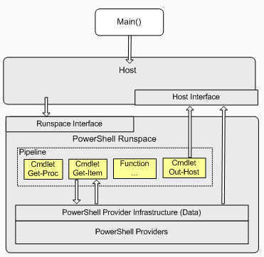
What is a PowerShell Runspace
An abstraction of the Windows PowerShell runtime used to simplify a user session
Holds configuration information
Data about commands and PowerShell providers that the hosting application supports
Startup scripts for the runspace
The Interface between the Host application and the user session
Notes:
Windows PowerShell operates within a hosting application (the default is powershell.exe) that exposes a command line to the user. The hosting application can be a console application. The hosting application uses its Main function to interact with the Windows PowerShell runtime through the internal host interface. Together, these classes allow direct communication between the application and Windows PowerShell commands.
The Windows PowerShell runtime is the execution engine that provides the operating environment for Windows PowerShell. The data retrieved and written by the runtime is in the form of data objects that are compatible with the .NET Framework
Invoked as a runspace, the Windows PowerShell runtime normally processes commands synchronously and delivers the results of processing to the hosting application, which then renders the results for the user. Windows PowerShell also supports the execution scenario in which the hosting application implements its own custom host. In this case, the runspace is kept open and any number of commands can be run. The custom host can retrieve the results of processing either synchronously or asynchronously.

Slide 5
Runspace Use Cases
Running background task without locking the current runspace
Running background task but keeping the option to communicate with it
Remove the penalty of creating additional PowerShell processes with their own overhead
Ability to orchestrate resource consumption in parallel running runspaces

Slide 6
Runspace VS PowerShell Jobs
Runspace
Jobs
Light weight - Less resources consumed
More control on initialization of environment
More work to manage - Monitoring Completion, Disposing
Additional thread in same process
Call dispose method manually
Much overhead - Resource intense
Less control over what is loaded on initialization
Job Manager - Stop, Start, Suspend, Resume
Start a new process host
Cmdlet Remove-Job
Notes:
In essence a runspace has more coding overhead at the advantage of reusing the current thread resources.
A Job has less coding overhead due to native cmdlets but will be created in its own new thread using more overhead and resources.
A third option exists of using workflow which is a separate runspace as you connect to a new session and due to the limited commands available as workflow you often need to create a new PowerShell runspace in the session cause more overhead.

Slide 7
Creating a Simple Runspace
A PowerShell Runspace class creates a new Runspace with all defaults
Using the Type Accelerator [PowerShell]
Checking the state after creation will show: Opened
$Powershell = [PowerShell]::Create()
$PowerShell.AddScript({Start-Sleep -Seconds 5;'Done'})
$PowerShell.Invoke()
$Powershell.Runspace.RunspaceStateInfo
State Reason
----- ------
Opened
Notes:
A PowerShell Runspace class creates a new Runspace with all defaults.
As this is a class that initializes all defaults already, you cannot customize it upon creation and the creation will directly open the runspace.

Slide 8
Cleaning Up Runspace resources
A runspace needs to be cleaned up to free resources
Open file handles
Open Network connections
Open Database connections
Assigned variables
Cleaning a runspace works by calling the method Dispose
Notes:
For a job there is a cmdlet remove-job
Whenever you call a dispose on a disposable item all the resources it used in memory will be marked as available for Garbage collection to reclaim. This will prevent memory leaks and free up not needed memory.
You could compare this with emptying your recycle bin.

Slide 9
Cleaning Up Runspace resources - Example
Starting the runspace
Disposing the runspace
Removing the references to the variable
$Powershell = [PowerShell]::Create()
$PowerShell.AddScript({Start-Sleep -Seconds 5;'Done'})
$PowerShell.Invoke()
$PowerShell.Dispose()
$PowerShell.Dispose()
Notes:
Garbage collection runs at intervals and should not need to be called manually (test purposes only – don’t leave in production code). If really needed can call
[System.GC]::Collect()
To look at memory consumption you can call the
[System.GC]::GetTotalMemory($false) / 1mb
Before GC can collect the memory make sure that if you saved the runspace into a variable that you also remove the variable else the reference to the runspace and its variables are not free, hence they will not be cleaned up properly

Slide 10
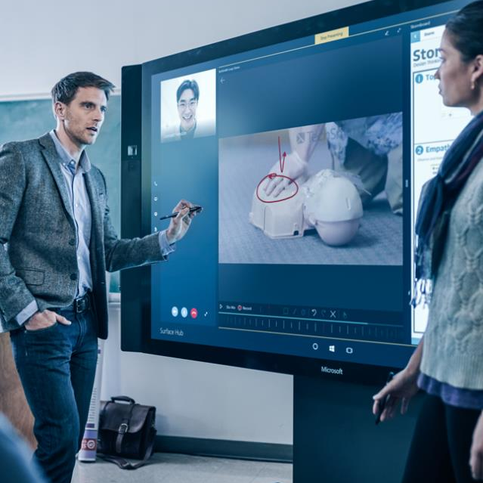
Demonstration
A Simple Runspace
Runspace VS Jobs

Slide 11

Questions?

Slide 12
Runspace commands

Slide 13
Runspace Commands
Name | Logic | Example
Get-Runspace | Shows runspaces in the current host | PS C:\> Get-Runspace Id Name ComputerName -- ---- ------------ 1 Runspace1 localhost
There is only 1 cmdlet for runspaces. Most actions are handled by the methods of the classes used.

Slide 14
PowerShell.exe Default Runspace

Slide 15
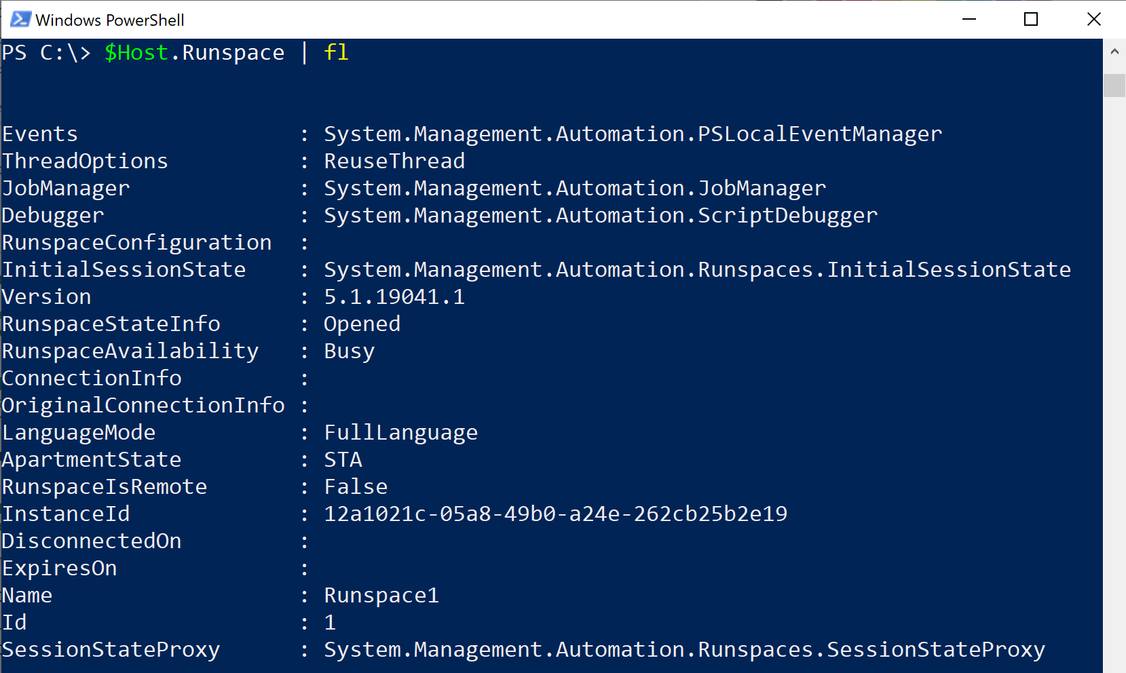
Inspecting the PowerShell.exe Runspace

Slide 16
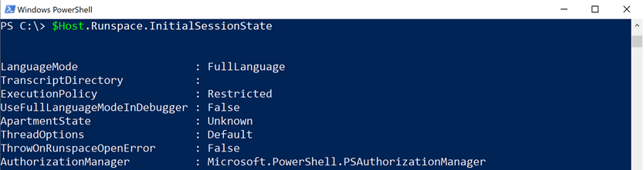
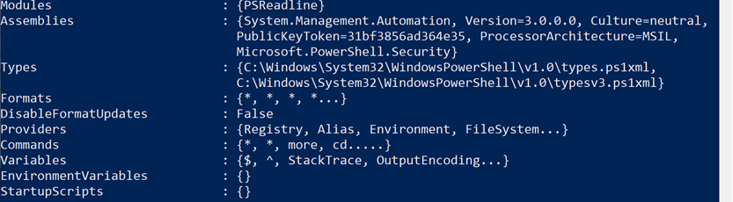
Inspecting the PowerShell.exe Runspace Session State
Loaded PS Providers
Loaded Modules
Loaded Assemblies
Loaded Startup Scripts
Loaded Environment
Variables
Loaded commands and variables
Notes:
Note that all the default commands, variables, Modules etc are loaded in this runspace.

Slide 17
Demonstration
Runspace Session States

Slide 18
Questions?

Slide 19
Creating and Initializing Runspaces

Slide 20
Creating and Initializing Custom Runspaces Flow
Initialize session configuration classes or states
Configure session configuration classes or states
Create a PowerShell runspace using a preconfigured session configuration
Notes:
PowerShell runspaces session configurations are read only objects and can only be configured upon creation of the runspace.

Slide 21
Creating and Initializing Custom Runspaces – Example 2
Directly Configuring an Initialsessionstate
Create a default initialsessionstate using its class
PS C:\> $InitialSessionState = [System.Management.Automation.Runspaces.InitialSessionState]::CreateDefault()
Add a variable to the initialsessionstate object
Use the initialsessionstate upon creation of the runspace
PS C:\> $sessionVariable = [System.Management.Automation.Runspaces.SessionStateVariableEntry]::new("name", "value", $null)
$InitialSessionState.Variables.Add($sessionVariable)
PS C:\> $PowerShell = [powershell]::Create($InitialSessionState)

Slide 22
Creating and Initializing Custom Runspaces – Example 3
Using a PSSessionConfiguration file to initiate from
Create a default initialsessionstate using its class
PS C:\> New-PSSessionConfigurationFile -Full –Path C:\psscconfig.pssc
Edit the PSSC file as you see fit (PSSC files are explained in detail in IT management workshop )
Use the PSSC to create the initialsessionstate
Use the initialsessionstate upon creation of the runspace
PS C:\> $ISS = [System.Management.Automation.Runspaces.InitialSessionState]::CreateFromSessionConfigurationFile("C:\psscconfig.pssc")
PS C:\> $PowerShell = [powershell]::Create($ISS)

Slide 23
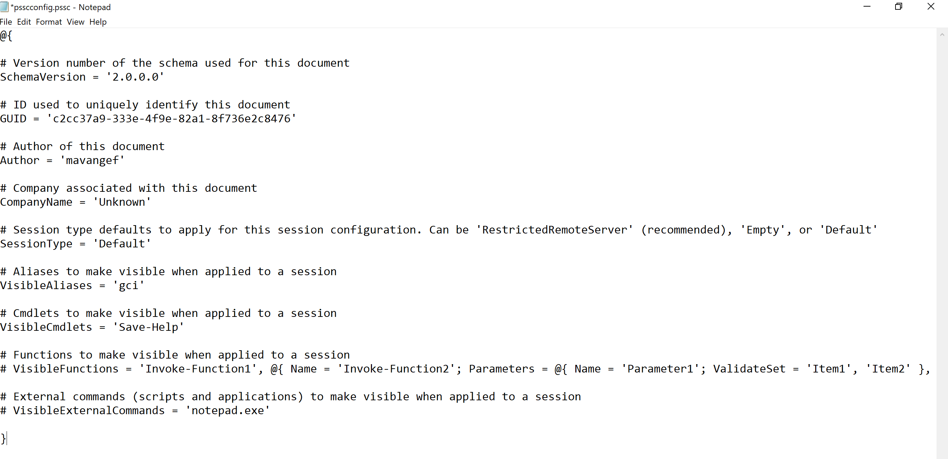
PowerShell Session Configuration Sample File
Notes:
PSSC files can be created with minimal or full options.
Do note that whenever you expose a cmdlet it should be available to the session. For example exposing get-aduser will not work without exposing the AD module as the session would have no idea as to where to load the cmdlet from if it does not have access to the module.

Slide 24
Demonstration
Runspace Session States

Slide 25
Questions?

Slide 26
Invoking Runspace Async and Sync

Slide 27
Synchronous Processing
Only 1 thread gets processed at a time
Runspace
GUI Shell

Slide 28
Synchronous Processing – Example
Create a default runspace
Add a PowerShell script block
Start the script block in Synchronous mode
Shell is frozen during compute but displays results
PS C:\>$Powershell = [PowerShell]::Create()
PS C:\>$PowerShell.AddScript({Start-Sleep -Seconds 5;'Done'})
PS C:\>$PowerShell.Invoke()
Done
Notes:
During the invoke method the shell freeze and does not accept any new input until the runspace is done.

Slide 29
Asynchronous Processing
All runspaces process at the same time
Runspace
GUI Shell

Slide 30
ASynchronous Processing – Example
Create a default runspace and Add Script block
Start the script block in ASynchronous mode
Wait till complete
Retrieve the output from the runspace
PS C:\>$Powershell = [PowerShell]::Create() PS C:\>$PowerShell.AddScript({Start-Sleep -Seconds 5;'Done'})
PS C:\>$Async = $PowerShell.BeginInvoke()
PS C:\>$Async
CompletedSynchronously IsCompleted AsyncState AsyncWaitHandle
---------------------- ----------- ---------- ---------------
False True
PS C:\>$PowerShell.EndInvoke($Async)
Done
Notes:
Saving the return of begininvoke in a variable $Async will make it easy to get the results later on.
During the invoke method the shell will not freeze and will accept new input as the runspace is running in a other thread and the main thread is not waiting for it.
You will need to retrieve the output from the runspace just like a job

Slide 31


Thread Safe Processing
Making sure a Runspace does not interfere with another Runspace
COM objects use ApartmentState: Multi Threaded Apartment / Single Threaded Apartment
Thread Safe
Reading a log file
Write to SQL
NOT Thread Safe
Writing into the same log file
Issue: File locks
Solution: 1 log per RunSpace

Slide 32
Demonstration
Runspace Session States

Slide 33
Questions?

Slide 34
Runspace pools

Slide 35
Types of Runspaces
Runspace
Single Thread
Runspace Factory
Can use Runspace Pools
1 Thread per Runspace in the Pool
Synchronously and Asynchronously processing
Synchronously and Asynchronously processing
Control of Max nr of Pools
Notes:
Whenever you need a single process to run you could create a runspace.
Whenever you need more than 1 simultaneously processing operations a runspace factory would be preferred

Slide 36
Runspace Pools
Work Queue items (PS Script blocks)
Runspace Factory
Notes:
Work Queue items are waiting in queue to be processed by a free Runspace
A runspace becomes available in the pool
The factory assigns a new work item from queue to the Runspace

Slide 37
Creating and Initializing a Runspace Factory With RS Pools
Creating a RunspaceFactory with Runspace Pools (Minimum 1 , Maximum 5)
Open the Runspace when all configuration is done
After opening the Runspace pool you can check availability
Optional: Create a list object to track runspaces
PS C:\> $RunspacePool = [runspacefactory]::CreateRunspacePool(1,5)
PS C:\> $RunspacePool.Open()
PS C:\> $RunspacePool.GetAvailableRunspaces()
PS C:\> [System.Collections.ArrayList]$RunspaceList = @()
Notes:
Before you open a runsapce make sure all initial configuration changes have been done. If you need to create sessionstate or configurations you will need to do that before you create the runspace.
Creating the list object with all runspace info will make it easier for you to track the progress and states of all runspaces.

Slide 38
Assigning Script Blocks to the Runspace factory
foreach($RunspaceInstance in 1..20)
{
#Create a runspace instance and assign it to the pool
$PowerShellInstance = [powershell]::Create()
$PowerShellInstance.RunspacePool = $RunspacePool
#Add the script to the runspace
[void]$PowerShellInstance.AddScript(
{
Get-ChildItem -Path C:\Windows -Recurse
})
#Optional: Add all the data into a results table
$RunspaceList.Add([pscustomobject]@{
RunspaceInstance = $RunspaceInstance
PowerShell = $PowerShellInstance
AsyncResult = $PowerShellInstance.BeginInvoke()
})
}
Notes:
Note that is you do not do the optional results table you will need to call: $PowerShellInstance.BeginInvoke() there to start the async invoke of the Runspace in the pool

Slide 39
Viewing Runspace Progress, Stop Processing
Using the optional list object to view progress
Stopping / aborting all runspaces
PS C:\> $RunspaceList
RunspaceInstance PowerShell AsyncResult
---------------- ---------- -----------
1 System.Management... System.Management....
2 System.Management... System.Management....
PS C:\> $RunspaceList.AsyncResult
CompletedSynchronously IsCompleted AsyncState AsyncWaitHandle
---------------------- ----------- ---------- ---------------
False True System.Threading...
False False System.Threading...
PS C:\> $RunspaceList.PowerShell.Stop()

Slide 40
Demonstration
Runspace Pools
Notes:
function Get-RunspaceState
{
[CmdletBinding()]
param
(
[Parameter(ValueFromPipelineByPropertyName=$true,Mandatory=$true)]
[Alias('PowerShell')]
[PowerShell]$PS,
[Parameter(ValueFromPipelineByPropertyName=$true,Mandatory=$true)]
[Alias('Handle')]
# Should be of type [System.Management.Automation.PowerShellAsyncResult]. value returned from BeginInvoke
[PSObject]$AsyncResult
)
Begin
{
# Set the Binding Flags for Reflection to get Non-Public Fields from PowerShell Instance
$BindingFlags = [System.Reflection.BindingFlags]'static','nonpublic','instance'
}
process
{
# Get Value Runspace Worker Field
$Worker = $PS.GetType().GetField('worker',$BindingFlags).GetValue($PS)
# Get the 'CurrentlyRunningPipline' Property for the runspaces worker
$CurrentlyRunningPipeline = $worker.GetType().GetProperty('CurrentlyRunningPipeline',$BindingFlags).GetValue($Worker)
# Check Com
if($AsyncResult.IsCompleted -and $null -eq $CurrentlyRunningPipeline)
{
$State = 'Completed'
}
elseif (-not $AsyncResult.IsCompleted -and $null -ne $CurrentlyRunningPipeline )
{
$State = 'Running'
}
elseif (-not $AsyncResult.IsCompleted -and $null -eq $CurrentlyRunningPipeline)
{
# The logic here is that pipeline will be cleared when Completed.
# So if it is Not Completed and there nothing in the Pipeline it has not started yet
$State = 'NotStarted'
}
[PSCustomObject]@{
PipelineRunning = [bool]$CurrentlyRunningPipeline
State = $State
IsCompleted = $AsyncResult.IsCompleted
Synchronous = $AsyncResult.CompletedSynchronously
}
}
}

Slide 41
Questions?

Slide 42
Debugging Runspaces

Slide 43


Debugging a Runspace
Local debugging:
Runspace uses the same debugger as scripts
Available in ISE and Shell
Debug-Runspace cmdlet starts debug session with local or remote runspace
Debugger needs to be attached to the runspace
Use Get-Runspace to list runspaces within the current PowerShell hosts
Notes:
Reference: https://docs.microsoft.com/en-us/powershell/module/microsoft.powershell.utility/debug-runspace?view=powershell-6

Slide 44
Debugging a Runspace continued
Remote debugging:
Need administrator access by default for remoting
Debug runspace scripts, in the same way remote session scripts are debugged
Notes:
Reference: https://docs.microsoft.com/en-us/powershell/module/microsoft.powershell.utility/debug-runspace?view=powershell-6

Slide 45
Debugging example
Create a Runspace and name it (easy to attach debugger per name)
Add a script and invoke the runspace async
Attach the debugger to the runspace
Debug
PS C:\> $ps = [powershell]::Create()
PS C:\> $ps.Runspace.name = "debugtest"
PS C:\> $ps.AddScript({do{$2 = 1 + $2 ;Start-Sleep -S 5}while($true)})
PS C:\> $async = $ps.BeginInvoke()
PS C:\> Debug-Runspace -Name "debugtest"
Debugging Runspace: debugtest
To end the debugging session type the 'Detach' command at the debugger prompt, or type 'Ctrl+C' otherwise.
Stopped at: do {$2 = 1 + $2 ; Start-Sleep -Seconds 5}while($true )
[DBG]: [Process:34644]: [debugtest]: PS C:\WINDOWS\system32>> L
1:* do {$2 = 1 + $2 ; Start-Sleep -Seconds 5}while($true )

Slide 46
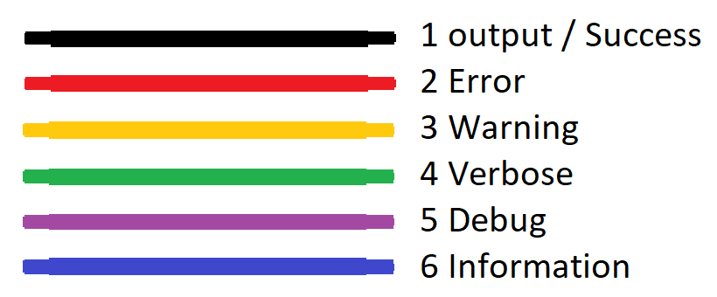
Runspace streams
All streams are available in the runspace
View them via the runspace object
PS C:\> $PowerShell = [PowerShell]::Create()
PS C:\> $powershell.AddScript({1/0})
PS C:\> $PowerShell.Invoke()
PS C:\> $PowerShell.Streams
Error : {Attempted to divide by zero.}
Progress : {}
Verbose : {}
Debug : {}
Warning : {}
Information : {}

Slide 47
Demonstration
Runspace Debugging

Slide 48
Questions?

Slide 49

Runspaces
60 minutes

