Slide 1

Zurich Python User Group
funcparserlib
or how to write your own programming language...
Aaron Richiger
a.richi@bluewin.ch
2. Mai 2013

Slide 2
Goals
What is a parser?
How to use funcparserlib?
What's the visitor pattern useful for?
What is an interpreter?
How to write a parser and an interpreter for your own programming language?

Slide 3
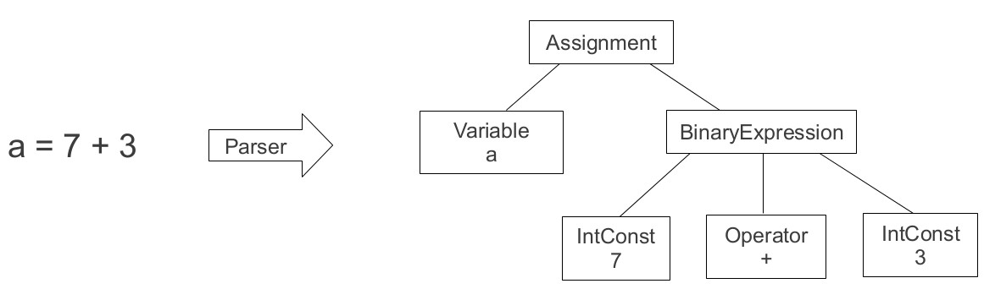
What does a parser do?
Input: Text
Output: AST (Abstract Syntax Tree)

Slide 4
Parsing with python
pyparsing
ANTLR
Many other tools exist
  Good overview: http://nedbatchelder.com/text/python-parsers.html
funcparserlib

Slide 5
funcparserlib
Pure python library, 500 LOC
Author: Andrey Vlasovskikh
Inspired by Haskell
LL(*) parser
Still under development

Slide 6
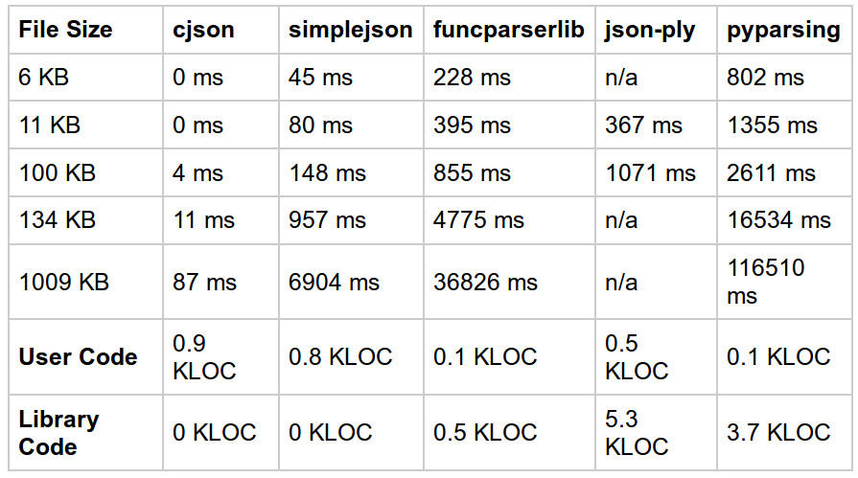
Performance

Slide 7
Fixing funcparserlib
Execute fix.py as admin
What it does
  Replaces line 273 of parser.py:
  Old: return (res, e.state)
  New: return res, State(s.pos, e.state.max)

Slide 8
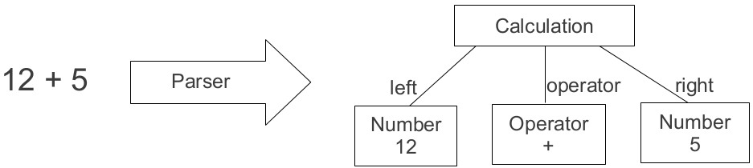
Example 1: Parsing Calculations
Input: Simple additions
Output: AST

Slide 9
Example 1: Parsing Calculations
Parsers you will need:
  + Concatenates two parsers calc = nr + operator + nr
  | One of both has to match digit = one | two | ...
  >> Send match to a function operator = op('+') >> Operator
Files:
  Parser: calc_parser.py to modify
  AST: calc_ast.py read only
  Helpers: funcparserlib_helpers.py read only
  Tests: calc_test.py read only
Your task: Add support for subtractions: ''12 – 5''

Slide 10
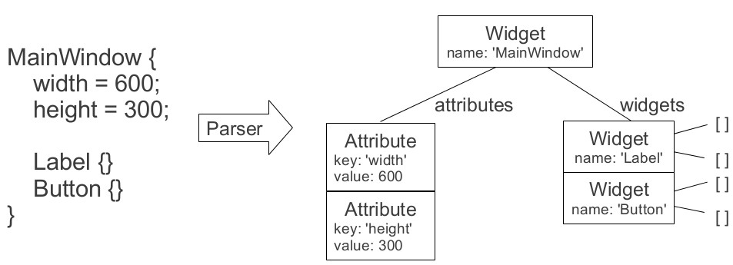
Example 2: pyml Parser
Input: UI modeling language: pyml
Output: AST

Slide 11
Example 2: pyml Parser
Parsers you will need:
  many() Match zero or more times nr = many(digit)
  forward_decl() For recursive parsers
Files:
  Parser: pyml_parser.py to modify
  AST: pyml_ast.py to modify
  Input input.pyml read only
  Helpers: funcparserlib_helpers.py read only
  Tests: pyml_test.py read only
Your task:
  Add support for calculation and list of strings attribute values:
    height = 1 + 2;
    colors = [''red'', ''green''];

Slide 12
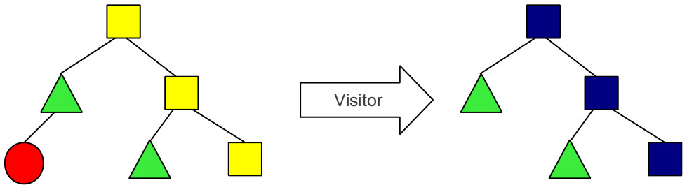
Visitor Pattern
Transformation of trees

Slide 13
Visitor Pattern:
Python Implementation
class BaseVisitor(object):
def visit(self, tree):
if isinstance(tree, Calculation):
self.visit_calculation(tree)
elif isinstance(tree, Number):
self.visit_number(tree)
def visit_calculation(self, calculation):
self.visit(calculation.left)
self.visit(calculation.right)
def visit_number(self, number):
pass
class IncrementVisitor(BaseVisitor):
def visit_number(self, number):
number.value += 1
ast = parser.parse("1 + 2")
incrementor = IncrementVisitor()
incrementor.visit(ast)

Slide 14
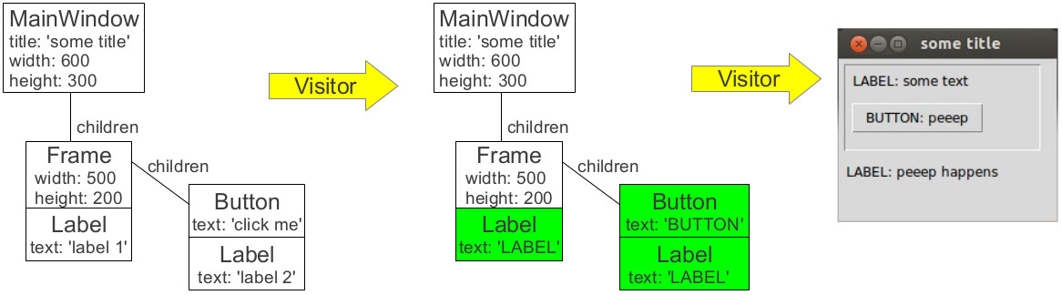
Example 3: pyml Visitor
Input: pyml AST
Output: Modified ASTs

Slide 15
Example 3: pyml Visitor
Files:
  AST: pyml_ast.py read only
  Default visitor: base_visitor.py read only
  Visitor 1: text_change_visitor.py read only
  Visitor 2: politeness_visitor.py to modify
  Visitor 3: enlarge_visitor.py to modify
  Visitor 4: gui_visitor.py read only
  Coordinator: coordinator.py read only
  Tests: visitor_test.py read only
Your task:
  Remove impolite text
  Enlarge the UI

Slide 16
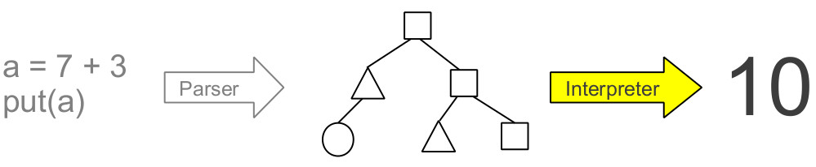
Interpreter
Input: AST of a program
Output: Program ''execution''
Python – Interpreter (parser and interpreter)

Slide 17
Example 4: javali Interpreter
Input: javali code
Output: Output of the javali program
a = 10
while (a < 13) {
a = a + 1
put(a)
b = 0
while (b < 2) {
b = b + 1
put(b)
}
}
put(3 + 5)
11
1
2
12
1
2
13
1
2
8
Javali - Interpreter

Slide 18
Example 4: javali Interpreter
Files:
  Parser: parser.py to modify
  AST: javali_ast.py to modify
  Default visitor: base_visitor.py read only
  Evaluator: evaluator_visitor.py to modify
  Interpreter: interpreter.py read only
  Tests: interpreter_test.py read only
Your task:
  Comparison operators: >, <=, >=, ==, !=
  Negative integers: a = -7
  if-else statement: if (1 <2 ) {...} else {...}

Slide 19
Conclusion
What is a parser?
How to use funcparserlib?
What's the visitor pattern useful for?
What is an interpreter?
How to write a parser and an interpreter for your own programming language?

