Slide 1

Zurich Python User Group
PySide
Creating GUIs with PySide or PyQt
Aaron Richiger
a.richi@bluewin.ch
5. Dezember 2013

Slide 2
Goals
What for is the Qt framework?
What's PySide, PyQt?
Differences between PySide and PyQt?
Tools to work with PySide?
How to create GUIs with PySide?
User interaction: event handling in Qt?
What is MVC?
(Database integration with Qt)?

Slide 3

Qt framework
cross-platform application and UI framework
huge C++ library
Started in 1991 by Trolltech
Bought by Nokia in 2008
Given to Open-Source-Community in 2011
http://qt-project.org/

Slide 4
PySide
Python bindings for Qt4
open source project (LGPL)
label = QLabel("Hello World!")
label.setAlignment(Qt.AlignCenter)
QLabel *label("Hello world!");
label->setAlignment(Qt::AlignCenter);
instead of

Slide 5
PySide vs. PyQt5
LGPL vs. GNU GPL v3
open source vs. closed source
Qt5 support planned vs. Qt5 support
Both APIs are almost the same, conversion is possible with very little effort.

Slide 6
Getting started
Install Qt 4.8 (not Qt 5.xy!):
http://qt-project.org/downloads
Install PySide:
http://qt-project.org/wiki/PySideDownloads
Test installation with 'import PySide'
Text Editor (e.g. Sublime with PySide plugin)
Qt 4 Designer (WYSIWYG editor)

Slide 7
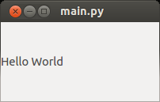
Example 1: Hello World
app = QApplication(sys.argv)
label = QLabel("Hello World")
label.show()
sys.exit(app.exec_())

Slide 8
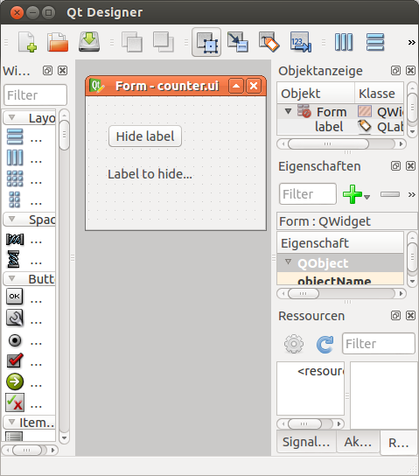
Ex. 2: Three ways to create UIs
Qt 4 Designer
QML
Programmatically
Rectangle {
width: 200
height: 150
}
lb = Qlabel(„Hello world“)
lb.resize(300, 400)

Slide 9
Example 3: Signals / Slots
Predefined signals
Custom signals
button.clicked.connect(self.on_button)
def on_button():
print „Button clicked“
class ClickableLabel(QLabel):
signal_clicked = Signal()
def __init__(self):
...
self.signal_clicked.emit()
lb = ClickableLabel()
lb.signal_clicked.connect(lb.hide)

Slide 10
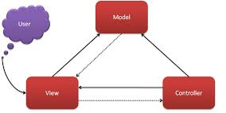
Ex. 4: MVC: Model – View - Controller
General design pattern
Qt was written with MVC in mind
Model: Models for (real) objects, e.g. Person
View: Define the look of the views
Controller: Manages interaction between Model & View

Slide 11
Example 5: QSql
For applications with a database
Qt has drivers for many relational databases
Special table views
Resolves foreign key references
Makes working with databases much simpler

Slide 12
Conclusion
What for is the Qt framework?
What's PySide, PyQt?
Differences between PySide and PyQt?
Tools to work with PySide?
How to create GUIs with PySide?
User interaction: event handling in Qt?
What is MVC?
(Database integration with Qt)?

