Slide 1
AI Agents
From chatbot thinking to multi-agent workflows
Chatbot
A practical workshop on how agents help technical
and non-technical teams turn ideas into real outputs.
Assistant
Developers
Managers
Multi-agent
Context-aware
RAG
Cost-aware
Agent
Multi-agent
For developers, managers, and technical & non-technical participants

Slide 2
OPENING
02
Sponsors & community support
Recognising the organisations behind this workshop
Main sponsor
Optum / UHC Tech
Supporting the workshop and enabling practical AI learning for teams.
Community representation
Global AI Community Letterkenny
Connecting local participants to a wider AI learning community.
Why this matters
This workshop combines enterprise perspective + community learning to show how agentic workflows can be applied in real work.
AI Agents Workshop

Slide 3

OPENING
03
About the speaker
Workshop links
https://github.com/raasalgul/workshop_agentic_sde_workflow
https://github.com/raasalgul/workshop_agentic_manager_workflow
http://globalai.community/eventbadge/116359
Sathish Kumar Krisnamoorthy
Senior Software Engineer
Optum Letterkenny
Focus areas: Software Engineering, Cloud, Data Engineering, and AI LLM technology.
Software Engineer
Cloud & Automation
Data Engineer
AI Agents Workshop

Slide 4
INTRO
04
Workshop objective
Show how multi-agent workflows help both technical and non-technical participants
For developers
Use agents to clarify requirements, build software, organise work, and accelerate delivery.
For managers
Use agents to turn meeting transcripts and unstructured input into structured actions and documents.
What participants will see
Two live-style examples:
• Business / manager workflow
• Software product workflow
AI Agents Workshop

Slide 5
INTRO
05
Workshop flow
One agenda. One clear story.
1
2
3
4
5
6
7
Opening
Why agents
How agents work
Context
Manager demo
Software demo
Tools & takeaways
Story of the workshop
How AI evolved → how agents work → what they need → how to control cost → two practical workflow demos.
AI Agents Workshop

Slide 6
FOUNDATIONS
06
From chatbot to multi-agent workflows
A quick view of how AI usage has evolved
Chatbot
Assistant
RAG
Agent
Multi-agent
Ask → answer
Helps with tasks
Uses external knowledge
Plans + uses tools
Specialists collaborate
Key idea
The workshop focus is the last step: multiple agents working together to deliver real outcomes.
AI Agents Workshop

Slide 7
AGENTS
07
What is an AI agent?
An agent works toward a goal instead of only answering a prompt
Goal
Reason
Use tools
Observe
Deliver
Assistant mindset
“Here is an answer.”
Agent mindset
“I used instructions, tools, and context to produce the output.”
AI Agents Workshop

Slide 8
AGENTS
09
Agent building blocks
The core pieces behind a useful agent system
Instructions
How should I behave?
Skills
What procedure can I follow?
Knowledge
What project or domain info do I know?
Tools
What systems can I access?
Model
What intelligence powers me?
Guardrails
What must I avoid or escalate?
AI Agents Workshop

Slide 9
AGENTS
10
Instruction hierarchy
Not all instructions have the same priority or scope
1. System instructions
2. Custom instructions
Higher
priority
↓
3. Custom agent rules (AGENTS.md)
4. Skills / procedures
5. Knowledge / RAG
6. Tools
7. User request
Runtime assembly
The model sees only the relevant instructions, files, retrieved context, tool results, and the current request.
AI Agents Workshop

Slide 10
AGENTS
08
Why multi-agent workflows?
Break larger work into specialist roles with clear handoffs
Specialists
Each agent focuses on a specific job, such as planning, coding, summarising, or reviewing.
Better handoffs
Outputs become structured inputs for the next step in the workflow.
Clearer control
You can tune prompts, tools, and cost by role instead of using one giant agent.
Workshop examples
Manager flow: transcript → business outputs | Software flow: specification → working product
AI Agents Workshop

Slide 11
CUSTOMISATION
12
Instruction files & reusable skills
These make an agent more consistent and repeatable
AGENTS.md
- Role
- Project rules
- Output format
- Guardrails
SKILL.md
- Reusable procedure
- Step-by-step method
- Expected output
Use in this workshop
We will show how instruction files and skills shape the Engineering Manager Agent and Software Engineer Agent.
AI Agents Workshop

Slide 12
CONTEXT
13
Only the current context is visible
Good outputs depend on sending the right information at the right time
Loaded now
Current user request
Relevant instructions
Selected files
Retrieved knowledge
Tool results
LLM
sees only
what is loaded
Not automatically loaded
All company docs
The whole internet
Every past message
All skills
Everything the user knows
AI Agents Workshop

Slide 13
CONTEXT
11
What the model actually sees
The model only sees the package assembled for the current request
System
instructions
Custom
Instructions
Selected
skill
Retrieved
docs
Tool
results
User
request
Orchestrator / runtime packaging
LLM
Assistant / agent response
AI Agents Workshop

Slide 14
AGENTS
16
Types of agents you can build
Examples across technical and business workflows
Developer agents
Architect
Software Engineer
QA / Test
DevOps
Security Review
Business agents
Meeting Assistant
Project Manager
Product / Intake
Priority / Routing
Support
Multimodal & domain agents
Document / PDF
Image / screenshot
Audio / transcript
Compliance / cost
Healthcare / operations
Demo focus
Engineering Manager Agent + Software Engineer Agent will be highlighted in the software workflow demo.
AI Agents Workshop

Slide 15
DEMO 1
17
From transcript to business outputs
A multi-agent workflow for managers and non-technical users
Input
Meeting transcript or discussion notes
Transcript
Orchestrator
Specialist agents
Business outputs
Outputs
Summary • Decisions • Action items • Intake document • Priority list • Follow-up agenda
AI Agents Workshop

Slide 16
DEMO 1
18
Manager workflow orchestration
How multiple agents collaborate inside the business demo
Transcript
Purpose
Turn unstructured discussion into structured follow-up work.
Orchestrator
Intake agent
Priority agent
Comms agent
Agenda agent
Summary
Priority list
Action Plan
Next agenda
AI Agents Workshop

Slide 17
DEMO 2
19
Application we will build
Ireland dataset → database → dashboards
Ireland dataset
Database
Static dashboard
Dynamic dashboard
Dataset input
Use an Ireland dataset as the starting point.
Build target
Load the data, structure it, and expose it through dashboards.
What this demonstrates
How agents help move from a requirement to a working software outcome.
AI Agents Workshop

Slide 18
DEMO 2
20
Turning specification into a working software product
The software workflow highlighted in this workshop
Specification
Engineering Manager Agent
Software Engineer Agent
Working product
Engineering Manager Agent
Clarifies the request
Frames the work
Breaks down tasks
Software Engineer Agent
Implements the solution
Builds DB + dashboards
Produces working outputs
Expected outcome
A more structured path from idea to product delivery.
AI Agents Workshop

Slide 19
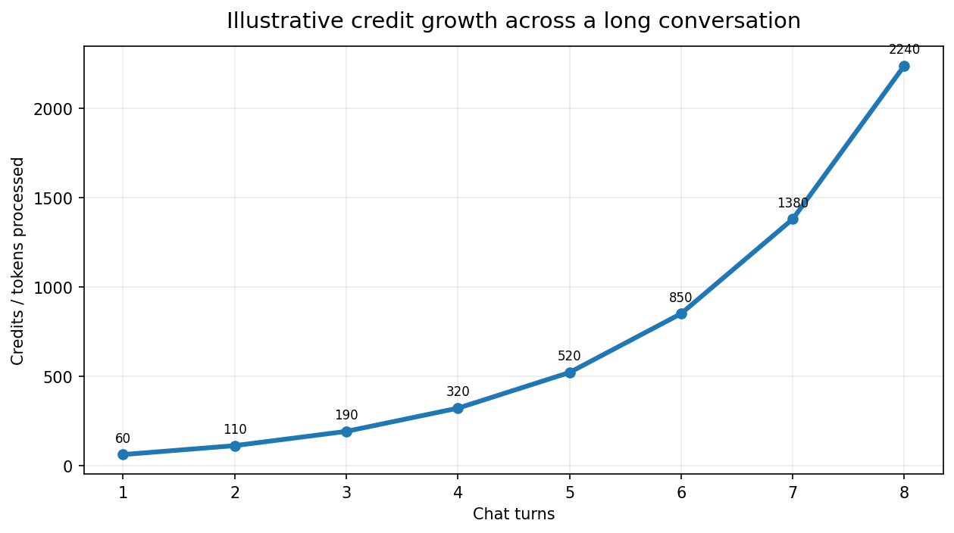
COST
14
Why credits can grow fast
Longer conversations can resend more context on every turn
What causes the jump?
• Each turn may resend instructions, history, and tool results.
• Retries and loops increase the total credits processed.
• Large context can grow cost faster than expected.
Takeaway
Keep conversations and context clean when possible.
AI Agents Workshop

Slide 20
COST
15
Cost control patterns
Simple ways to keep agentic workflows efficient
Right model
Smaller context
Fewer retries
Clear instructions
Stop bad loops early
Use cheaper sub-agents
Golden rule
Use the smallest sufficient model with the smallest sufficient context.
AI Agents Workshop

Slide 21
REFERENCES
21
Open-source tools & repositories
Useful examples to explore after the workshop
Spec Kit
An example of structured agentic workflow setup.
https://github.com/github/spec-kit
GSD
A reference point for agent-based workflow setup.
https://github.com/gsd-build/get-shit-done
Awesome Copilot
A collection of agent, prompt, and workflow ideas.
https://github.com/github/awesome-copilot
Skills
Examples of various skills patterns.
https://www.skills.sh
Use these as references, not prerequisites
We will point participants to these resources so they know what is available without trying to cover everything in one workshop.
AI Agents Workshop

Slide 22
TAKEAWAYS
22
Key takeaways
What participants should leave with
Workflow first — Design the process, not just the prompt.
Specialists help — Multiple agents can divide and clarify work.
Instructions matter — Files and skills make outputs more consistent.
Context drives quality — Send the right information at the right time.
Cost needs control — Model choice, context size, and retries all matter.
AI Agents Workshop

Slide 23
CLOSING
23
Thank you
Acknowledgements
Special thanks
David McVeigh
Optum / UHC tech leadership
Pauline Coll
Security team
With appreciation
Health & Safety team
Food & real estate
Volunteers: Zia, Srini & Soundar
And thank you
Attendees
For joining, engaging, and helping make the workshop valuable.
AI Agents Workshop

