Slide 1
GPS Camera — Ads Architecture & AdMob Integration
Complete Technical Specification: Google AdMob, Custom In-House Campaigns, Database Schema, Mobile APIs & Administrative Controls
Technology Stack: Laravel 11 Backend (API & Admin) • Flutter Mobile Client • Google AdMob SDK
Publisher Setup
Global IDs & UMP Consent
Dual Ad Engine
AdMob + In-House Campaigns
REST API Contract
Dynamic Screen Placements
Policy & Safety
Anti-Ban & Test Device Mode

Slide 2
SYSTEM ARCHITECTURE
Dual Engine Architecture: Google AdMob vs. Custom Campaigns
How the hybrid ad delivery pipeline operates between Laravel Admin and the Mobile App
1. Google AdMob Network Engine
Ad Source: Google Mobile Ads Network (Global programmatic advertisers)
Creatives: Dynamically supplied by Google via Google Mobile Ads SDK
Laravel's Role: Stores Ad Unit IDs (Banner, Native, Interstitial), remote on/off switches, frequency caps, and targeting rules
Flutter's Role: Instantiates Google SDK AdWidget/BannerAd with remote IDs
Monetization: Generates real cash revenue (eCPM / impressions / clicks)
Best Used For: Free-tier users, gallery feeds, app exit/save interstitials
2. Custom In-House Campaigns Engine
Ad Source: Your Own Database & Laravel Asset Storage
Creatives: Uploaded custom graphics (1200x628), custom headlines & CTA buttons
Laravel's Role: Hosts media files, tracks click conversions, handles deep link routing (`app://subscription/upgrade`)
Flutter's Role: Renders a native custom Flutter Card widget styled to match the app
Monetization: Drives in-app subscriptions, GPS feature upsells, and partner deals
Testing Policy: 100% Safe to click — zero risk of Google Invalid Traffic bans

Slide 3
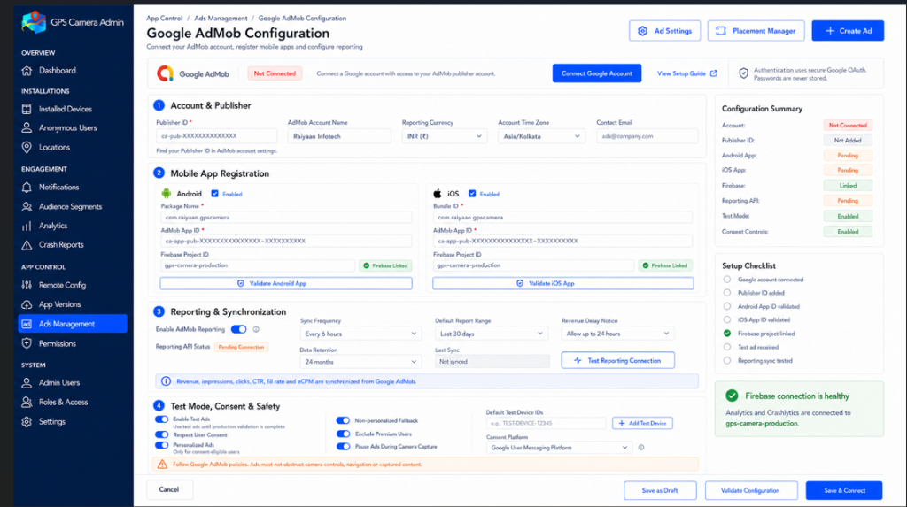
SETUP & INTEGRATION
AdMob Account & App-Level Configuration (Ad Settings)
Establishing publisher credentials, mobile app IDs, and automated reporting synchronization
Configuration Components
1. Account & Publisher
Publisher ID (ca-pub-XXXXXXXX), currency (INR/USD), and time zone for accurate revenue reporting.
2. App Registration
Android Package Name (com.raiyaan.gpscamera) and iOS Bundle ID paired with Google AdMob App IDs.
3. Firebase Linkage
Binds Firebase Analytics & Crashlytics to monitor ad-induced crashes and engagement drop-offs.
4. Automated Reporting
Syncs revenue, eCPM, fill rates and impressions every 6 hours via Google AdMob Reporting API.
5. Consent & Safety
Enforces Google UMP (GDPR) consent, pauses ads during camera capture, and auto-excludes paid users.

Slide 4
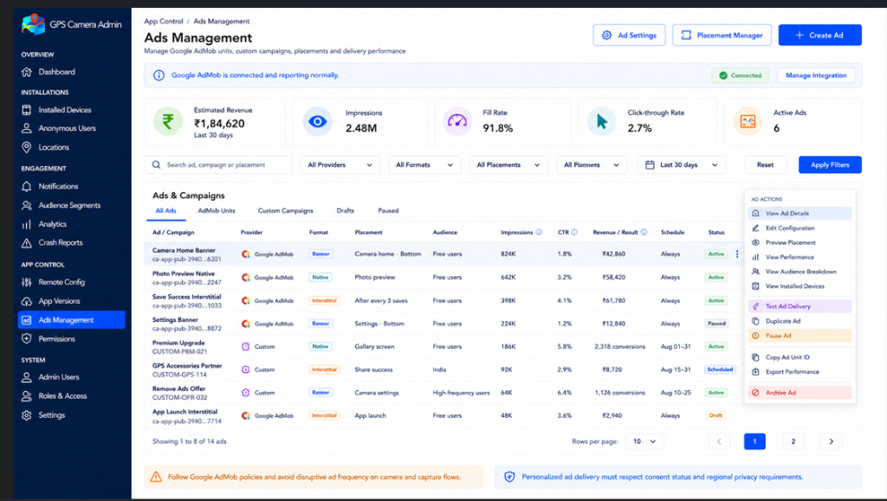
OPERATIONS & CONTROL
Ads Management Dashboard & Performance Analytics
Unified control room for monitoring live ad units, performance metrics, and deployment status
Dashboard Capabilities
Key KPI Metrics
Estimated Revenue, Impressions (2.48M), Fill Rate (91.8%), CTR (2.7%), and Active Ad counts at a glance.
Unified Hybrid List
Displays Google AdMob units and Custom In-House campaigns side-by-side with individual status tags.
One-Click Actions
Instantly pause underperforming ads, duplicate campaigns, or copy Ad Unit IDs for testing.
Remote Emergency Kill Switch
Disable any ad format or placement across all installed mobile apps in seconds without app store review.
Policy Warning Guardrail
Built-in alerts reminding admins to follow Google policies regarding camera capture disruptions.

Slide 5
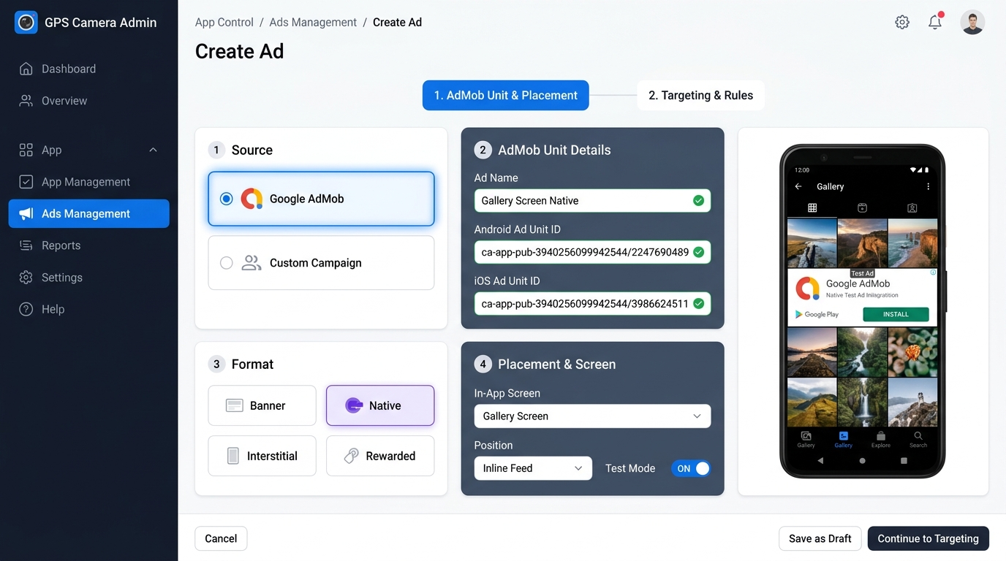
AD CREATION WORKFLOW
Creating an Ad: Google AdMob Source
Why AdMob ad units require only a fast 2-step setup instead of creative uploads
AdMob Creation Fields
1. Streamlined 2 Steps
No creative upload needed! Step 1 handles Unit IDs & Placement; Step 2 configures Targeting & Frequency.
2. Dual Platform IDs
Separate input fields for Android (ca-app-pub-.../...2247) and iOS (ca-app-pub-.../...3986) AdMob units.
3. Standard Formats
Select Banner (docked), Native (inline styled), Interstitial (full screen), or Rewarded (incentivized).
4. Screen & Placement Binding
Assigns the ad unit to an agreed app screen ('Gallery Screen') and slot position ('Inline Feed').
5. Instant Test Mode Switch
Individual test mode toggle safely overrides unit ID with Google's official test ad unit during staging.

Slide 6
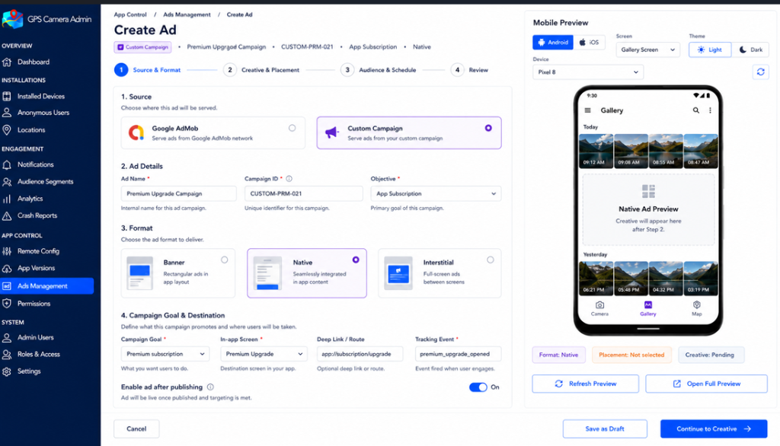
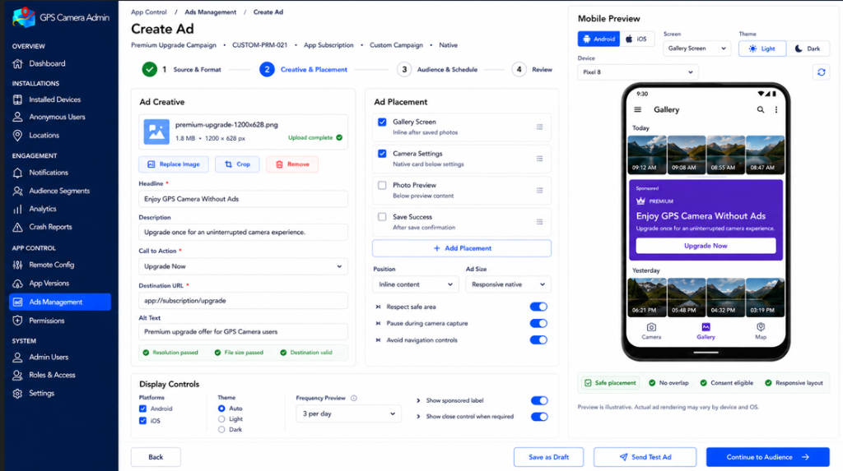
IN-HOUSE ADS ENGINE
Custom Campaigns: Source, Creative & In-App Placement
Steps 1 & 2 of the 4-step wizard for promoting in-app upgrades and features
Step 1: Source & Campaign Objective
• Set internal Campaign ID (e.g., CUSTOM-PRM-021) and Objective (App Subscription).
• Choose format (Native Card vs Banner vs Interstitial).
• Specify Destination In-App Screen, Deep Link (`app://subscription/upgrade`), and Analytics Tracking Event.
Step 2: Creative Assets & Placement Rules
• Upload 1200x628 creative image, define Headline ('Enjoy GPS Camera Without Ads').
• Write description and Call to Action ('Upgrade Now').
• Multi-select app placement screens (Gallery Screen, Camera Settings, Photo Preview) with real-time phone preview.

Slide 7
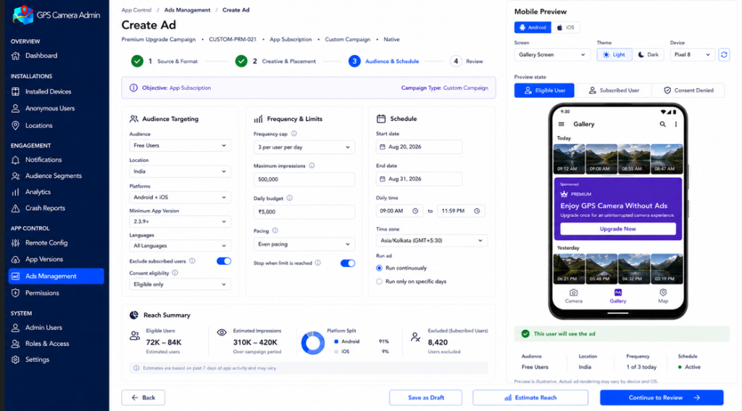
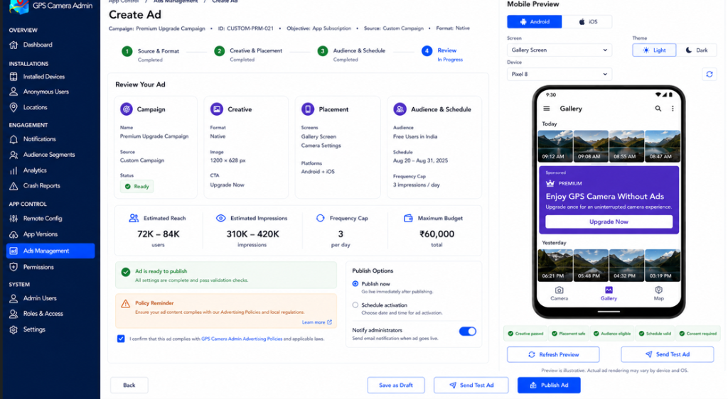
IN-HOUSE ADS ENGINE
Custom Campaigns: Audience Targeting, Schedule & Review
Steps 3 & 4 of the 4-step wizard for precision targeting and pre-publish validation
Step 3: Audience & Delivery Scheduling
• Audience Targeting: Target Free Users, filter by Country (India, US, Global).
• Pacing & Caps: Max impressions (500k), frequency cap (3 per user per day).
• Scheduling: Date range (Aug 20 - Aug 31), daily operating hours (9:00 AM - 11:59 PM), and reach estimation calculation.
Step 4: Comprehensive Review & Publishing
• Automated Validation: Creative pass, placement safe check, audience eligible check, schedule valid.
• Instant Test Ad: Send test push payload to registered developer device before publishing.
• Publish Options: Immediate activation or scheduled activation with admin email notification.

Slide 8
SYSTEM INTEGRATION
Placement Architecture: Backend vs. Flutter Responsibilities
Clarifying the division of responsibility between the Flutter developer and the Laravel Admin Panel
Flutter Developer Role
(App UI Container)
Builds UI Slot Widgets
Implements layout containers in code where ads can physically render (e.g. Gallery grid item).
Defines Placement Keys
Agrees on strict unique screen keys: `gallery_screen`, `camera_home`, `save_success`.
Handles Loading States
Displays shimmer placeholders and gracefully hides container if API returns `show_ad: false`.
Executes SDK Commands
Loads AdMob `BannerAd` or renders Custom Native Card with deep-linking.
Event Telemetry
Dispatches impression and click events back to Laravel.
Predefined Placement Keys
(The Shared Contract)
`gallery_screen`
Position: `inline_feed`
Format: Native Card
Trigger: Scroll past row 2 in photo gallery.
`camera_home`
Position: `bottom_banner`
Format: Banner (320x50 / Adaptive)
Trigger: Docked below controls (paused while shooting).
`save_success`
Position: `interstitial_trigger`
Format: Interstitial
Trigger: After user taps 'Save' (frequency capped).
`unlock_feature`
Position: `modal_dialog`
Format: Rewarded Video
Trigger: User requests free trial of premium filter.
Laravel Admin Panel Role
(Remote Decision Engine)
Remote Master Switch
Toggle ads on or off on any screen instantly without releasing a new app store version.
Ad Source Selector
Dynamically swap any slot between Google AdMob and Custom In-House promos.
Unit ID Management
Swap live AdMob IDs or switch specific devices to Test Unit IDs safely.
Targeting Rules
Filter by user subscription tier (free vs paid), country code, and minimum app version.
Frequency Control
Cap interstitial frequency to avoid user churn.

Slide 9
DATA MODELING
Database Schema & Table Architecture
Core database tables supporting global AdMob settings, ad units, placements, and metrics
Table 1: `admob_configurations` (Single Global Row)
• `publisher_id` (VARCHAR: `ca-pub-XXXXXXXXXXXX`)
• `android_app_id` / `ios_app_id` (VARCHAR: `ca-app-pub-XXXX~YYYY`)
• `firebase_project_id` (VARCHAR: `gps-camera-production`)
• `reporting_api_token` (TEXT encrypted)
• `test_mode_enabled` (BOOLEAN: default true)
• `exclude_premium_users` (BOOLEAN: default true)
• `pause_during_camera` (BOOLEAN: default true)
Table 2: `ads` (Hybrid Ad Inventory)
• `source` (ENUM: 'admob', 'custom')
• `name` (VARCHAR: 'Gallery Screen Native')
• `campaign_id` (VARCHAR unique: 'CUSTOM-PRM-021')
• `format` (ENUM: 'banner', 'native', 'interstitial', 'rewarded')
• `admob_android_unit_id` / `admob_ios_unit_id` (VARCHAR nullable)
• `image_url` / `headline` / `cta_text` / `destination_url` (TEXT nullable)
• `status` (ENUM: 'active', 'paused', 'scheduled', 'draft')
Table 3: `ad_placements` (Screen Bindings & Rules)
• `ad_id` (BIGINT UNSIGNED foreign key -> ads.id)
• `screen_key` (VARCHAR index: 'gallery_screen', 'camera_home')
• `position` (VARCHAR: 'inline_feed', 'bottom_banner')
• `audience_target` (VARCHAR: 'free_users', 'all')
• `frequency_cap` (INT: max impressions per user/day)
• `starts_at` / `ends_at` (TIMESTAMP nullable)
• `is_active` (BOOLEAN: remote on/off toggle)
Table 4: `ad_metrics` (Aggregated Telemetry)
• `ad_id` (BIGINT UNSIGNED foreign key -> ads.id)
• `date` (DATE index)
• `impressions_count` (BIGINT UNSIGNED default 0)
• `clicks_count` (BIGINT UNSIGNED default 0)
• `conversions_count` (BIGINT UNSIGNED default 0)
• `estimated_revenue` (DECIMAL(10,2) default 0.00)
• `source_synced` (ENUM: 'admob_api', 'internal_telemetry')

Slide 10
API SPECIFICATIONS
Mobile REST APIs: Laravel & Flutter Endpoints
Complete JSON payload contracts for dynamic placement delivery and ad tracking
Endpoint 1: Fetch Placement Config
GET /api/v1/ads/placement/{screen_key}
Headers: Authorization: Bearer <token>, X-Platform: android
// Response (AdMob Source):
{
"show_ad": true,
"source": "admob",
"format": "native",
"ad_unit_id": "ca-app-pub-394025.../2247690489",
"is_test_mode": false,
"rules": {
"pause_during_capture": true,
"frequency_cap": 3
}
}
// Response (Custom In-House Source):
{
"show_ad": true,
"source": "custom",
"format": "native",
"creative": {
"headline": "Enjoy GPS Camera Without Ads",
"description": "Upgrade once for ad-free camera.",
"image_url": "https://api.geocam.com/ads/prm.png",
"cta_text": "Upgrade Now",
"deep_link": "app://subscription/upgrade"
}
}
Endpoint 2 & 3: Telemetry & Rewarded SSV
POST /api/v1/ads/{id}/impression & click
Tracks delivery metrics for custom campaigns.
// AdMob Rewarded Video SSV Callback:
GET /api/v1/admob/reward-callback
?ad_network=545021321
&ad_unit=ca-app-pub-...
&reward_amount=1
&reward_item=gps_filter_trial
&user_id=usr_892019
&signature=MEQCID6Kx...
Security Note on SSV:
When a user finishes watching a Rewarded Ad, Google's servers make an HTTP GET callback to Laravel.
Laravel cryptographically verifies Google's ECDSA public key signature before crediting rewards to the user's database record. This prevents client-side hack attempts completely.

Slide 11
COMPLIANCE & PROTECTION
AdMob Safety, Test Devices & Anti-Ban Policies
Strict Google guidelines to prevent Invalid Traffic (IVT) penalties and account suspension
Official Google Test Unit IDs
Banner (Android):
ca-app-pub-3940256099942544/6300978111
Banner (iOS):
ca-app-pub-3940256099942544/2934735716
Interstitial (Android):
ca-app-pub-3940256099942544/1033173712
Interstitial (iOS):
ca-app-pub-3940256099942544/4411468910
Rewarded (Android):
ca-app-pub-3940256099942544/5224354917
Rewarded (iOS):
ca-app-pub-3940256099942544/1712485313
Native Advanced (Android):
ca-app-pub-3940256099942544/2247690489
Native Advanced (iOS):
ca-app-pub-3940256099942544/3986624511
Critical Policy Rules (Must Follow!)
NEVER Click Your Own Live Ads
Clicking real ads from company WiFi or team phones triggers Google's Invalid Traffic (IVT) system, causing account suspension and forfeit of all earnings.
Register Test Devices
Add team phones' Advertising IDs in AdMob Console and in Flutter's `RequestConfiguration(testDeviceIds: [...])`.
No Disruption on Camera Flows
AdMob policy forbids intrusive popups that block camera viewfinders or shutter buttons while capturing pictures.
Transparent 'Ad' / 'Sponsored' Badges
All Native Ad layouts in Flutter must display an obvious 'Ad' or 'Sponsored' badge to avoid misleading accidental clicks.
Enforce UMP Consent (GDPR/ePrivacy)
Show Google User Messaging Platform consent form in the EU prior to requesting personalized ad bids.

Slide 12
EXECUTION PLAN
Step-by-Step Implementation Roadmap
Structured sequence to roll out the Ads Management architecture in Laravel & Flutter
STEP 01
Phase 1: Laravel Backend
Create migrations (`admob_configurations`, `ads`, `ad_placements`), seed default screens, and implement repository models.
STEP 02
Phase 2: Admin Panel UI
Build Ads Management views: Dashboard table, Ad Settings modal, and the 2-step / 4-step ad creation wizard.
STEP 03
Phase 3: Mobile REST APIs
Expose `/api/v1/ads/placement/{screen}` with test-mode detection, frequency capping, and telemetry webhooks.
STEP 04
Phase 4: Flutter Integration
Install `google_mobile_ads` package, register test device IDs, and wrap screens in dynamic AdSlot widgets.

