Slide 1
Offboarding Team SPOC’s and SLA’s

Slide 2

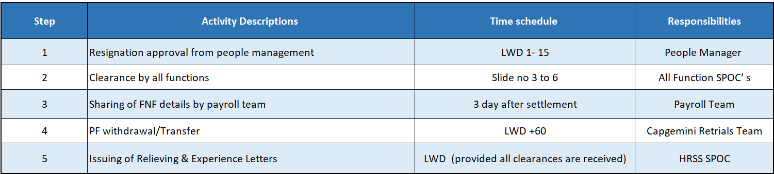
Check List
Offboarding Formalities

Slide 3
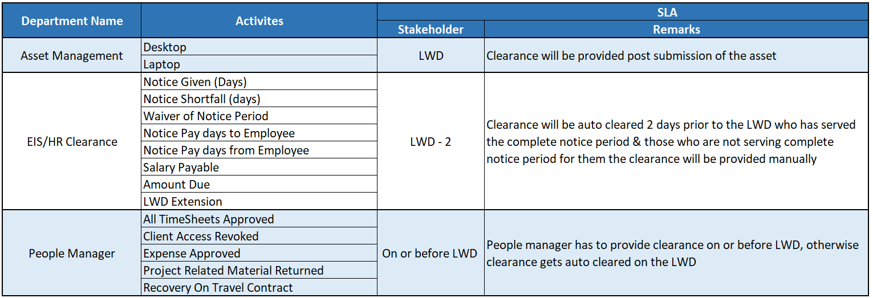
Offboarding Department Wise Clearance
Service Level Agreement (SLA)

Slide 4
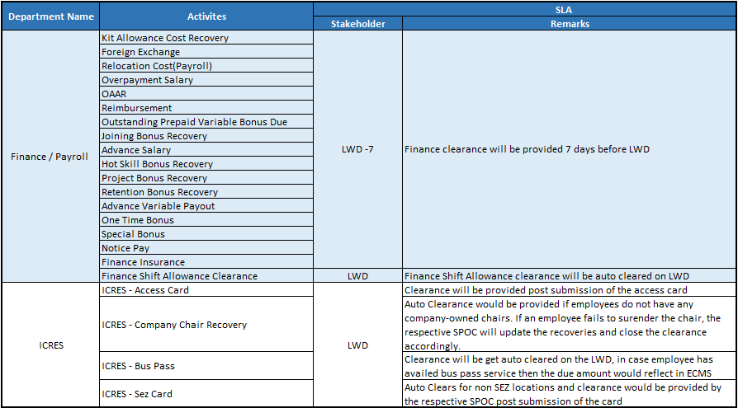
Offboarding Department Wise Clearance
Service Level Agreement (SLA)

Slide 5
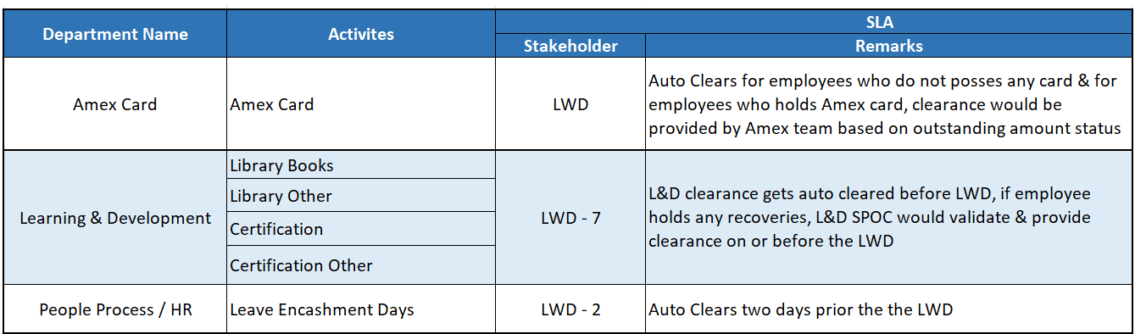
Offboarding Department Wise Clearance
Service Level Agreement (SLA)

Slide 6
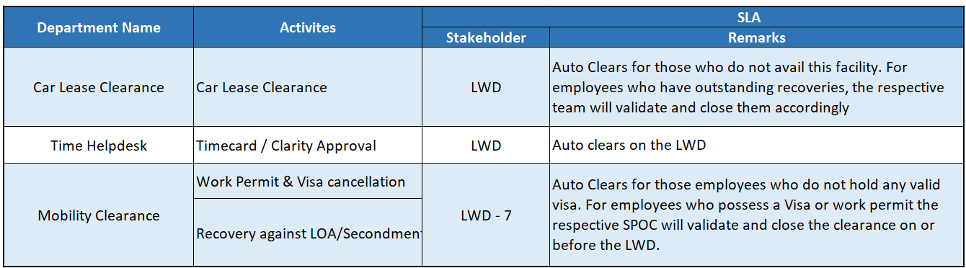
Offboarding Department Wise Clearance
Service Level Agreement (SLA)

Slide 7
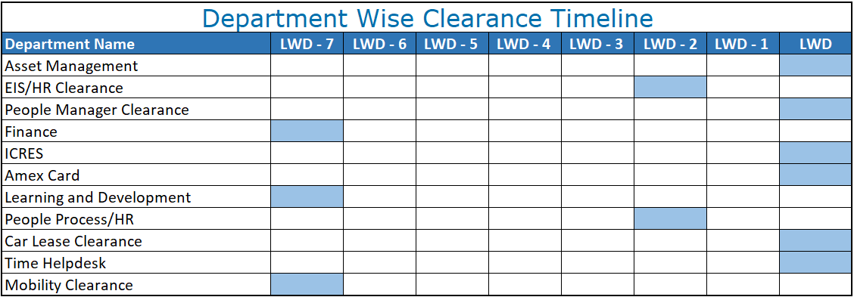
Department Wise Clearance Timeline

Slide 8
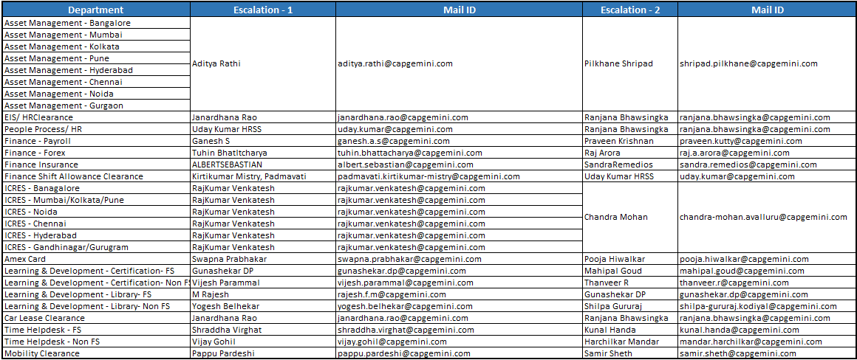
Escalation Matrix

