Slide 1
FA-REWORK POWER APPS SOLUTION - POC
POWER APPS SOLUTION APPROACH
February 29th 2024

Slide 2



AGENDA
01
Summary
02
Solution Design
03
Difference between both approach
04
Risk
05
Future D365 integration
Presentation Title | Author | Date
Company Confidential © Capgemini 2023. All rights reserved |
2

Slide 3
Summary – Benefits of Both approach
 | Approach-1 | Approach-2 | Reference
Benefits / dis-benefits | Reusable Solution for similar project (lesser development cost) Scalable Solution for D365 | Apollo development need to be re-developed for similar solution Scalable Solution for D365 | Slide 10
Costs (excluding software License Cost & AX Stored Procedure) | Power Platform Development – € 20,053 (36.5 MD) | Power Platform Development - € 19,328 (31.5 MD) + Apollo - €4,321.09 (14.57 MD)
Cost ( Support + Maintenance) | Less Cost due to 2 teams | More costly Due to 3 teams | Slide 09
Risks | Equal Risk | Equal Risk | Slide 08
Stakeholder impact | No-Impact , Less cost | No-Impact, More costly
Recommendation | Less Costly in Long term Effective use of PP License Faster development/re-development (one Team) | Reduced Testing effort ( tested approach) Costly re-development for new project (not re-usable)

Slide 4
Detail slides

Slide 5
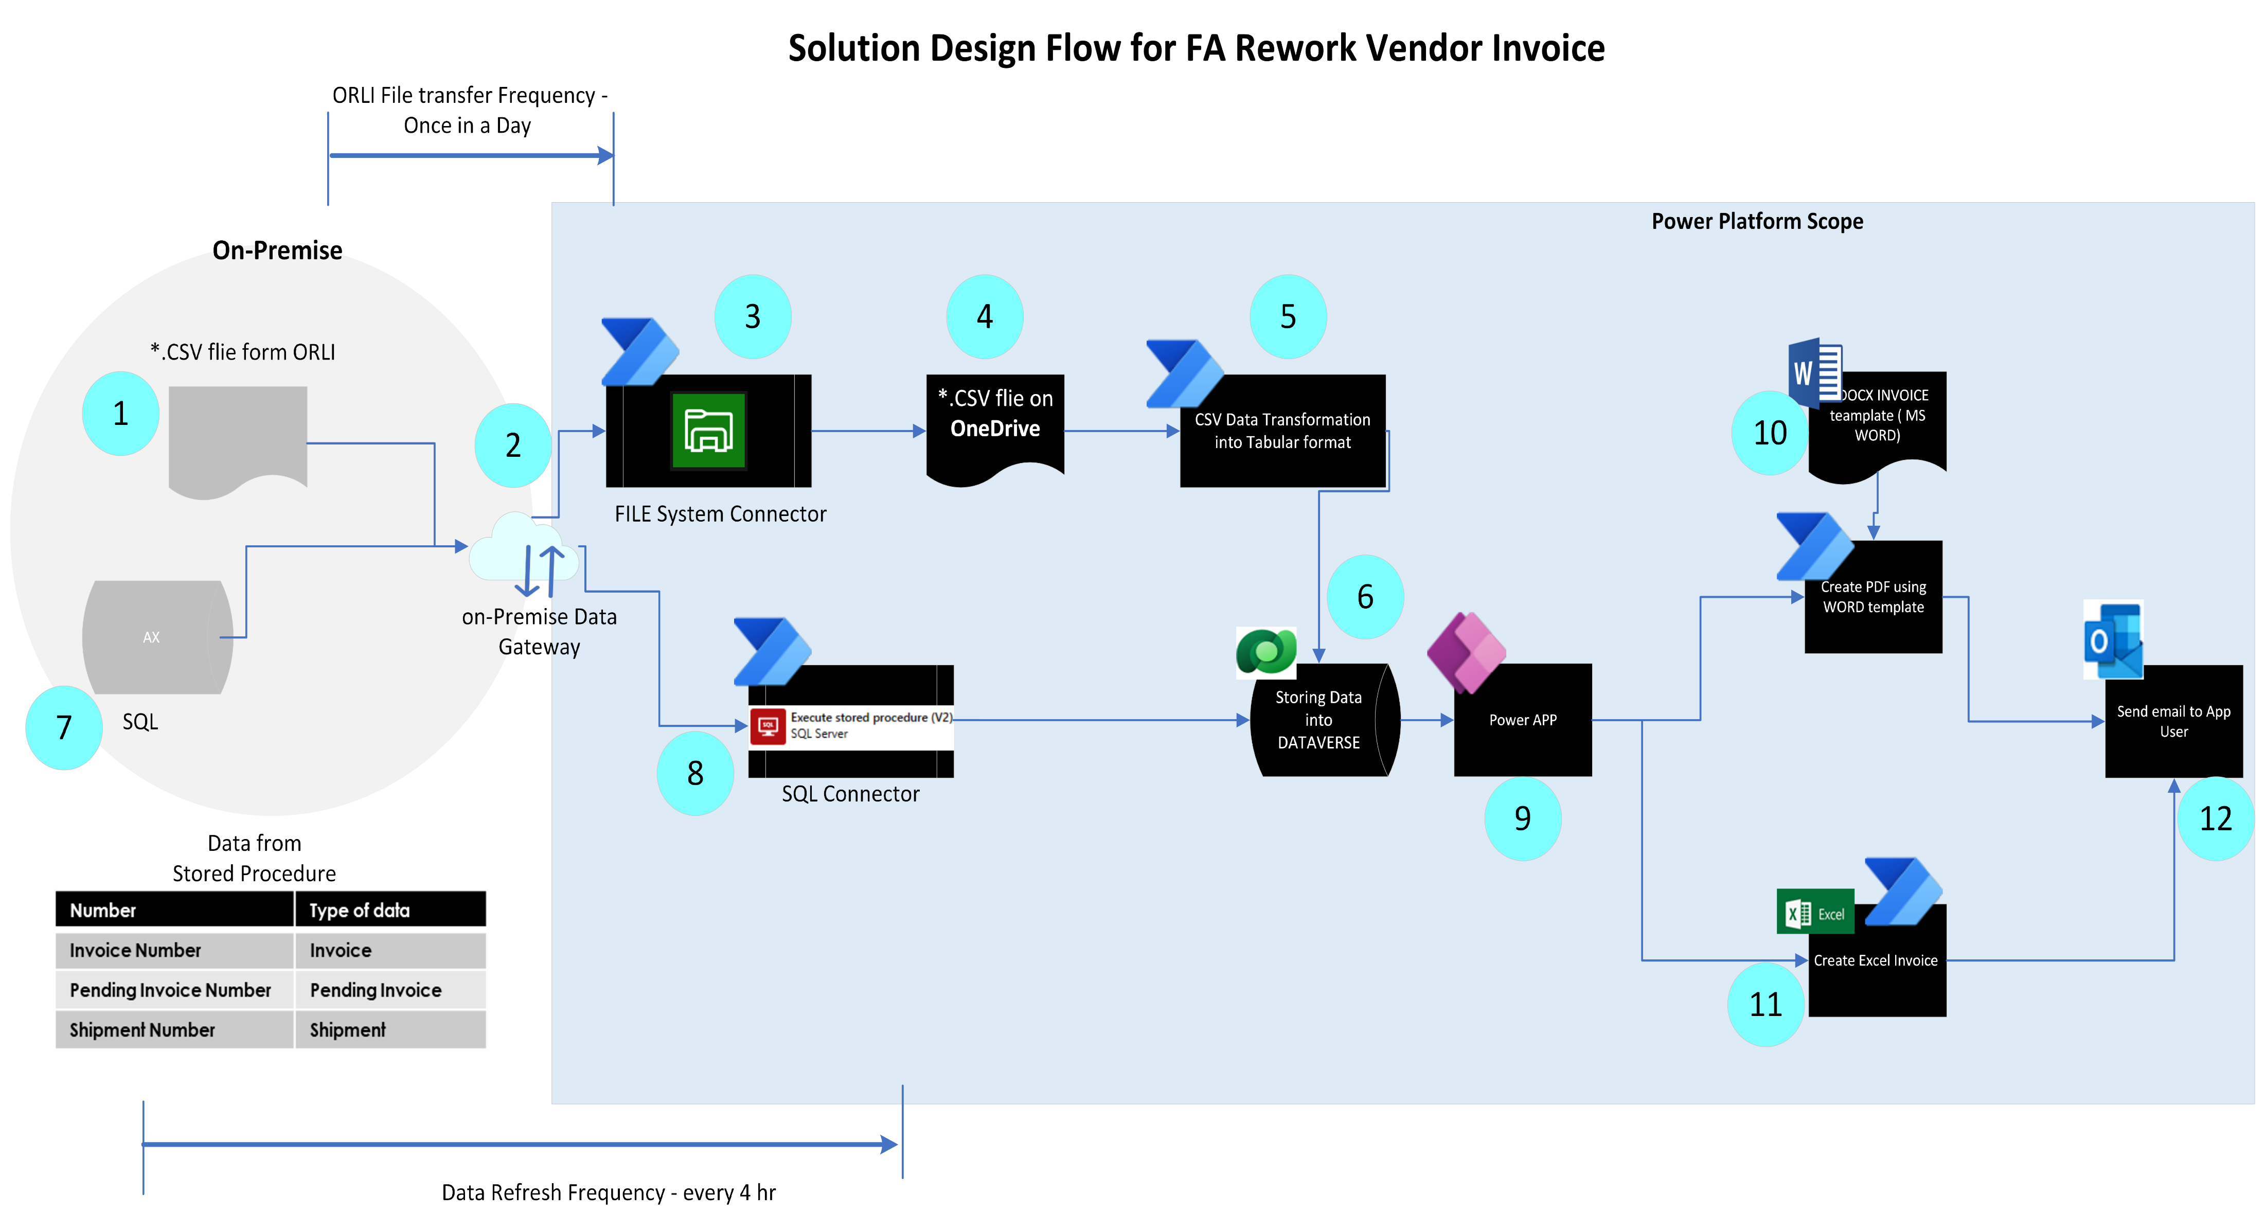
AX+ Power Platform Solution – Approach 1
Component list
Sr# | Components | Values
1 | *.CSV File from ORLI | Path
2 | Datagateway | SA-APACFARework_DGW ( hyperautomation)
 | Service account | SA-APACFARework
3 | FILE System connector | PowerApps FILE system connector
4 | *.CSV File on OneDrive | XXXXXXXX
5 | Power automate job to read file and update Dataverse table | XXXXXXXXXX
6 | Dataverse database | Table 1 : Table 2:
7 | SQL stored Procedure | XXXX
8 | SQL connector | Execute stored procedure connector
9 | Power App | Xxxx
10 | Generate PDF report using word template | PDF Reoprt (option-1)
11 | Generate Excel | Excel report (option-2)
12 | Send PDF/EXL report as attachment by mail | Power Automate Send email
Power Automate Trigers / Action | Trigger | Frequency
ORLI file | When a new file arrives | Once in a day
Data From Stored Procedure | Schedule Trigger | Once in every 4 hrs
Notes:
Environment to develop this APP as POC - (APAC_POCFARework_DEV)
on-premise data gateway (SA-APACFARework_DGW)
Serice Account ((SA-APACFARework)) to be used in on-premise Data gateway

Slide 6
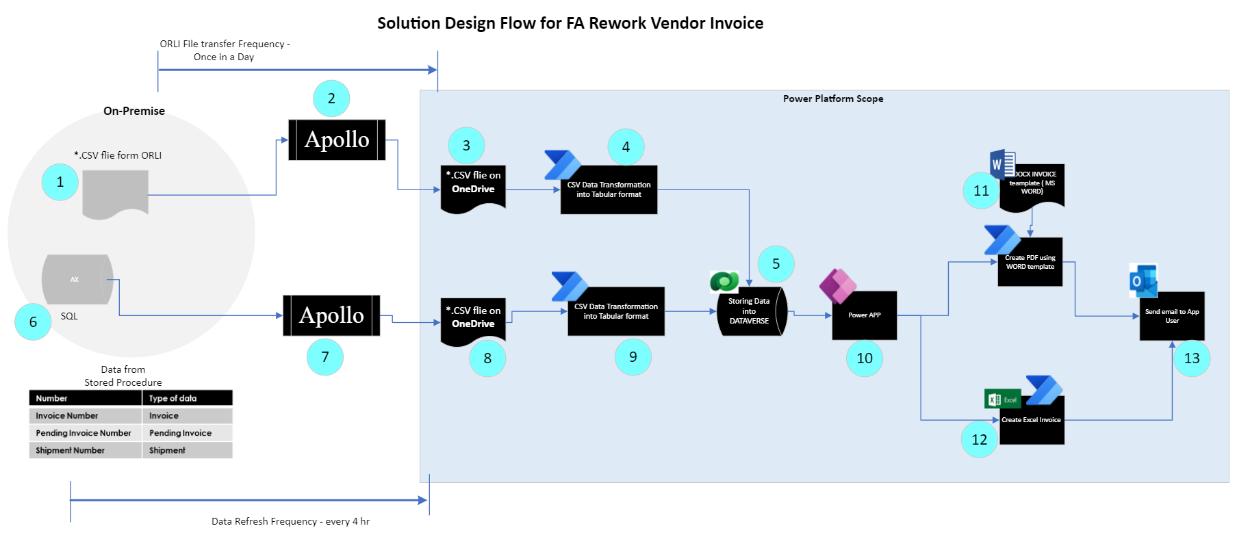
AX + Apollo + Power Platform Solution – Approach 2
Component list
Sr# | Components | Values
1 | *.CSV File from ORLI | Path
2 | Apollo | Apollo Gateway
 | Service account | Apollo_service_Account
 | Apollo End Point | OneDrive folder path
3 | *.CSV File on OneDrive | XXXXXXXX
4 | Power automate job to read file and update Dataverse table | XXXXXXXXXX
5 | Dataverse database | Table 1 : Table 2:
6 | SQL stored Procedure | XXXX
7 | Apollo Execute Stored procedure generate *.CSV | Execute stored procedure
 | Apollo End Point | OneDrive Folder Path for status data
8 | *.CSV file with Invoice status | Xxxx
9 | Power automate job to read file and update Dataverse table | XXXXXXXXXX
10 | Power App | Xxxx
11 | Generate PDF report using word template | PDF Reoprt (option-1)
12 | Generate Excel | Excel report (option-2)
13 | Send PDF/EXL report as attachment by mail | Power Automate Send email
Power Automate Trigers / Action | Trigger | Frequency
ORLI file | Apollo - When a new file arrives | Once in a day
Data From Stored Procedure | Apollo - Schedule Trigger | Once in every 4 hrs

Slide 7
Difference in both the Approaches
 | Approach-1 | Approach-2
Ease of Support | Medium (2 team) | Complex (3 teams)
Approach | File system connectors SQL connectors On-premise Data gateway | Apollo – old and tested approach
Technology | New re-usable technology | Not scalable approach as Apollo has to re-do it for new projects
Cost of Support | Comparatively low | Comparatively High
Cost of Development | Comparatively low | Comparatively High

Slide 8
Risks
Consideration:
AX : An ERP (Enterprise Resource Planning) system is a software that integrates various business processes and data sources into a single platform, governed by access control.
Sr# | Risk | Mitigation
1 | SQL Stored procedure | Need to be validated for business Process alignment
2 | Access Control | App User access need to be restricted and aligned with business user, as the solution using Service Account app user will have access to these data.

Slide 9
RUN – Cost Higher in Approach -2
Support Activity
Approach -2 (three teams involved)
Approach -1 (Two teams involved)
Exception | AX | Power Platform Support team | APOLLO (Approach -2)
End User not able to access App (SR) | - | X | -
Data related Exception ( incident) | X | X | X
Monitoring | X | X | X
Change Management (CR) | X | X | X
Maintenance Activity (archival and clean-up process) | X | X | X
X = applicable
- = not Applicable
Approach-2 is costlier based on involvement of 3 teams with comparing to 2 teams in Approach -1
Troubleshooting and maintenance will be easier in Approach-1 with only 2 teams involved

Slide 10
Future D365 integration with Approach-1, Approach -2 is possible
D365
As D365 and Power platform is closely integrated with d365 connector, both file system and SQL connector is not required. Hence both the approach can be scaled to integrate with D365 in future.
API

Slide 12
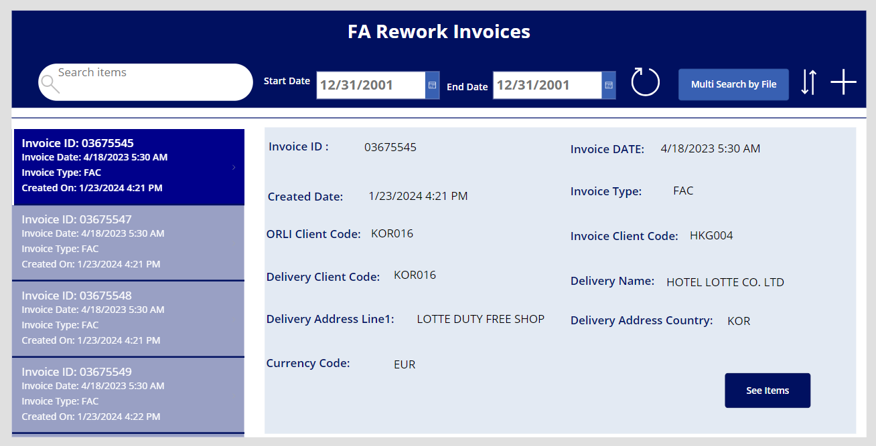
App Screenshots

Slide 13
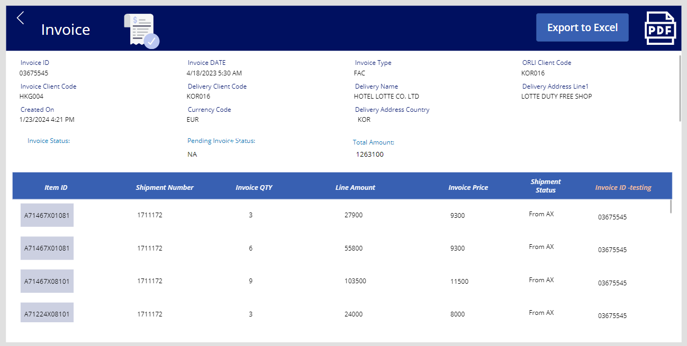
App Screenshots

Slide 14
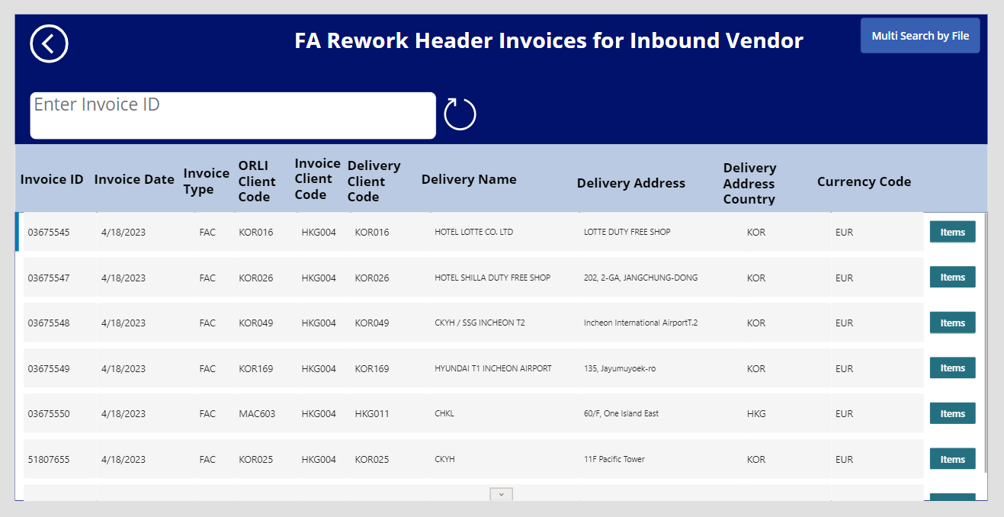
App Screenshots

