Slide 1
Walk-it
Team Rocket

Slide 2
Design Problem
Problem: long wait times at walk-in clinics
  Ambiguity for when you see doctor
Solution: a waitlist system and a check-in application
  Display Client
  Receptionist Client
  Mobile Application

Slide 3
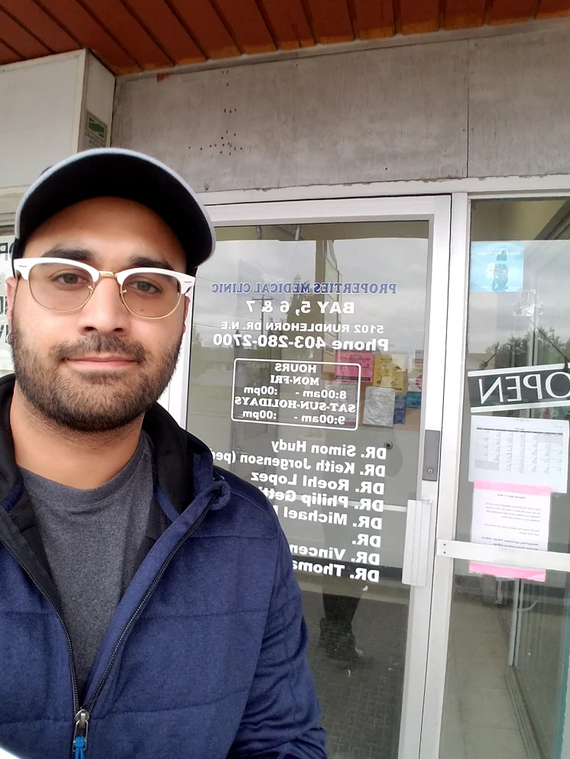
Research
Methods: Interviews & Observation
Findings:
  Problem exists
  Features could be added to reduce workload for receptionist
  Patients desired such an application

Slide 4
Design Decisions
Must haves:
Display waitlist times
A simple and easy way for the receptionist to add/move patients in the waitlist
Display multiple clinics in which the patient can check-in

Slide 5
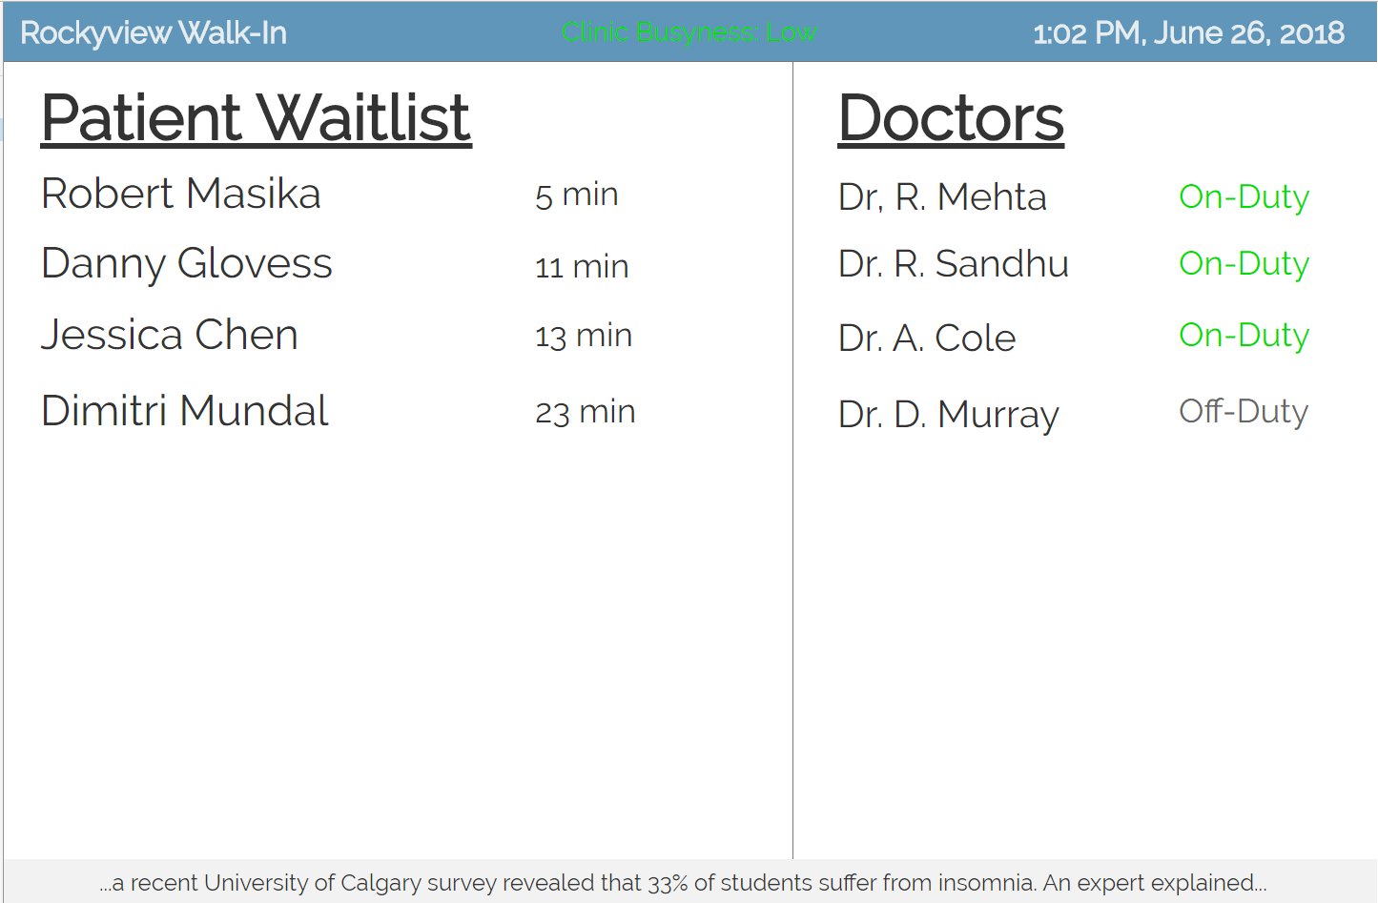
Design Decisions
Should haves:
Display client:
  Doctors on duty display
  A way to identify who is currently
  being helped
  Indicator of how busy the clinic is
  Date and time

Slide 6
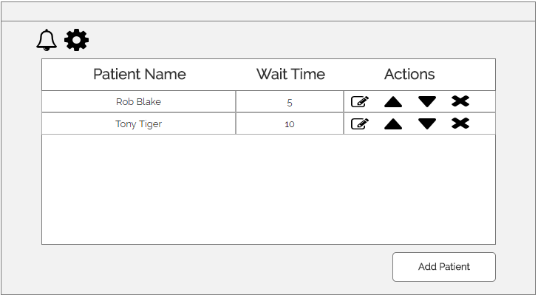
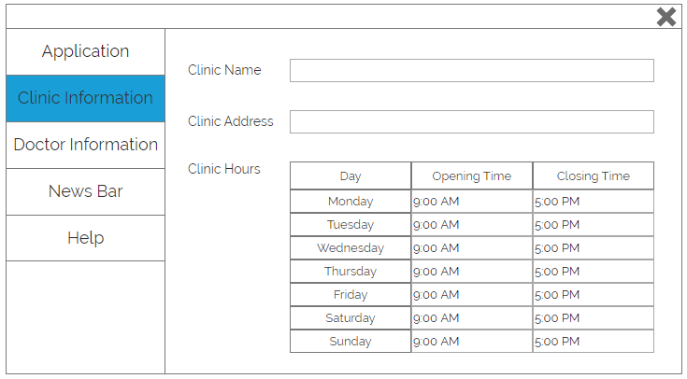
Design Decisions
Should haves:
Receptionist client:
  A way to be notified when patients
  check-in through the app
  A way to edit the information in
  the in-clinic waitlist display

Slide 7
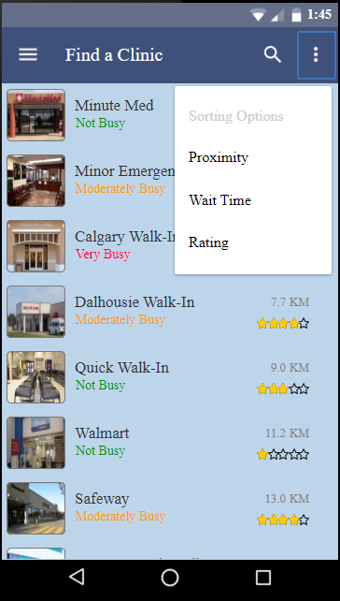
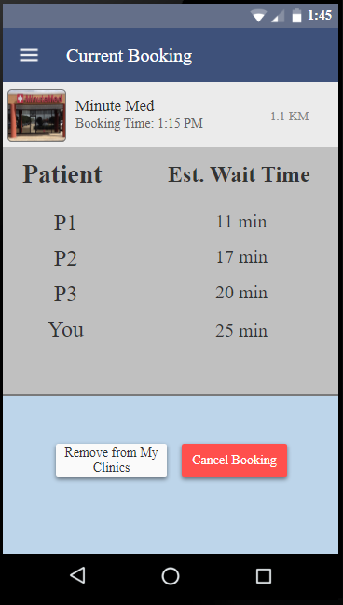
Design Decisions
Should haves:
Mobile application:
  A way to filter through the
  clinics by proximity, rating
  and how busy they are
  A way to add clinics to a
  favourites list
  A way to view the clinic’s waitlist

Slide 8
Heuristic Evaluation
Aesthetically pleasing
Simple and minimalistic interface
Needs improvement on text readability
Needs to be more consistent across platforms
Improve functionality

Slide 9
User Testing Methodology
Explain general purpose of system and components
Ask user to perform tasks on the system
Ask user questions after successfully performing each task
Record using Camtasia for analysis

Slide 10
Tasks for Users
Receptionist Client
Add a patient to the list
Remove a patient from the list
Change the colour theme of the application
Change the clinic hours on Monday
Mobile Client
Sign up for an account using email
Find the closest clinic and check in to it
Cancel current booking
Find the clinic “Safeway” and add it to your favourite clinics. Find the favourite clinics screen.

Slide 11
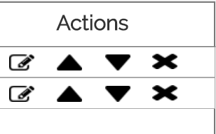
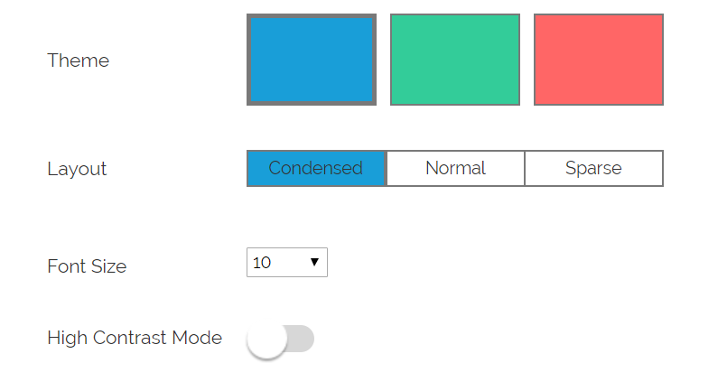
User 1: Glen
Middle-aged, fairly tech-savvy, has been to walk-in clinics in the past
Interesting Findings:
  Receptionist Client
    When deleting patients, was uncertain what buttons actually did
    For changing settings, was unsure whether his changes actually did anything

Slide 12
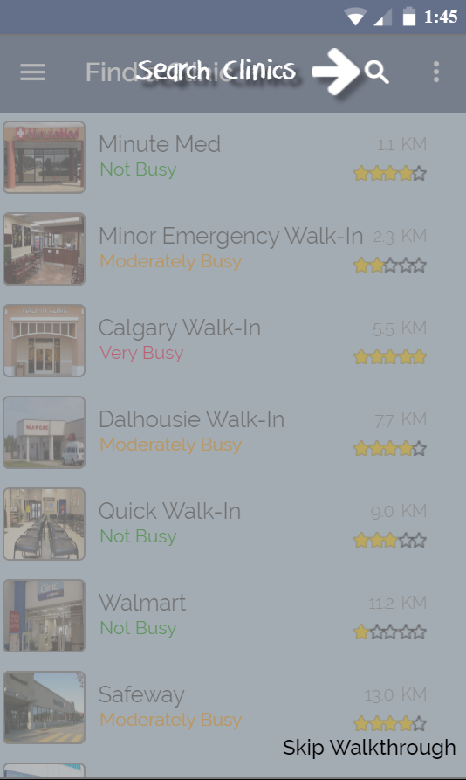
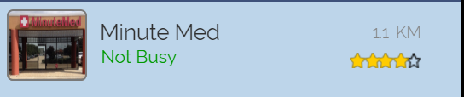
User 1: Glen
Mobile Client:
  Found walkthrough very confusing
  Difficulty reading clinic distances

Slide 13
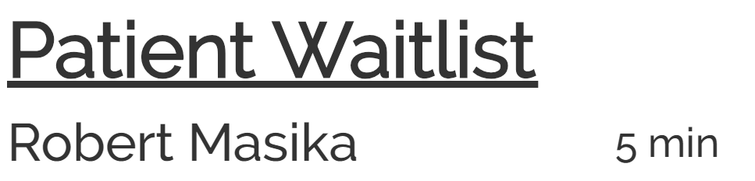
User 2: Renee (Receptionist)
Receptionist at Clinic, limited technical ability
Interesting Findings:
  Display Client
    Told us we cannot have full names on the waitlist

Slide 14
User 2: Renee (Receptionist)
Interesting Findings:
  Receptionist Client
    Found it very intuitive
    Again, changing settings could use more feedback

Slide 15
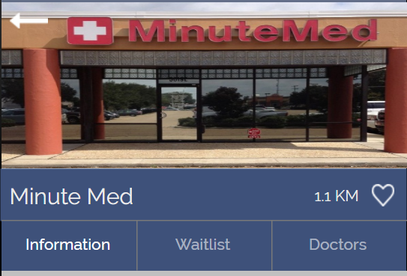
User 2: Renee (Receptionist)
Interesting Findings:
  Mobile Client
    Confused by sort feature
    Difficulty reading clinic distances
    Had trouble with adding clinic to her favourites

Slide 16
User 3: Beauty
A general practitioner (GP) resident
Key Findings:
  Receptionist Client:
    Found the interface a little dull
    Expected to automatically type into text-field before clicking the box
  Mobile Client:
    Issues with text readability
    Expected to find clinics from any screen

Slide 17
User 4: Lally
Non-technical user, uses iPad as primary communication tool
Key Findings:
  Receptionist Client:
    Discovered new bugs
  Mobile Client:
    Had difficulty with which information was required when checking in
    Had difficulty with navigation since she was more used to the IOS design ecosystem

Slide 18
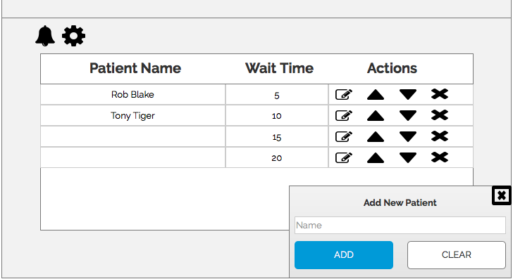

Slide 19
Recommendations for Next Iteration

Slide 20
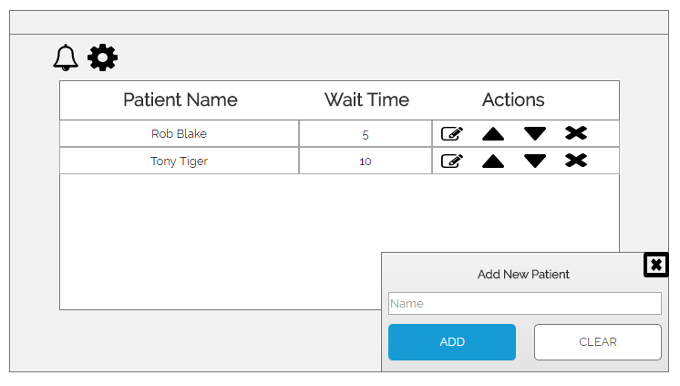
Receptionist Client
Bug: Dialog doesn’t close automatically when adding a patient

Slide 21
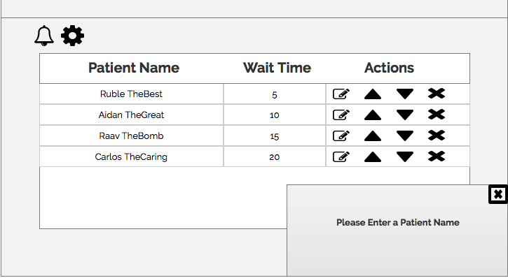
Receptionist Client
Bug: Can add patient with no name
OLD
NEW

Slide 22
Receptionist Client
Improvement: Confirmation messages when managing waitlist

Slide 23
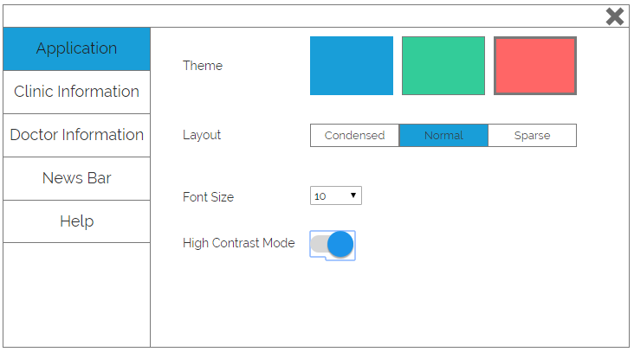
Receptionist Client
Improvement: Confirmation that setting was changed successfully

Slide 24
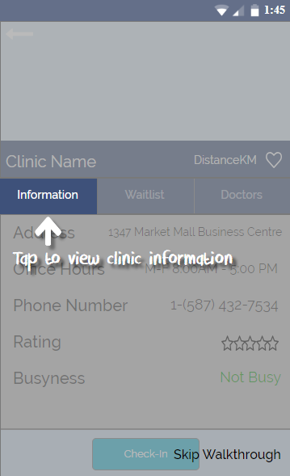
Mobile App
Improvement: Walkthrough usability and
font
Notes:
next/previous buttons

Slide 25
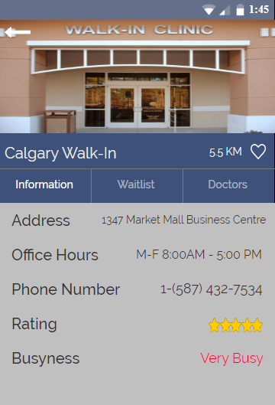
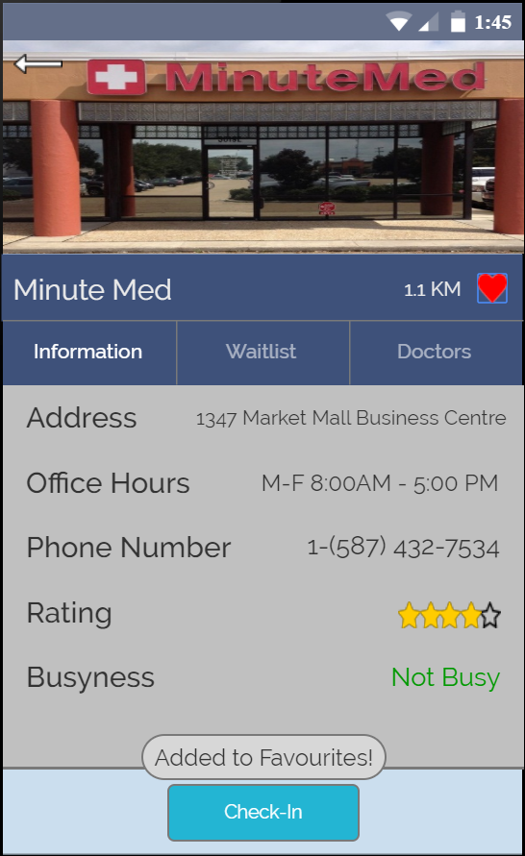
Mobile App
Improvement: Confirmation when adding clinic to favourites
OLD
NEW
Notes:
next/previous buttons

Slide 26
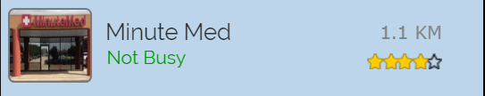
Mobile App
Improvement: Legibility of text/icons
OLD
NEW
Notes:
next/previous buttons

Slide 27

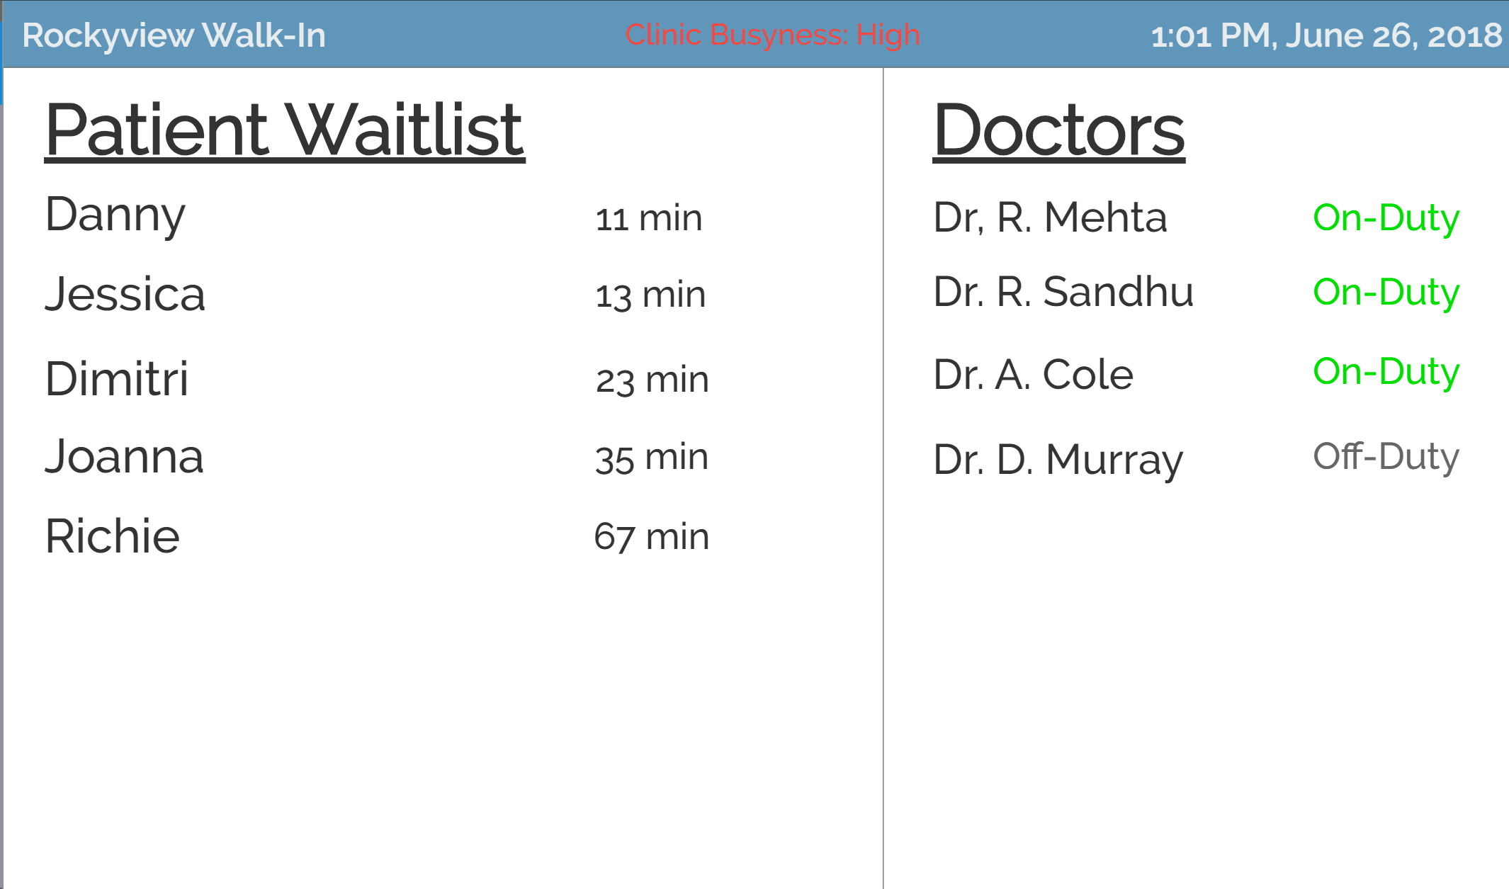
Display Client
Bug: Remove last names for patient waitlist
OLD
NEW

Slide 28
Conclusion
Research showed a need for a walk-in clinic wait-list application exists
Three component design
Lo-fi and Hi-fi prototypes
Evaluation and testing
Improve and re-evaluate our design

