Slide 1

Descriptive & Predictive Analytics
Mailing Campaign Donor Prediction
Our Team:
Alice Wolfe
Carlos Pirela
Rahul Raavi
Vishnu Vijayan
IÉSEG - School of Management, Campus de Lille et Paris

Slide 2
Table of Contents:
BACKGROUND
MODEL
Goals
Timelines
Random Forest
DONOR PROFILE
CAMPAIGN COST
General
Targeted
DONATIONS RECEIVED
General
Targeted
RESULT COMPARSION
Why Use Our Model?

Slide 3
Background
Fundraising donations for 22 organizations
Current response rate: 1.8%
To better help your company and the people you help, we want to improve donation rate on future campaigns
How? Using existing donor and donation data to better target potential donors

Slide 4
Our Model : Goals
"Data driven decisions over Randomness"
Target variables predicting donors
Social Stats: gender, language, province and age range
Relationship Stats: Length of Relationship, # gifts given, Average gift amount Gifted > $30?
Timeline Stats: Days since last gift, Have they gifted in last year? Last 3 years?
Using these stats we can predict how likely donors are to gift in your next campaign
Model Accuracy: 92%
Predicted response rate: 6%

Slide 5
Our Model: Timelines
Past
Future
5 years of donation data
Ingestion data limit
2 week gap before launch
1 month prediction
Campaign Release
Stop data ingestion

Slide 6
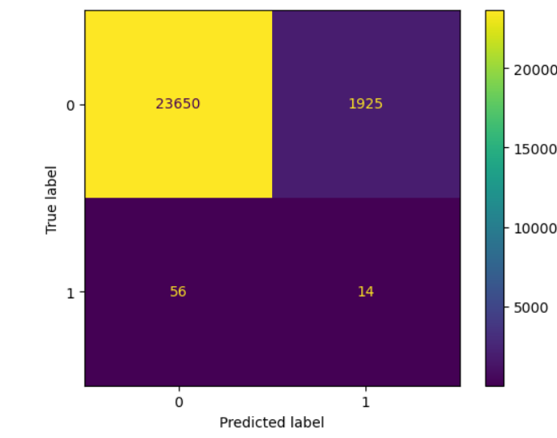
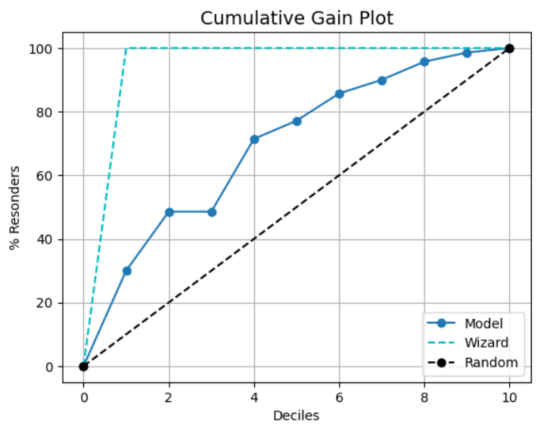
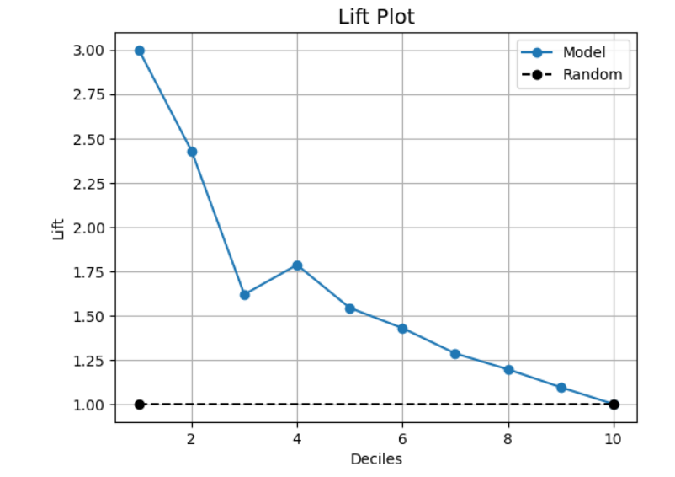
Our Model : Random Forest
Training Set Accuracy : 93.13%
Test Set Accuracy : 92.3 %

Slide 7
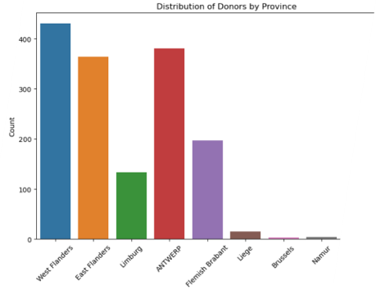
Donor Profile
Average donation = €30.68
Average response rate = 6%
Province

Slide 8
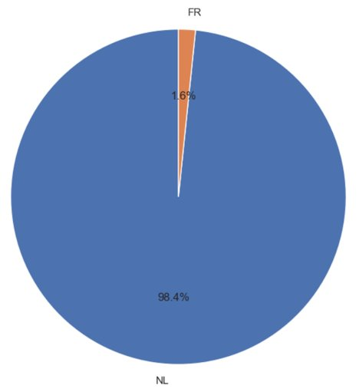
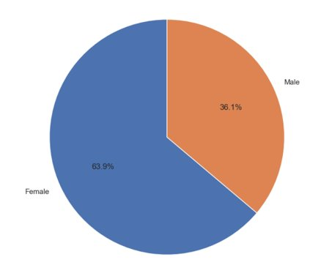
Donor Profile
Average previous gifts: 1.2 donations
Gender:
Language:

Slide 9
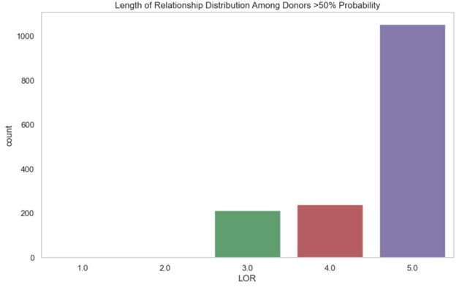
Donor Profile
55% of donors have gifted > €30
LOR (Length of Relationship):

Slide 10
Campaign Cost - General
Stats | Campaign 6169 | Campaign 7244 | Campaign 7362
# Donors targeted: | 34,888 | 25,645 | 26,522
Campaign Cost: | €28,000 | €20,500 | €21,000

Slide 11
Campaign Cost - Targeted
Donors predicted to donate + 25% additional contacted
Stats | Campaign 6169 | Campaign 7244 | Campaign 7362
# Donors targeted: | 3,275 | 1,708 | 1,944
Campaign Cost: | €2,620 | €1,366 | €1,556

Slide 12
Donations Received - General
Stats | Campaign 6169 | Campaign 7244 | Campaign 7362
# Donors targeted: | 34,888 | 25,645 | 26,522
Donations Received: | €98,653.56 | €18,616 | TBD

Slide 13
Donations Received - Targeted
Stats | Campaign 6169 | Campaign 7244 | Campaign 7362
# Donors targeted: | 3,275 | 1,708 | 1,944
Donations Received*: | €81,180 | €56,216 | €46,948
*Used average donation amount of Donors predicted to gift to calculate

Slide 14
Results Comparison
Stats* | Status Quo | With our Model
# Donors targeted: | 60,533 | 4,983
Campaign Costs: | €48,500 | €3,986
Donations Received: | €117,000 | €137,396
Value: | €68,500 | €133,410
>€64,000 into the hands of charities!
*Only considering campaigns 6169 and 7244

Slide 15
Other Considerations
contacting fewer people saves time & manpower
Frees up others for new projects

Slide 16
Why Use Our Model?
€64,000 increase in realized value
12x Lower campaign costs
Time saved for team

Slide 17
Thank You!

Slide 18
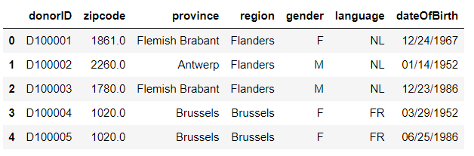
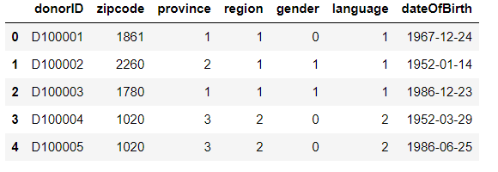
Clean The Data - Donors
Cleaned the donors table by :
Imputing missing values
Converting required objects for later predictions into numeric
Converting date into date type
Province
Flemish Brabant : 1
Antwerp : 2
Brussels : 3
Walloon Brabant : 4
West Flanders : 5
East Flanders : 6
Liege : 7
Gender
M : 1
F : 0
Region
Flanders : 1
Brussels : 2
Wallonia : 3
Language
NL : 1
FR : 2
EN : 3

Slide 19
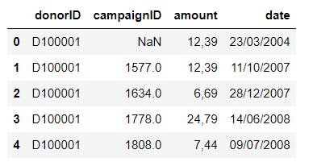
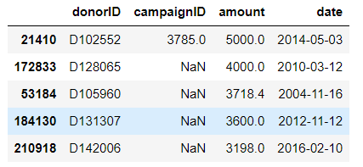
Clean The Data - Gifts
Cleaned the gifts table by :
Dealing with outliers in the amount column
Imputing missing values with 0 to indicate no gift given
Converting date into respective date type column
Removing 4 major outliers using the quantile method where the cap amount was 5000

Slide 20
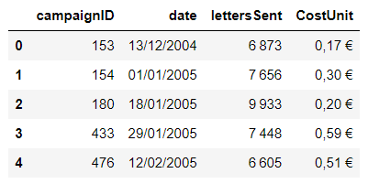
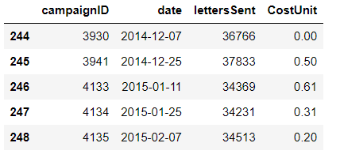
Clean The Data- Campaigns
Cleaned the campaign table by :
Converting date into respective datetime column
Filtered the date for post December 2014
Imputed missing values for cost unit, letters sent
Added € to the cost unit

Slide 21
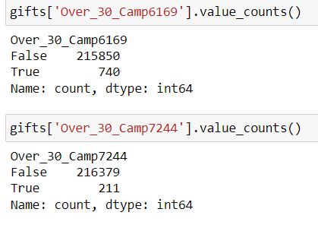
Data Prep – Creation of Dependent Variable
Creation of 2 new variables :
Donation_over_Camp_6169 : filtered for donation above 30 and before 2018-10-04
Donation_over_Camp_7244 : filtered for donation above 30 and before 2019-07-18
Converted them into boolean values

Slide 22
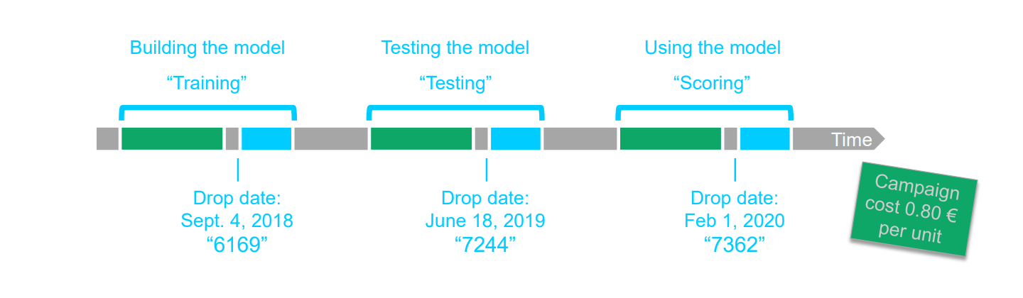
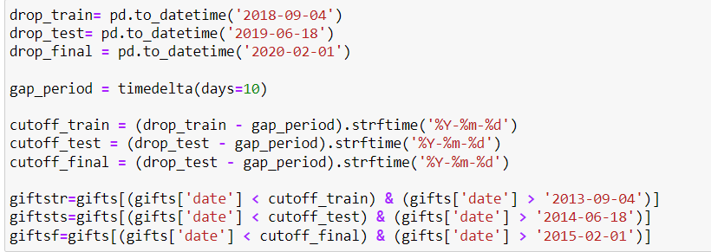
Split Gifts Into Train & Test
5 Year Gap

Slide 23
Create Features From Gifts
The following features were grouped by donorID and created to be used through the training, test and final set :
n_gifts_camp() : counts the number of gifts donated
sum_gifts_camp() : calculates the sum of donations
avg_gifts_camp() : calculates the average donation
max_gifts_camp() : calculates the maximum gift amount donated
min_gifts_camp() : calculates the minimum gift amount donated
firstgift_camp() : calculates the first gift amount donated
lastgift_camp() : calculates the most recent gift amount donated

Slide 24
Merge Tables
Merged the tables thrice :
To create the training set – where we merged campaigns, gifts and selection campaign 6169
To create the test set – where we merged campaigns, gifts and selection campaign 7244
To use for the final set – where we merged campaigns, gifts and selection campaign 7362

Slide 25

Create Training Set & Additional Features
Set the training set's date 2018 – 09 – 04
New features respecting the above time frame were added such as :
Age - age of donor
LOR - length of relationship of donor
DaysLastGift - number of days since last donation
ThreeYear - binary column indicating whether a donor made a donation over 30 within the last three years
OneYear - binary column indicating whether donor a made a donation over 30 within the last year
SixMonths - binary column indicating whether donor a made a donation over 30 within the last six months
Created bins for Age, LOR, DaysLastGift, sum_gifts, avg_gifts, min_gifts & max_gifts

Slide 26
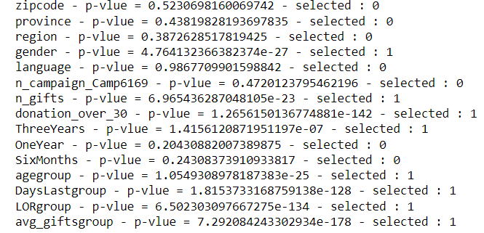
Pearson Analysis

Slide 27
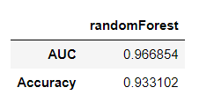
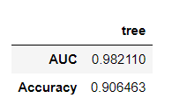
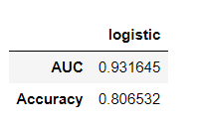
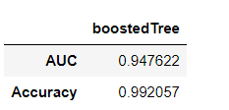
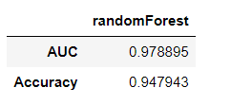
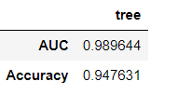
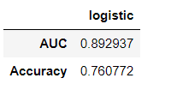
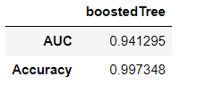
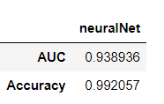
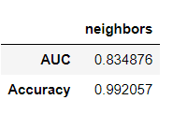
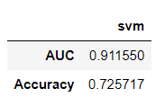
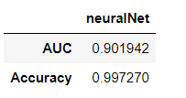
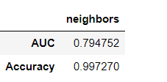
Choosing Our Algorithm

Slide 28
Donor Profile
Knowing the last donation made - ranging from the past one year to three years
Knowing their length of relationship and counting their total donations made
Knowing the average donation made by the donor
Identifying their gender
Identifying their language
Identifying their province
Features Used :
DaysLastGroup
LorGroup
OneYear
ThreeYears
agegroup
avg_giftsgroup
donation_over_30
gender
language
n_gifts
province

