Slide 1


Department of Computing, FEST
Hamdard University
FYP- 2
Rabail Arshad (1397-2021)
Syeda Sara Shehnaz (2230-2021)
Syeda Maryam Shehnaz (2231-2021
Supervisor
Engr. Farooq Iqbal
FitFeast: Personalized Nutrition & Meal Planning System

Slide 2
Summary
Problem Statement
Objective
FYP Scope
Our methodology
Our Project Plan (Time lines)
Budget / Costing (if any)
FYP Deliverables
Literature Review
Demo of 100% of Work
Experimental Evaluations & Results
Test Plan & Test Cases
References

Slide 3
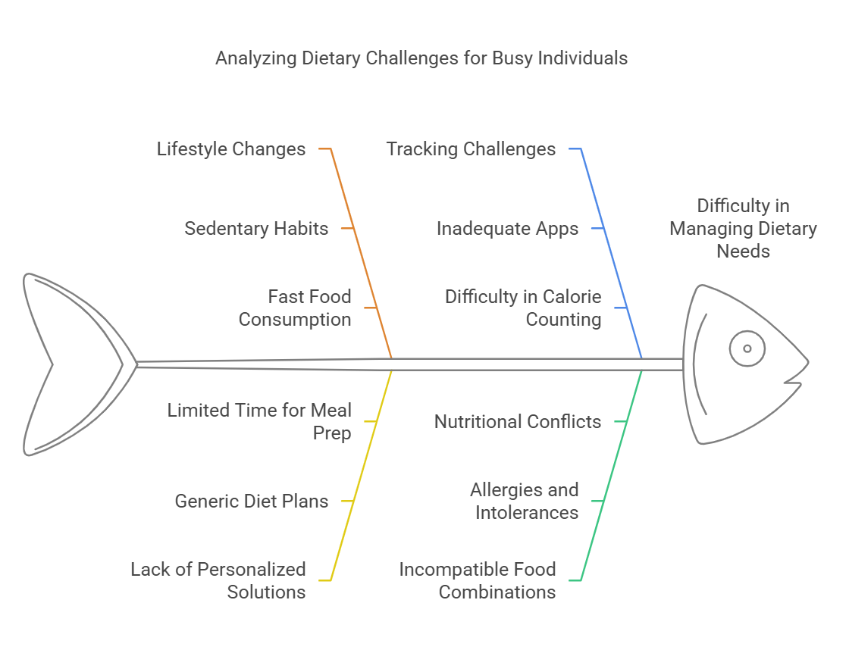
Problem Statement
‘The Challenge of Healthy Eating’
Increasing obesity and lifestyle-related diseases.
Lack of personalized dietary solutions for busy individuals.
Users struggle to track calorie intake and avoid incompatible food combinations.

Slide 4
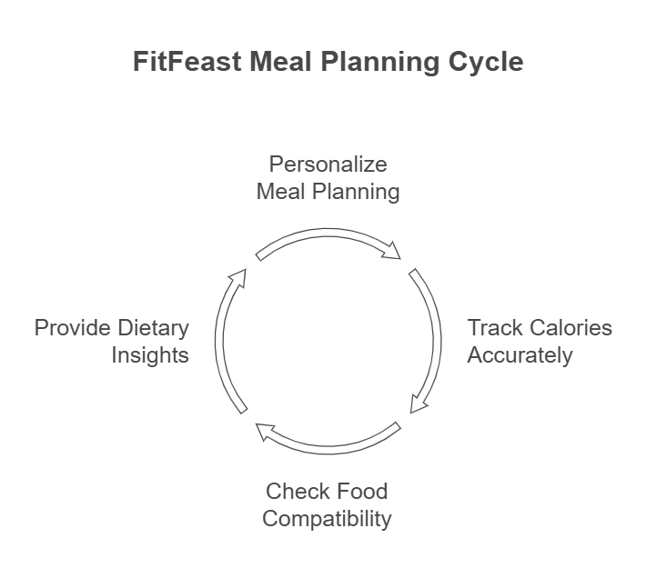
Objective
Provide meal planning based on personal dietary goals (e.g., vegan, high protein).
Enable real-time nutritional and calorie tracking per meal.
Detect and alert users about incompatible ingredient combinations.
Offer personalized recipe recommendations with detailed breakdown using APIs.

Slide 5
FYP Scope
Included | Not Included
Meal kit customization | Live food delivery logistics
Calorie + nutritional tracking | Payment gateway integration
Ingredient compatibility detection | Wearable device integration
Recipe recommendations via Edamam API | Dietician chatbots
Allergen & dietary preference filtering | VR-based cooking guides

Slide 6
Methodology
Agile Model
Sprint-based development
Weekly module testing
Continuous user feedback
Modular architecture for future extension
Tech Stack: Flutter (Frontend) | Python + Flask (Backend) | MySQL | Edamam API | Nutritionix API

Slide 7
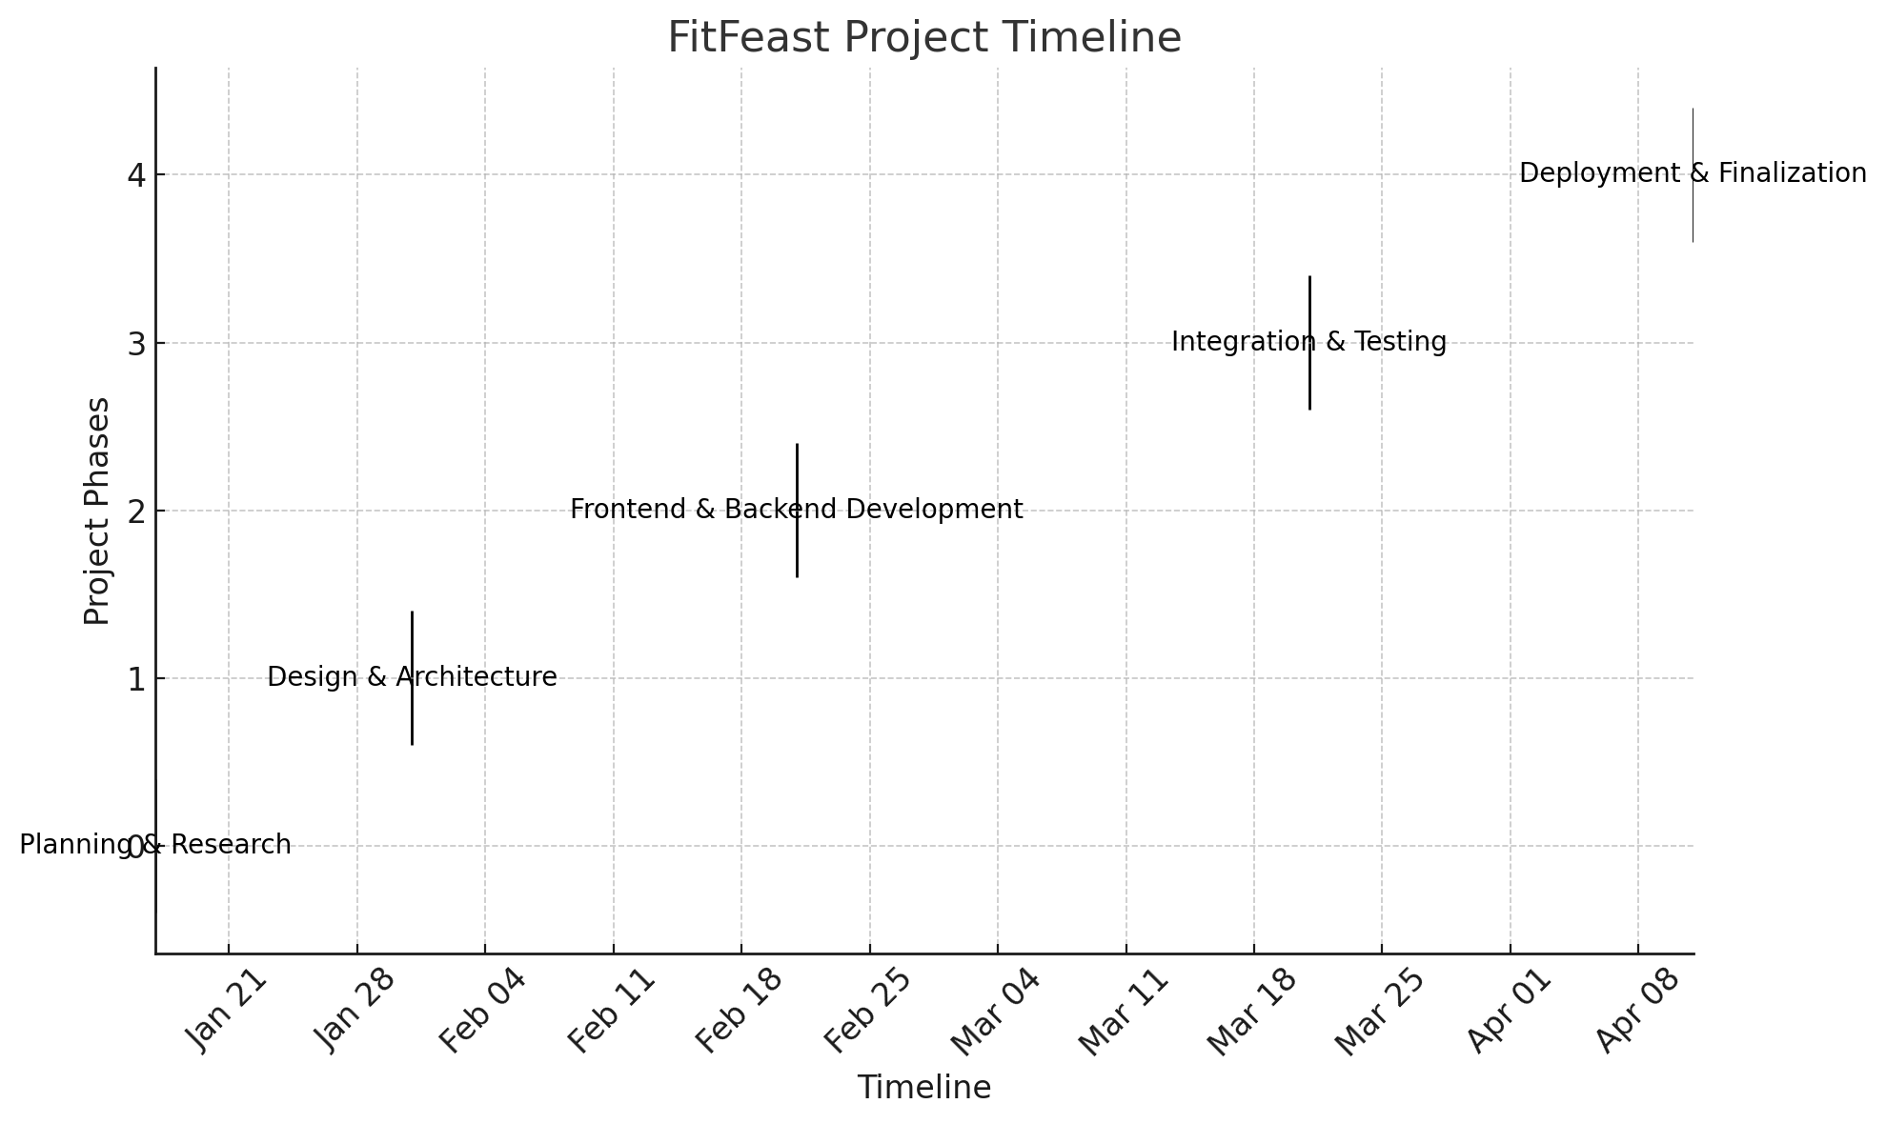
Project Plan - Chart

Slide 8
Project Plan - Chart
Item | Cost (PKR)
Visual Studio Code | Free
Python | Free
MySQL Community Edition | Free
Microsoft 365 Subscription | Free
MS-Project (educational license) | Free
Figma | Free
Flutter | Free
React Native | Free
Development Machines (3 members) | 150,000
Internet Connectivity (10 months) | 20,000
Domain Registration and Hosting | 5,000
Third-Party API Integrations | 10,000
Miscellaneous | 2,000
Total | 187,000

Slide 9
FYP Deliverables
Functional Application (Demo)
Project Report (Proposal, SRS, SDS)
UI/UX Screens
Test Plan & Cases
Presentation Slides
GitHub Repository
Demo Video
Poster

Slide 10
Literature Review
Paper / Source | Contribution to FitFeast | Link
"Healthy Personalized Recipe Recommendations" (2023) | Provides a framework for AI-based personalized meal planning, aligned with our system’s recommendation engine. | ResearchGate Link
"Machine Learning in Dietary Assessment" – Springer (2020) | Explores how ML models improve food tracking accuracy – supports our ingredient incompatibility detection. | ResearchGate Link
Nutritionix API Documentation | Source of real-time calorie data, used in our calorie calculation feature. | -
Edamam API Documentation | Powers the nutritional breakdown for selected meals and ingredients. | -

Slide 11
Experimental Evaluations & Results
Feature | Expected Output | Status
Calorie Alerts | Shown when exceeded | Not real-time
Ingredient Incompatibility | Trigger warning | Working
Meal Planner | Personalized meals shown | Passed
API Fetch | Recipes + Nutrients shown | Passed

Slide 12
Test Plan & Test Cases
Module | Tested Features | Status
Login & Signup | Credential input, navigation, success validation | Working
Meal Customization | Ingredient add/remove, incompatibility alerts | Working
Nutrition Breakdown | calorie update, macro details | Working
Calorie Alert System | Alert on exceeding daily intake | Partial
Meal Planner (Preferences) | Filters for allergies, diet types, calorie range | Working
Profile Update | Calorie goal update reflected across modules | Working
API Integration – Edamam | Nutritional info retrieval from ingredients | Working
UI Testing | Layout validation, navigation | Working

Slide 13
Gap Analysis Summary
Problem / Gap | Achieved Solution
No personalized nutrition in apps | Built tailored meal planner
No real-time incompatibility checks | Ingredient alert system
Lack of nutrient breakdown | Edamam-based nutrient view
Incomplete food suggestions | Calorie-friendly recipe recommendations

Slide 14
References
Pressman, R. S. (2014). Software Engineering: A Practitioner’s Approach. McGraw-Hill.
Sommerville, I. (2016). Software Engineering (10th ed.). Pearson.
Wiegers, K. E. (2013). Software Requirements (3rd ed.). Microsoft Press.
Graham, R. (2014). Managing Software Requirements: A Use Case Approach. Addison-Wesley.
IEEE (1998). IEEE Std 830-1998, IEEE Recommended Practice for Software Requirements Specifications.
Kotonya, G., & Sommerville, I. (1998). Requirements Engineering: Processes and Techniques. Wiley.
Lamsweerde, A. v. (2009). Requirements Engineering: From System Goals to UML Models to Software Specifications. Wiley.

Slide 15
THANKYOU

