Slide 1
PROJECT PRESENTATION
Sekhukhune District Hospital IT Infrastructure Upgrade
GROUP MEMEBERS
Ruth Rabambi
Maria Tsakane Mthunzi
Kabelo Mokwape
Kamogelo Jack Makuwe

Slide 2
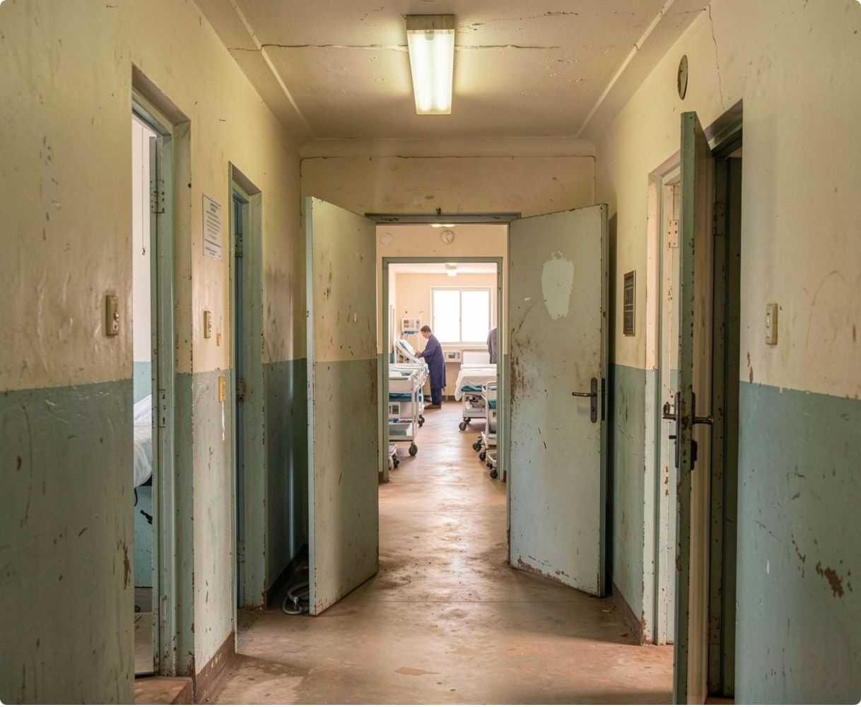
01 · OVERVIEW
Project overview
Extend the municipal network to the hospital and modernise its internal infrastructure.
Hospital context
Rural public hospital in Limpopo serving about 600 staff, 20 wards, 5 offices, and more than 100 patients daily.
Expected delivery window
24 August 2026 to 30 November 2026.

Slide 3
02 · CASE FOR CHANGE
Why this project was selected
PROJECT B
PROJECT A
DIRECT VALUE
Project B offers broader district impact but carries higher complexity, more stakeholders, and a longer delivery horizon.
Project A is a contained single-site upgrade with lower risk and a manageable one-year scope.
It directly supports healthcare delivery while closing a rural digital gap.

Slide 4

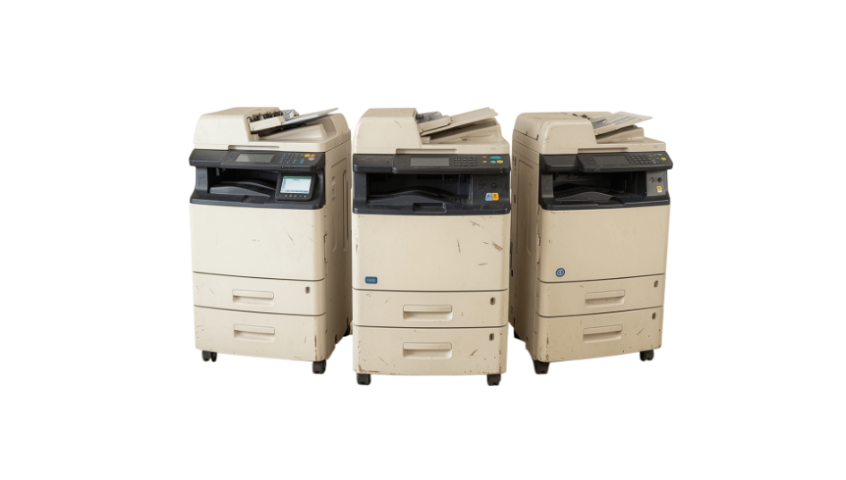

03 · BASELINE
Current-state context
LIMITED ICT CAPACITY
A very small support team is responsible for the network.
15 COMPUTERS
3 PRINTERS
Only 15 old computers support the hospital’s operations.
Only 3 printers support the hospital’s operations.
EXISTING PROCESSES
Patient management, operations, finance, supply chain, supplier collaboration, and communication.

Slide 5
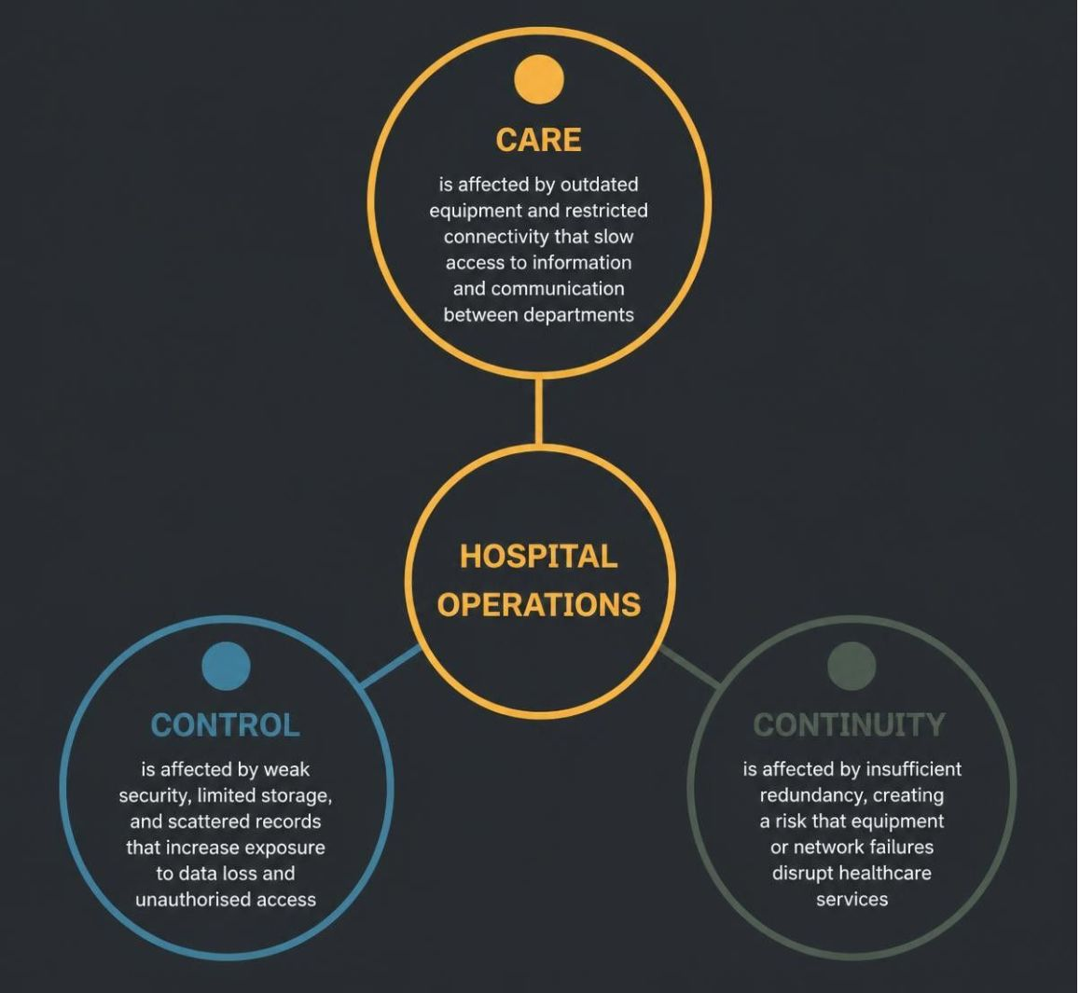
04 · THE PROBLEM
The problem affects care, control, and continuity
Outdated equipment and restricted connectivity slow access to information and communication between departments.
Weak security, limited storage, and scattered records increase exposure to data loss and unauthorised access.
Insufficient redundancy creates a risk that equipment or network failures disrupt healthcare services.

Slide 6
05 · AIM AND MEASURES
Project aim and success criteria
Create a secure, reliable, scalable IT infrastructure that supports clinical, administrative, communication, and information-management processes.
Network performance
Access and communication
Scalable platform
Reliable fibre connectivity and at least 99.5% network performance after deployment.
Improve secure access, interdepartmental communication, patient-information retrieval, cybersecurity, uptime, and future growth.
Improve secure access, interdepartmental communication, patient-information retrieval, cybersecurity, uptime, and future growth.

Slide 7
06 · DELIVERY SCOPE
Scope: what the project delivers
Connectivity and infrastructure
Platforms and protection
Design and readiness
Municipal-to-hospital fibre, wired and wireless networking, structured cabling, servers, storage, backups, UPS, printers, end-user devices, and monitoring.
Active Directory, Microsoft 365, cybersecurity, backup and disaster recovery, testing, documentation, and staff training.
Technical designs, equipment specifications, implementation requirements, preliminary costing, and risk assessment.

Slide 8
07 · DELIVERY CONTROL
Scope boundaries protect delivery
PLATFORM
OUTSIDE SCOPE
The project provides the platform for existing applications; it does not build a new hospital information system.
Building construction or renovation
Medical-equipment replacement
New healthcare application development
Long-term operational support
Improvements to external municipal infrastructure

Slide 9
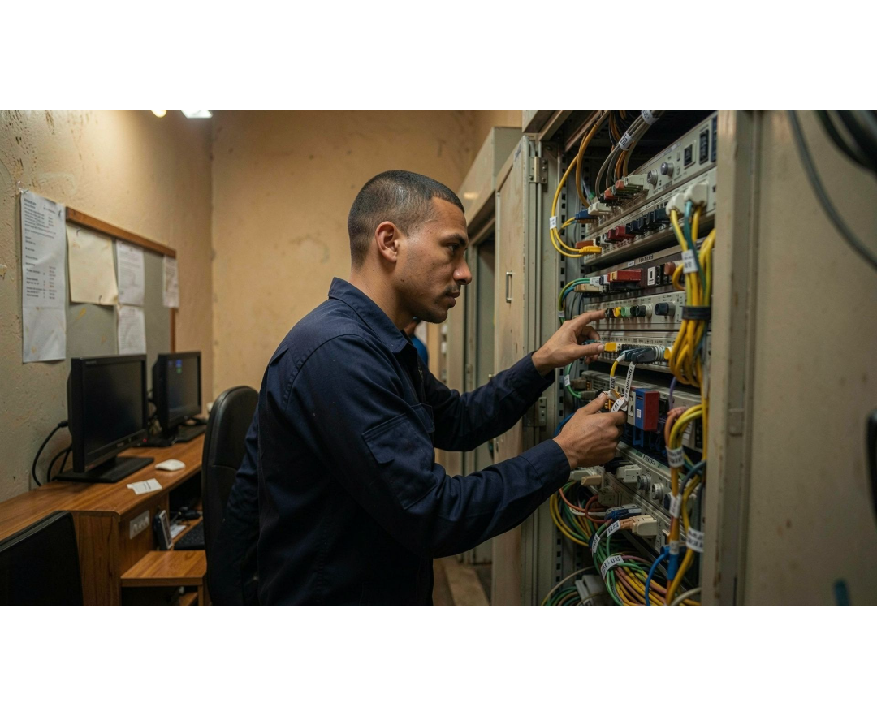




08 · CHARTER
Project charter and governance
Charter field | Approved detail
Project name | Sekhukhune District Hospital Infrastructure Upgrade Project
Project manager | Kamogelo Jack Makuwe
Sponsor | Sekhukhune District Hospital
Project management
Network infrastructure
Systems and security
Documentation and support

Slide 10




09 · PEOPLE AND REQUIREMENTS
Stakeholders, customers, and special needs
Hospital and ICT
External partners
Hospital management, ICT, clinical departments, finance, and procurement.
Municipality, vendors, and the ISP.
Final customers
Special needs
Hospital staff and patients.
Activities must continue, patient information must remain confidential, equipment must meet standards, and disruption must be limited.

Slide 11
PART 2 · HOSPITAL IT INFRASTRUCTURE
From architecture
to operation
Systems, controls, delivery model, and decisions needed to make the infrastructure dependable in practice.
Notes:
Continue the comprehensive project story from architecture into operation. This part focuses on the systems, controls, delivery model, and decisions that make the infrastructure dependable in practice.

Slide 12
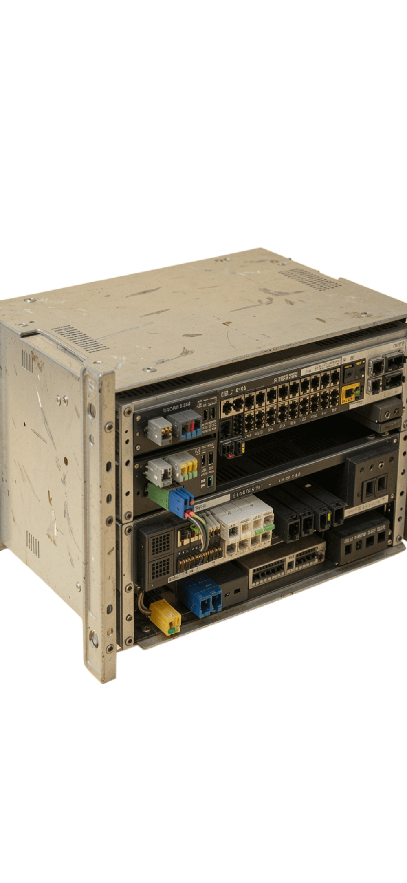
Hardware foundation: network, servers, and power
The physical platform has to carry clinical, administrative, voice, printer, and supplier traffic without becoming a single point of failure.
Network core
Two managed 48-port PoE core switches; managed 24/48-port access switches; 10Gb SFP+ aggregation, fibre transceivers, and structured Cat6/Cat6A cabling.
Compute, storage, and resilience
Two virtualisation servers, a backup server, NAS storage, and lockable racks. UPS units, cooling, environmental sensors, and standby power integration protect availability.

Slide 13



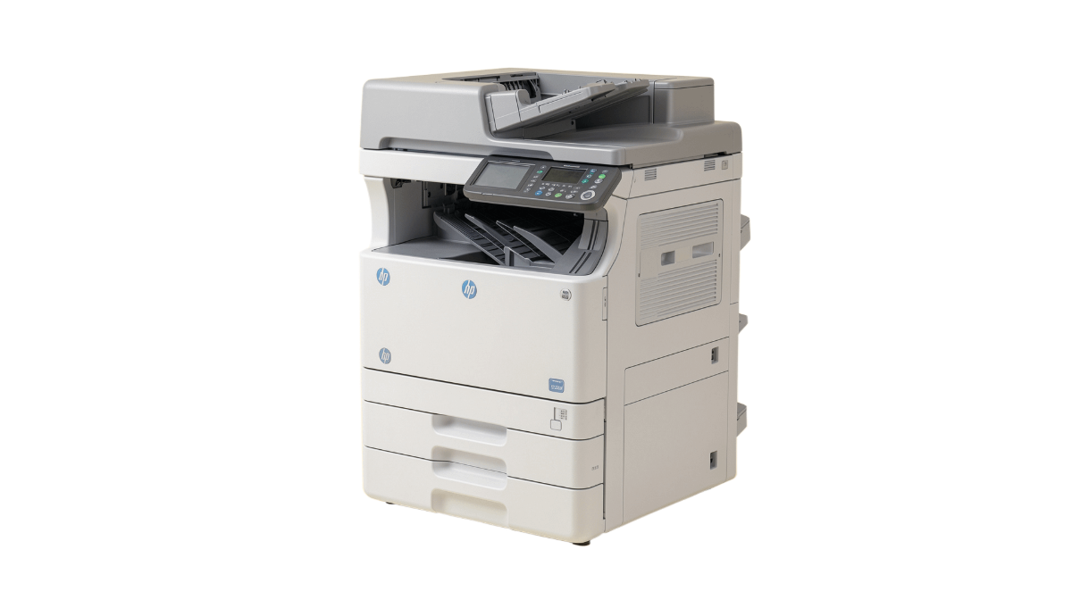
End-user equipment closes the access gap
Workstations
Printing
Business desktops, laptops, monitors, peripherals, document scanners, and authentication readers where justified.
Eight HP LaserJet Enterprise multifunction printers replace reliance on three shared printers. IP phones, wireless access points, surge protection, portable power, and server-room air conditioning support reliable daily work.

Slide 14




Software platform: manage, secure, and recover
Source: supplied project brief
Platform
Identity
Operate
Recover
Windows Server and virtualisation.
Active Directory and database management.
Network management, security, patching, and monitoring software. Microsoft 365 Enterprise E3 supports email, documents, Teams, SharePoint, OneDrive, and collaboration.
Backup software. Existing operations, finance, supply-chain, and supplier systems remain in use on the stronger platform.

Slide 15
Integrated hospital information flow
The design integrates existing functions without implying that a new hospital application is being built.
Patient registered and record created.
Records stored centrally and retrieved by authorised users.
1
2
3
4
Medical, finance, supply-chain, and supplier information captured in the appropriate module.
Automated backup and recovery protect availability.

Slide 16
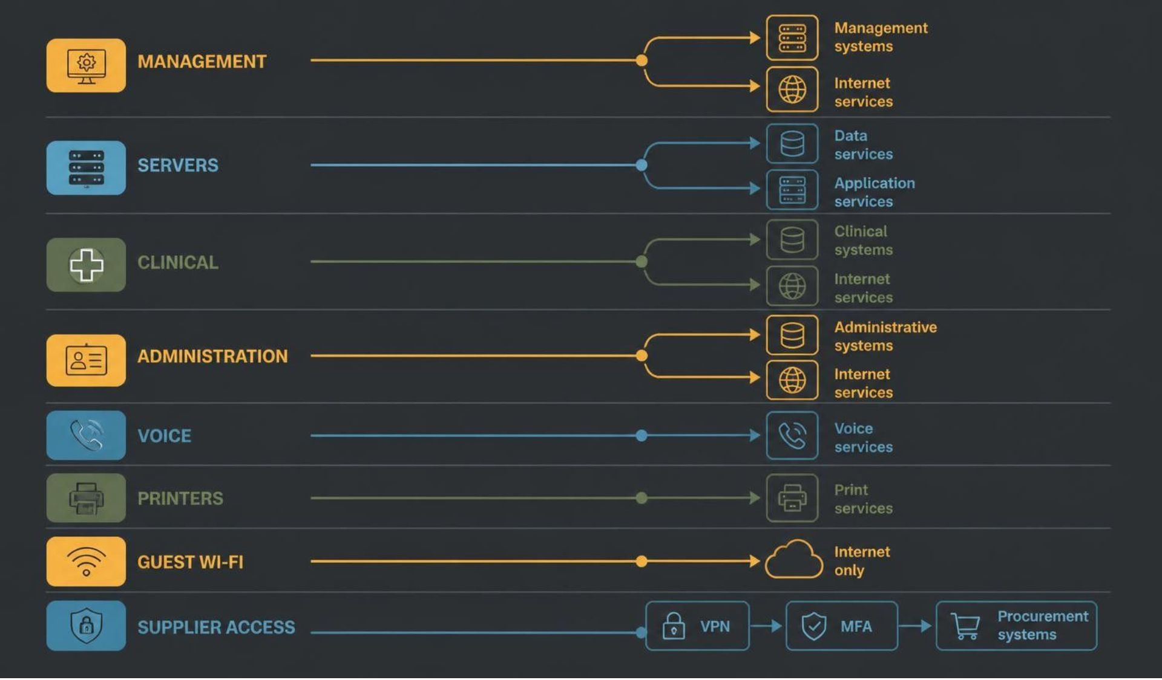
VLAN segmentation separates risk domains
Segmentation limits blast radius and keeps each user group close to the services it actually needs.
Source: supplied project brief

Slide 17
Security is layered from perimeter to endpoint
Perimeter
Identity & endpoint
Physical & recovery
High-availability firewalls provide intrusion prevention, web filtering, VPN, and controlled ports.
Named accounts, role-based access, MFA, endpoint protection, automatic patching, encryption, and monitored logs protect patient information.
Locked server rooms, access logs, UPS protection, backups, and restore testing address physical and recovery risks.
Source: supplied project brief

Slide 18
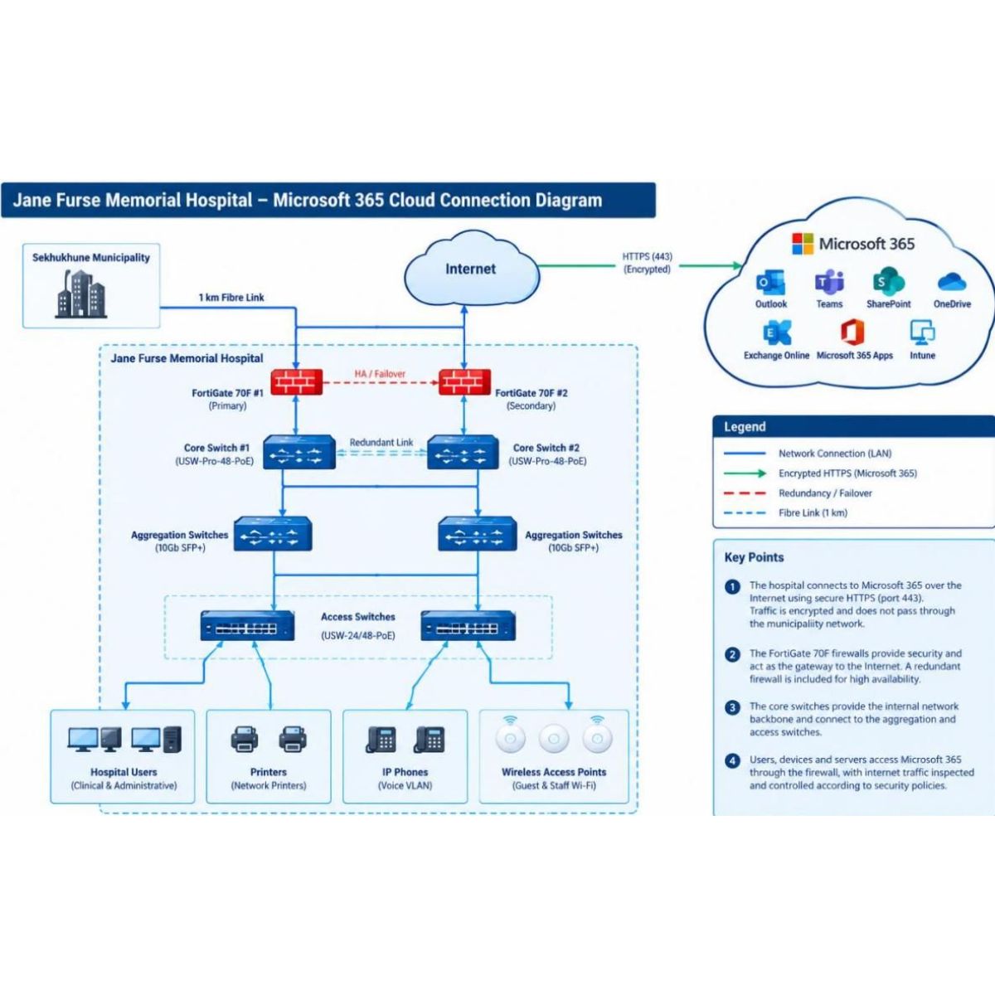
Microsoft 365 extends collaboration securely
01
02
03
Work together
Connect safely
Control access
Outlook, Teams, SharePoint, OneDrive, and Microsoft 365 Apps support email, meetings, document sharing, and departmental cooperation.
Hospital traffic reaches cloud services through redundant firewalls using encrypted HTTPS.
Dependable internet, MFA, access controls, and data-protection measures are required for safe cloud use.

Slide 19



Policies and SOPs make the design operational
Access control
Backup and disaster recovery
Network security
Approve access, create individual accounts, assign permissions, configure MFA, and remove access when roles change.
Monitor, investigate, report, resolve, and record suspicious activity.
Identify critical data, schedule backups, check results, test restores, and document outcomes.

Slide 20




Change, asset, incident, and training controls
Change management
Asset management
Requests, impact assessment, approval, controlled implementation, verification, and documentation.
Equipment, serial numbers, placement, testing, and the asset register.
Incident management
Training
Logs, prioritises, escalates, resolves, tests, and closes issues.
Covers systems, cybersecurity, and procedures.
Source: supplied project brief

Slide 21
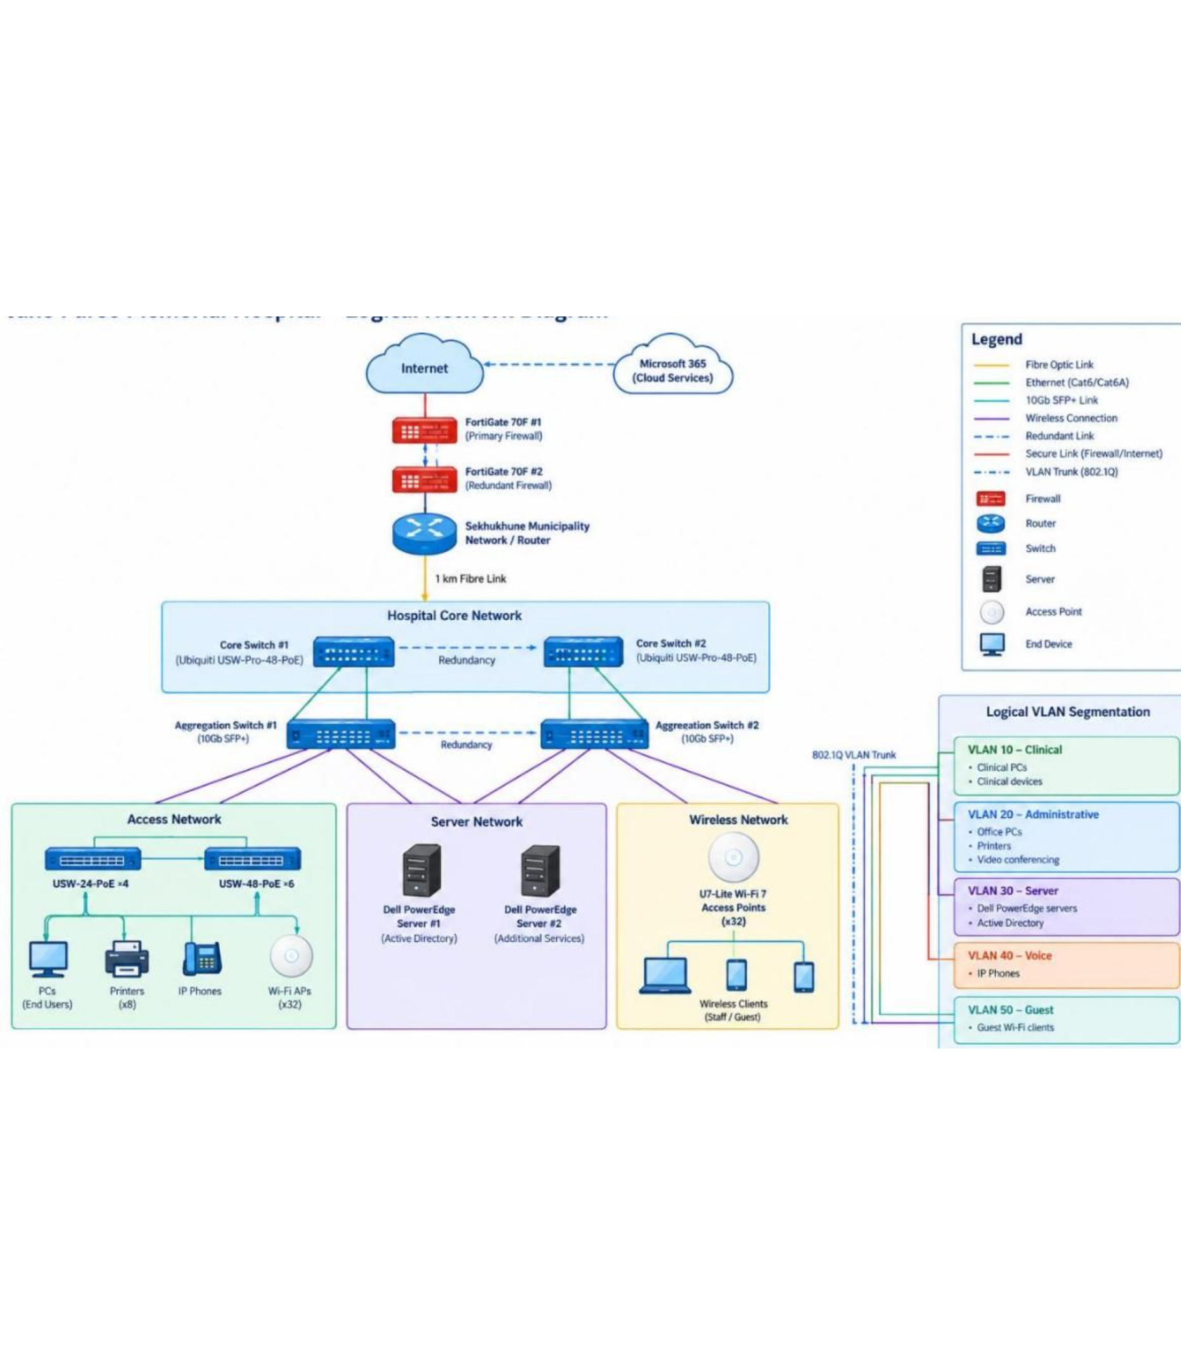
02 · LOGICAL VIEW
Logical network diagram
Internet and Microsoft 365 → redundant FortiGate firewall pair → municipal router → 1 km fibre link → redundant hospital core → aggregation, access, server, and wireless layers.
SOURCE REPORT
Logical VLAN groupings: clinical, administration, servers, voice, and guest traffic.

Slide 22
03 · PHYSICAL VIEW
Physical network diagram
WARD BLOCKS
SECURE ICT / SERVER ROOM
BACKBONE
Distribution cabinets
1 km fibre link
Core equipment
Access switches and patching.
Firewalls · Core switches
Aggregation switches · Servers
Backup storage · UPS · Patch panels
Fibre backbone and inter-cabinet links.
OFFICES
Distribution cabinets
Access switches and patching.
END DEVICES · CAT6 / CAT6A COPPER
Nearby end devices: PCs · Printers · Phones · Wireless access points

Slide 23





05 · 12-MONTH ROLLOUT
Rollout sequence protects hospital continuity
Site survey, needs analysis, final design, and supplier quotes.
Months 1–2
Fibre extension, cabinets, structured cabling, and certification.
Months 3–4
Server room, servers, storage, UPS, and backup system.
Months 5–6
Switching, Wi-Fi, firewalls, VLANs, PCs, printers, identity, and endpoint security.
Months 7–10
Testing, restore and failover tests, training, handover, and documentation.
Months 11–12

Slide 24
06 · ACCOUNTABILITY
Eight project phases create accountable handoffs
01
02
03
04
Initiation and requirements
Current infrastructure and business-process analysis
Network and security design
Costing and procurement planning
05
06
07
08
Implementation planning
Testing and validation
Training and documentation
Final review and project closure
Each phase produces a defined deliverable, from approved requirements to a final project report.

Slide 25
07 · PEOPLE AND OWNERSHIP
Resources and stakeholders keep the project grounded
SOURCE REPORT
Project team
Support resources
Process owner and final customers
Kamogelo Jack Makuwe, Kabelo Rephus Mokwape, Ruth Rabambi, and Maria Tsakane Khoza.
Hospital ICT, executive management, procurement, finance, network vendor, and ISP.
Process owner: Hospital ICT Manager; final customers: hospital staff and patients.

Slide 26
08 · DECISION GATE
Cost scenarios must be reconciled before approval
The source material reports three different figures. None should be silently selected as the final budget.
HEADLINE PROJECT ESTIMATE
DETAILED EQUIPMENT TABLE TOTAL
PRELIMINARY PROJECT PROPOSAL
R1,975,000
R1,975,000.00
R2.97 million
Includes EDR, cabling, servers, fibre, endpoints, UPS, printers, and training.
Preliminary estimate without final Microsoft 365 licensing; all scenarios need scope and quantity reconciliation.

Slide 27



09 · VALUE CREATED
Benefits are operational, security, and strategic
More consistent access to systems and information; stronger departmental communication; better user/device management; reduced downtime.
Operational
Improved protection through firewalls, endpoint security, segmentation, authentication, monitoring, backups, and POPIA-aware controls.
Security
The charter estimates R237,750 in combined benefits across savings, productivity, compliance, decision-making, maintenance, and avoided costs.
Strategic

Slide 28
10 · GOVERNANCE REGISTER
Risks, constraints, assumptions, and governance
Risks
Constraints
Assumptions
Cyberattacks; outage during installation; procurement delays; budget overruns; insufficient ICT capacity.
Funding; timeline; procurement restrictions; equipment availability; need to keep healthcare services running.
Municipal connectivity and the fibre route are viable; funding is available; management supports the change; staff participate; current systems are compatible.
PROCESS OWNER
FINAL CUSTOMERS
Hospital ICT Manager
Hospital staff and patients

Slide 29
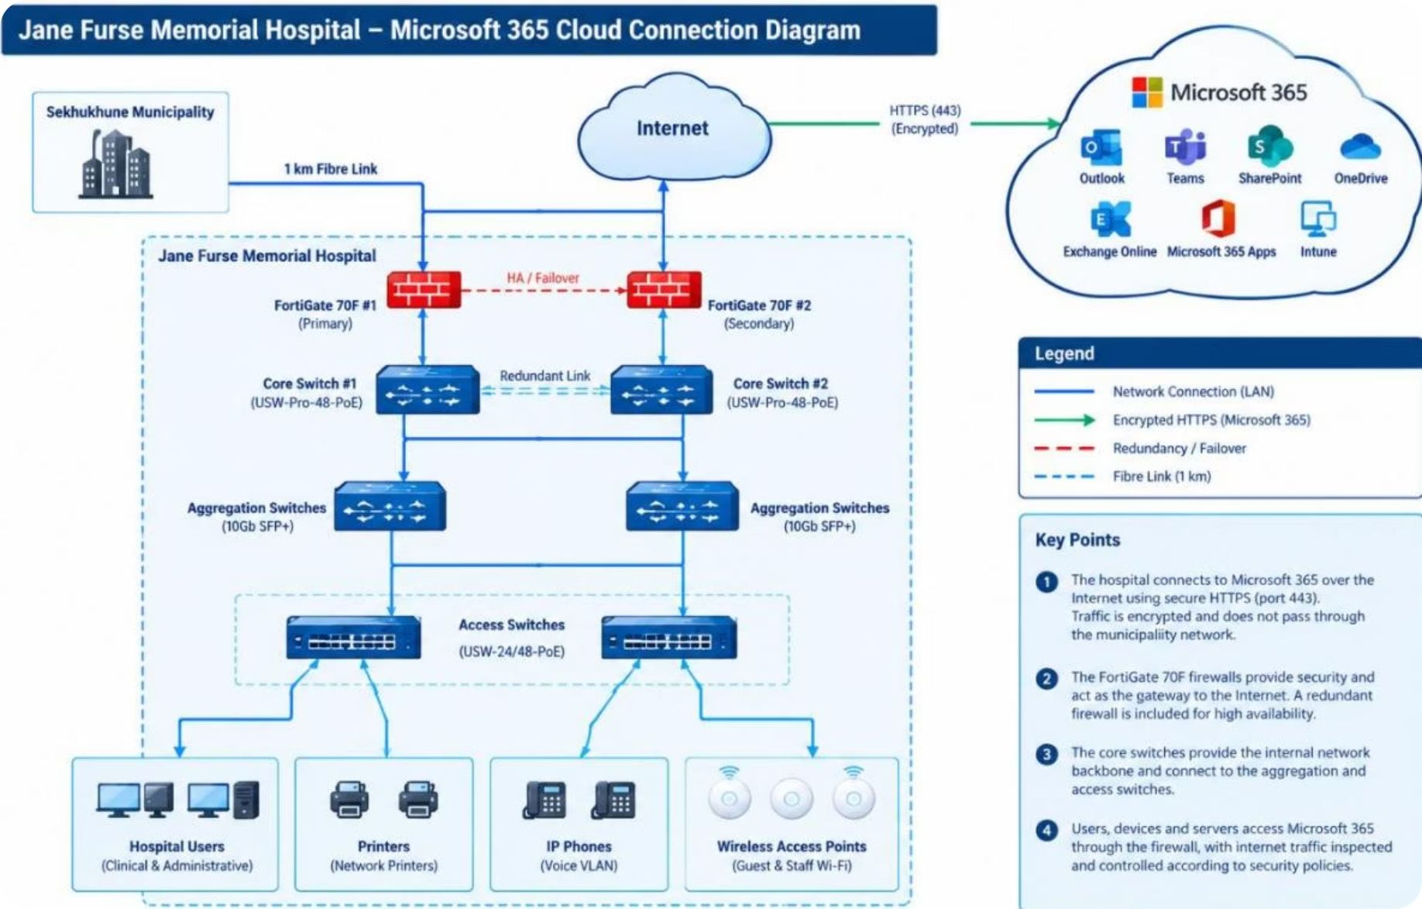
04 · CLOUD PATH
Cloud connection diagram
Hospital users reach Microsoft 365 through access, aggregation, and core switching, redundant firewalls, encrypted HTTPS, and the Internet.
SOURCE REPORT
Controls: encryption in transit, MFA, access controls, reliable Internet, and POPIA-aligned data protection.

