Slide 1


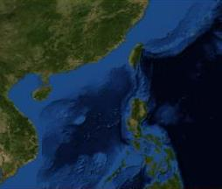
18APR22: USS TORCH INTERACTION WITH 1x REP LCAT III
NONCLASSIFIED
BLUF: TOR CO assessed incident as SAFE, PROFESSIONAL AND ROUTINE.
Timeline of Events
28/0915Z: USS TORCH OBSERVED A REPUBLIC RPC LCAT III DFG-170 COMMENCE SHADOWING OPERATIONS ON THE PORT QUARTER AT 11NM.
28/0945Z: DFG-170 WAS OBSERVED PARALLELING TOR COURSE REMAINING ON THE PORT QUARTER AT 8NM.
28/1014Z: DFG-170 REMAINED ON TOR PORT QTR AT 9NM.
28/1021Z DFG-170 CPA’D TOR PORT QTR AT 7NM PARALLELING COURSE AT 25KTS. NO COMMUNICATIONS WERE ESTABLISHED. FORWARD MOUNTED GUN WAS OBSERVED. REPUBLIC FLAG WAS VISIBLE. NO PERSONNEL VISIBLE.
28/1035Z NO CHANGE NOTED IN DFG-170 POSTURE.
USS TORCH
RPC LCAT III DFG 170
N
5
5
4
4
3
7NM
3
2
2
1
1
0524N 11327E
Distance Scale
5NM
Video/Photos capture point(s)
Current as of 280918APR22
NONCLASSIFIED
Enclosure (3)

