Slide 1
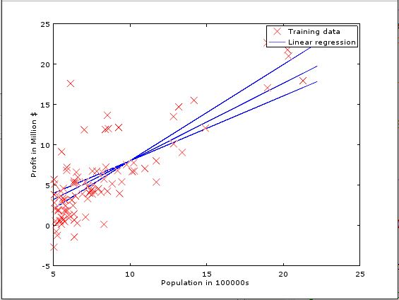
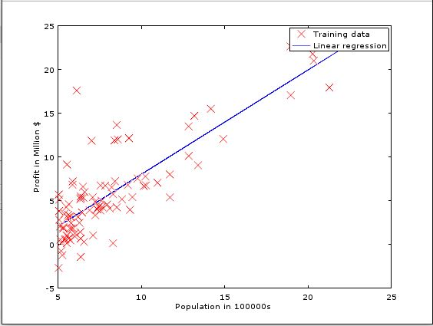
Linear Regression with One Variable
a=0.02 , a=0.002, a=0.0001
a=0.02 → Best
a=0.02:
Theta0= -3.87 Theta1=1.19
Profit Prediction: 3.805
a=0.002:
Theta0=-1.58 Theta1=0.96
Profit Prediction: 4.614
a=0.0001:
Theta0=-0.027 Theta1=0.804
Profit Prediction: 5.161
For a population of 645996 , the total predicted profit is : 3.805 Million
Using alpha=0.02 , Profit= -3.87 + 1.19 * (6.45) = 3.805

