Slide 1
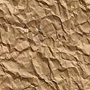
Phisics 2
Md Mukhlesur Rahman Kanon
B.Sc Hon’s M.Sc (Chemistry) M.ED
Instructor (Non-tech)

Slide 2
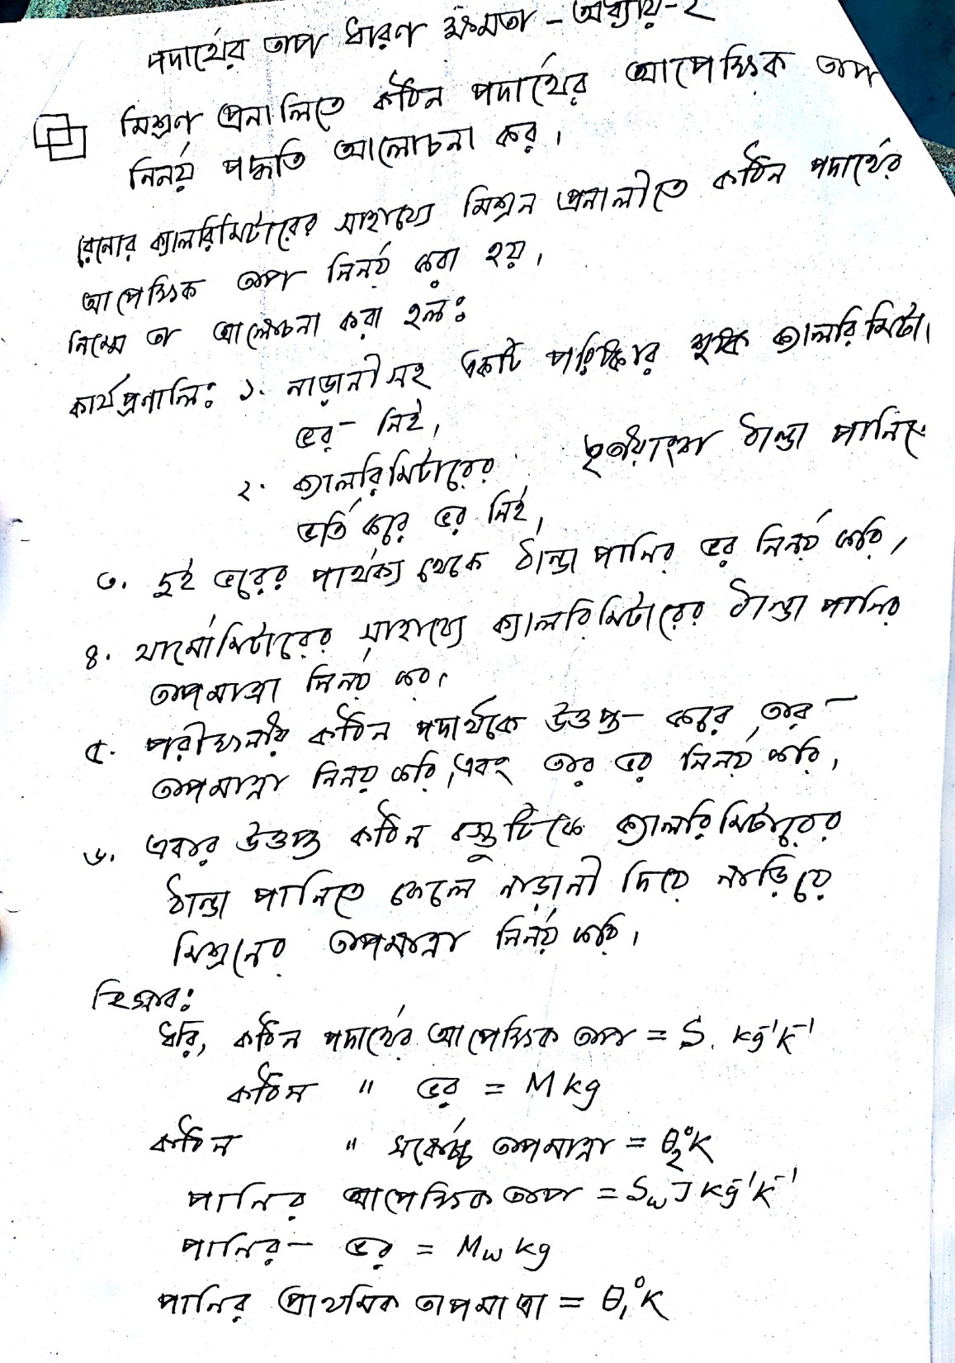

Slide 3
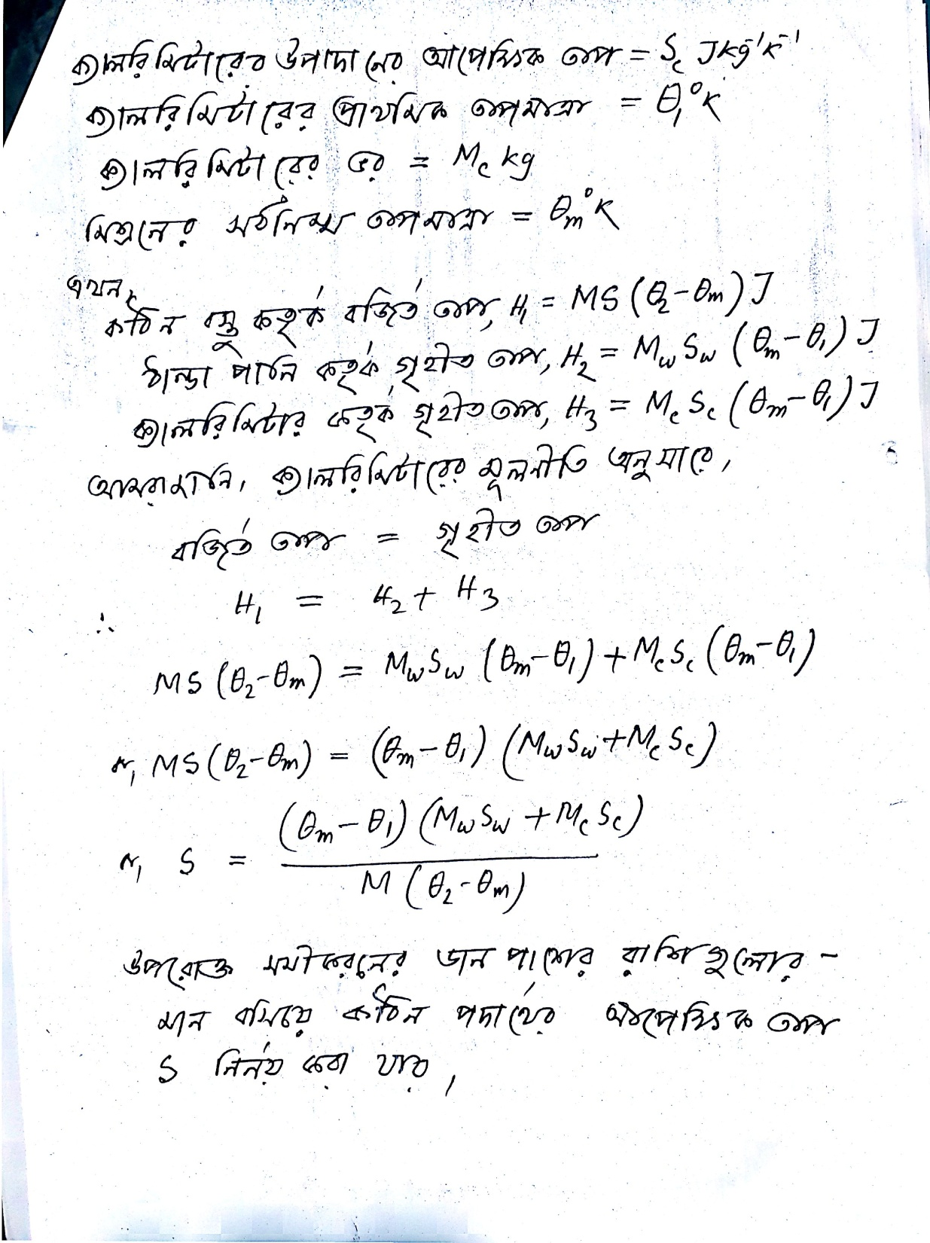

Slide 4
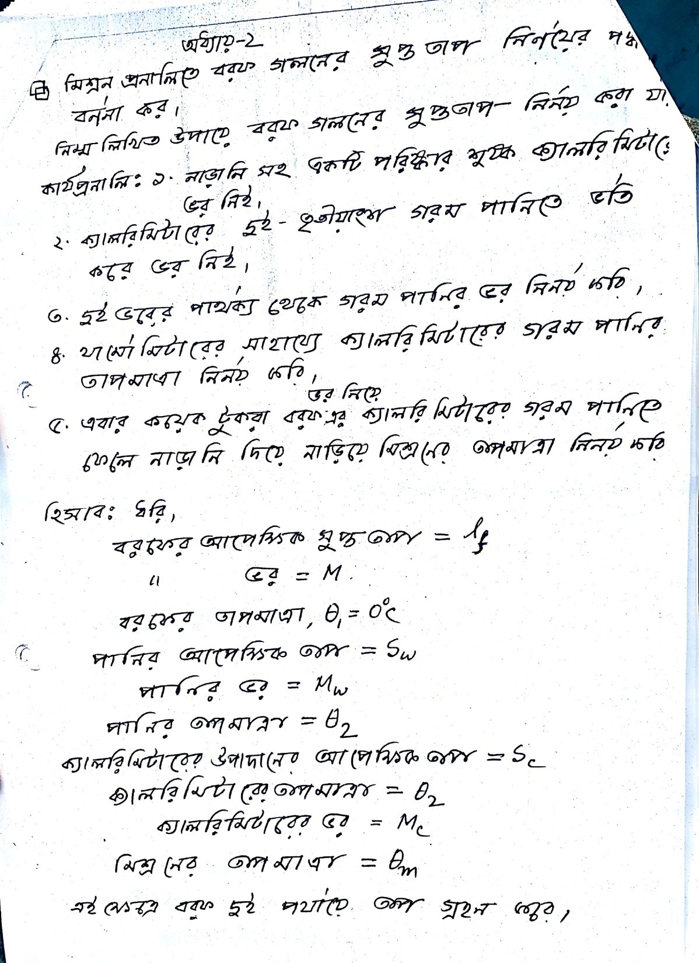

Slide 5
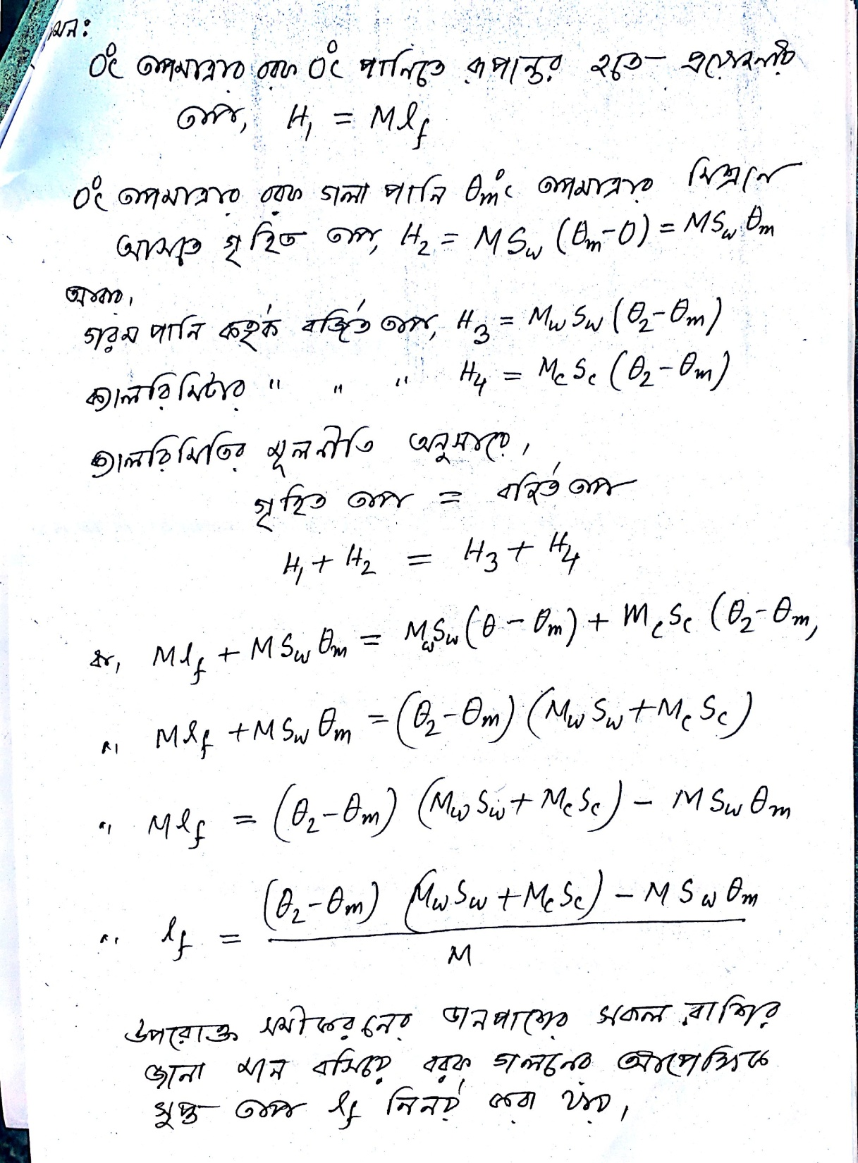

Slide 6

Thank You
Try your best

