Slide 1
BrickView Real Estate Analytics Platform
Developed by Shaik Rabbani GUVI AI/ML Bootcamp Project

Slide 2
Self Introduction
Good evening, everyone
My name is Shaik Rabbani. I am currently working as an Assistant Professor and have over 13 years of experience in Software Development, primarily in Full Stack Development.
As part of the GUVI AI/ML Bootcamp, I developed BrickView – Real Estate Analytics Platform, which helps users analyze real estate data through interactive dashboards, SQL analytics, and data visualizations.

Slide 3
Problem Statement
In the real estate industry, large amounts of property data are generated every day. As the volume of real estate data grows, manually analyzing property prices, sales trends, buyer behavior, and agent performance becomes time-consuming and inefficient.
The main problem this project addresses is converting raw real estate data into meaningful insights through an easy-to-use dashboard.

Slide 4
Project Objectives
The objectives of this project are:
Analyze real estate listings and sales data.
Build an interactive dashboard.
Perform business analysis using SQL.
Visualize trends through charts.
Implement CRUD operations for managing records.
Follow modular programming for better maintainability.

Slide 5
Technical Stack
Technology | Purpose
Python | Core programming language
Pandas | Data analysis and manipulation
SQLite | Database management
SQL | Data retrieval and analytics
Streamlit | Dashboard development
Matplotlib | Data visualization
HTML/CSS | UI customization

Slide 6
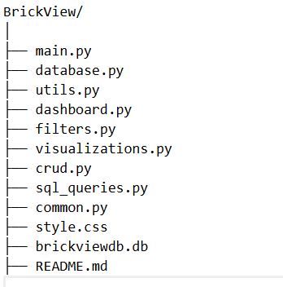
Project Structure
database.py => Database connection
dashboard.py => Dashboard interface
filters.py => Filtering logic
visualizations.py => Charts
crud.py => CRUD Operations
sql_queries.py => Business SQL Queries
utils.py/common.py => Reusable helper functions.

Slide 7
Database
Table | Purpose
Listings | Stores property details
Buyers | Stores buyer information
Sales | Stores completed sales
Agents | Stores agent details
Property Attributes | Stores additional property information

Slide 8
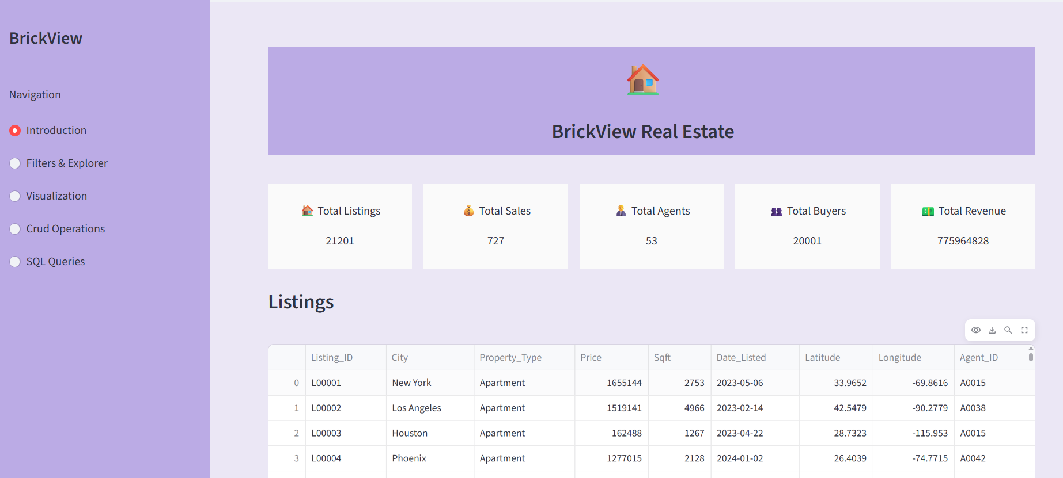
Dashboard
This is the main dashboard of the BrickView Real Estate Analytics Platform. The dashboard is designed to provide users with a quick overview of the real estate data through Key Performance Indicators, interactive filters, and visualizations.
At the top of the dashboard, I have displayed five important Key Performance Indicators (KPIs):
Total Listings – Shows the total number of properties available in the system.
Total Sales – Displays the total number of properties that have been sold.
Total Buyers – Indicates the total number of registered buyers.
Total Agents – Shows the number of real estate agents managing the properties.
Total Revenue – Displays the overall revenue generated from property sales.

Slide 9
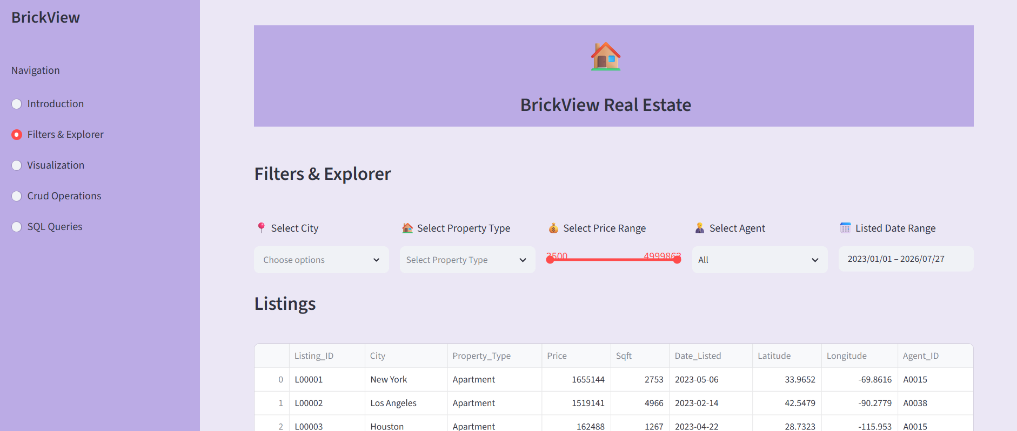
Filters & Explorer
To make the dashboard interactive, I implemented several filters that allow users to explore the data according to their requirements.
The available filters are: City – View properties from a specific city. Property Type – Filter properties such as apartments, villas, or commercial properties. Price Range – Analyze properties within a selected budget. Agent – Display properties managed by a particular real estate agent. Listed Date – Filter properties based on their listing date. Sale Date – Analyze properties sold during a selected time period. Whenever a filter is applied, the dashboard dynamically updates the displayed property listings and analytics, allowing users to perform focused data exploration

Slide 10
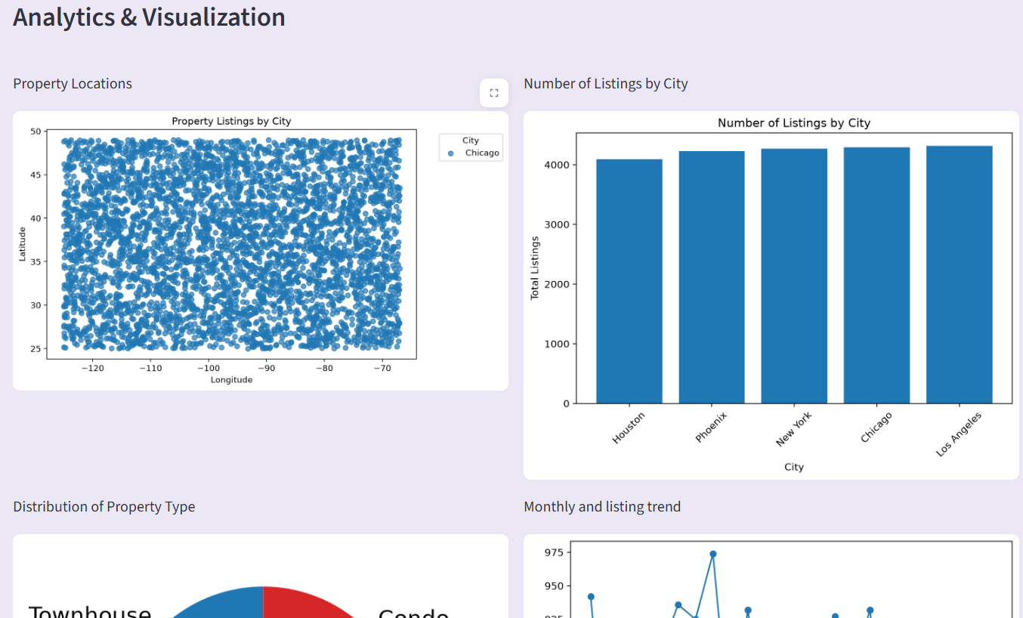
Visualizations
The dashboard also includes multiple visualizations to help users understand trends and patterns in the data.
The visualizations include:
Property Listings Map – Displays the geographical distribution of properties.
Average Price by City (Bar Chart) – Compares the average property prices across different cities.
Property Type Distribution (Pie Chart) – Shows the percentage distribution of different property types.
Monthly Sales Trend (Line Chart) – Helps analyze how property sales change over time.
Interactive Data Tables – Allow users to view and explore the filtered data in tabular format.

Slide 11
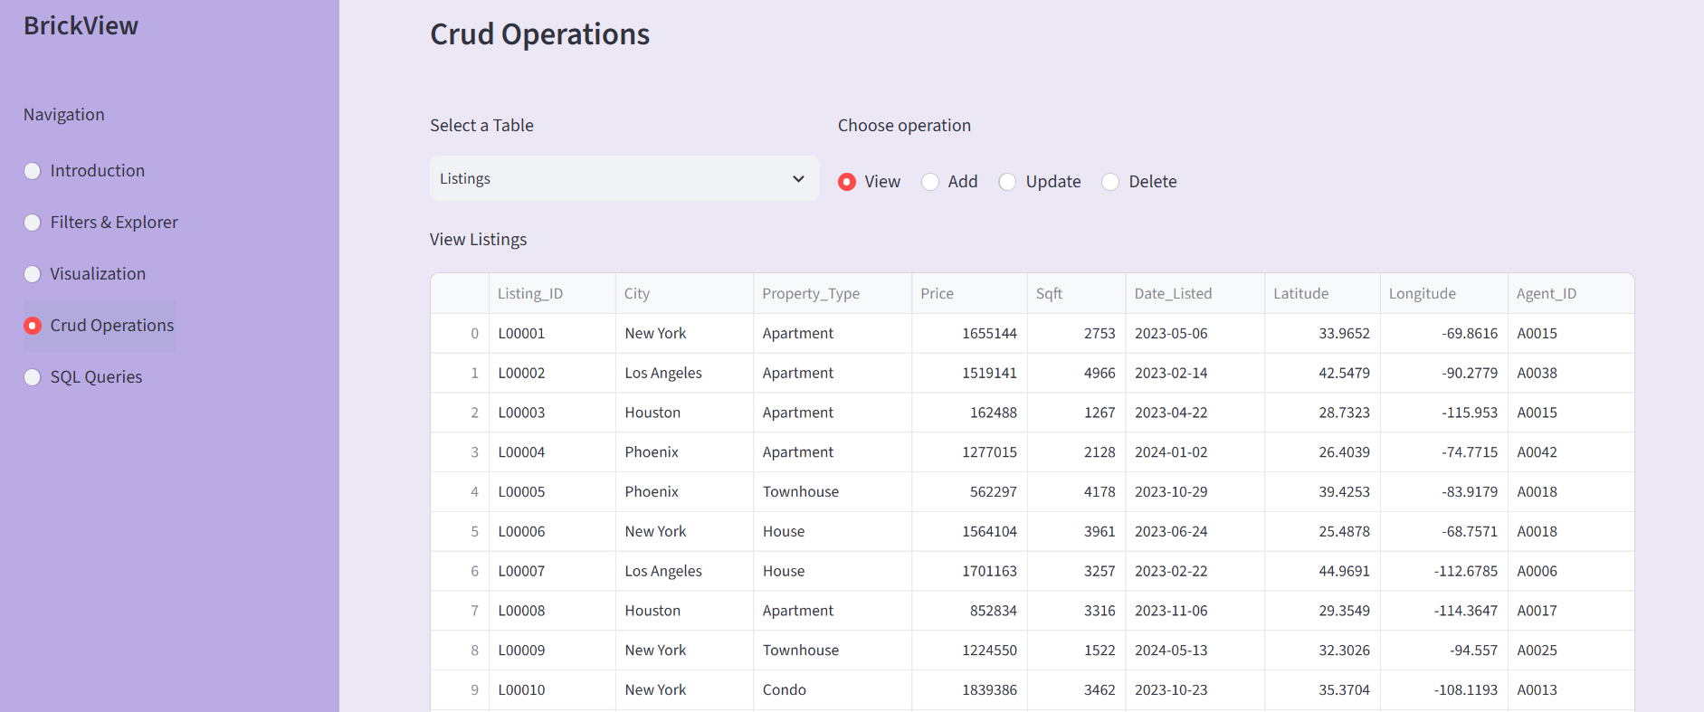
CRUD Operations
One of the key features of the BrickView Real Estate Analytics Dashboard is the implementation of CRUD operations. CRUD stands for Create, Read, Update, and Delete, which are the fundamental operations used to manage data in any database-driven application.
In this project, I implemented complete CRUD functionality for all the major database tables. This allows users to not only analyze data but also maintain and update it through the application interface.

Slide 12
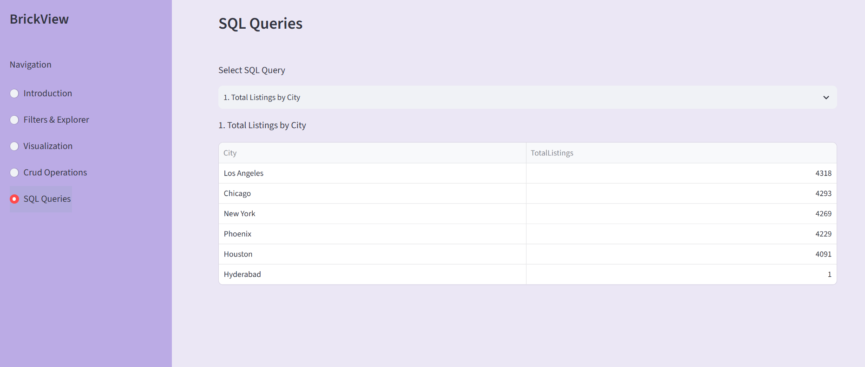
SQL Analytics
One of the core features of the BrickView Real Estate Analytics Dashboard is the SQL Analytics module.
The purpose of this module is to extract meaningful business insights from the real estate database by executing SQL queries. Instead of displaying raw data, SQL helps transform the data into actionable information that supports business decision-making.
In this project, I implemented 30 business-oriented SQL queries covering different aspects of the real estate business, such as sales, revenue, buyer behaviour, agent performance, and property analysis. The query results are displayed in an interactive table, allowing users to explore and interpret the data easily.

Slide 13
Conclusion
To conclude, BrickView is a Real Estate Analytics Dashboard that combines Python, Pandas, SQLite, SQL, Streamlit, and Matplotlib to provide meaningful business insights through interactive dashboards, visualizations, and analytics.
This project helped me strengthen my skills in data analysis, dashboard development, SQL, and modular Python programming.

