Slide 1

Southeast university Department of Computer Science & Engineering
Tournament Management System
Information system design
&
Software Engineering lab
Group Name: Alpha
Submitted By: Md shamim Rahman 2018000000008 Md Golam Rabbi 2018000000154 Dipu Mridha 2017100000123

Slide 2
Table of Contents
Introduction — 03
Goal of System — 03
Case Study — 03
Problem Statement — 03
Issues of System — 04
Objectives of the System— 04
Feasibility Analysis
Technical Feasibility: — 05
Economic Feasibility: — 05
Operational Feasibility: — 05
Cost-Benefit Analysis
Tangible Costs — 06
Intangible Costs — 06
Tangible Benefits— 06
Intangible Benefits — 06
Types of Stakeholders— 06
Functionality Grouping According to Users ----------------------------------------07
Non-Functionality Requirements (NFRs)------------------------------------------08
Overall Constraints— 08
Entity Relationship Diagram—--------------------------------------------------------09
ERD Description--------------------------------------------------------------------------10
Project Specification---------------------------------------------------------------------10
Use Case Diagram Description------------------------------------------------------------11
Use Diagram-------------------------------------------------------------------------------12
The relationship between actors and the use cases-------------------13
Activity Diagram---------------------------------------------------------------------------14
Description for Create account Activity Diagram---------------------------------15
For Online payment case---------------------------------------------------------------15
Description For Online Payment Activity Diagram-------------------------------16
GANTT Chart------------------------------------------------------------------------------16

Slide 3
Introduction: Tournament management system would like to host a Cricket tournament for students. The purpose of this project will be to help promote this tournament by making a simple website for students. The reason behind this is for students to visit and gain more information about the tournament. This website will include the time, date, and venue of the tournament.
Goal of Entire Project: The main goal of this project is to create a website. Other aims include multiple different designs, and a structured layout to create a suitable website for users to access and explore the information provided.
Case Study: This website is very useful for various sports organizations and sports club. It will also help to school and Colleges for manage tournament at school and College. So, our website provides them a single platform for all the details and management of tournament.
Problem Statement: Generally, most sports tournament management systems have problems like offline registration, planning, and budget. It is difficult to manage records of each player’s profile. There is also a problem to manage the schedule of the match

Slide 4
Issues of entire system: 1. Tournament scheduling problems. 2. Match scored card updating problems. 3. Sending problems of the match scorecard. 4. Invisibility of player performance time to time. 5. Selecting the right team for the tournament
Objective of entire system:
1. Administrators can publish match fixtures, results and there are live scoring and Tournament management capabilities.
2. Fans can monitor players and team’s performance and compare against others.
3. Analyses player information for retention, growth, talent identification and commercial opportunities.
4. Players can monitor their own performance and compare against others.
5. Coaches can do the high-performance analysis based on the reports
Feasibility Analysis :

Slide 5
Feasibility Analysis :
➢ We are planning to do this project with available resources that can implement it properly.
➢ This reliable website helps their entire technology to exist.
➢ We build updating scoping for development so that website can update in future for users' requirements.
Economical Analysis :
➢ This android application is based on MySQL, HTML, CSS, Java-Script. This application is built at a low budget and its helpful companies cost and availability of any users.
➢ If we need anything to add, we will build it via application by taking funds from companies' policies.
Operation Analysis:
➢ User friendly interfaces so that travelers can find any information easily.
➢ This system is updated on a regular basis.

Slide 6
Cost Benefit Analysis:
Tangible Cost:
1. System analyst cost.
2. Resources cost.
3. Developer cost.
Intangible Cost:
1.Internet cost.
2. Users' satisfaction.
Tangible Benefit:
Saving time for users. 2. Manage tournament.
Intangible Benefit:
1. Users satisfaction. 2. User’s services. 3. Security system.
Types of Stakeholder of Entire System:
1. Tournament Owner 2. Player 3. Admin

Slide 7
Functionally Grouping according to Types of users:
Tournament Owner:
i. Tournament owner can register for new tournament.
ii. Tournament owner can create f new tournament.
iii. Tournament owner give the confirmation about tournament registration to player.
iv. Tournament owner can view all matches details.
v. Tournament owner manage schedule.
2. Player: i. Player can register in the tournament.
ii. Player can view their profile.
iii. Player can view detail of different matches and different tournament.
iv. Player can search Tournament after registration in the system.
v. Player can view different match schedule.
3. Admin: i. Admin can upload news.
ii. Admin can approve player and tournament.
iii. Admin manage all data

Slide 8
Non-Functional Requirements (NFRs):
Error handling: This product handle expected and nonexpected error in ways that prevent loss information and long downtime period.
2. Authentication Requirements: System checks username and password every time when user log into the system and system hive different type of privilege to different users.
3. Security Requirements: System will use secured database normal users can just read information but they cannot edit or modify anything. System will have different types of users and every user has access constraints.
Conclusion: Sports management system is not only rewarding but it also helps the programmer to quickly organize the sports events and lists in short interval of time. I personally see this as a great way to find even more information for my topic. It will be able to check anything related to sports at any time. Paper work and manual work is reduced through this system. The system is user friendly and easy to use. I hope that the user would not only enjoy this system, but also get satisfaction from finding how each and every feature of sports management is implemented.

Slide 9
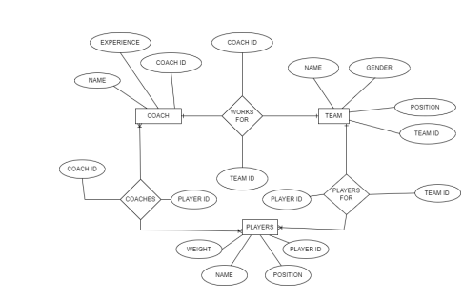
Entity Relationship Diagram

Slide 10
ERD DESCRIPTION: This project is initiated for to maintain the recording the information of the different players and athletes. This project will be quite affected in the sports events or sports clubs. This project will replace the old manual ways to record the information of the players and athletes and the sports and the event organizer don’t need the more people to maintain the records. He just needs the data base expert to maintain the records and information of the players and athletes and may be information about the event or the sports club.
Project Specification: This database application is used to maintain the current and the previous information about the event. We can sort the data by team, by player, by game, by match, by season, by event, by city, by country so that is organized and arranged in database that is very faster than the user to organized and arrange the data. For example, we sort out the data by player now there will be his current season information, his name, id, from which team he is belong and his previous and his history.

Slide 11
Use Case Diagram Description:
This Use Case Diagram is a graphic depiction of the interactions among the elements of Tournament Management System. It represents the methodology used in system analysis to identify, clarify and organize system requirements of Tournament Management. The main actors of Tournament Management in this Use Case Diagram are: Super Admin, System User, Trainer, Cricketer who perform the different type of use cases such as Manage Cricket, Manage Trainer, Manage Players, Manage Schedules, Manage Equipment, Manage Attendance, Manage Users and Full Tournament Management Operations. Major elements of the UML use case diagram of Tournament Management are shown on the picture below

Slide 12
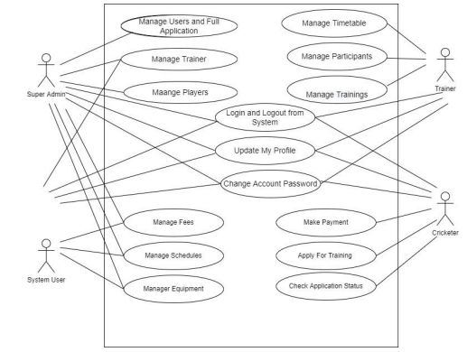
Use Diagram:

Slide 13
The relationship between and among the actors and the use cases of Tournament Management.
• Super Admin Entity: Use cases of Super Admin are Manage Cricket, Manage Trainer, Manage Players, Manage Fees, Manage Schedules, Manage Equipment Manage Attendance, Manage Users and Full Tournament Management Operations.
• System User Entity: Use cases of System User are Manage Cricket, Manage Trainer, Manage Players, Manage Fees, Manage Schedules, Manage Equipment Manage Attendance.
• Trainer Entity: Use cases of Trainer are Manage Participants, Manage Timetables, Manage Trainings, Manage Schedules.
• Cricketer Entity: Use cases of Cricketer are Apply for Training, Search Training, Check Application Status, Make Payment.

Slide 14
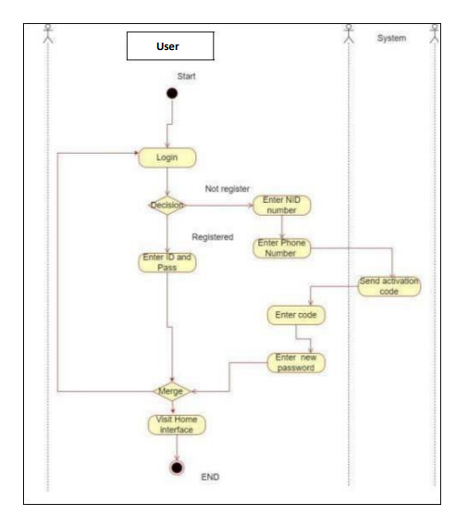
Activity Diagram:

Slide 15
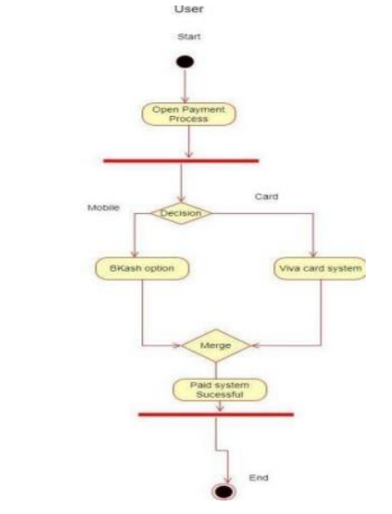
Description for Create account Activity Diagram: Here the activity that’s perspective for user and transport driver login page. If any user is a first-time user, then they go to the registration page. And then provided first name, last name and phone number and NID number. After that System sends the mobile verification that he/she provides on the registration page. Finally, user give password number and go through the home page of Application.
For Online payment case

Slide 16
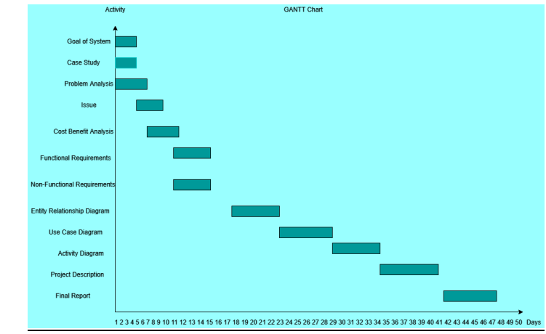
Description For Online payment Activity Diagram:
Here is this activity diagram for online payment which is defined by a single actor. User actors give to their online process by two types which is mobile banking and visa card. If anyone can pay for one of these, then get notifications of their interface Paid Process Successfully
GANTT Chart:
In this GANNT chart project starts at 0 and ends at 50 So total project duration is 48-0=48days

