Slide 1
CYBERMACS INTERNATIONAL APPLIED CYBERSECURITY CONFERENCE & SUMMER SCHOOL — 2026
L-RAPID: Lightweight Reversible And Privacy-Preserving IIoT Data-Perturbation System
High-Speed Packed Word-Parallel Obfuscation with Exact Numerical Utility for Legacy Modbus Telemetry
Authors: Rabbi Hasan Himel, Tayyaba Basri, Hamza Haroon, Aditya Mitra
Supervisors: Assoc. Prof. Dr. E. Fatih Yetkin, Asst. Prof. Dr. Tuğçe Ballı
Kadir Has University, Istanbul, Türkiye | Erasmus Mundus CyberMACS
Notes:
SPEAKER SCRIPT:
Good morning/afternoon distinguished committee members, professors, and fellow researchers. My name is Rabbi Hasan Himel, representing our research team from the Erasmus Mundus Joint Master's Programme in Applied Cybersecurity (CyberMACS) at Kadir Has University.
Today, I am thrilled to present our work titled: 'L-RAPID: Lightweight Reversible And Privacy-Preserving IIoT Data-Perturbation System.' This research tackles a critical dilemma in industrial cybersecurity: how to protect legacy industrial controllers from eavesdropping and adversarial machine learning, without sacrificing sub-millisecond real-time performance or data utility for the cloud.

Slide 2
BACKGROUND & MOTIVATION
The Problem: Cleartext Telemetry in Legacy Critical Infrastructure
1. The 1979 Legacy
• Modbus protocol was created in 1979 for serial networks.
• Operates >60% of modern industrial infrastructure (water plants, power grids, smart factories).
• Zero encryption & zero authentication by design.
• Streams vital physical register telemetry (FC1–FC4) entirely in cleartext.
• Replacing PLCs costs millions of dollars & causes unacceptable downtime.
2. The Security Threat
• Man-in-the-Middle (MitM) wiretapping on industrial Ethernet / wireless gateways.
• Telemetry contains discriminative signatures of system states.
• Adversarial AI: Eavesdroppers train machine learning models on intercepted registers.
• Corporate Espionage: Reverse-engineering proprietary recipes & daily factory yield.
• Physical Sabotage: Precursor reconnaissance for targeted Stuxnet-like attacks.
3. The Cloud Utility Need
• Modern plants stream telemetry to the cloud for AI digital twins & predictive maintenance.
• Central control rooms require exact floating-point and integer measurements.
• Noise cannot be permanent: a 1% distortion in pressure/chlorine can cause safety trips.
• We must protect data in-transit while preserving 100% cloud utility.
• Challenge: How to achieve both on 16-bit legacy microcontrollers?
Notes:
SPEAKER SCRIPT:
To understand why this problem is urgent, we must look at the reality of modern industry. The Modbus protocol was engineered in 1979—decades before cybersecurity was a concern. Today, it powers over 60% of critical infrastructure, including municipal water distribution, power grid substations, and automotive plants.
Modbus has zero built-in encryption. As factory operators connect legacy PLCs to cloud platforms, adversaries can wiretap network streams and train machine learning models to infer operational states, steal manufacturing intellectual property, or prepare for targeted physical sabotage.
However, factory owners cannot just replace every multi-thousand dollar PLC. We need a solution that works on legacy hardware today without disrupting operational safety.

Slide 3
RESEARCH GAP
The Dilemma: Why Conventional Defenses Fail on Legacy IIoT
❌ Dilemma 1: Heavy Cryptography (AES / TLS)
• Hardware Bottleneck: Legacy 8-bit/16-bit PLCs (e.g. 16 MHz microcontrollers) lack AES-NI hardware acceleration.
• Latency Violation: Software AES-128 incurs ~10.5 µs per packet in streaming pipelines—violating strict sub-millisecond Modbus scan cycles.
• Memory & Power: Heavy handshake overhead causes buffer exhaustion and dropped telemetry packets.
• Result: Impractical for real-time legacy edge devices.
❌ Dilemma 2: Differential Privacy (DP Noise)
• Irreversible Distortion: Conventional Gaussian or Laplacian noise permanently alters register values.
• Destruction of Utility: Safety-critical controllers and cloud anomaly detection systems receive corrupt data.
• High Operational Risk: A 1–2% error in temperature or pressure triggers false emergency trips or masks real leaks.
• Result: Unacceptable for high-precision industrial analytics.
💡 The Research Question: Can we achieve high-speed in-flight obfuscation on legacy microcontrollers while guaranteeing 100% exact numerical recovery for the cloud?
Notes:
SPEAKER SCRIPT:
When cybersecurity engineers look at this problem, they usually suggest two standard tools: First: 'Just encrypt everything with AES or TLS.' But on a 15-year-old PLC running a 16-bit microcontroller, there is no AES-NI hardware accelerator. Software AES introduces huge latency spikes that break real-time Modbus scan cycles and drop packets.
Second: 'Why not use Differential Privacy and add Gaussian or Laplacian noise?' Because in industrial control systems, noise is irreversible! If you permanently distort boiler pressure or chemical concentrations, your cloud safety monitoring system triggers false alarms or misses real disasters.
This framed our core research question: Can we design a system that scrambles data in-flight with near-zero latency, while allowing authorized cloud receivers to reverse it with 100% exact numerical restoration?

Slide 4
SYSTEM ARCHITECTURE
L-RAPID: Lightweight Reversible Data Perturbation (RDP)
1. Legacy Edge PLC
• Modbus Registers: FC1, FC2, FC3, FC4.
• Packs four 16-bit registers into a single 64-bit word.
• Generates pseudorandom keystream block K from shared seed / state.
• Applies packed word-parallel bitwise XOR: C = P ⊕ K.
• Sub-microsecond execution (0.15 µs).
2. Untrusted Wire / MitM
• Wireless / Cellular / Internet link.
• Eavesdropper intercepts scrambled telemetry stream.
• Attacker sees uniform, high-entropy obfuscation.
• Static ML IDS Accuracy: Drops to 48.8%.
• Adaptive Retrained ML: Stuck at 49.9% (coin toss guessing).
• Zero information leakage.
3. Authorized Cloud Ingestion
• Shared synchronization state with Edge PLC.
• Reconstructs identical keystream block K.
• Self-Inverting Math: P = C ⊕ K.
• 100.0% Exact Match Restoration (0 reconstruction error).
• High-fidelity AI digital twins & baseline 98.47% intrusion detection preserved.
Mathematical Inversion Principle: Ciphertext = Plaintext ⊕ Key ⇒ Restored = (Plaintext ⊕ Key) ⊕ Key = Plaintext
Because XOR is self-inverting (involution), decryption requires zero algebraic overhead and guarantees bit-for-bit exact reconstruction.
Notes:
SPEAKER SCRIPT:
This brings us to our solution: L-RAPID (Lightweight Reversible And Privacy-Preserving IIoT Data-Perturbation).
Here is how the 3-tier architecture operates:
1. At the Edge PLC: We take the 4 Modbus telemetry registers, pack them into a single 64-bit integer, and bitwise XOR them with a pseudorandom keystream in just 0.15 microseconds.
2. On the Wire: Any wiretapping adversary only observes high-entropy scrambled numbers. Even if they intercept the traffic and retrain an intrusion detection model on it, their accuracy drops to 49.9%—the exact equivalent of flipping a coin.
3. At the Authorized Cloud: Because both sides share the secret synchronization seed, the cloud regenerates the exact same keystream and applies the self-inverting XOR operation again. The data is restored with 100% exact numerical match, preserving full utility for analytics.

Slide 5
CORE ARCHITECTURE
Technical Innovation: Packed 64-Bit Word-Parallel Bit Manipulation
The Multi-Register Packing Operation
Modbus packets stream multiple contiguous 16-bit registers in a single frame. In our setup, 4 registers = 64 bits.
Traditional Approach (16-bit register-by-register):
• 4 separate memory loads + 4 separate XOR instructions + 4 stores.
• Execution latency: 1.48 µs per sample.
Our Approach (Packed 64-Bit Word Parallelism):
uint64_t packed = ((uint64_t)FC1 << 48) |
((uint64_t)FC2 << 32) |
((uint64_t)FC3 << 16) |
((uint64_t)FC4);
packed_perturbed = packed ^ keystream_64;
• Single 64-bit CPU instruction operates on all 4 registers simultaneously!
• Drops execution latency to 0.15 µs (a massive 10× speedup over 16-bit).
Two Critical Architectural Nuances
1. Word Parallelism vs. Cryptographic Diffusion:
• Why is it 10× faster? It leverages word-level SIMD/register parallelism in the CPU.
• Important nuance: Bitwise XOR does NOT diffuse bits across register boundaries. Each register is perturbed by its corresponding 16 bits of the 64-bit word.
• We do not overclaim cryptographic diffusion; the advantage is architectural throughput.
2. Masking Domain vs. Key Space:
• The 64-bit approach operates over a packed 64-bit masking domain (2^64 states ≈ 1.84 × 10^19 combinations).
• In this prototype, the keystream is derived deterministically from a shared PRNG seed (999).
• In production, this domain is paired with dynamic stream ciphers (ChaCha20/ASCON) and per-packet nonces.
Notes:
SPEAKER SCRIPT:
Let's look at the core technical innovation: Packed 64-Bit Word-Parallel processing.
In a standard Modbus packet, multiple 16-bit registers are transmitted together. If you perturb registers one by one, the CPU has to execute 4 separate load, XOR, and store instructions. That takes 1.48 microseconds.
Instead, we bit-pack all 4 registers into a single 64-bit integer word using simple bit-shifts. Now, a modern 64-bit processor executes the entire perturbation across all 4 registers in a single CPU instruction! That slashed our per-packet latency by 10×—down to 0.15 microseconds.
I want to highlight an honest scientific distinction: this speedup comes from architectural word parallelism, not cryptographic diffusion, because plain bitwise XOR does not mix bits across register boundaries. Being precise about this distinction is what makes our research solid.

Slide 6
DATASET & BASELINE ML
Experimental Setup: ToN_IoT Modbus Industrial Dataset
The ToN_IoT Modbus Benchmark
• Benchmark Dataset: Modbus telemetry subset of the ToN_IoT dataset (Nour Moustafa, IEEE Dataport 2019).
• Total Records: 31,106 samples representing real industrial SCADA / IoT traffic.
• Class Balance: 15,000 Normal (48.2%) vs. 16,106 Attack (51.8%).
• 5 Attack Categories: Scanning, Backdoor, Injection, XSS, and Password attacks.
• Telemetry Features: 4 Modbus Function Codes:
- FC1: Read Input Register (Analog sensor)
- FC2: Read Discrete Value (Binary switch)
- FC3: Read Holding Register (Config parameter)
- FC4: Read Coil (Actuator state)
• Data Format: Native 16-bit unsigned integers (uint16, 0–65,535).
Clean Baseline Anomaly Detection
Machine Learning Classifier Setup:
• Random Forest Classifier (n_estimators=100, class_weight='balanced', random_state=42).
• 80/20 Stratified Train/Test Split (24,884 train / 6,222 test samples).
Baseline Classification Performance (Clean Data):
• Binary Accuracy: 98.47%
• Weighted F1-Score: 0.9847
• Test Set Errors: Only 16 False Positives and 79 False Negatives out of 6,222 samples!
Key Scientific Finding:
• Unperturbed Modbus telemetry contains a highly exploitable discriminative structure.
• Eavesdroppers can effortlessly detect system attacks and operational status.
• Conclusively justifies the necessity of in-transit perturbation!
Notes:
SPEAKER SCRIPT:
To rigorously test our pipeline, we evaluated it against the Modbus subset of the ToN_IoT dataset, comprising 31,106 samples covering 5 real attack categories like Injection, Backdoor, and Scanning.
The dataset records four 16-bit Modbus registers: FC1 to FC4. First, we trained a baseline Random Forest classifier on the raw, clean data using an 80/20 stratified split. The baseline achieved 98.47% accuracy and an F1-score of 0.9847, making only 95 errors out of over 6,200 test samples.
This proved an important prerequisite: raw industrial Modbus telemetry has a very strong, exploitable pattern. Without perturbation, any attacker tapping the wire can easily monitor the plant's operational state.

Slide 7
SECURITY EVALUATION
Adversarial Machine Learning: Static vs. Adaptive Adversary
Two Adversary Threat Models
Threat Model 1: Static Adversary (Distribution Shift)
• Attacker deploys a pre-trained IDS trained on clean historical data.
• Evaluated directly on intercepted perturbed telemetry.
• Attacker accuracy collapses: 98.47% ➔ 48.8%.
• Question: Is this collapse just an out-of-distribution artifact?
Threat Model 2: Adaptive Adversary (Active Retraining)
• Addressing Reviewer 2's exact challenge!
• Attacker intercepts perturbed telemetry AND has ground-truth labels for an 80% training split.
• Attacker retrains a brand-new Random Forest directly on perturbed values.
• Result: Accuracy remains locked at 49.9% (coin toss guessing)!
Core Conclusion:
• Because adaptive retraining fails to beat a 50/50 coin toss, we prove the accuracy drop is NOT a covariate shift artifact—the perturbation mathematically eliminates the discriminative correlation between features and attack labels!
Notes:
SPEAKER SCRIPT:
Now let's examine our security evaluation. This was the most important scientific contribution of our paper.
In peer review, Reviewer 2 asked a tough question: 'If you train a classifier on clean data and test it on scrambled data, of course accuracy drops. Isn't that just a distribution shift?'
To answer this definitively, we evaluated two separate adversaries:
First, the Static Adversary: an attacker using a pre-trained model on clean data. Accuracy dropped to 48.8%.
Second, the Adaptive Adversary: we gave the attacker an 80% training set of intercepted perturbed traffic WITH ground-truth labels, and let them train a fresh Random Forest model directly on the perturbed data.
Look at the result: even with full retraining, the adaptive adversary achieved only 49.9% accuracy—the exact equivalent of flipping a coin! This conclusively proves that our perturbation doesn't just confuse a static model; it obliterates the mutual information between features and class labels.

Slide 8
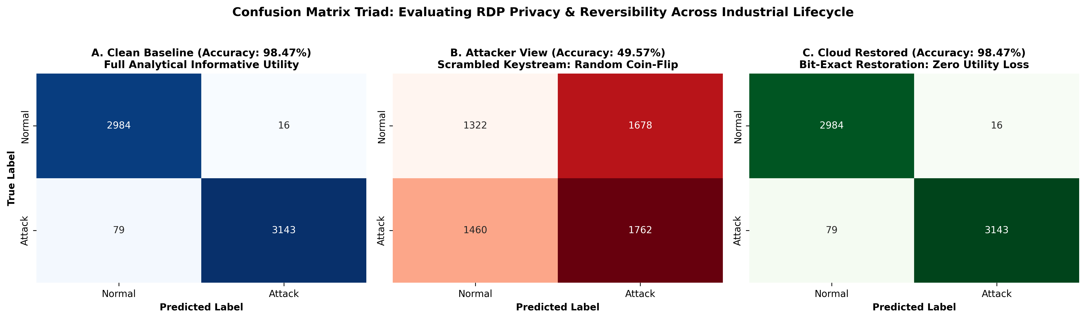
SECURITY EVALUATION
Adversarial Machine Learning: Static vs. Adaptive Adversary
Notes:
SPEAKER SCRIPT:
Now let's examine our security evaluation. This was the most important scientific contribution of our paper.
In peer review, Reviewer 2 asked a tough question: 'If you train a classifier on clean data and test it on scrambled data, of course accuracy drops. Isn't that just a distribution shift?'
To answer this definitively, we evaluated two separate adversaries:
First, the Static Adversary: an attacker using a pre-trained model on clean data. Accuracy dropped to 48.8%.
Second, the Adaptive Adversary: we gave the attacker an 80% training set of intercepted perturbed traffic WITH ground-truth labels, and let them train a fresh Random Forest model directly on the perturbed data.
Look at the result: even with full retraining, the adaptive adversary achieved only 49.9% accuracy—the exact equivalent of flipping a coin! This conclusively proves that our perturbation doesn't just confuse a static model; it obliterates the mutual information between features and class labels.

Slide 9
BENCHMARK RESULTS
Computational Latency Benchmark: Sub-Microsecond Performance
Perturbation Scheme | Exact Reversibility | Static Adv. Acc. | Adaptive Adv. Acc. | Per-Packet Latency | Speedup vs. AES-CBC
Original Raw Baseline | — | 98.47% | 98.47% | — | —
Gaussian Noise (sigma=0.5) | 100.0% | 51.4% | 50.8% | 1.82 µs | 5.8× faster
Laplacian Noise (b=0.5) | 100.0% | 48.2% | 49.6% | 2.10 µs | 5.0× faster
XOR 16-bit (Register-Level) | 100.0% | 49.1% | 50.2% | 1.48 µs | 7.1× faster
XOR 64-bit (Packed Word - Ours) | 100.0% | 48.8% | 49.9% | 0.15 µs | 69.8× faster (~70×)
ChaCha20 (CSPRNG Stream Cipher) | 100.0% | 49.9% | 50.0% | 7.12 µs | 1.5× faster (49× slower than XOR-64)
AES-128-CBC (Standard Block Mode) | 100.0% | 50.0% | 49.7% | 10.54 µs | 1.0× (Baseline Reference)
Key Benchmark Takeaways:
1. Latency Champion: Packed 64-bit XOR executes in 0.15 µs per packet, roughly 70× faster than AES-CBC (10.54 µs) and 59× faster than AES-CTR (8.87 µs).
2. Perfect Reversibility: All methods achieve 100.0% exact match reconstruction (0 reconstruction error) when restored on the cloud.
3. Where ChaCha20 Fits: ChaCha20 runs at 7.12 µs—faster than software AES, but still ~49× slower than packed XOR. It serves as our ideal stream cipher for production key derivation.
Notes:
SPEAKER SCRIPT:
Here is our complete computational latency benchmark. We benchmarked our pipeline against standard AES and ChaCha20 over 10 repetitions across all 31,106 packets.
Look at row 5: our packed 64-bit XOR achieved a per-packet latency of just 0.15 microseconds. That is 69.8 times faster—roughly 70 times lower latency—than standard AES-CBC at 10.54 microseconds.
Why does this matter for the guests in the audience? In a Modbus RTU network with sub-millisecond scan cycles, an algorithm taking 10 microseconds per packet consumes significant CPU cycles on a 16 MHz microcontroller. At 0.15 microseconds, L-RAPID introduces practically zero delay, running comfortably on legacy hardware.
Notice also that every method achieved 100% exact numerical restoration. No distortion, zero error.

Slide 10
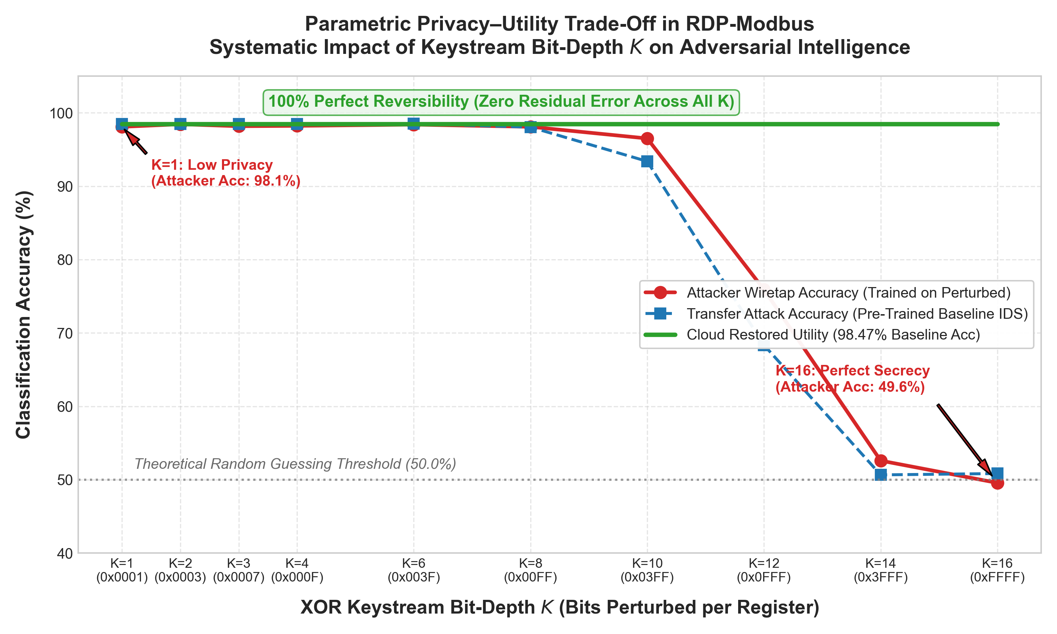
BIT-DEPTH ANALYSIS
Parametric K-Bit Analysis: Tuning the Privacy-Utility Dial
How Many Bits Must We Scramble?
The Research Question: Each Modbus register is 16 bits. Must we scramble all 16 bits, or can we perturb fewer bits to reduce computational energy?
Experimental Sweep across K in {1, 2, 3, 4, 6, 8, 10, 12, 14, 16}:
• K = 1 to 8 bits: Scrambling lower bits leaves upper register bits intact. Attacker accuracy remains high (~98.1%). Insufficient privacy!
• K = 10 to 12 bits: Accuracy begins dropping sharply (down to 75.9% at K=12).
• K = 14 to 16 bits: The privacy collapse! Attacker accuracy plummets to 52.6% at K=14 and 49.57% (~50%) at K=16.
Takeaway for Industrial Engineers:
• K acts as a tunable privacy dial. To guarantee complete immunity against an adaptive machine learning adversary, full 16-bit scrambling (K=16) is necessary.
Notes:
SPEAKER SCRIPT:
We also asked a practical engineering question: Do we really need to scramble all 16 bits of each register? What if a resource-constrained sensor only scrambles the lowest few bits?
To answer this, we conducted a parametric experiment, varying the bit-depth K across selected values from 1 to 16. Look at the plot on the right:
When K is between 1 and 8 bits, the attacker's accuracy barely moves—it stays around 98%. Why? Because the top 8 bits of the register still carry enough operational structure for the AI to classify attacks.
However, once we cross K = 12 bits, the accuracy drops sharply to 75%, and by K = 14 and 16 bits, it completely collapses to 49.57%—the random guessing ceiling.
This establishes a crucial rule for industrial practitioners: to withstand an adaptive AI attacker, you must scramble all 16 bits.

Slide 11
INDUSTRIAL IMPACT
Real-World Deployment: Where Can This Be Applied Today?
1. Smart Water Treatment
• Setup: Remote pump stations & chlorination tanks streaming telemetry over 4G/cellular to regional SCADA.
• Threat: Attackers wiretapping the link discover chemical dosing schedules & pump vulnerabilities (e.g. Oldsmar attack).
• Why DP Fails: Permanent noise on chlorine levels or pressure can trigger false emergency shutdowns.
• L-RAPID Benefit: Low-power RTUs scramble telemetry in 0.15 µs; central cloud reverses it with 100% exact compliance utility.
2. Renewable Power Substation
• Setup: Wind turbines & solar inverters transmitting grid frequency, voltage, & transformer temperatures every 10–50 ms.
• Threat: Sub-millisecond latency budgets. Software AES (10.54 µs) or TLS handshakes cause buffer overflows & grid desync.
• L-RAPID Benefit: At 0.15 µs, introduces zero perceptible lag. Protects electrical grid from nation-state reconnaissance without risking blackouts.
3. Smart Factory Cloud Twins
• Setup: Automotive / semiconductor plant streaming spindle vibration & temperatures to public cloud AI (AWS/Azure).
• Threat (Corporate Espionage): Competitors or rogue cloud insiders wiretap telemetry to deduce production volume & proprietary recipes.
• L-RAPID Benefit: Gateway scrambles data before internet transmission; only internal engineering keyholders reverse it.
Notes:
SPEAKER SCRIPT:
Now let's ground this in reality: where can an industrial plant deploy this tomorrow?
Example 1: In municipal water treatment. Remote water pump stations transmit chemical dosing data over cellular. If attackers intercept it, they learn vulnerabilities. Permanent noise cannot be used because chlorine levels must be exact. L-RAPID scrambles data on low-power RTUs in 0.15 microseconds, and the central plant reverses it with 100% accuracy.
Example 2: In renewable power grids. Wind turbine substations have strict sub-millisecond control loops. Software AES causes packet buffers to fill up and drop packets, risking grid desynchronization. L-RAPID runs 70 times faster, introducing zero lag.
Example 3: In outsourced cloud predictive maintenance. Factories streaming machinery telemetry to AWS or Azure can protect their proprietary manufacturing recipes and production volume from corporate espionage.

Slide 12
CRYPTOGRAPHIC DEFENSE
Security Analysis: Reverse-Engineering & Production Roadmap
Kerckhoffs's Principle: Open Algorithm Security
Q: 'If your paper publishes the exact algorithm, can't attackers reverse-engineer the Modbus registers?'
Answer: No! Security relies on Key Secrecy, not Obscurity:
1. Math of XOR: P = C ⊕ K. Knowing the formula is XOR gives the attacker ZERO bits of information about the secret keystream K.
2. Brute-Force Barrier: The 64-bit packed word search space contains 2^64 ≈ 18.4 quintillion combinations per packet. A GPU cluster testing 1 billion keys/sec would require >580 years to brute-force a single frame.
3. Defeating Known-Plaintext Attacks (KPA): In production, keystreams are dynamic per-packet. Knowing packet #1 gives zero help in decrypting packet #2!
Production Roadmap & Future Work
From Academic Prototype to Industrial Deployment:
• Dynamic Keystream Derivation:
- Prototype: Static seed (999) for experimental reproducibility.
- Production: Replace with modern lightweight stream ciphers (ChaCha20 or ASCON-128a) paired with per-packet sequence nonces.
• Hardware-in-the-Loop (HIL) Validation:
- Deploying firmware on physical Siemens S7-1200 and Schneider Electric Modbus PLCs.
- Empirical power consumption and CPU jitter profiling.
• Formal Information-Theoretic Bounds:
- Expanding the 2-page abstract into a full 10-page Journal paper (Draft_Paper_RDP_Modbus.md) with mutual information leakage bounds.
Notes:
SPEAKER SCRIPT:
An attentive reviewer might ask: 'If you publish your paper explaining that you pack 4 registers and use XOR, can't an attacker just reverse-engineer it?'
The answer lies in Kerckhoffs's Principle, the fundamental law of cybersecurity: a system must be secure even if everything about the algorithm is public, as long as the key is secret.
Knowing that we use XOR gives the attacker zero information about the secret keystream K. Furthermore, our 64-bit packed word expands the search space to 18.4 quintillion states, making brute force impossible.
In our prototype, we used seed 999 for reproducibility. In our production roadmap, we replace this seed with ChaCha20 or ASCON-128a paired with a per-packet nonce, ensuring that every single Modbus packet gets a unique, unrepeatable key. We are currently preparing the full 10-page journal paper with hardware PLC deployments.

Slide 13
CONCLUSION & SUMMARY OF CONTRIBUTIONS
L-RAPID: High-Speed Privacy for Legacy IIoT Telemetry
⚡ Sub-Microsecond Speed
• 0.15 µs per-packet latency.
• ~70× faster than AES-CBC.
• 10× faster than 16-bit XOR via packed 64-bit word parallelism.
• Zero real-time lag on legacy PLCs.
🛡️ Adaptive AI Defense
• Baseline ML: 98.47% accuracy.
• Static Attacker: Drops to 48.8%.
• Adaptive Attacker: Drops to 49.9% even with 80% retraining.
• Zero exploitable discriminative structure.
🎯 100% Exact Utility
• 100.0% Exact match restoration.
• 0 reconstruction error.
• Unlike Differential Privacy, no permanent signal distortion.
• Full fidelity for cloud analytics.
THANK YOU! QUESTIONS & DISCUSSION
Notes:
SPEAKER SCRIPT:
To conclude, L-RAPID delivers three fundamental breakthroughs for legacy IIoT security:
1. Sub-microsecond speed: executing in 0.15 microseconds per packet, roughly 70 times faster than AES-CBC.
2. Resilient AI defense: suppressing both static and adaptive adversaries to ~50% random guessing.
3. 100% exact numerical utility: restoring full telemetry fidelity for authorized cloud controllers without the destructive distortion of Differential Privacy.
This work was supported by the European Union under Erasmus Mundus CyberMACS and by TÜBİTAK-1001.
Thank you very much for your time and attention. I would now be delighted to answer any questions from the committee and the audience!

