Slide 1
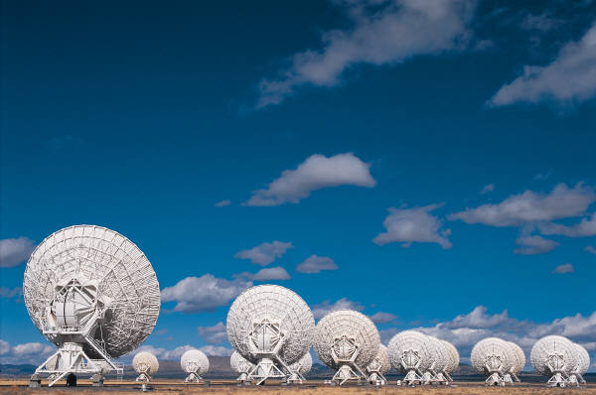
Virtualization
A move towards Greener Planet

Slide 2
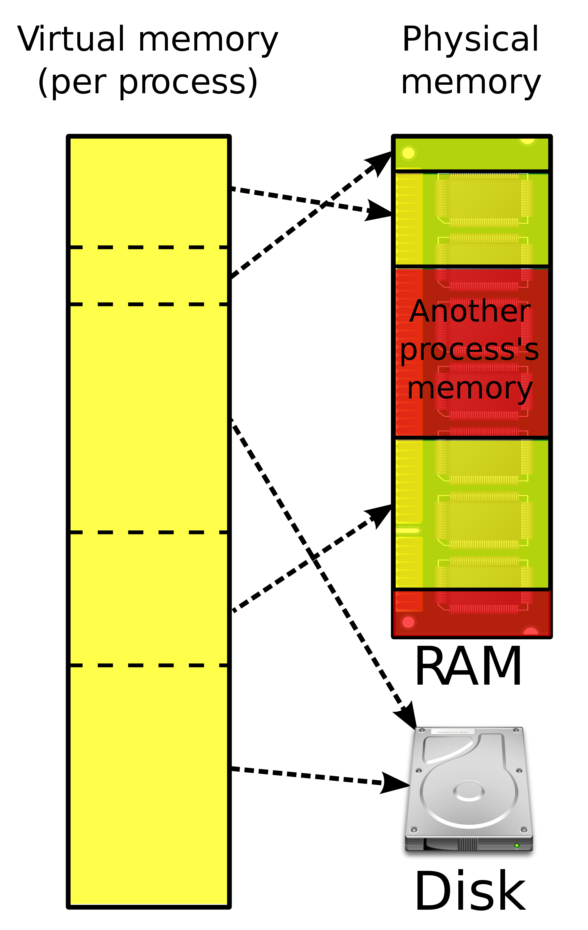
Virtualization
Virtual : Imaginary

Slide 3
Definition
It is the technology which is making a transformation in IT by saving cost, energy, time.
Virtualization provides an emulation of hardware (computer resources) to different virtual machines. A virtual machine is an illusion of existing machine, which uses the resources of underlying machine & works as actual machine.

Slide 4
Virtualization is to run different operating systems and different applications on same machine at the same time, giving an illusion that each is running on different machines.
One physical machine to support multiple virtual machines that run in parallel.

Slide 5
Virtualization:Abstraction
Virtualization is a framework or methodology of dividing the resources of a computer into multiple execution environments, by applying one or more concepts or technologies such as hardware and software partitioning, time- sharing, partial or complete machine simulation, emulation, and quality of service.

Slide 6
Multiple Operating System on a single physical system
Sharing the underlying hardware
Time Sharing
Complete or Partial Emulation of resources
Multiple Executions

Slide 7
Greener Approach
The Reality:
Most servers only use 5-15% of their capabilities on average, while consuming 60-90% of their peak power.
The Solution - Virtualization:
Use one server to host multiple applications.
Reduce energy consumption
Reduce CO2 emissions
Running fewer, highly utilized servers frees up space and power. Less space and power is better for environment and saves money.

Slide 8
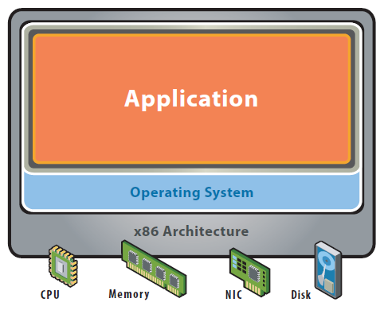
Need for Virtualization
Single OS image per machine
Software and hardware tightly coupled
Running multiple applications on same machine often creates conflict
Inflexible and costly infrastructure

Slide 9
Need…
Cloud computing promises to give you as much as you desire. It is a fully scalable and elastic model. But to fulfill the real time demands a lot of infrastructure is required, which would require a lot of cost and energy consumption too. The solution to it is Virtualization. As with virtualization the same resource can be made available to many user concurrently. Therefore virtualization is the basic need of cloud computing

Slide 10
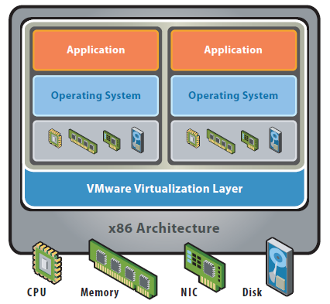
Virtualization Gave..
Hardware-independence of operating system and applications
Virtual machines can be provisioned to any system
Can manage OS and application as a single unit by encapsulating them into virtual Machines

Slide 11
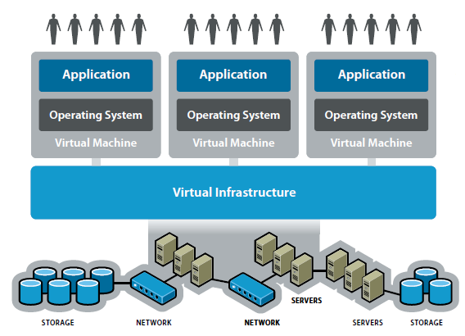

Slide 12
Benefits of Virtualization
Reduce the number of physical machines
Isolate environments but share hardware
Make better use of existing capacity
Virtualize Network and SAN interfaces to reduce infrastructure needs
Ultimately save on maintenance
More Flexible
Energy Saving
…

Slide 13
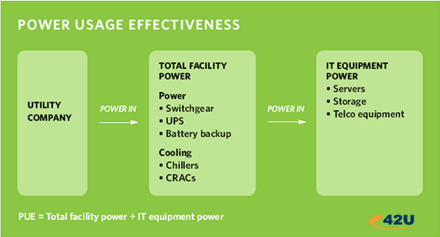
Cloud Computing - Green - PUE
How efficient is your data-center?
PUE = Power Usage Effectiveness
Notes:
Better define PUE in plain language
Excessive energy usage equals increased cost
Excessive server space equals increased cost
Inefficient server usage equals increased cost
Outcome -
Cloud providers use less energy, less data center space and more efficiently leverage server usage than traditional data-centers.

Slide 14
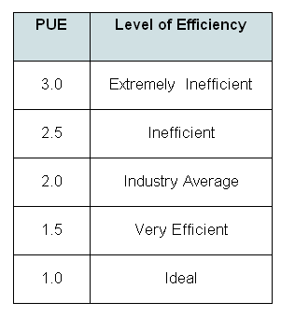
Cloud Computing and Green IT
Cloud Platforms PUE
Salesforce: 1.5 --- Google: 1.2
Salesforce is co-located in highly efficient data centers.
Google manages their own data centers.
Notes:
Speak to data center consolidation effort - Use as
Traditional Offices even worse -
Data Center average is 2.0 ...

Slide 15
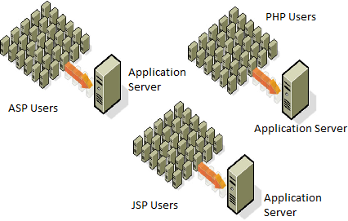
Cost Reduction Example

Slide 16
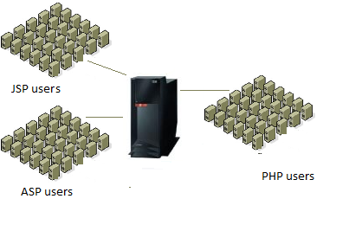
Cost Reduction Example

Slide 17
Types
Execution Level
Operating System
Programming
Application
Storage

Slide 18
Execution
This type of virtualization provides an execution environment for executing the applications /operating system/ byte code.
It can be achieved by:
Hardware Level Virtualization: - This type of virtualization provides an illusion of having many resources (hardware) over one machine (hardware). Same hardware is emulated (reproduced) to many users. Same hardware can be used as different hardware.

Slide 19
Hardware Virtualization
For it a Virtual Machine Manager (VMM) is required, which is called hypervisor. A hypervisor is one, which receives the request from created Virtual Machine for a resource and allocates the resource from underlying hardware.

Slide 20
In it the complete hardware is emulated by VMM to create different Virtual machines. These Virtual machines can have different operating system if desired. Thus, actually (physically) there is only one machine with one operating system but it appears as if there are many machines with different operating system. Application shares the resources & run concurrently as if running on different machines.

Slide 21
Hypervisor
A computing layer which allows multiple operating systems to run on a host computer at the same time.
Originally developed in the 1970s as part of the IBM S/360
Also known as VMM (Virtual Machine Monitor)

Slide 22
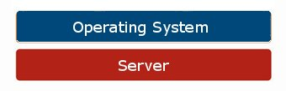
The Hypervisor
Conceptual diagram of typical server configuration without virtualization

Slide 23
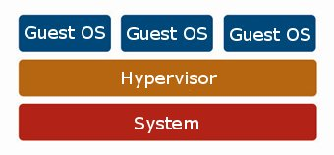
The Hypervisor
The role of the Hypervisor in supporting Guest Operating Systems on a single machine.

Slide 24
Hypervisor is a software program that manages multiple operating systems (or multiple instances of the same operating system) on a single computer system. The hypervisor manages the system's processor, memory, and other resources to allocate what each operating system requires.

Slide 25
Types of Hypervisor
Two Types
Type1:Bare Metal, Native (Hosted without host O/S)
Type2: (Hosted on Host O/S)

Slide 26
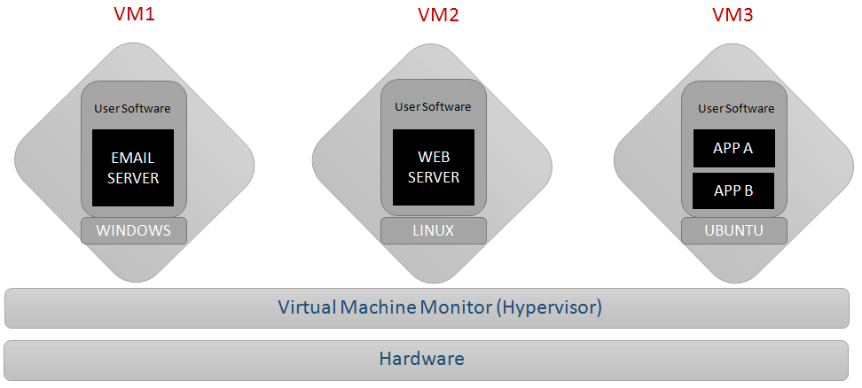
BARE-MATEL ARCHITECTURE

Slide 27
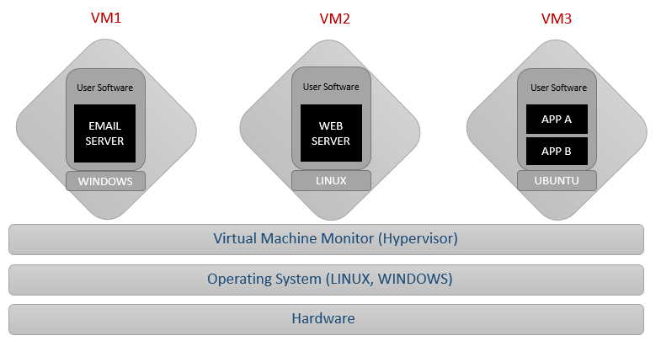
HOSTED ARCHITECTURE

Slide 28
Hardware Virtualization Types
Full virtualization:- This allow running an application / operating system or virtual machine, in the same way as it would have run on host, without any modification in the code. It provides complete isolation.
Para virtualization:- In it the guests need to be modified. The operating system to be put on virtual machine need some modifications, this they are generally used for open source operation system.
Partial Virtualization:- It provides partial emulation of underlying hardware, thus the complete hardware (resources) are not virtualized, only some part is virtualized. It results not complete isolation of guest operating system. Many application can run transparently, but not all the features of operating system can be supported.

Slide 29
Binary Translation
Kernel code of non-virtualizable instructions are translated to replace with new sequences of instructions that have the intended effect on the virtual hardware.
Each virtual machine monitor provides each Virtual Machine with all the services of the physical system, including a virtual BIOS, virtual devices and virtualized memory management.
This combination of binary translation and direct execution provides Full Virtualization as the guest OS is fully abstracted from the underlying hardware by the Virtualization layer.
The guest OS is not aware it is being virtualized and requires no modification.
The hypervisor translates all operating system instructions on the fly and caches the results for future use, while user level instructions run unmodified at native speed.
Examples VMware
Microsoft Virtual Server

Slide 31
Paravirtualization – via a modified OS kernel as guest OS
Paravirtualization involves modifying the OS kernel to replace non-virtualizable instructions with hypercalls that communicate directly with the Virtualization layer hypervisor.
The hypervisor also provides hypercall interfaces for other critical kernel operations such as memory management, interrupt handling and time keeping.
Paravirtualization is different from full Virtualization, where the unmodified OS does not know it is virtualized and sensitive OS calls are trapped using binary translation.
It is very difficult to build the more sophisticated binary translation support necessary for full Virtualization, modifying the guest OS to enable paravirtualization is relatively easy.
Paravirtualization cannotsupport unmodifiedOS
Example:
Xen -- modified Linux kernel and a version of Windows XP

Slide 33
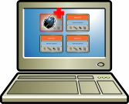
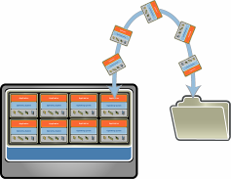
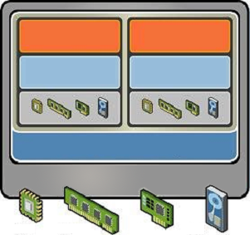
KEY FEATURES
.Partitioning
.Different OS can run on one physical machine
.System resources can be divided between virtual machines
Isolation
Fault and security isolation on a hardware level
Extended resource control for constant performance
Encapsulation
Complete status of a virtual machine can be stored in a file
Move and copy of a virtual machine is as easy as it is with files

Slide 34

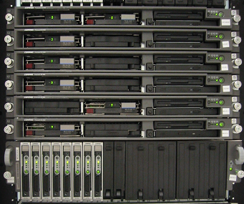
SERVERS CONSOLIDATION
110 Servers without VMware software
12 Servers, 1 rack with VMware software

Slide 35
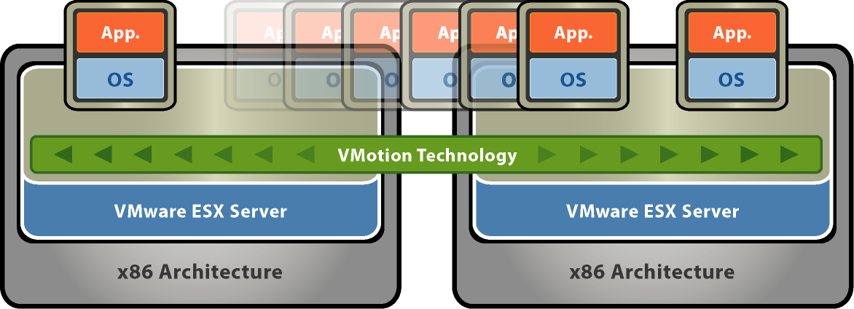
VMWARE VMOTION
The VMotion technology allows the live migration of virtual machines
from one physical server to another and needs therefore no downtime for maintenance activities.
Move running applications to other servers without disruption. Zero downtime for hardware maintenance.
Automates moving virtual machines to other hosts and automates re-balancing after maintenance complete

Slide 36
Operation System virtualization
In it the same operating system, provides different execution environment for different concurrent applications. There is no hypervisor, all the application runs on same machines having one operating system. Different applications share the resources and run concurrently as if running on different machines. A separate user space instance is created. This is provided by time-sharing operation system like UNIX. Different user space is provided to all users

Slide 37
Programming Level Virtualization
In it the code of program is complied for a Virtual machine not for machine code eg. Java.

Slide 38
Application Level Virtualization
Application Level Virtualization allows application to be run on run time environment, which natively do not support all the features required by such application. It allows running application on one operating system, which actually does not support that application. It allows executing a program, compiled for different network. This is done at operating system level by emulation, using a thin log on program or operating system components eg. Cross over provides facility to run windows application on Mac operating system.

Slide 39
Storage
In this type of virtualization basic focus is on storage of the data. User can have access to unlimited amount of storage without even worrying about their actual location. Data is accessed by logical address or path. Google drive, Drop-box are examples of this category

Slide 40
Network
It can be grouped in two categories. Internal and External. In External Network Virtualization a virtual LAN (VLAN) is created, it gives capability of real network. It is a combination of Hardware appliances and some soft-wares for network virtualization. The groups of hosts make a VLAN that communicate with each other as if they are in real LAN. In Internal Network Virtualization, network facility is provided by Operating System.

Slide 41
Common Hypervisors
Xen Developed by Xen Project Team in 2003. > Runs on Linux, BSD, Solaris.
KVM
Developed by OVA(Open Virtualization Alliance) and released in 2012.
Supports many of Linux, BSD, Solaris, Windows, ReactOS, and AROS Research
Operating System.
QEMU Open-Source, developed by QEMU Team. Runs on Linux, Windows, and some UNIX Platforms.
Virtual Box Developed by Oracle Corporation in 2007. Runs on Linux, Mac OS X, Windows(from XP), Solaris, and OpenSolaris
VM Ware Developed by VMWare. inc in 1997 >Runs on Windows, Linux, Mac OS X

