Slide 1
Python
python class
by Ali Fazeli
Kashmar
oct 2019

Slide 2
Why Python?
Python code is easy to read and understand
Python is productive
Python is a scripting language
Python is cross platform
Python gets lots of help from third-party modules

Slide 3
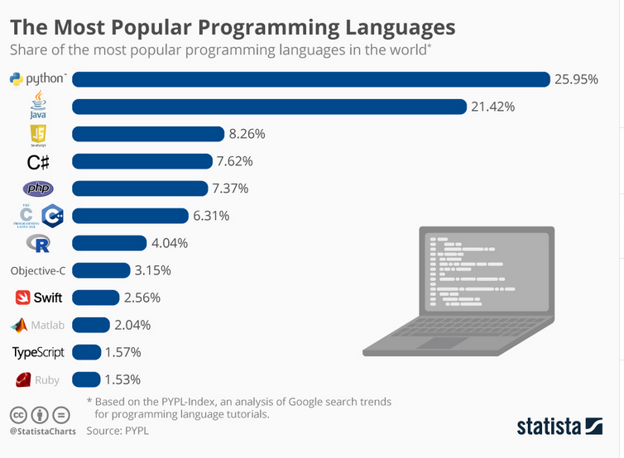
what you can do with python?

Slide 4
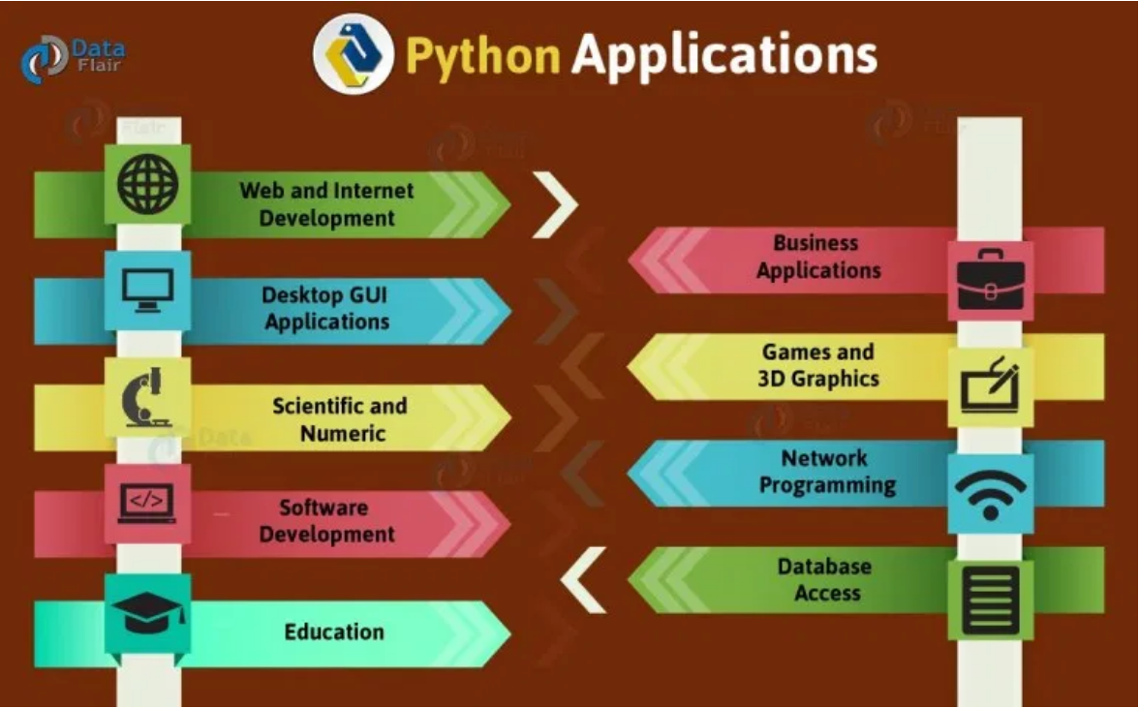
Notes:
Web Development
Machine Learning
Game Development
Computer Vision
Web Scraping
Raspberry Pi - ardoinu
Browser Automation
GUI Development
Data Science
Artificial Intelligence
Big Data
Mobile App

Slide 5









who use Python?

Slide 6
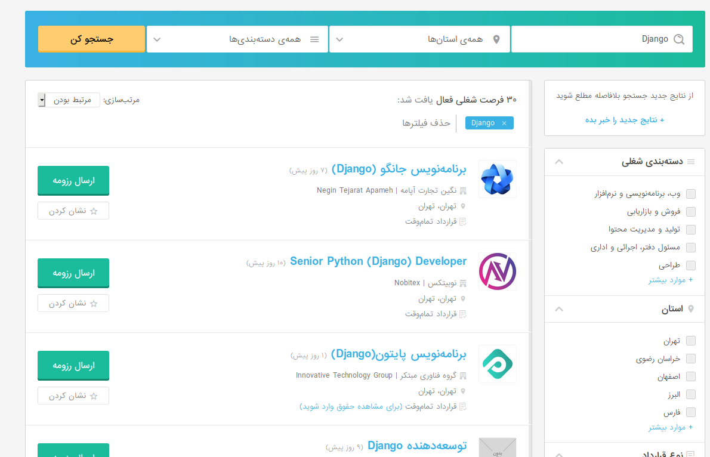
what's up here??

Slide 7
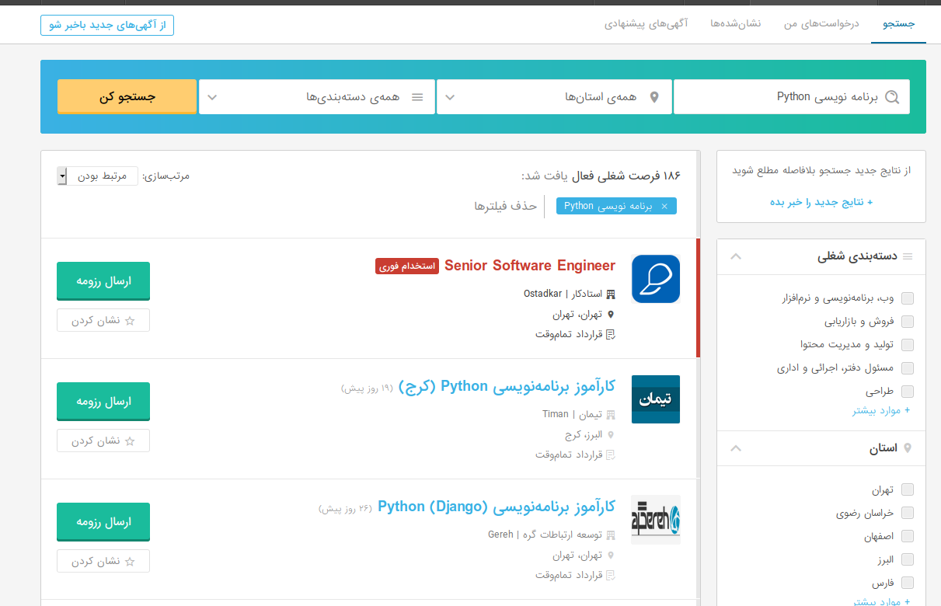

Slide 8
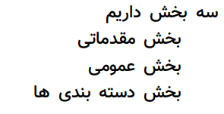
so,what we gonna do?

Slide 9
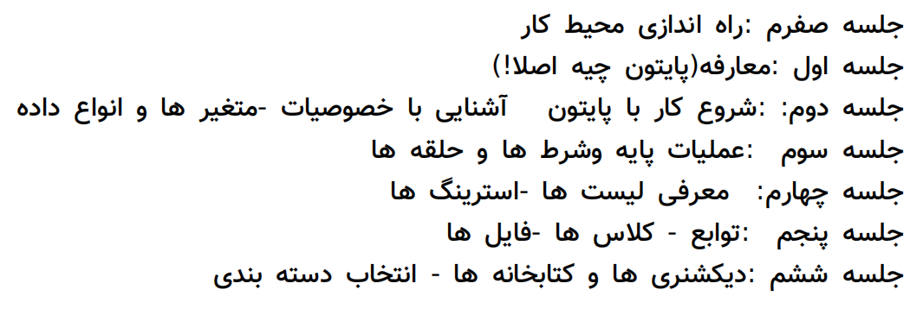
مقدماتی بخش

Slide 10
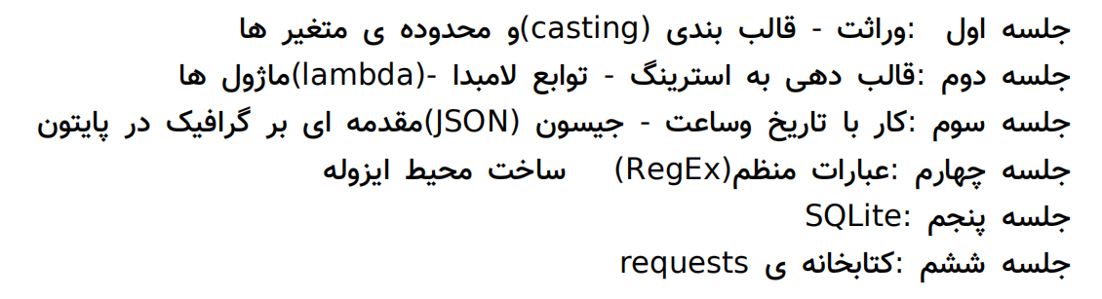
عمومی بخش

Slide 11
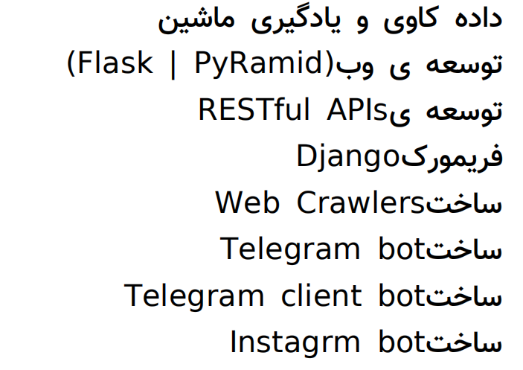
ها بندی دسته

Slide 12
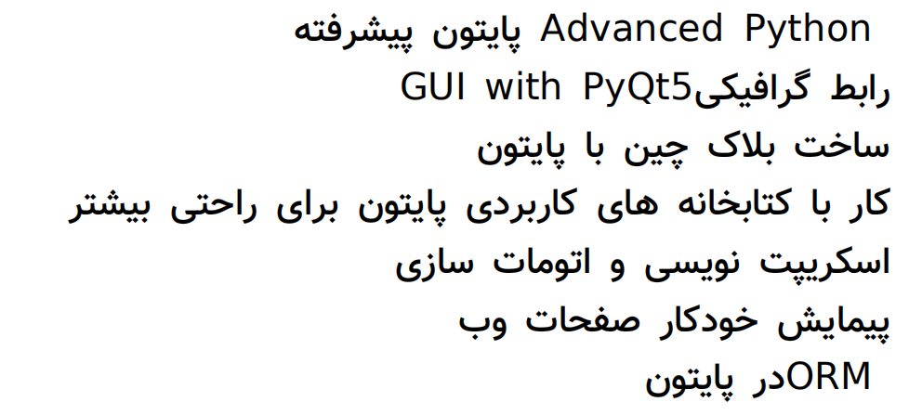
ها بندی دسته

