Slide 1
Internet Protocol for Business Messaging
AMQP 1.0 Public Review
San Diego, April 2009
By members of the AMQP Working Group
Cisco Systems
Credit Suisse
Deutsche Börse Systems
Envoy Technologies
Goldman Sachs
iMatix
IONA (a Progress company)
JPMorgan Chase
Microsoft
Novell
Rabbit Technologies
Red Hat
Solace Systems
Tervela
TWIST
WSO2
29West

Slide 2
Agenda
Time | Activity | Who
 | Welcome | John Orcutt (Director OOI Cyberinfrastructure)
1:15 | Introduction to AMQP
 | Motivations and real world use cases AMQP | John O'Hara (JPMorgan)
 | User SIG findings | Mark Blair (Credit Suisse)
 | Overview of the MOM capability
2:15 | Refreshment Break
2:30 | AMQP in detail
 | Detail of the peer-to-peer model | Rafi Schloming (RedHat)
 | Detail of the organisation-to-organisation model | Robert Godfrey (JPMorgan)
 | Security Roadmap
 | Management Roadmap
4:45 | Refreshment Break
5:00 | Break Out Interactive Sessions | Facilitator:
 | Tell us what you think, ask the unaskable! | Matthew Arrott
5:30 | AMQP in Action Implementers present real customer stories | iMatix, Rabbit MQ, Red Hat
6:00 | Drinks Reception | All

Slide 3
What’s Happening Today?
  Launching AMQP1.0 Public Review
    Present the outcome of 4 years evolution and experience
    Invite input from the outside world
      Refine & Correct, but not Redefine
      Check that we are not wearing the Emperor’s New Clothes ☺
    AMQP 1.0 will only be advanced to Final when there are multiple implementations of the Committee Draft that play nicely together
  Academic Setting
    NOT a commercial dog and pony show (mostly!)
    We come to the public with humility seeking input and validation
  A Short Time to cover a Lot
    Ask questions as we go along, bit issues may be parked
    Feedback session to capture feedback at 5pm
    Working Group Members should save issues for the private sessions

Slide 4
AMQP Motivation

Slide 5

AMQP was born of frustration
MOM needs to be everywhere to be useful
  dominant solutions are proprietary
    too expensive for everyday use (Cloud-scale)
    they don’t interoperate
  has resulted in lots of ad-hoc home-brew
    how hard can middleware be?
Middleware Hell
  100’s of applications
  10,000’s of links
  every connection different
  massive waste of effort
The Internet’s missing standard
  Why has no one done this before?
Notes:
You are accepting something in your network you wouldn’t accept anywhere else.
You maybe can’t even see the wood for the trees.
Why is there no RJ45 for communication between business systems?
Imagine If:
your laptop could only connect to a same brand network
your email client could only send email to people with the same email client
your JMS could only send messages to the same vendors JMS ?!??
Those are problems you expect not to put up with.
FIX for everything else.

Slide 6
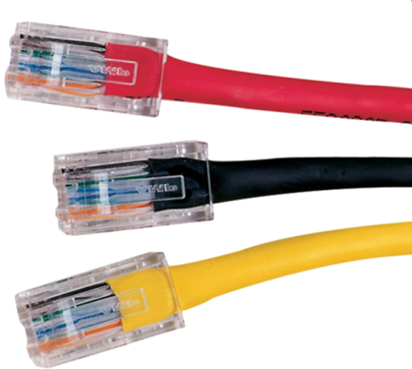

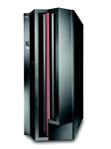

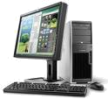


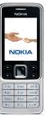


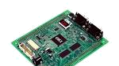
The AMQP Working Group
Set up by JPMorgan in 2006
  Goal to make Message Oriented Middleware pervasive
  Make it practical, useful, interoperable
  Bring together users and vendors to solve the problem
We say AMQP is an “Internet Protocol for Business Messaging” so end users feel a connection to the technology.
  AMQP aspires to define MOM

Slide 7
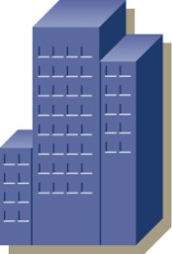








AMQP Vision
Enterprise
Business
Partners
AMQP Aware Services
C/C++, Java JMS,
Microsoft WCF
and Business Applications
Internet
AMQP Aware
Infrastructure
AMQP
Global
Addressing
AMQP “Message Bus”
orders@supplier.com
Branch Offices
treasury@fundmanager.com
AMQP Aware Clients
Devices & workstations

Slide 8
Ubiquitous => Unencumbered
AMQP Intellectual Property Policy
  Unambiguous Right to Implement
    The Authors each hereby grants to you a worldwide, perpetual, royalty-free, non-transferable, nonexclusive license to (i) copy, display, distribute and implement the Advanced Messaging Queue Protocol ("AMQP") Specification and (ii) the Licensed Claims that are held by the Authors, all for the purpose of implementing the Advanced Messaging Queue Protocol Specification.
    "Licensed Claims" means those claims of a patent or patent application, throughout the world, excluding design patents and design registrations, owned or controlled, or that can be sublicensed without fee and in compliance with the requirements of this Agreement, by an Author or its affiliates now or at any future time and which would necessarily be infringed by implementation of the Advanced Messaging Queue Protocol Specification.
  The License is attached to the AMQP Specification itself
    You get the rights when you download it!

Slide 9






AMQP Working Group – Strong Governance
Protocol
Products
Credit-Suisse, JPMorgan,
Deutsche Borse Systems, Goldman Sachs, TWIST, 29West, Envoy, Novell, Tervela, WSO2,..
iMatix
Red Hat
Apache
Rabbit
Cisco
Community Feedback
End Users
iMatix OpenAMQ
Red Hat MRG
Apache
Qpid
Rabbit MQ
Cisco AON
AMQP Working Group controls the standard
Diverse products implement the standard
Notes:
Parallels to FIX, FPML
We’re fixing the bit we forgot first time round.

Slide 10
AMQP Requirements

Slide 11
Agreed User Requirements (User SIG)
  UBIQUITOUS AND PERVASIVE
    Open internet protocol standard
    Binary WIRE protocol so that it can be ubiquitous, fast, embedded
    Unambiguous core functionality for business message routing and delivery within Internet infrastructure
    Scalable, so that it can be a basis for high performance fault-tolerant lossless messaging infrastructure, i.e without requiring other messaging technology
    Fits into existing enterprise messaging applications environments in a practical way

Slide 12
Agreed User Requirements
  UBIQUITOUS AND PERVASIVE
  SAFETY
    Infrastructure for a secure and trusted global transaction network
      Consisting of business messages that are tamper proof
      Supporting message durability independent of receivers being connected
    Transport business transactions of any financial value
    Sender and Receiver are mutually agreed upon counter parties
      No possibility for injection of Spam

Slide 13
Agreed User Requirements
  UBIQUITOUS AND PERVASIVE
  SAFETY
  FIDELITY
    Well-stated message queuing and delivery semantics covering
      at-most-once
      at-least-once
      and once-and-only-once (e.g. 'reliable’, ‘assured’, ‘guaranteed’)
    Well-stated message ordering semantics describing what a sender can expect
      a receiver to observe
      a queue manager to observe
    Well-stated reliable failure semantics
      so exceptions can be managed

Slide 14
Agreed User Requirements
  UBIQUITOUS AND PERVASIVE
  SAFETY
  FIDELITY
  UNIFIED
    AMQP aspires to be the sole business messaging tool for organizations
    Global addressing standardizing end-to-end delivery across any network scope
    Any AMQP client can initiate communication with, and then communicate with, any AMQP broker over TCP/IP
    Optionally, extendable to alternate transports via negotiation
    Provide a core set of messaging patterns via a single manageable protocol:
      asynchronous directed messaging
      request/reply, publish/subscribe
      store-and-forward
    Provide for Hub-and-Spoke messaging topology within and across business boundaries
    Provide for Hub-to-Hub message relay across business boundaries through enactment of explicit agreements between broker authorities

Slide 15
Agreed User Requirements
  UBIQUITOUS AND PERVASIVE
  SAFETY
  FIDELITY
  UNIFIED
  INTEROPERABILITY
    Multiple stable and interoperating broker implementations
      Each with a completely independent provenance (min. 2 to move to Final)
      Each broker implementation is conformant with the specification, for all mandatory functionality, including fidelity semantics
    Stable core (client-broker) wire protocol so that brokers do not require upgrade during 1.x feature evolution: Any 1.x client will work with any 1.y broker if y >= x
    Stable extended (broker-broker) wire protocol so that brokers do not require upgrade during 1.x feature evolution: Any two brokers versions 1.x, 1.y can communicate using protocol 1.x if x<y
    Layered architecture, so features & network transports can be independently extended by separated communities of use

Slide 16
Agreed User Requirements
  UBIQUITOUS AND PERVASIVE
  SAFETY
  FIDELITY
  UNIFIED
  INTEROPERABILITY
  MANAGEABLE
    Decentralized deployment with independent local governance
    Intermediated: supports routing and relay management, traffic flow management and quality of service management
    Interaction with the message delivery system is possible, sufficient to integrate with prevailing business operations that administer messaging systems using management standards.

Slide 17
Banking Security Requirements
  SSL support
  Service Context (incl. Security Context):
    A standard Message property for for propagation of Security Tokens
  Support for carrying Security Tokens:
    Principal-ID, SAML, Kerberos ticket, etc.
    Carried within the Service Context in the Message
  Unique Security Token per Message:
    Enables multiplexing of different Security Contexts on a given messaging session (e.g. for proxying)
  Hash and sign of Message (including Security Context)
    Assure authenticity of the contents in addition to encryption (content verified by final-destination).
    Full-path privacy for business transactions that might pass through a number of hubs enroute to the final destination, where you would not want to have the exposed content of the message sitting in some queue and disk along the way.
  Chains of trust within trust realms - optional

Slide 18
AMQP 1.0 Functionality

Slide 19
AMQP 1.0 Scope
AMQP is Message Oriented Middleware (MOM)
  Transfers application data units from senders to receivers – layer 7
  An expectation that the message transfer is via trusted intermediaries
    An expectation that messages will be delivered unchanged
    An expectation of security
    Applications can be separated by (large amounts) of space and time
  Abstract from the underlying technology
    Physical network limits should be hidden (message size, node location)
    Technology concerns should be hidden (platform, language, OS)
  The intermediaries offer various delivery options, as defined by either the sender or the receiver (s)
  The intermediaries provided various defined qualities of service for the sender and the receiver (s)
  Provide stability and backwards compatibility (10yrs+)

Slide 20



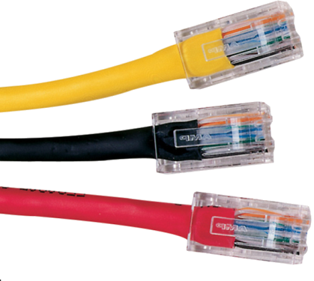
AMQP 1.0 Covers…
Publish/
Subscribe
  Queuing with strong Delivery Assurances
  Event distribution with Flexible Routing
  Large Message capability (gigabytes)
  Global Addressing Scheme (email-like)
  Meet common requirements of mission-critical systems
Implications
  Candidate for a common information infrastructure
  A foundation for other protocols and products
    E.g. In finance alone: FIX 5, FpML, ISO20022
detect
Messaging
transact
File Transfer
report

Slide 21
AMQP 1.0 is an Overlay Network
Broker
  Applications Connect to a Broker to participate in the AMQP network
  The Connection is used to establish a Session
    Sessions provide state between Connections, establish identity, ease failover
  Connections are further subdivide into Channels
    Multiple threads of control within an Application can share one Connection
Queues
  Applications logic interacts ONLY with Queues
  Queues have well known Names == Addressable
  Applications do not need to know how messages get in/out of Queues
  Queues can be smart, they are an extension point
  Applications will assign implied semantics to Queues (e.g. “StockOrderQueue”)
Links
  Links move Messages between Queues and/or Applications
  Contain Routing and Predicate Evaluation Logic – similar to Complex Event Processing

Slide 22
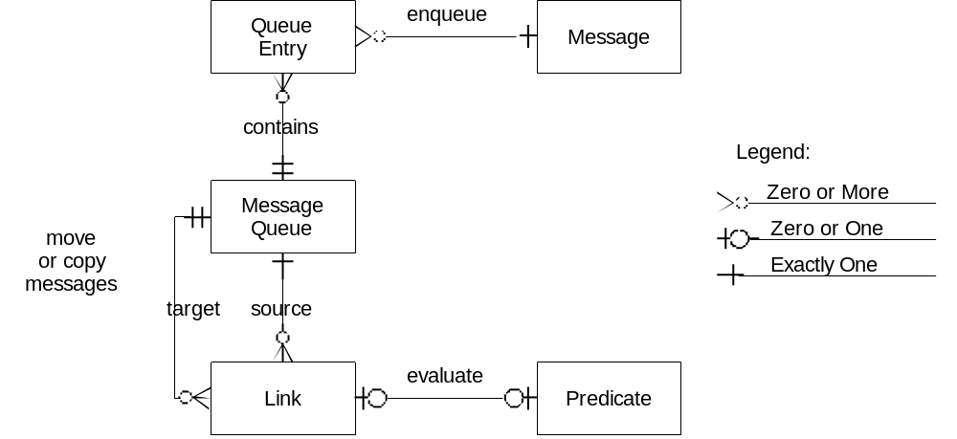
AMQP 1.0 Model Entities
  The following entities are discoverable in any full AMQP 1.0 implementation:
  There will be many more entitles in an implementation which a portable application must not depend on!

Slide 23
What Happened to Exchanges?
Exchange provided the core routing concept previously
  Upon reflection, exchanges were redundant
    Global Addressing drove the change
    Need one abstract name to route, need to hide implementation details
    Exchanges/Exchange Instance/Exchange type were “leaky abstractions”
  Exchange == Queue -> Links -> Queues
    Input Queue provide an abstract Address
    Links contain a Function to evaluate Messages
    Function parameterised by the Link predicates
    Output Queue = Link( message, predicates)
  New approach is more abstract and more flexible
    Moves complexity from Clients to Brokers
      Simpler to implement and use
      Lots of opportunity to differentiate

Slide 24
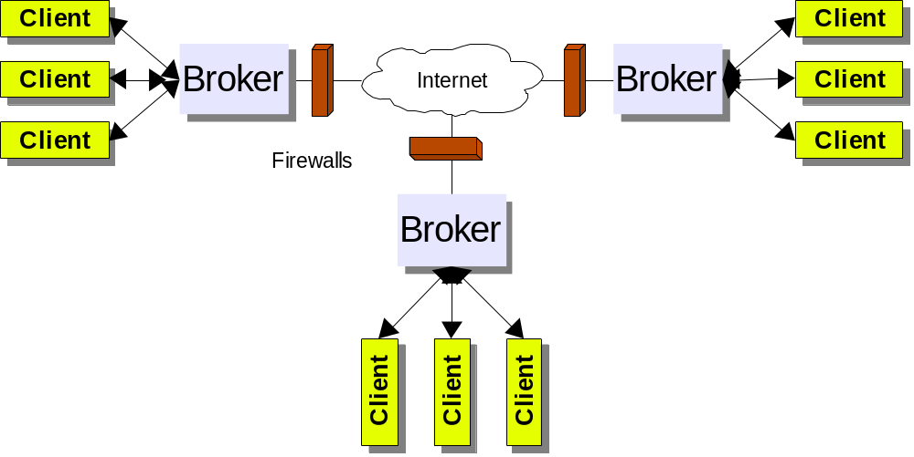
Inter-Network Connectivity

Slide 25
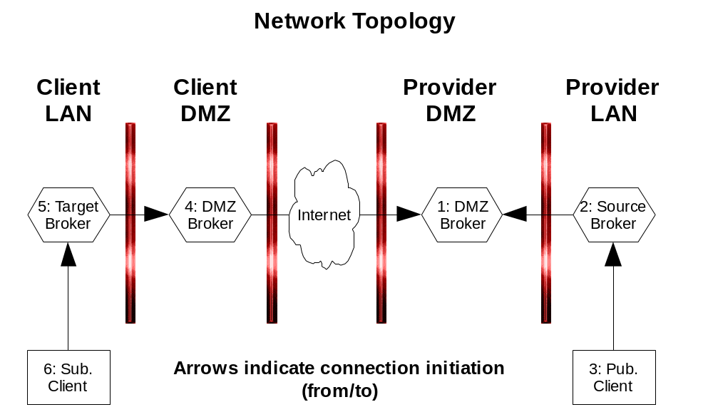
Inter-Company Firewalls

Slide 26
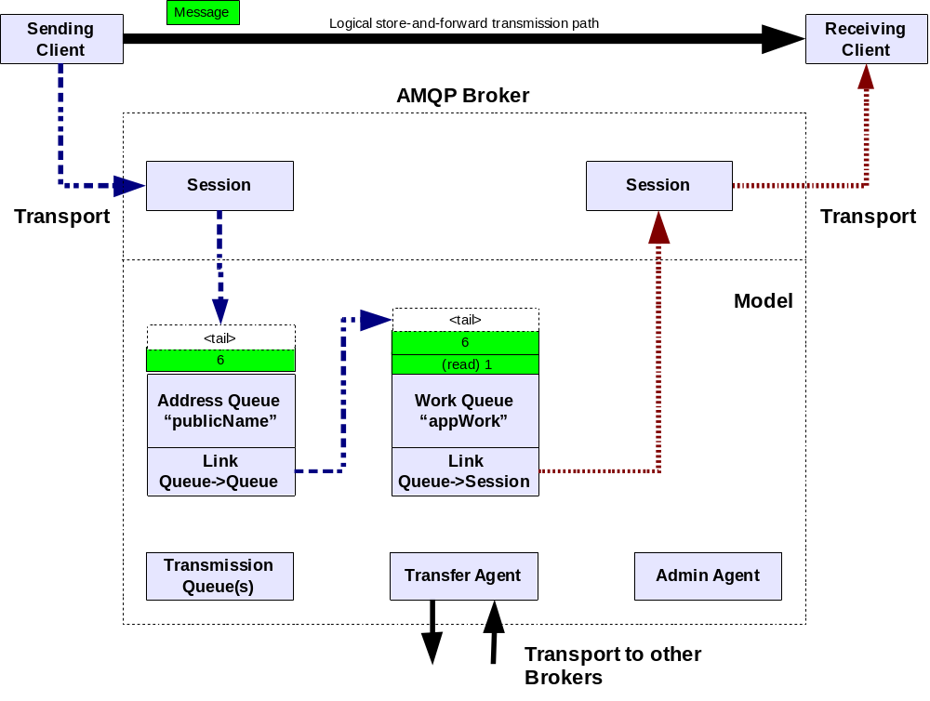
AMQP 1.0 Data Flow Overview

Slide 27
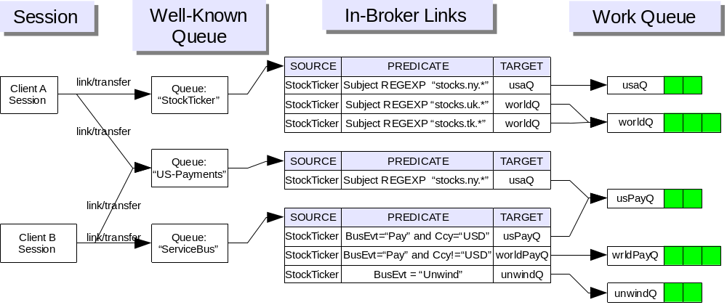
Traditional Topologies Built from Parts
  Queues are used both for Persistent stores and transient buffers.
  Link model unifies point-to-point and publish/subscribe
    Finance example shows client messages being routed to various Queues
    Example mixes traditional Store & Forward and Transient Pub/Sub

Slide 28
Global Addressing
Queues have abstract names, but when routing between organisations a convention is required.
AMQP follows many RFC822 email convention for Queue names
  Queue_Name @ example.org
  Domain names are only required for relaying to remote Brokers
  The Address is opaque to the sending Client, but behind that Address, the owner of the Broker creates Links (either administratively or dynamically) to deliver Messages sent to that Address to one or more Message Queues on the same or different Brokers.
  Broker is autonomous; no privileged access is required on a remote Broker to deliver messages. The targets topology must be hidden except for the Queue name and authentication credentials.
  In later versions of AMQP we will standardise subscription propagation between entities

Slide 29
Management
Standardising AMQP Management and Administration too
  Management is a MOM application!
    Therefore commands can be secured and routed at the MOM level
  Seen control Messages to a well known service Queue
  Responses come back to private response Queues
Questions as to whether management is fully transacted/async
  Decided to do like most RDBMS’s
    Management commands are not transacted
    When you get the response, you know it has taken effect
Features
  Queue management, queue depth/alerts, top talkers, slow consumers, kill clients, etc.
Vendors free to implement
  Bridges to additional management standards
  Additional features beyond the core

Slide 30
AMQP1.0 Typical Usage Patterns

Slide 31
Point-to-point Queue Delivery
AMQP Broker
Client
Producer
Session
Link
Tail
Entry 3
Entry 2
Session
Client
Consumer
Entry 1
Head
Link
Queue (source)
-Persistent
Highlights:
Only “Source” queue is required and can be read directly by consumer over Link (i.e. dedicated consumer Worker queue and bridging between Source and Worker unnecessary).

Slide 32
Abstracted Point-to-point Queue
AMQP Broker
Client
Producer
Session
Tail
Link
Tail
Entry 3
Entry 2
Link
Entry 2
Entry 1
Head
Entry 1
Head
Queue (Source)
-Persistent
Queue (worker)
-Persistent
Highlights:
One Queue performs the role of holding the “Well Known” name for the outside world.
All messages are automatically forward on to the real worker queue.
Allows internal topology to change without the outside world seeing (this PO Box)

Slide 33
Load-Balanced Point-to-point Queue Delivery
AMQP Broker
Client
Producer
Session
Session
Client
Consumer
Link
Tail
Entry 3
Link
Entry 2
1 Head or 2 ?
Entry 1
Queue (source)
-Persistent
Session
Client
Consumer
Link

Slide 34
Dynamic (non-persistent) Pub/Sub Delivery
AMQP Broker
Client
Subscriber
Session
Link
Client
Publisher
Session
Link
Tail
Entry 3
Head
Entry 2
Head
Session
Client
Subscriber
Entry 1
Head
Link
Queue (Source)
-Non-persistent
Session
Client
Subscriber
Link
Highlights:
Messages are “garbage collected” in an implementation specific manner after delivery.
AMQP makes some guarantees about how long messages are valid for.

Slide 35
Durable (persistent) Pub/Sub Delivery
AMQP Broker
Tail
Session
Client
Subscriber
Link
Entry 2
Head
Client
Publisher
Session
Tail
Link
Entry 1
Link
Entry 3
Queue (Worker)
- persistent
Entry 2
Head
Entry 1
Head
Queue (Source)
- persistent
Link
Client
Subscriber
Session
Entry 1
Head
Link
Queue (Worker)
- persistent

Slide 36
Technical Details Follow…
Robert Godfrey – JPMorgan
Rafi Schloming – Red Hat

