Slide 1
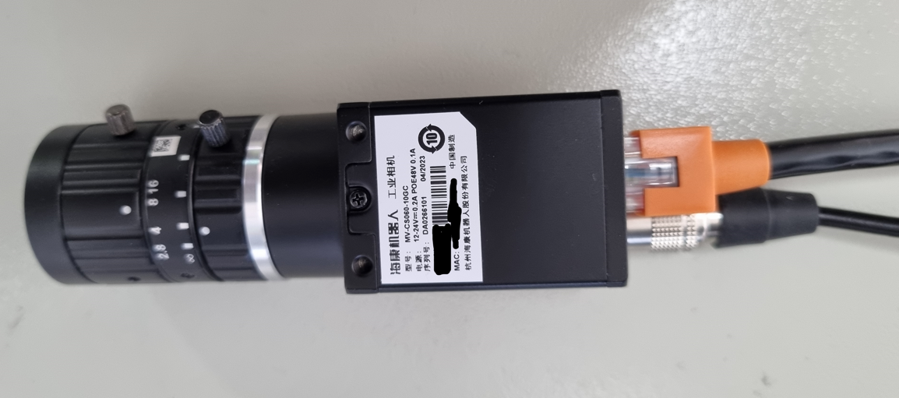
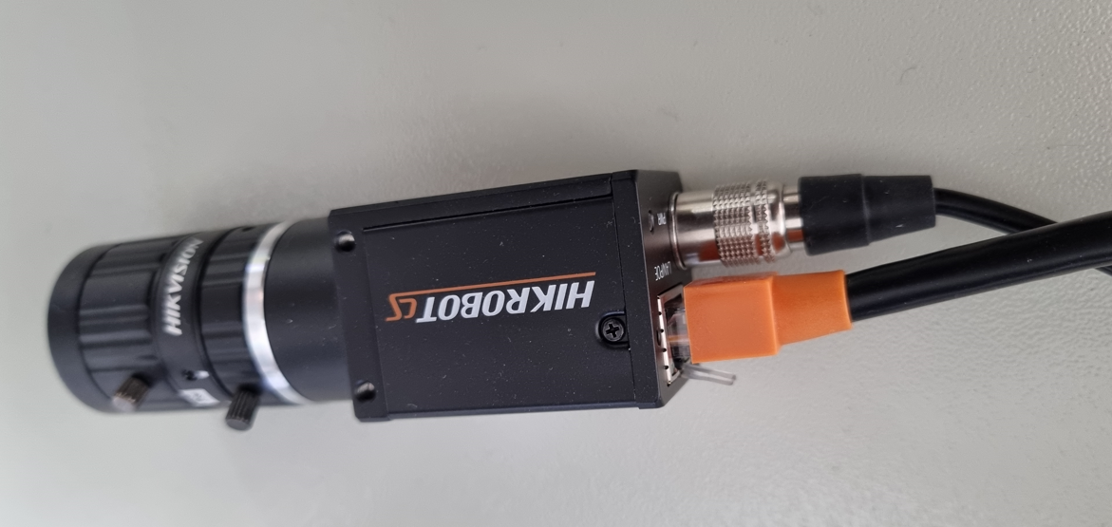
Lenz
Industrial Camera
UTP-RJ45
(Cross Cable)
Basler ACE GigE Camera Hirose 6 Pin 12V Power Supply Adapter

Slide 2
