Slide 1
VIDEO LEC-17 FROM SYSTEM PROGRAMMING

Slide 2
PROCESS VS FILES
KERNAL DATA STRUCTURES( executable obj file ,process address space)
PCB (task struct)
Process tree
Process Chain
Process
Fan

Slide 3
everything in UNIX is a file and if it is not a file then it is a process
PS command is to process status command and LS is used to list the contents of the present working directory
process live in user space and we can explore the contents of the user space with this PS command, files reside on some permanent storage medium and we can explore the file system using the LS command
do PS - a and LS - a we can use - a option that PS command to view the process is being run by by other users and maybe at other terminals
Uname –r (sudo apt- get install linux-header-kali-linux-2024.3-virtualbox-amd64)

Slide 4
if I do PS - L , you might have used this LS - L to display it long listing of the current working directory and it display all the attributes of file similarly we can use - L option with the PS command to view different attributes of a process
the way a file is uniquely identified on a file system with an inode number (LS-Li)
a process is uniquely identified in the user space with its PID
We can create delete files as well as processes
see the statistics of all the processes running using the famous talk command okay you must have used this command before as well it actually monitors the CPU users in real-time and refreshes its output every every three seconds I think it has two main portions upper portion and this lower portion the first line in the upper portion actually show you the current time the time since last boot total users and and finally the load average in the last one minute five and fifteen minutes this second line shows you the total process is running sleeping starved and zooming processes as well if any this is the percentage of CPU or four uh nice projector system processes nice processors
/proc directory-> explore through man

Slide 5
A process tree shows the overall hierarchy of parent-child process relationships.
A process chain represents a linear sequence of processes, where each process has exactly one parent and one child (except the first and last processes).
A process fan is when one process creates multiple child processes, forming a fan-like structure.

Slide 6
VIDEO LEC-18 FROM SYSTEM PROGRAMMING

Slide 7
VIDEO LEC-8 FROM OPERATING SYSTEM

Slide 8
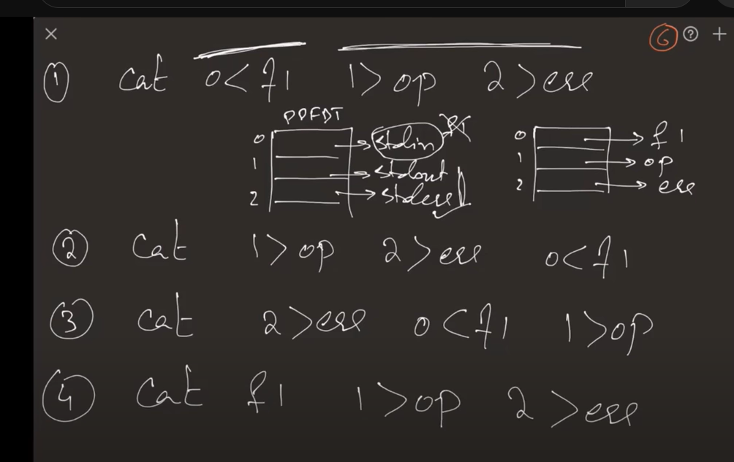
WC
Run the io redirection and in cases where file doesn’t exist, f1,f2,err

