Slide 1
AID Navigator
Turning a resident's own words into a caseworker's next right action
Built for AWS ‘Agents for Humans’ Hackathon: Good Neighbor Track
#AgentsForHumans
1

Slide 2



The Problem
Every year, thousands of DC households facing utility disconnection apply for LIHEAP heating assistance.
Intake is manual: caseworkers cross-check stories against documents, income tables, and eligibility rules, while genuinely urgent cases sit in the queue behind routine ones.
Documents to verify
Time-sensitive queue
Urgent cases waiting
2

Slide 3


Who It's For & Why It Matters
WHO IT'S FOR
WHY IT MATTERS
DC DOEE caseworkers and intake staff, and by extension, the residents whose cases get resolved faster.
For a household with a shutoff notice already issued, same-day triage vs. a multi-day queue can mean the difference between keeping heat and losing it.
3

Slide 4

Challenges & What I Learned
Amazon Bedrock model access rejected with a payment authorization failure at the account level; unresolved as of submission, unrelated to IAM or configuration
AgentCore cloud deployment blocked by an account-level quota override (limit set to 0, AWS default is 1,000); confirmed via AWS Support, case open since Sep 12
Adapted by keeping AgentCore Runtime + Strands SDK architecture, moving extraction to Groq
4

Slide 5
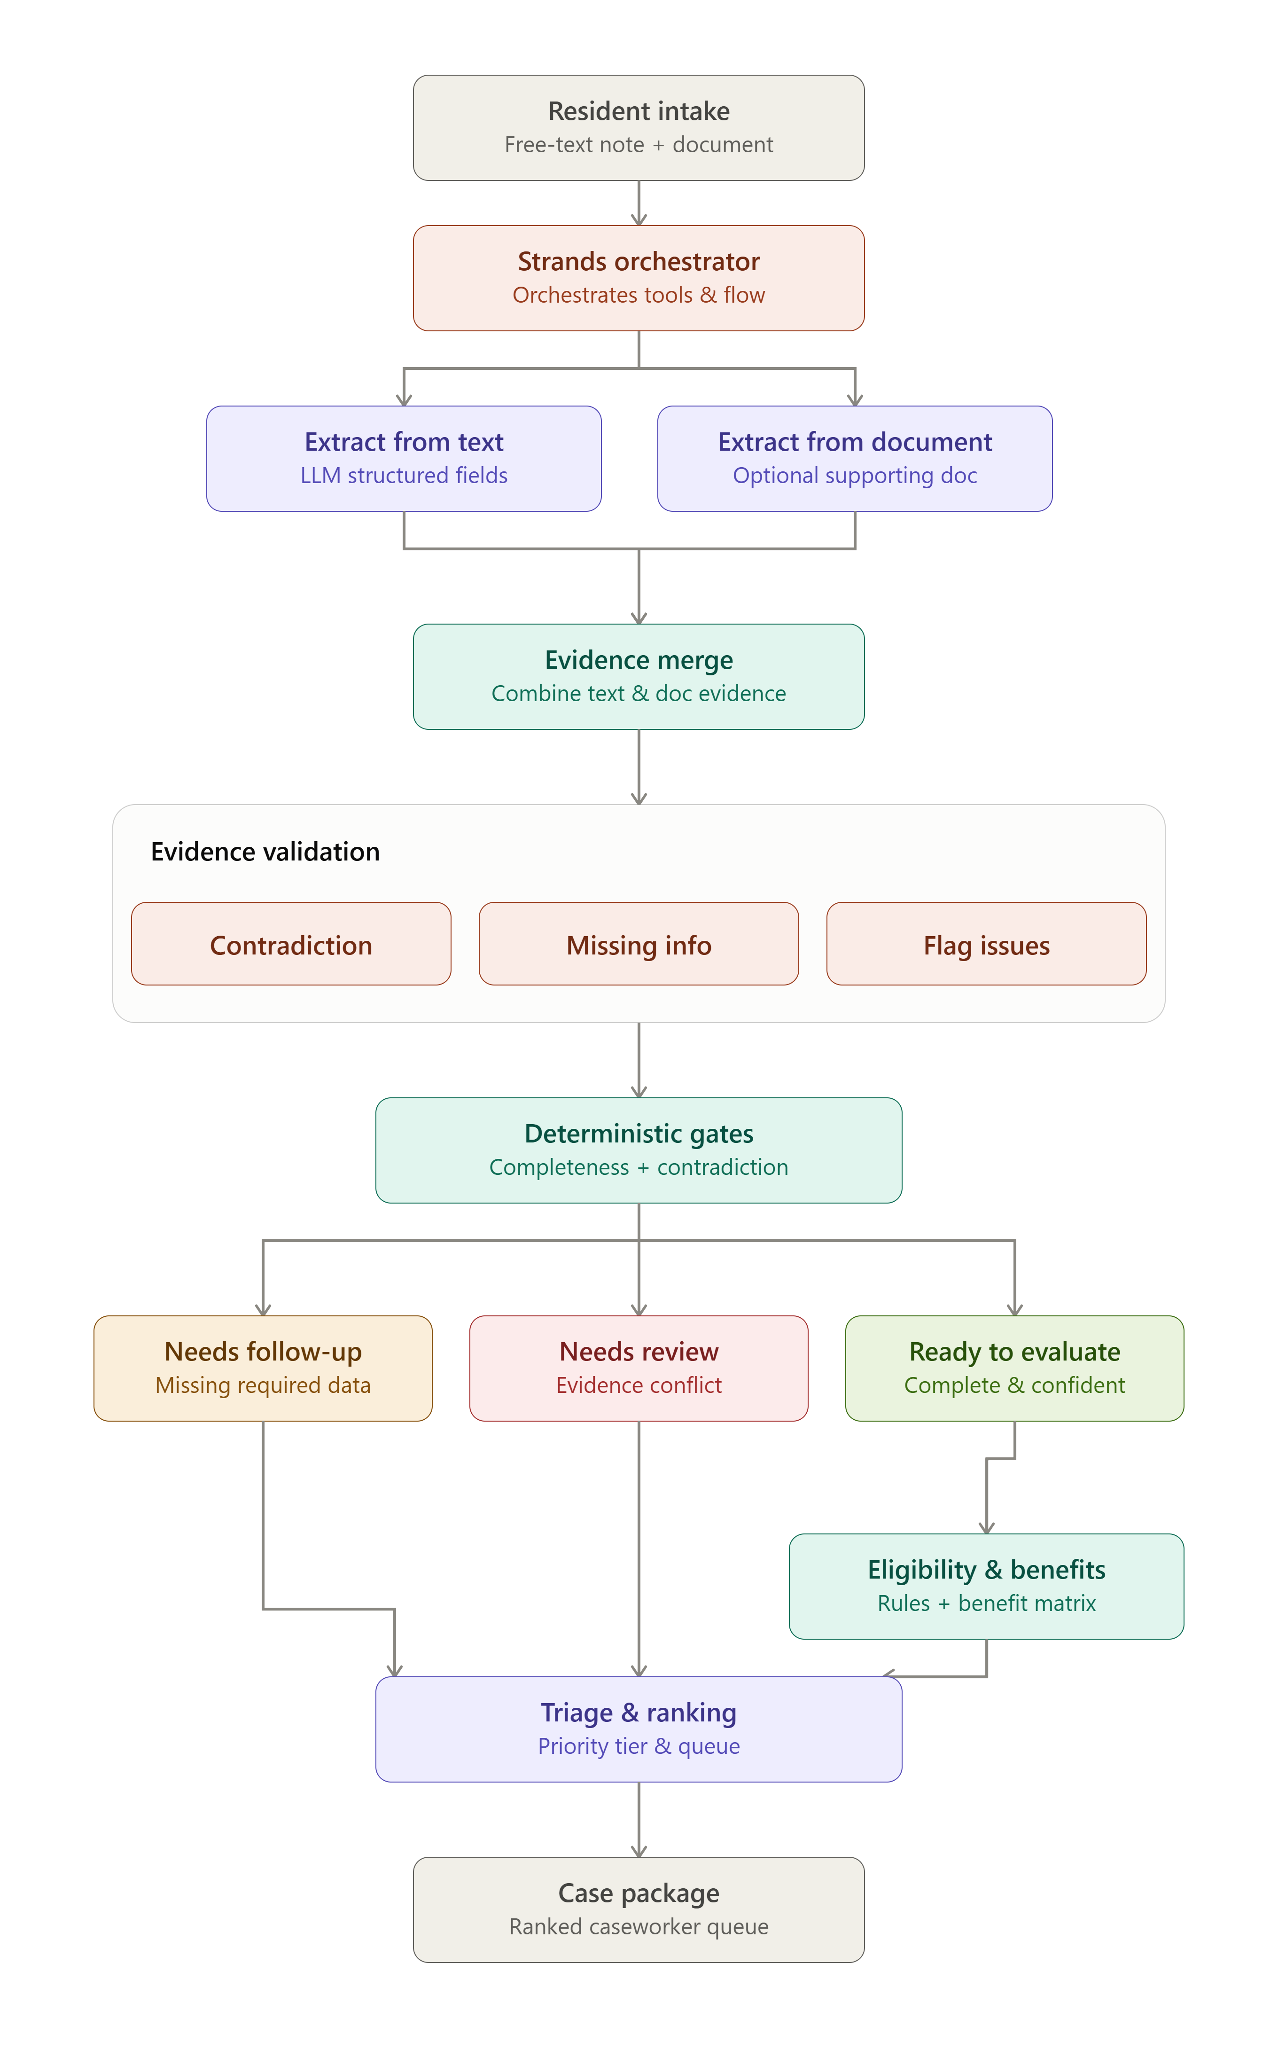

How It Works
LLM extracts
Code decides
The agent gathers evidence that deterministic Python owns every eligibility, benefit, and contradiction decision.
AID Navigator — https://github.com/rabbiyariaz/AgentForHuman_AID_Navigator
5

