Slide 1


Group Chat App using Java
Submitted By:
Submitted To:
Green University of Bangladesh
CSE 312 – 213 D8
Rabea Khatun
Lecturer
Green University of Bangladesh
Md.Rabby Khan
ID:-213902037
Mostak Ahmmed
ID:-213902126

Slide 2
Outlines
Introduction
Why Java?
Project Overview
Architecture and Design
Tools and Technologies
Implementation
Future Enhancements
conclusion

Slide 3
Introduction
The chat application project is designed to enable users to communicate over a network. It comprises both client and server components, implemented in Java with a JavaFX-based graphical user interface (GUI).
User authentication, real-time messaging, group management, notifications, and media sharing.

Slide 4

Why Java?
Java is a versatile and widely used programming language.
Its object-oriented nature promotes code reusability and maintainability.
Java offers robust libraries and frameworks for network programming, including sockets.
The large Java developer community provides extensive support and resources.

Slide 5
Project Overview
Objective:
The main objective of this project is to develop a scalable, secure, and user-friendly group chat application using Java. The application aims to facilitate real-time communication among users in various groups, supporting features such as text messaging, media sharing, and notifications.
Key Features:
User Authentication:
Real-time Messaging:
Group Management:
Notifications:
Media Sharing:

Slide 6
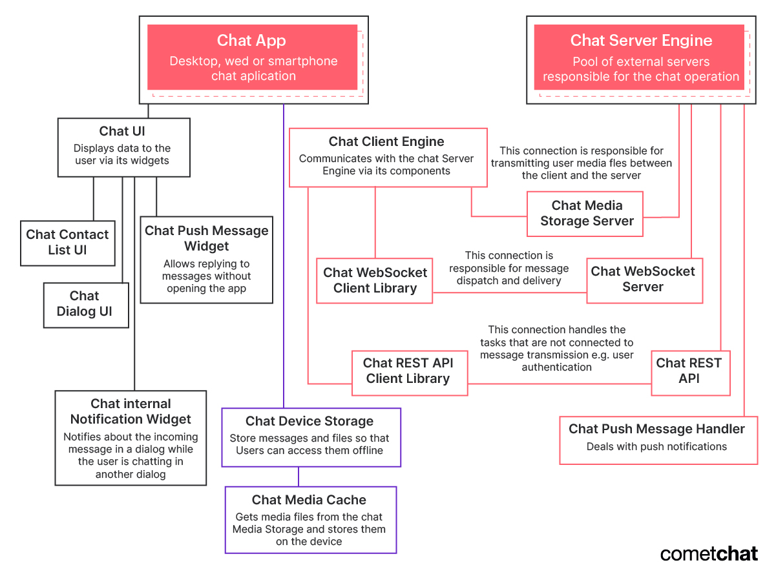
Architecture and Design
Fig 1: Chat Application Architecture Diagram

Slide 7
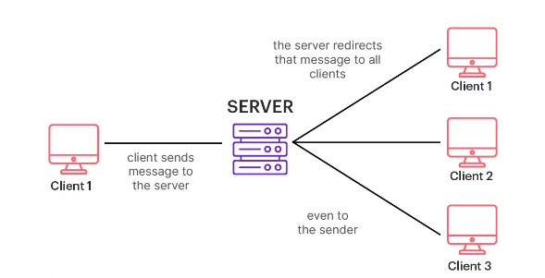
Architecture and Design
Chat Client:
The chat client is what users interact with. It can be a desktop, web, or smartphone application.
Responsibilities include sending messages, displaying data to the user, and storing messages and files.
Chat Server:
The chat server hosts the necessary software, frameworks, and databases.
It securely receives messages, identifies recipients, queues messages, and forwards them to the appropriate chat clients.

Slide 8
Tools and Technologies
Java SE (Standard Edition):
JavaFX
Netbeans IDEA/Eclipse:
MySQL/PostgreSQL:
WebSocket API
Spring Boot:

Slide 9
Implementation
Client-Side:
User Interface (UI)
Main Chat Window
Event Handling
Media Handling
Client-Server Communication
Handling Real-time Updates
Error Handling and Notifications
Code Structure and Organization

Slide 10
Implementation
Server-Side:
Architecture
WebSocket Communication
Database Management
Security
Real-time Communication
Database Schema
Error Handling and Logging
Code Structure and Organization

Slide 11
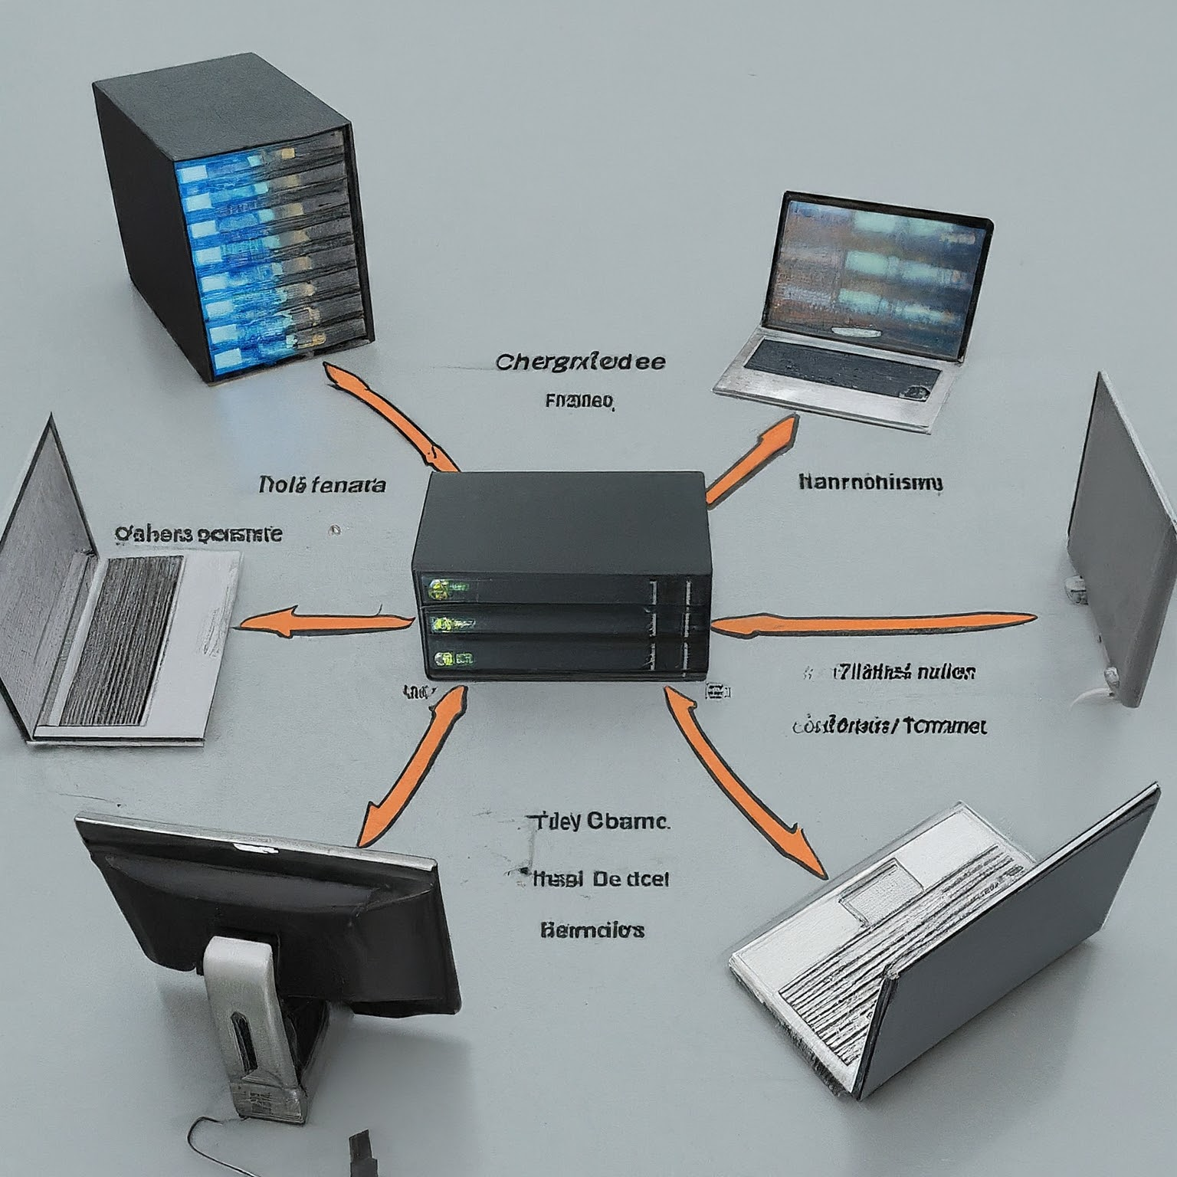
Implementation
Real-time Communication (WebSocket)
WebSocket is a protocol that provides full-duplex communication channels over a single TCP connection. It is designed to be implemented in web browsers and web servers but can be used by any client or server application.
Using WebSocket for real-time communication in a group chat application enables efficient and instant message

Slide 12
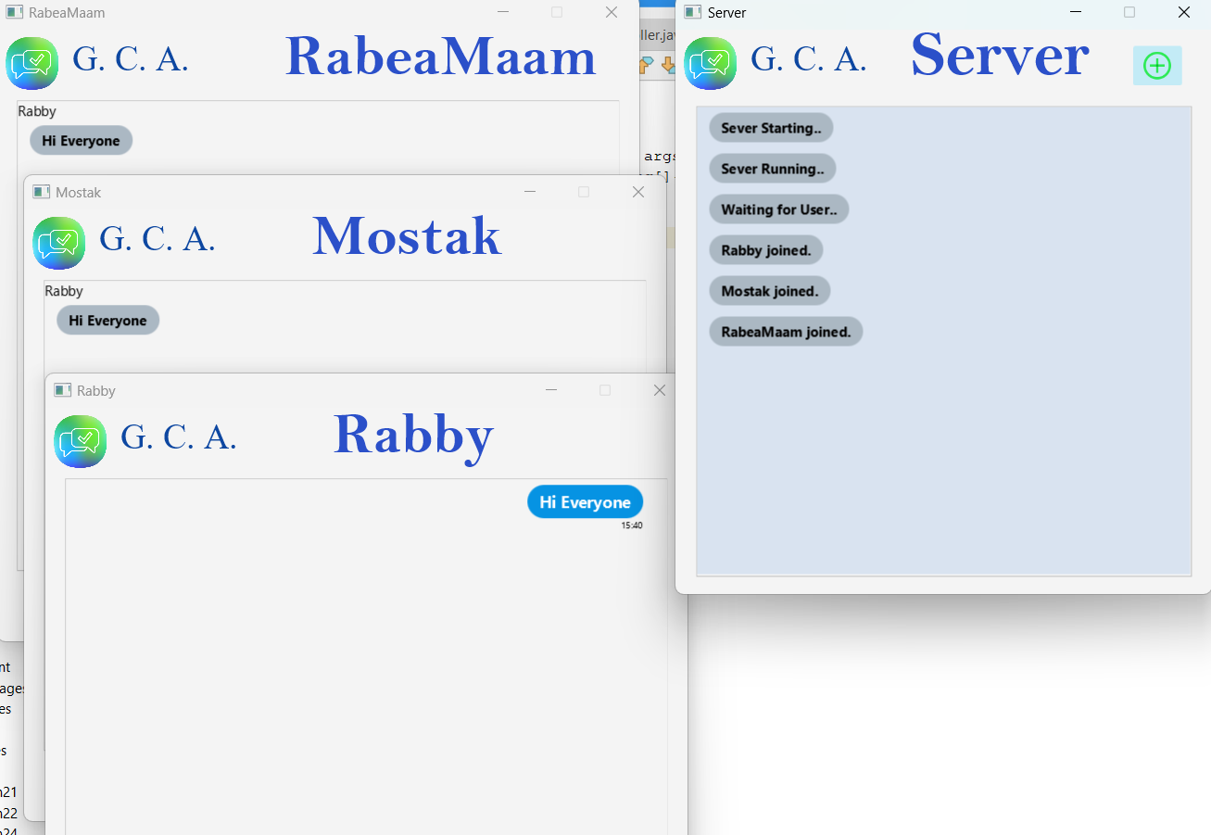
Functionalities /Output

Slide 13
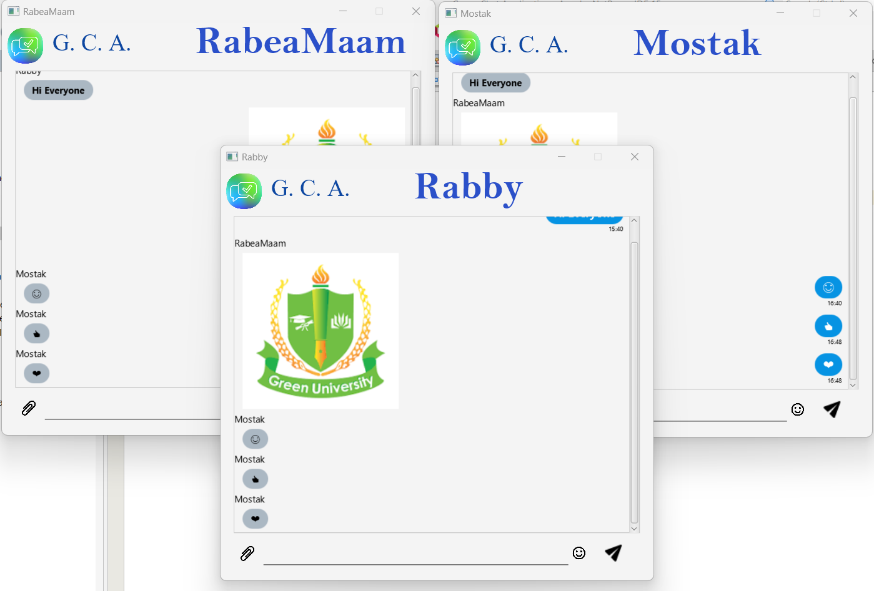
Functionalities /Output

Slide 14
Future Enhancements
Mobile Support: Plans for Android/iOS apps.
Advanced Features: Voice/video calls, file sharing.
Enhanced Security: End-to-end encryption.
Performance Optimization: Further improvements.

Slide 15
Conclusion
Developing a group chat application using Java involves a comprehensive understanding of both client-side and server-side technologies. Leveraging JavaFX for the user interface, Spring Boot for backend services, and WebSocket for real-time communication, this project provides a robust and scalable platform for instant messaging and group interactions.

Slide 16
Thanks!
Any questions?

