Slide 1
Operating System Algorithm Simulator Using Shell Script
Green University of Bangladesh
Rabby Khan
ID:-213902037
Mostak Ahmmed
ID:-213902126
Green University of Bangladesh
CSE 310 – 213 D4
Md. Shoab Alam
Lecturer
Green University of Bangladesh

Slide 2
Operating Systems
Outlines
Introduction
Objective
Tools and Technologies
Implementation
Limitations
Conclusion

Slide 3
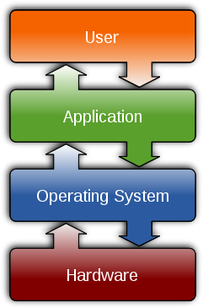
Operating Systems
Operating Systems
The operating system is the most important program that runs on a computer.
Operating system is an interface between computer and user.
It is responsible for the management and coordination of activities and the sharing of the resources of the computer.

Slide 4
Operating System Algorithm
Objective
The objective of this project is to simulate fundamental operating system services using shell scripting. Specifically, this report focuses on simulating CPU scheduling algorithms, page replacement algorithms, and contiguous memory allocation algorithms.

Slide 5
Operating System Algorithm
Tools and Technologies:
Bash Scripting Language:
Text Editors CODE:
Terminal Emulator:
Documentation Tools: Latex Format

Slide 6
Operating System Algorithm
Implementation:
The project is divided into three main components, each simulating a different operating system service:
Menu Options:
CPU Scheduling Algorithms
Page Replacement Algorithms
Contiguous Memory Allocation Algorithms
Exit

Slide 7
Operating System Algorithm
Sub-menu:
CPU Scheduling Algorithms
There are three algorithms included:
1. Priority Scheduling:
2. Shortest Job First (SJF) Scheduling:
3. First Come First Served (FCFS) Scheduling:

Slide 8
Operating System Algorithm
Sub-menu:
Contiguous Memory Allocation Algorithms:
1. First Fit Allocation
2. Best Fit Allocation
3. Worst Fit Allocation
4. Next Fit Allocation

Slide 9
Operating System Algorithm
Sub-menu:
Page Replacement Algorithms
1. FIFO (First In First Out)
2. LRU (Least Recently Used)
3. Optimal Page Replacement

Slide 10
Operating System Algorithm
limitations
Graphical user interface (GUI):
Limited scope:
Simplified simulation:
Include more algorithms:

Slide 11
Operating System Algorithm
conclusion
The Operating System Algorithm Simulator serves as a powerful tool for both educational and practical purposes. It facilitates deeper understanding, fosters innovation, and ultimately contributes to the advancement of operating system technology. As we continue to refine and expand its capabilities, we look forward to further enhancing our understanding of operating system algorithms and their impact on computing systems.

Slide 12
THANK YOU
Operating System Algorithm

