Slide 1



Slide 2
Blockchain-based AI-enabled Cybersecurity Framework for IoT Networks
Presented by-
Md. Dulal Hossain – 213902116
Md. Rabby Khan - 213902037
Mostak Ahmed – 213902126
Batch: 213 (Day)
Dept. of CSE
Green University of Bangladesh
Presented to -
Prof. Dr. Md : Ahsan Habib
Professor,
Dept. of CSE
Green University of Bangladesh

Slide 3



Comprehensive Review of Selected Thesis Papers

Slide 4







Contents

Slide 5
Contents

Slide 6
Contents
Cryptography
SSL
Integrity
Network Layer Security
End Point Authentication
Operational Security (Firewall)

Slide 7
Contents
Challenges in IoT Privacy
3WADD Algorithm
Experimental Result
Advantages of the Model
Key Concepts
Proposed Model
Conclusion

Slide 8
Introduction
Background:
• Growth of IoT brings challenges in data privacy.
• Sensitive data (financial, medical, personal) is often at risk.
Problem:
• Traditional privacy methods either reduce data utility or leave data vulnerable to attacks.

Slide 9
Challenges in IoT Privacy
Issues with Current Approaches:
• Hiding all sensitive data reduces utility.
• Aggregate data can still be reverse-engineered.
• Manual division of data attributes is costly and time-consuming.
Need for Automation:
• Manual expert-based methods don’t scale with large datasets.

Slide 10
Key Concepts
Differential Privacy:
• Adds controlled noise to anonymize sensitive data.
• Balances privacy with data utility.
𝑓(𝐷𝑜 ) + (𝐿𝑎𝑝(𝛥𝑓∕𝜖)). (1)
The 𝛥𝑓 is known as the sensitivity of a query which is computed as,
𝛥𝑓 = max ‖ 𝑓(𝐷𝑜 ) − 𝑓(𝐷𝑖 ) ‖1 ,
𝑖∈{1,2,3,…,𝑁} (2)

Slide 11
Key Concepts
Three-Way Decisions:
• Divides data into three categories:
- Sensitive (not stored),
- Non-sensitive (stored without modification),
- Ambiguous (anonymized using differential privacy).
POS(𝛼,𝛽) = {𝑥 ∈ 𝑈 | 𝑒(𝑥) ⪰ 𝛼} , (3)
NEG(𝛼,𝛽) = {𝑥 ∈ 𝑈 | 𝑒(𝑥) ⪯ 𝛽} , (4)
BND(𝛼,𝛽) = {𝑥 ∈ 𝑈 | 𝛽 ≺ 𝑒(𝑥) ≺ 𝛼} . (5)

Slide 12
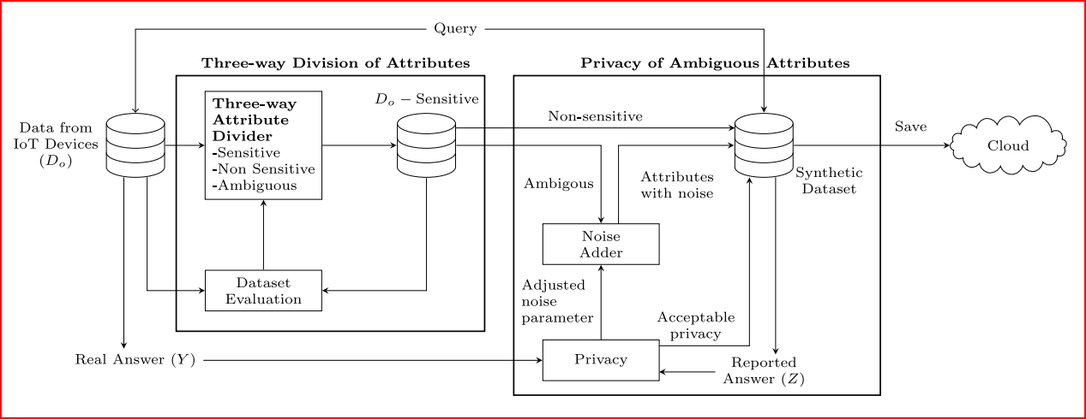
Proposed Model
Fig. 1. High level view of the proposed architecture.

Slide 13
Proposed Model
Model Objective:
• Automatically categorize data attributes into sensitive, non-sensitive, and ambiguous categories.
Main Components:
• Attribute division using three-way decisions.
• Demonstration of three-way division of attributes.
• Three-way attribute division algorithm for differential privacy ( 3WADD ).

Slide 14
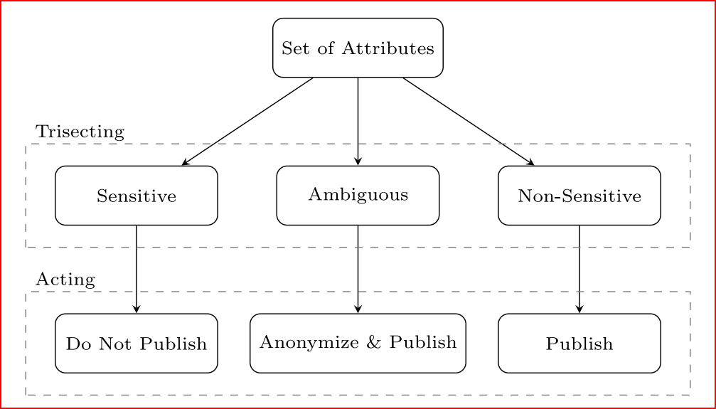
Proposed Model
Attribute division using three-way decisions :
Fig. 2. Three-way decision classification of attributes.

Slide 15
Proposed Model
Attribute division using three-way decisions :
1.1. Measures of information content :
Entropy is a common measure of computing the amount of information in an attribute .
Entropy(𝐴𝑖 ) = − ∑ 𝑃 (𝑎𝑖 ) log 𝑃 (𝑎𝑖 ),
𝑎𝑖∈𝐴𝑖 (6)

Slide 16
Proposed Model
Attribute division using three-way decisions :
1.2. Systematic division of attributes:
Once the evaluation function values are computed, we next divide the set of attributes into sensitive, non-sensitive and ambiguous groups using the following equations,
Sensitive(𝛼,𝛽) = { 𝐴𝑖 ∈ 𝐴𝑡 | 𝑒(𝐴𝑖 ) ≥ 𝛼 } , (7)
Non-Sensitive(𝛼,𝛽) = { 𝐴𝑖 ∈ 𝐴𝑡 | 𝑒(𝐴𝑖 ) ≤ 𝛽 } , (8)
Ambiguous(𝛼,𝛽) = { 𝐴𝑖 ∈ 𝐴𝑡 | 𝛽 < 𝑒(𝐴𝑖 ) < 𝛼} , (9)

Slide 17
Proposed Model
Attribute division using three-way decisions :
1.3. Utility assessment of resulting datasets:
This aspect is typically quantified in existing studies by making use of the measure of utility which is defined as,
Utility(𝐷(𝛼,𝛽) ) = − ∑ ... ∑ 𝑃 (𝑎1 , … , 𝑎𝑛 ) log 𝑃 (𝑎1 , …, 𝑎𝑛 ), (10)
𝑎1∈𝐴1 𝑎𝑛∈𝐴𝑛

Slide 18
Proposed Model
Attribute division using three-way decisions :
1.4. Quantifying trade-off between stability and utility :
Stability(𝐷(𝛼,𝛽) ) $=\frac{\text{|}\text{Non}\text{−}\text{Sensitive}\text{(}\text{α}\text{,}\text{β}\text{) | × |}\text{Ambiguous}\text{(}\text{α}\text{,}\text{β}\text{) |}}{\text{|}\text{At}\text{| × (|}\text{Ambiguous}\text{(}\text{α}\text{,}\text{β}\text{) | + |}\text{Non}\text{−}\text{Sensitive}\text{(}\text{α}\text{,}\text{β}\text{) |)}}$
(11)
Stability(𝐷(𝛼,𝛽) ) $=\frac{\text{2}}{{Utility}^{−1}\text{(}\text{D}\text{(}\text{α}\text{,}\text{β}\text{) ) + }{\text{Stability}}^{−1}\text{(}\text{D}\text{(}\text{α}\text{,}\text{β}\text{) )}}$
(12)

Slide 19
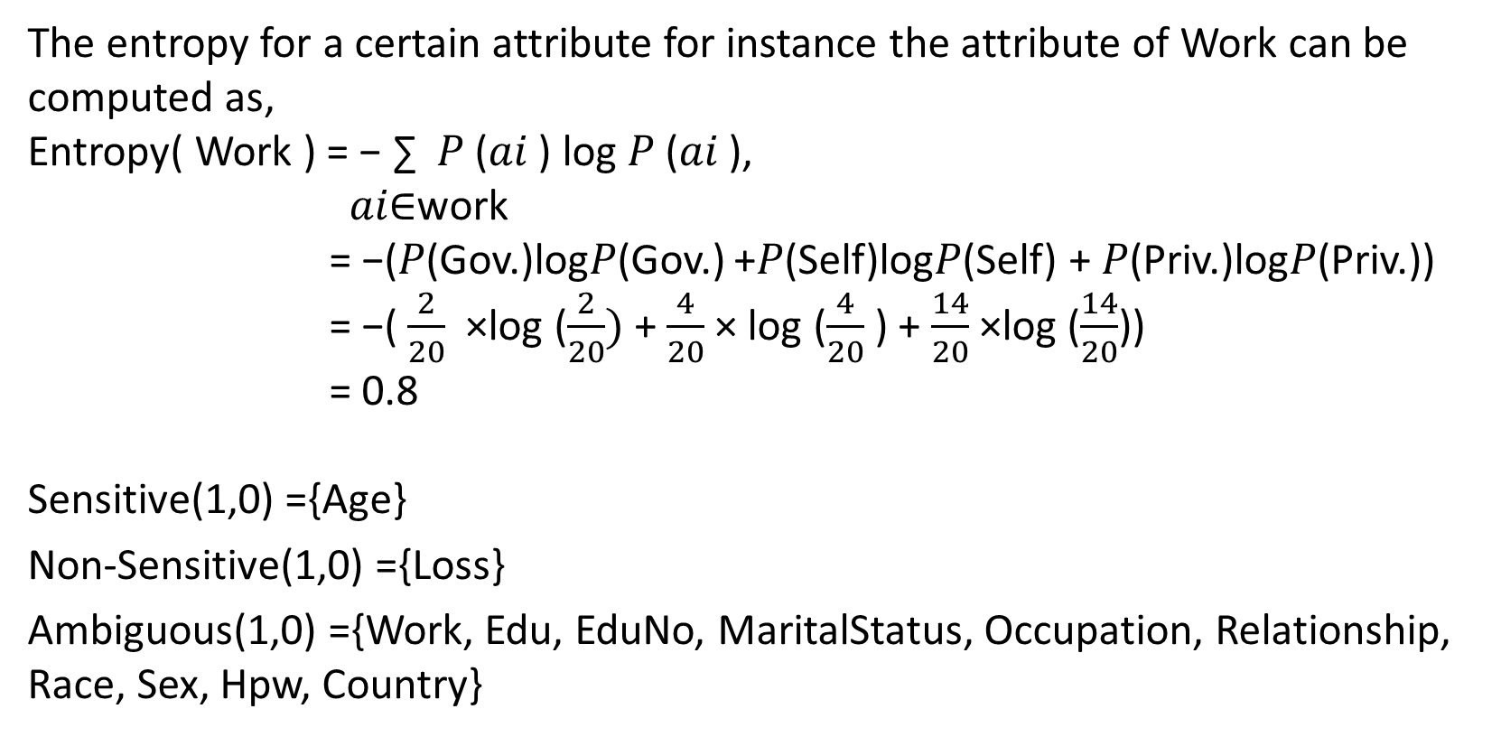
Proposed Model
2. Demonstration of three-way division of attributes:
The entropy for a certain attribute for instance the attribute of Work can be computed as,
Entropy( Work ) = − ∑ 𝑃 (𝑎𝑖 ) log 𝑃 (𝑎𝑖 ),
𝑎𝑖∈work
= −(𝑃(Gov.)log𝑃(Gov.) +𝑃(Self)log𝑃(Self) + 𝑃(Priv.)log𝑃(Priv.))
= −( $\frac{2}{20}$ ×log ($\frac{2}{20})$+ $\frac{4}{20}$× log ($\frac{4}{20}$ ) + $\frac{14}{20}$×log ($\frac{14}{20}$))
= 0.8
Sensitive(1,0) ={Age}
Non-Sensitive(1,0) ={Loss}
Ambiguous(1,0) ={Work, Edu, EduNo, MaritalStatus, Occupation, Relationship, Race, Sex, Hpw, Country}

Slide 20
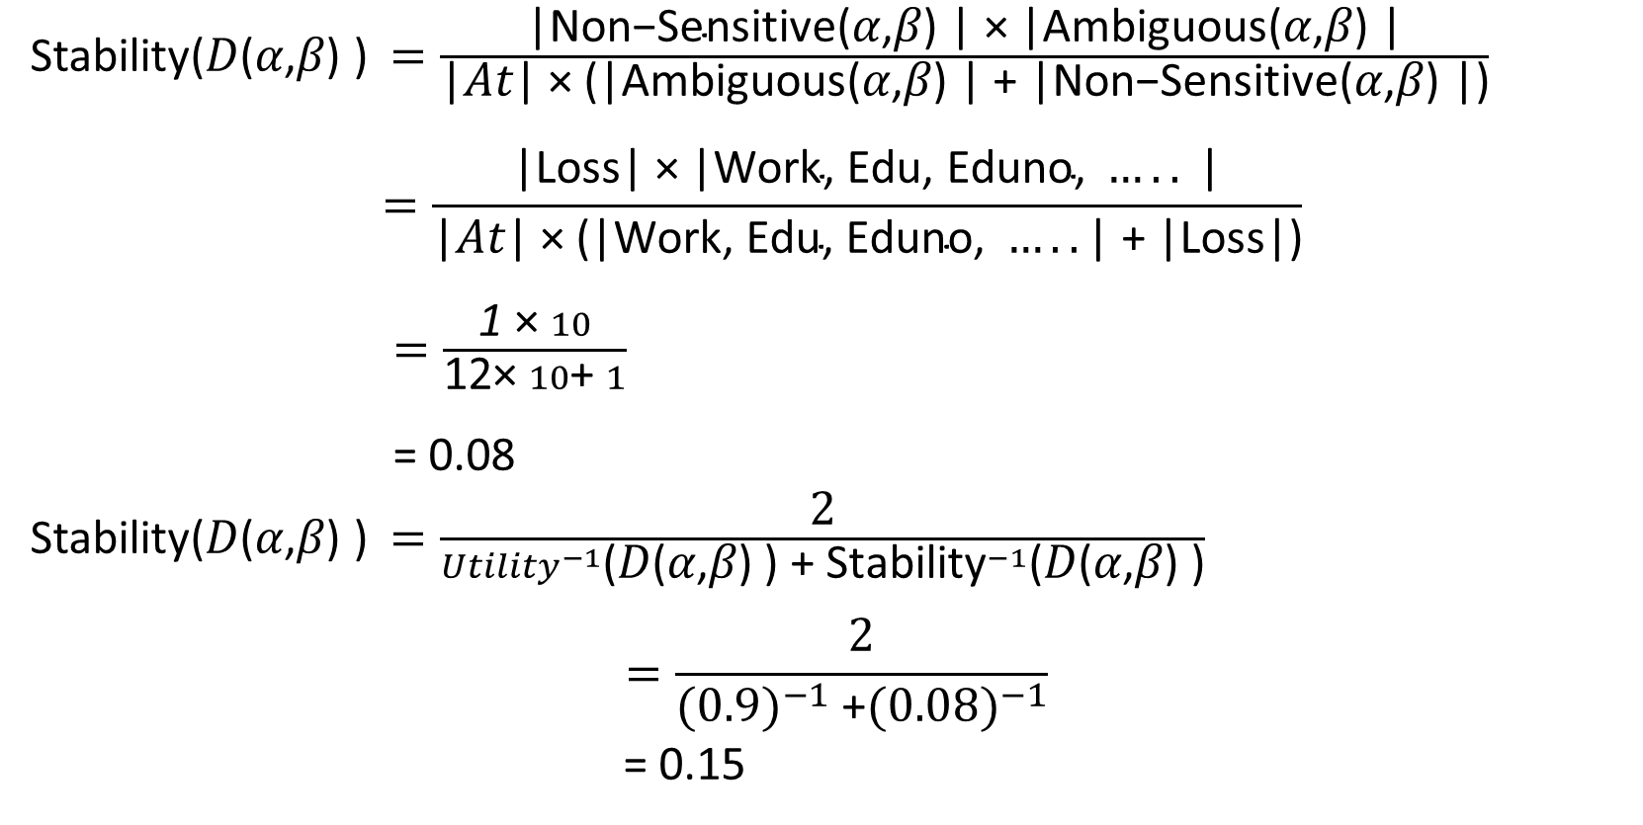
Proposed Model
2. Demonstration of three-way division of attributes:
Stability(𝐷(𝛼,𝛽) ) $=\frac{\text{|}\text{Non}\text{−}\text{Sensitive}\text{(}\text{α}\text{,}\text{β}\text{) | × |}\text{Ambiguous}\text{(}\text{α}\text{,}\text{β}\text{) |}}{\text{|}\text{At}\text{| × (|}\text{Ambiguous}\text{(}\text{α}\text{,}\text{β}\text{) | + |}\text{Non}\text{−}\text{Sensitive}\text{(}\text{α}\text{,}\text{β}\text{) |)}}$
$$=\frac{\text{|}\text{Loss}\text{| × |}\text{Work}\text{, }\text{Edu}\text{, }\text{Eduno}\text{, }…..\text{ |}}{\text{|}\text{At}\text{| × (|}\text{Work}\text{, }\text{Edu}\text{, }\text{Eduno}\text{, }…..\text{| + |}\text{Loss}\text{|)}}$$
$=\frac{\text{1} \text{× }10}{\text{12}\text{× }10\text{+ }1}$
= 0.08
Stability(𝐷(𝛼,𝛽) ) $=\frac{\text{2}}{{Utility}^{−1}\text{(}\text{D}\text{(}\text{α}\text{,}\text{β}\text{) ) + }{\text{Stability}}^{−1}\text{(}\text{D}\text{(}\text{α}\text{,}\text{β}\text{) )}}$
$$=\frac{\text{2}}{{(0.9)}^{−1}\text{ +}{(0.08)}^{−1}}$$
= 0.15

Slide 21
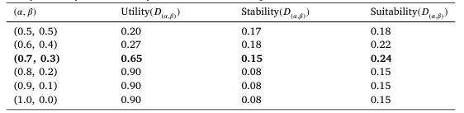
Proposed Model
2. Demonstration of three-way division of attributes:
Table 01 : Utility, Stability and Suitability of the dataset resulting from different thresholds.

Slide 22
Proposed Model
3. Three-way attribute division algorithm for differential privacy (3WADD):
Input: Original Dataset 𝐷𝑜 , thresholds (𝛼, 𝛽), step size 𝜆
Output: Publishable Dataset 𝐷𝑝
1: Compute Utility of 𝐷𝑜
2: (𝛼 ′ , 𝛽′ ) ← (𝛼, 𝛽)
3: do
4: (𝛼, 𝛽) ← (𝛼 ′ , 𝛽′ )
5: Sensitive(𝛼,𝛽) ← { 𝐴𝑖 ∈ 𝐴𝑡 | 𝑒(𝐴𝑖 ) ≥ 𝛼 }
6: Non-Sensitive(𝛼,𝛽) ← { 𝐴𝑖 ∈ 𝐴𝑡 | 𝑒(𝐴𝑖 ) ≤ 𝛽 }
7: Ambiguous(𝛼,𝛽) ← { 𝐴𝑖 ∈ 𝐴𝑡 | 𝛽 < 𝑒(𝐴𝑖 ) < 𝛼}
8: 𝐷(𝛼,𝛽) ← Non-Sensitive(𝛼,𝛽) ∪ Ambiguous(𝛼,𝛽)
9: (𝛼 ′ , 𝛽′ ) ← max (𝛼,𝛽) (Suitability(𝐷(𝛼−𝜆,𝛽) ), Suitability(𝐷(𝛼+𝜆,𝛽) ), Suitability(𝐷(𝛼,𝛽−𝜆) ), Suitability(𝐷(𝛼,𝛽+𝜆) ))
10: while (Suitability(𝐷(𝛼 ′ ,𝛽′ ) ) ≥ Suitability(𝐷(𝛼,𝛽) )
11: 𝐷Anonymized(𝛼,𝛽) ← Anonymize data corresponding to Ambiguous(𝛼,𝛽) using differential privacy
12: 𝐷𝑝 ← 𝐷Non-sensitive(𝛼,𝛽) ∪ 𝐷Anonymized(𝛼,𝛽)
13: return 𝐷p

Slide 23
3WADD Algorithm
Function:
• Automatically divides attributes into three categories.
• Adjusts thresholds for optimal utility and stability of data.
• Uses entropy to measure the information content of each attribute.
Outcome:
• Balances privacy and utility by anonymizing ambiguous attributes.

Slide 24
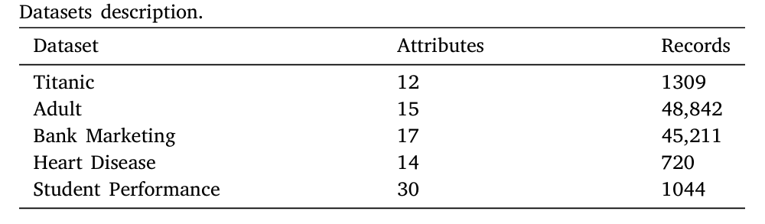
Experimental Results
Experimental setup and datasets:
Table 02 : Datasets description.

Slide 25
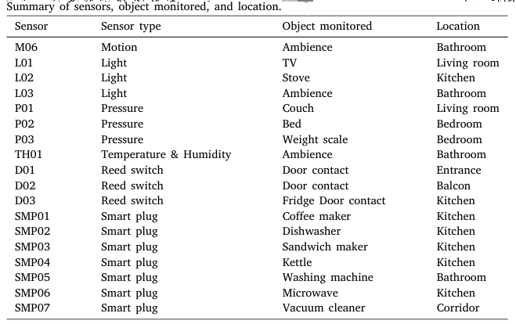
Experimental Results
Experimental setup and datasets:
Table 03 : Summary of sensors, object monitored, and location.

Slide 26
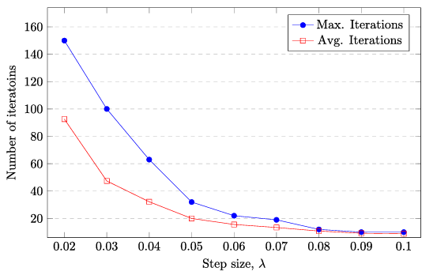
Experimental Results
Experimental setup and datasets:
Fig. 3. Step size 𝜆 and number of iterations.

Slide 27
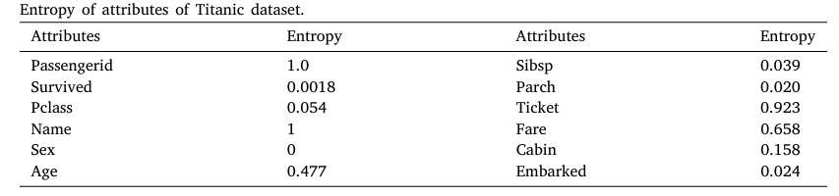
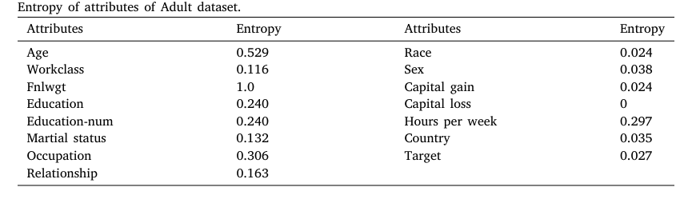
Experimental Results
Experimental setup and datasets:
Table 04 : Entropy of attributes of Titanic dataset.
Table 05 : Entropy of attributes of Adult dataset.

Slide 28
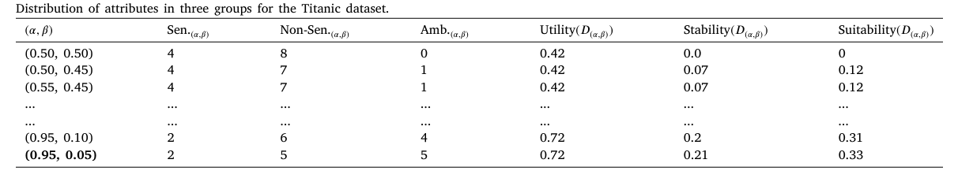
Experimental Results
2. Three-way attribute division results :
Table 06 : Distribution of attributes in three groups for the Titanic dataset.

Slide 29
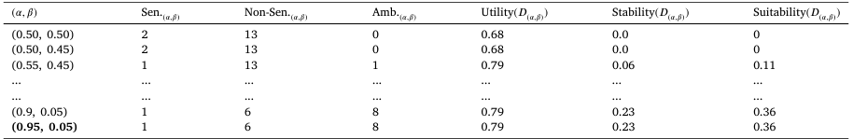
Experimental Results
2. Three-way attribute division results :
Table 07 : Distribution of attributes in three groups for the Adult dataset.

Slide 30
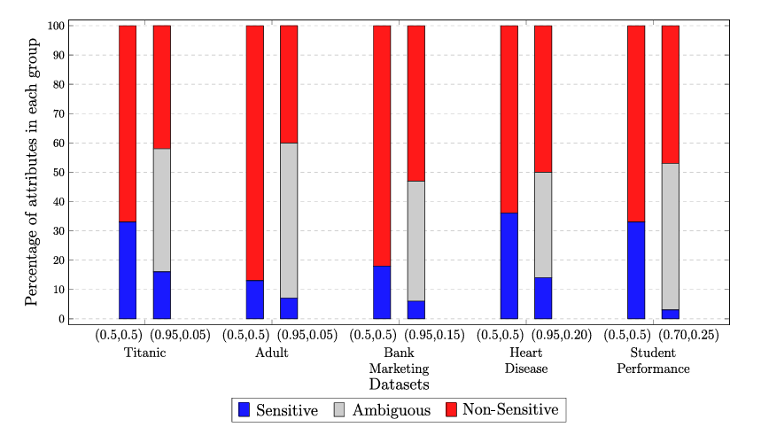
Experimental Results
2. Three-way attribute division results :
Fig. 4. Percentage of attributes in each group for (0.5, 0.5) and determined thresholds.

Slide 31
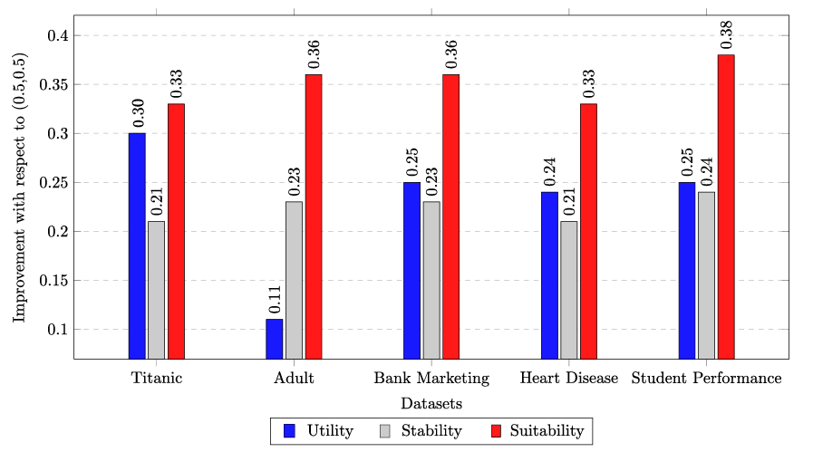
Experimental Results
2. Three-way attribute division results :
Fig. 5. Improvements in Utility, Stability and Suitability with respect to starting thresholds.

Slide 32
Experimental Results
2. Three-way attribute division results :
Table 08 : Distribution of attributes in three groups for the Adult dataset.

Slide 33
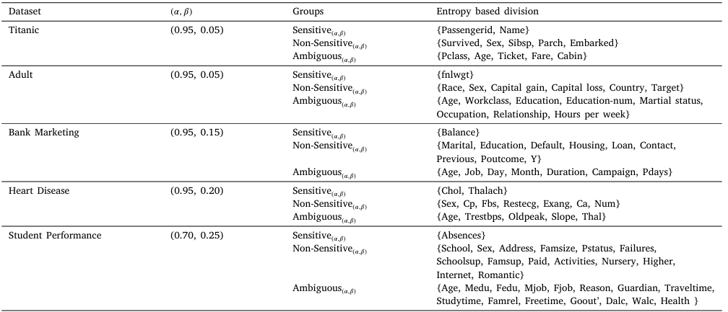
Experimental Results
2. Three-way attribute division results :
Table 09 : Division of attributes with the determined thresholds.

Slide 34
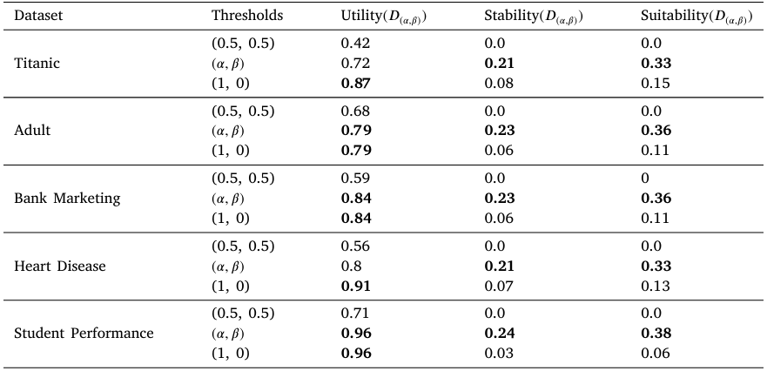
Experimental Results
2. Three-way attribute division results :
Table 10 : Comparison of the determined thresholds with extreme thresholds of (0.5, 0.5) and (1, 0).

Slide 35
Advantages of the model
Automation:
• Eliminates manual, costly processes of data categorization.
Balance:
• Preserves privacy while maintaining the utility of IoT data.
Scalability:
• Applicable to large IoT datasets, reducing processing time and effort.

Slide 36
Conclusions
Summary:
• The proposed model enhances IoT data privacy using three-way decisions and differential privacy.
Impact:
• Provides a scalable, automated solution for balancing privacy and utility in IoT systems.
Future Work:
• Exploring more sophisticated evaluation functions for improved attribute classification.

Slide 37

References
Paper 01 link ( Click to open it )
Paper 02 link ( Click to open it )
Any Questions

