Slide 1
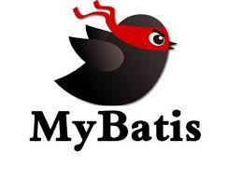
Mybatis (IBATIS)

Slide 2

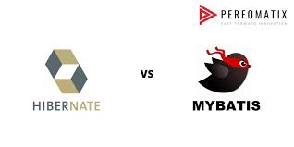

What is the difference between Mybatis & Hibernate?

Slide 3
What is MYBATIS (IBATIS)?
MYBATIS is a persistence framework that automates the mapping among SQL databases and objects in Java, .NET, and Ruby on Rails. MYBATIS makes it easier to build better database oriented-applications more quickly and with less code.(BUT) MyBatis uses JAVA programming language while developing database oriented application.
MyBatis is an open source, lightweight, persistence framework. It is an alternative to JDBC and Hibernate.
It abstracts almost all of the JDBC code, and reduces the burden of setting of parameters manually and retrieving the results. It provides a simple API to interact with the database. It also provides support for custom SQL, stored procedures and advanced mappings.

Slide 4
MYBATIS Design Features
Simplicity
Fast Development.
Portability
MyBatis can be implemented for nearly any language or platform such as Java, Ruby, and C# for Microsoft .NET.
Independent Interfaces
MyBatis provides database-independent interfaces and APIs that help the rest of the application remain independent of any persistence-related resources.
Open source− MyBatis is free and an open source software.

Slide 5
Advantages of MYBATIS
Supports stored procedures − MyBatis encapsulates SQL in the form of stored procedures so that business logic can be kept out of the database, and the application is more portable and easier to deploy and test.
Supports inline SQL − No pre-compiler is needed, and you can have the full access to all of the features of SQL.
Supports dynamic SQL − MyBatis provides features for dynamic building SQL queries based on parameters.
Supports O/RM − MyBatis supports many of the same features as an O/RM tool, such as lazy loading, join fetching, caching, runtime code generation, and inheritance.

Slide 6
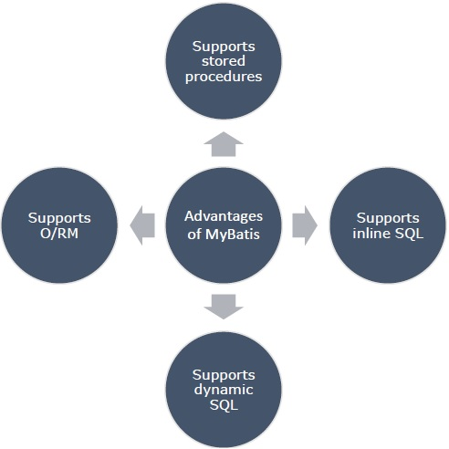
Advantages of MYBATIS

Slide 7
Difference between MyBatis and Hibernate
Both Hibernate and MyBatis are open source Object Relational Mapping (ORM) tools available in the industry. Use of each of these tools depends on the context you are using them.
MyBatis | Hibernate
It is simpler. It comes in a much smaller package size. | Hibernate generates SQL for you, which means you don’t have to spend time on generating SQL.
It is flexible, offers faster development time. | It is highly scalable, provides a much more advanced cache.
It uses SQL, which could be database dependent. | It uses HQL, which is relatively independent of databases. It is easier to change db into Hibernate.
It maps the ResultSet from JDBC API to your POJO Objects, so you don’t have to care about table structures. | Hibernate maps your Java POJO objects to the Database tables.
It is quite easy to use stored procedure in MyBatis. | Use of stored procedures is a little difficult in Hibernate.

Slide 8
Dynamic SQL
Dynamic SQL is a very powerful feature of MyBatis. It enables programmers to build queries based on the scenario dynamically.
MyBatis uses a powerful Dynamic SQL language that can be used within any mapped SQL statement. Following are the OGNL based Dynamic SQL expressions provided by MyBatis.
if
choose (when, otherwise)
trim (where, set)
foreach

Slide 9
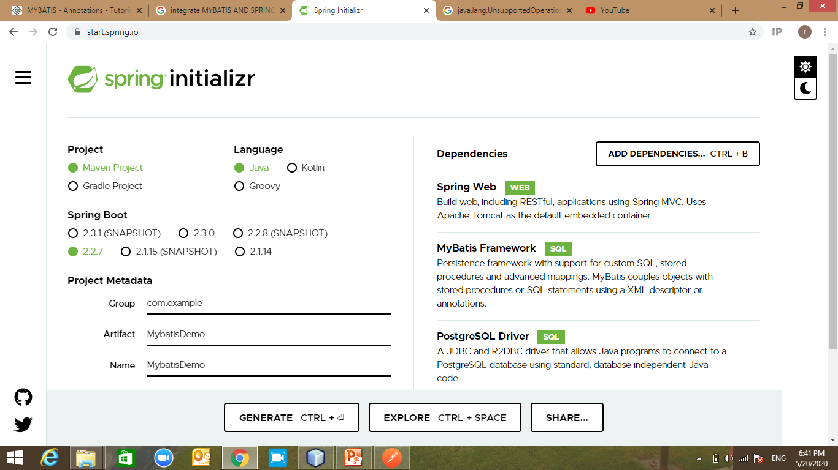
Spring & Mybaits

