Slide 1
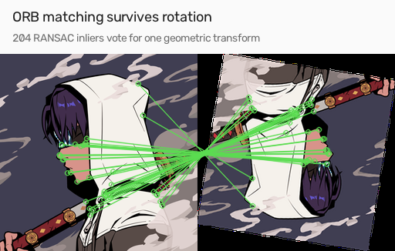

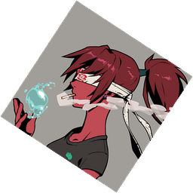

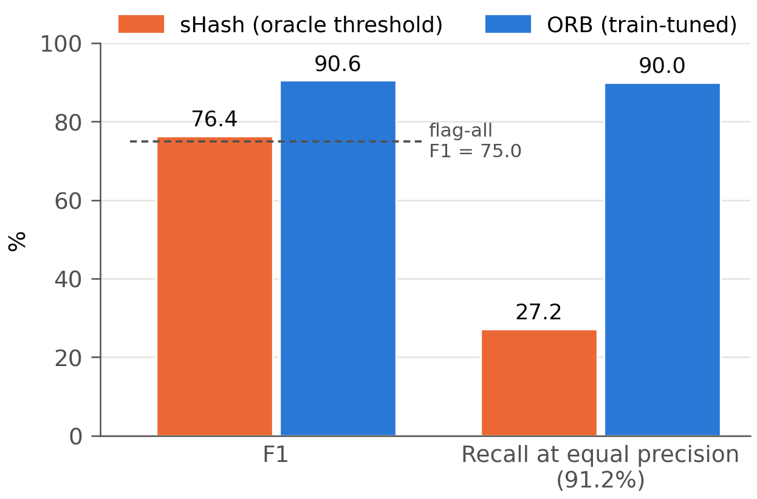
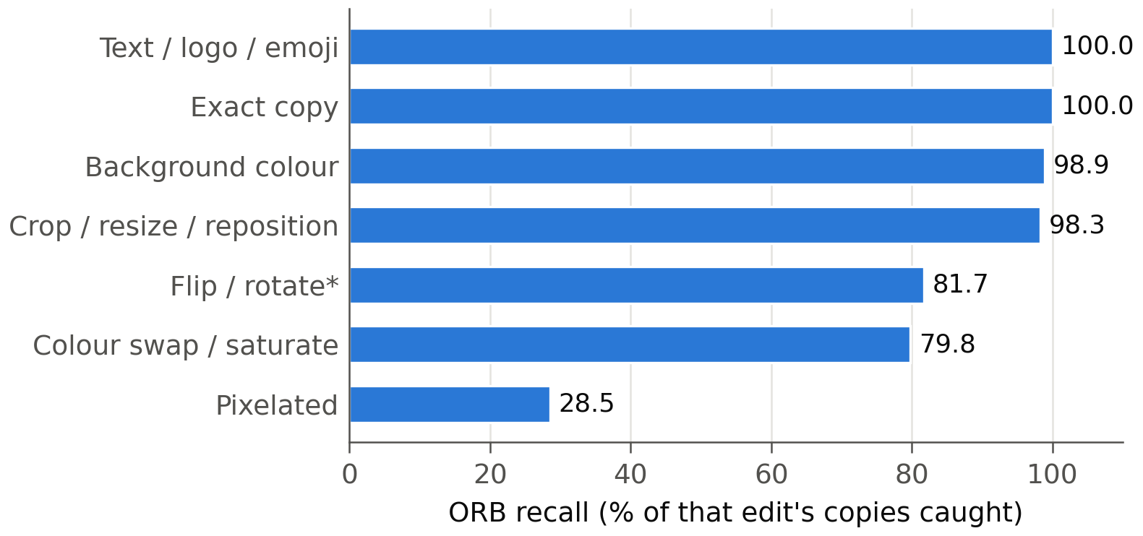
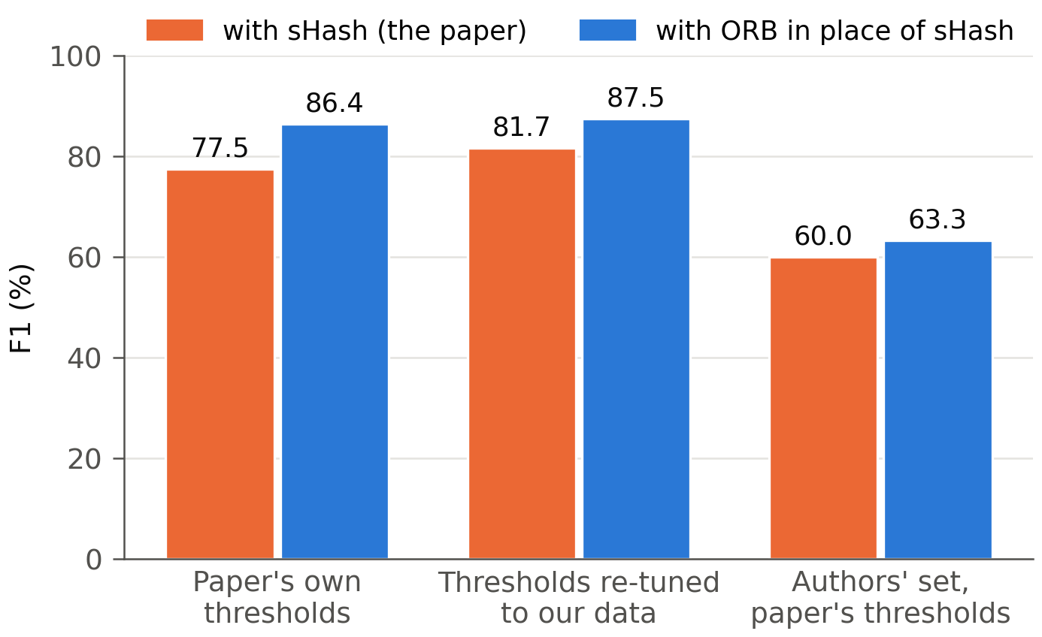
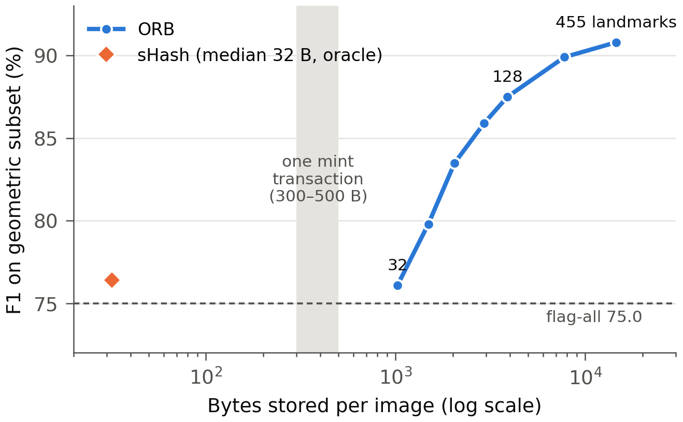
TECHNION
Israel Institute of Technology
02360340 · Project in Computer Communications
Detecting Copied NFT Images
Replacing a broken signal in an NFT copymint detector
Rabea Yassin · Ahmad Nassar Instructor: Eran Tavor
The problem: copymints
Our replacement: ORB feature matching
A copymint takes someone's NFT artwork, edits it a little, and mints it as new. Exact hashing (SHA-256) can't see it: one changed pixel gives an unrelated digest. Detection needs fingerprints of what the image looks like.
Find landmarks (corners) in both images, match them, and let RANSAC keep only the matches that agree on one transformation.
Here 204 matches agree on one rotation. ORB replaces sHash; the other three hashes and the vote are untouched.
original
rotated copy
recoloured copy
Result 1: +14.2 F1 on sHash's own job
What the researchers built
On the crop and rotation copies sHash was built for.
sHash was allowed to pick its threshold on the test answers; ORB's was set on training data.
sHash keeps its recall by flagging 1,630 of 2,400 innocent images.
Kotzer et al. compute four perceptual hashes per image, search each in its own BK-tree, and call it a copy when at least two agree.
aHash
brightness layout
pHash
coarse shapes
2 of 4
agree?
copy /
not a copy
hsvHash
colour mix
sHash
image pieces (cropping)
Result 2: it wins almost everywhere
What we found: sHash isn't a distance
Share of each edit's copies ORB catches (precision 91.2%).
One clean failure: pixelation destroys the detail corners are made of.
*Always includes rotation; pure mirrors: 100%.
sHash fingerprints each piece of an image and compares the lists one way. In the data the authors shared with us, the reported distance matches one direction on all 1,802 pairs, and the other on only 240.
B
cat+dog
A
cat
2
16
30 > 2 + 16
Result 3: +8.9 F1 in the whole detector
C
dog
Change only sHash; keep the paper's own thresholds.
At the same 98.1% precision, recall rises from 64.1% to 77.2%: ~1,500 more copies caught.
Our test set is 82.6% copies, so equal precision is the fair comparison.
30
A search tree assumes the direct route is never longer than the detour. With sHash it can be, so the tree skips a branch holding a real copy and nothing looks wrong.
The honest part: what ORB costs
The paper stores its four hashes, ≈56 bytes, inside each mint transaction (300–500 bytes). ORB stores 14,560 bytes per image: about 36 transactions.
What we learned
Check the maths before optimising it. We set out to make the search faster and found it was unsound.
How a signal is stored decides how it can be searched. A fingerprint fits a tree; a set of landmarks needs LSH, and far more space.
A negative result is still a result. Our edit classifier predicts which signals an edit breaks (100% / 97.5%), but doesn't improve the detector: broken signals go silent rather than voting wrongly.
Next: keep ORB's landmarks off-chain with a small commitment on-chain. Letting the cheap hashes shortlist candidates for an off-chain ORB check is an untested idea.
Shrink it and the advantage goes first: at 32 landmarks (1 KB, still 2.6 transactions) ORB only ties sHash. No size both fits and wins.
Based on Kotzer, Reviriego, Conde Diaz and Rottenstreich, "Combating NFT Copymints in Blockchain Networks: An Image Hashing Approach". Code and full report in the project repository.

