Slide 1
Practicing & Executing Basic OGL Program
Open GL Lab01

Slide 2
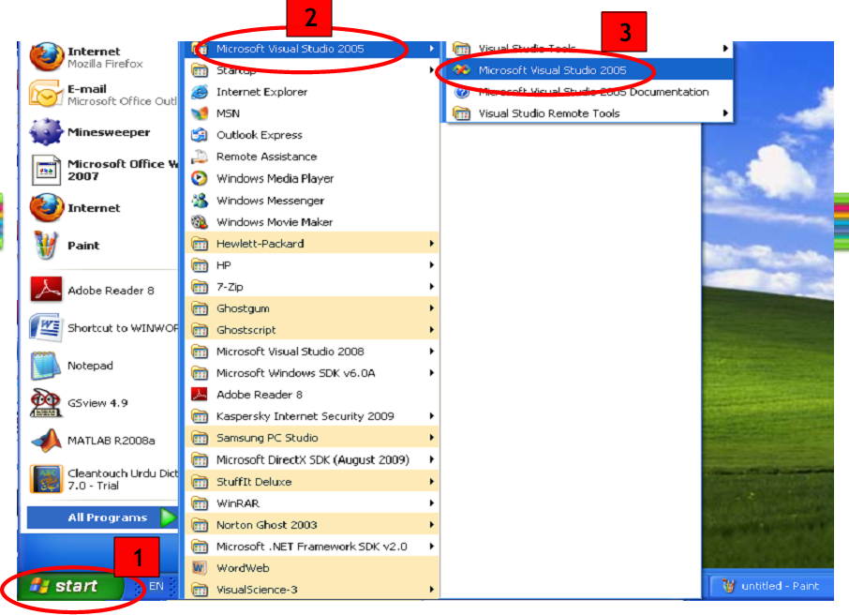
Setting up Your First OpenGL Program

Slide 3
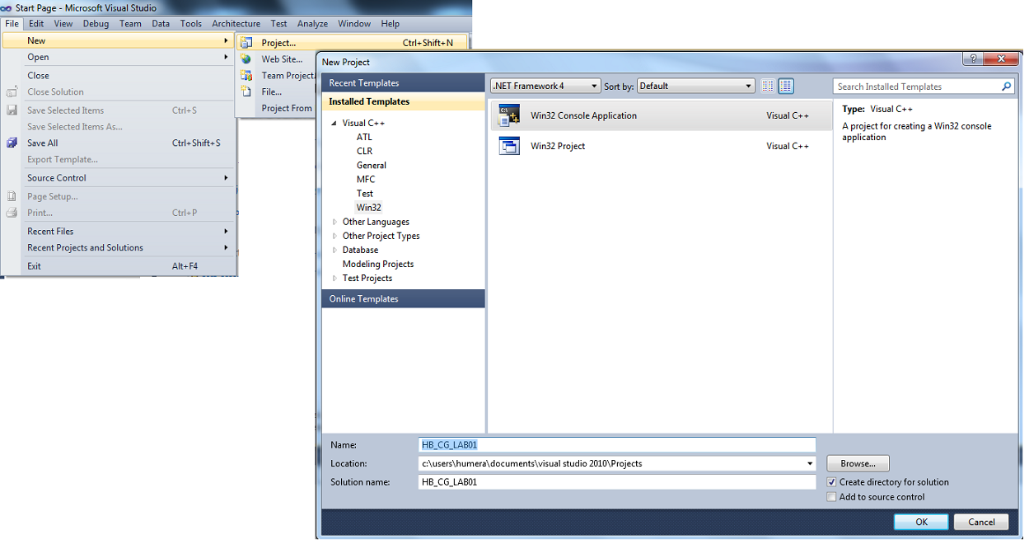
1
3
2
4
5

Slide 4
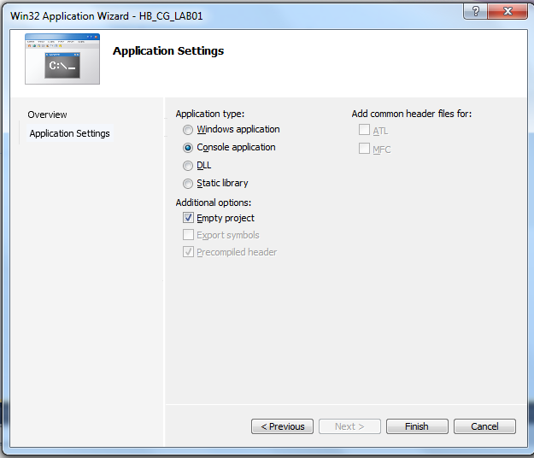
1
2
3
4

Slide 5
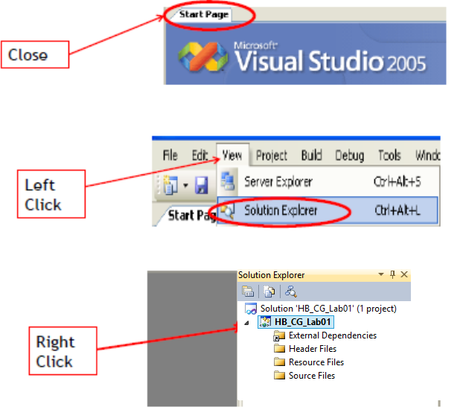

Slide 6
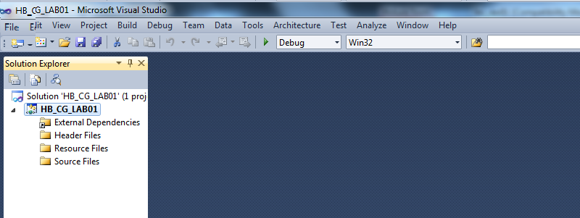
1
Right Click

Slide 7
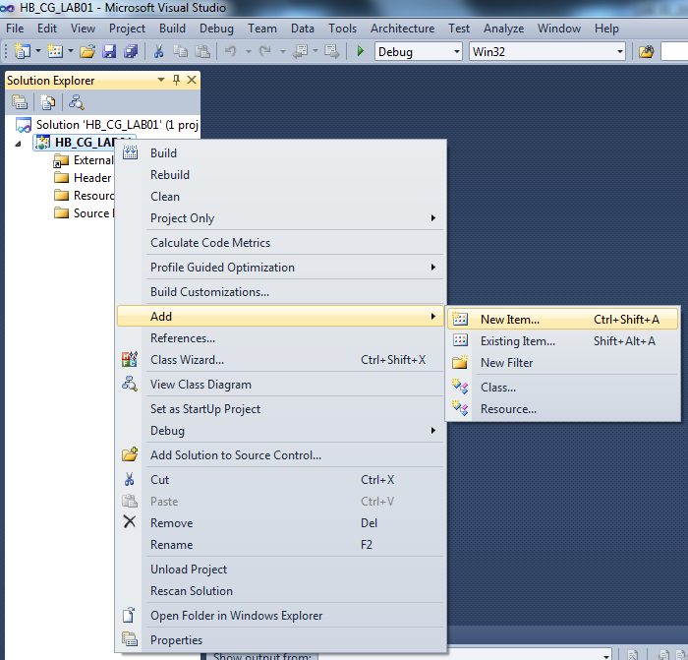
2
3

Slide 8
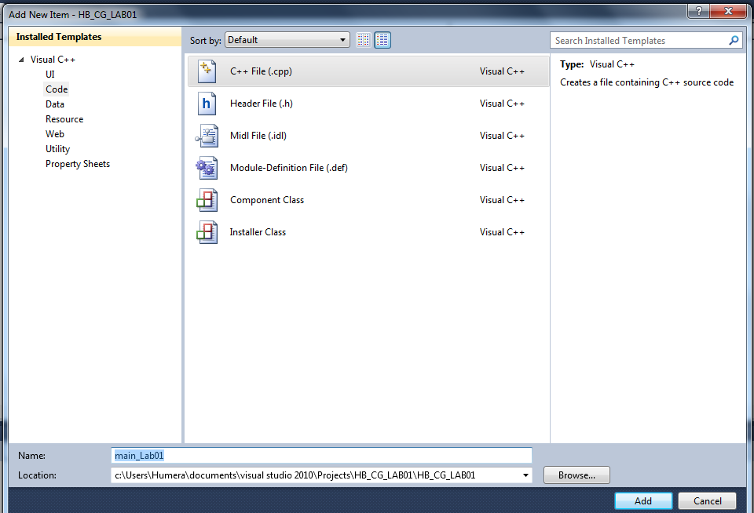
2
1
3
4

Slide 9
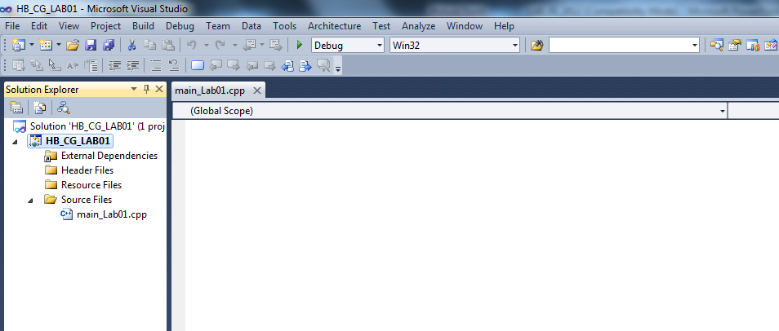

Slide 10

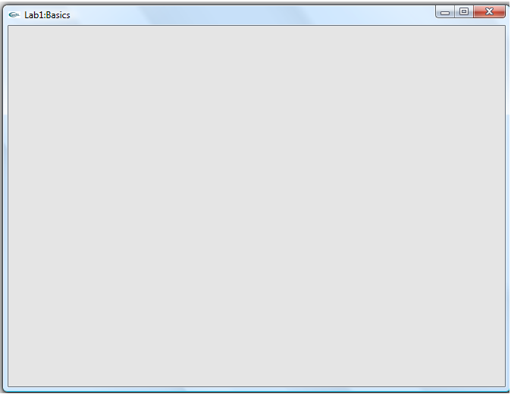


Type and Run the Code to Open an Output(viewport) Window

Slide 11
Write CODE To Open an Output Window:

Slide 12
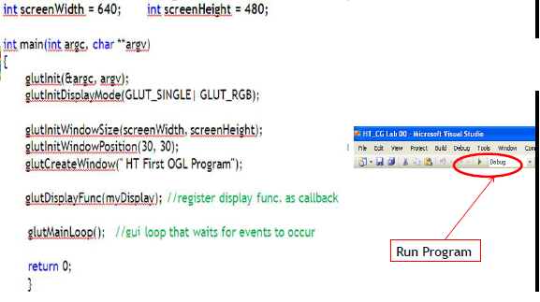

Slide 13
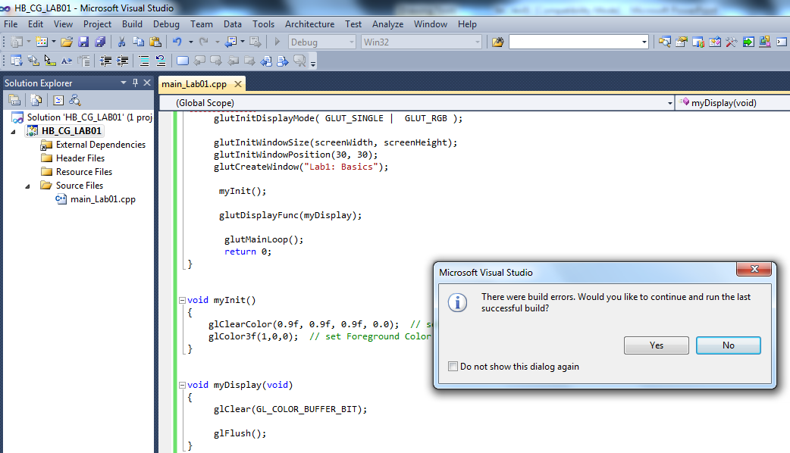
Click to execute

Slide 14
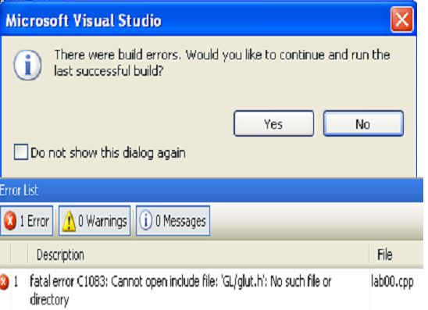
Place glut32.dll into C:\Windows\System32.
Place glut.h into C:\ProgramFiles\VS2010\Vc7\PlatformSDK\Include\GL
Place glut32.lib into C:\Program Files\VS2010\Vc7\PlatformSDK\Lib

Slide 15
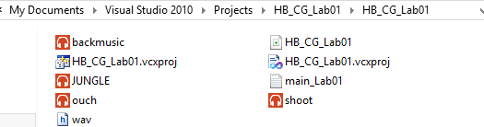
Adding Sound to your Program

Slide 16
