Slide 1

SALHI KHALIL
mongodb.org

Slide 2
Content
Part 1: Introduction & Basics
2: CRUD
3: Schema Design
4: Indexes
5: Aggregation
6: Replication & Sharding

Slide 3
History
mongoDB = “Humongous DB”
Open-source
Document-based
“High performance, high availability”
Automatic scaling
-blog.mongodb.org/post/475279604/on-distributed-consistency-part-1
-mongodb.org/manual
Notes:
Too much text.
Open Source
High Performance
CA bullets

Slide 4
Motivations
Problems with SQL
Rigid schema
Not easily scalable (designed for 90’s technology or worse)
Requires unintuitive joins
Perks of mongoDB
Easy interface with common languages (Java, Javascript, PHP, etc.)
DB tech should run anywhere (VM’s, cloud, etc.)
Keeps essential features of RDBMS’s while learning from key-value noSQL systems
http://www.slideshare.net/spf13/mongodb-9794741?v=qf1&b=&from_search=13
Notes:
Quotes from a person

Slide 5

Company Using mongoDB
“MongoDB powers Under Armour’s online store, and was chosen for its dynamic schema, ability to scale horizontally and perform multi-data center replication.”
http://www.mongodb.org/about/production-deployments/

Slide 6
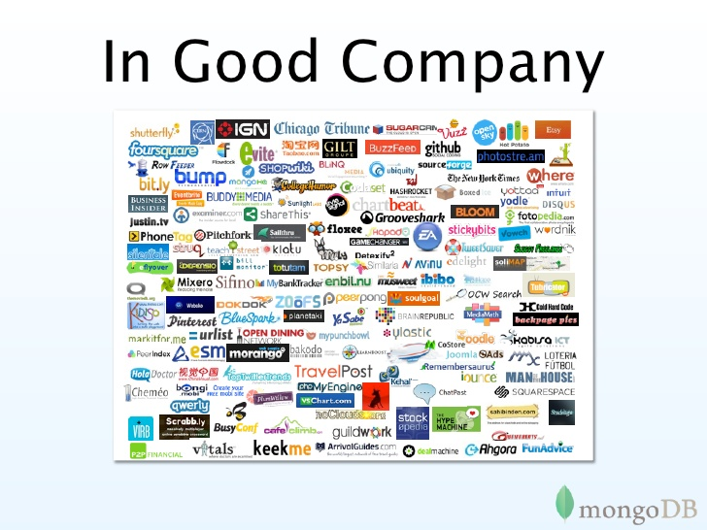
-Steve Francia, http://www.slideshare.net/spf13/mongodb-9794741?v=qf1&b=&from_search=13

Slide 7
Data Model
Document-Based (max 16 MB)
Documents are in BSON format, consisting of field-value pairs
Each document stored in a collection
Collections
Have index set in common
Like tables of relational db’s.
Documents do not have to have uniform structure
-docs.mongodb.org/manual/

Slide 8
JSON
“JavaScript Object Notation”
Easy for humans to write/read, easy for computers to parse/generate
Objects can be nested
Built on
name/value pairs
Ordered list of values
http://json.org/

Slide 9
BSON
“Binary JSON”
Binary-encoded serialization of JSON-like docs
Also allows “referencing”
Embedded structure reduces need for joins
Goals
Lightweight
Traversable
Efficient (decoding and encoding)
http://bsonspec.org/

Slide 10
BSON Example
{
"_id" : "37010"
"city" : "ADAMS",
"pop" : 2660,
"state" : "TN",
“councilman” : {
name: “John Smith”
address: “13 Scenic Way”
}
}

Slide 11
The _id Field
By default, each document contains an _id field. This field has a number of special characteristics:
Value serves as primary key for collection.
Value is unique, immutable, and may be any non-array type.
Default data type is ObjectId, which is “small, likely unique, fast to generate, and ordered.” Sorting on an ObjectId value is roughly equivalent to sorting on creation time.
http://docs.mongodb.org/manual/reference/bson-types/

Slide 12
mongoDB vs. SQL
mongoDB | SQL
Document | Tuple
Collection | Table/View
PK: _id Field | PK: Any Attribute(s)
Uniformity not Required | Uniform Relation Schema
Index | Index
Embedded Structure | Joins
Shard | Partition

Slide 13
CRUD Create, Read, Update, Delete

Slide 14
CRUD: Using the Shell (cont.)
To insert documents into a collection/make a new collection:
db.<collection>.insert(<document>)
<=>
INSERT INTO <table>
VALUES(<attributevalues>);

Slide 15
JSON (JavaScript Object Notation)
Syntax to represent objects in JavaScript
[{ “x”: 3, “y”: “Good”}, { “x”: 4, “y”: “Bad” }]
One of the most popular data-exchange formats over Internet
As JavaScript gained popularity, JSON’s popularity grew
Simple and easy to learn
Others popular formats include XML, CSV, …

Slide 16
Basic JSON Syntax
Supports basic data types like numbers and strings, as well as arrays and “objects”
Double quotes for string: “Best”, “UCLA”, “Worst”, “USC”
Square brackets for array: [1, 2, 3, “four”, 5]
Objects: (attribute, name) pairs. Use curly braces
{ “sid”: 301, “name”: “James Dean” }
Things can be nested
{ “sid” : 301, “name”: { “first”: “James”, “last”: “Dean” }, “classes”: [ “CS143”, “CS144” ] }

Slide 17
RDBMS for JavaScript Object Persistence
JavaScript applications need a “persistence layer” to store and retrieve JavaScript object
Traditionally (until mid 2010) this was done with RDBMS
RDBMS as massive, safe, efficient, multi-user storage engine
Q: How can we store JavaScript object in RDB?
“Impedance mismatch”: Two choices
Store object’s JSON as a string in a column
“Normalize” the object into set of relations
Q: Pros and cons of each approach?
Q: Can we just create “native database” for JSON?

Slide 18
MongoDB
Database for JSON objects
Perfect as a simple persistence layer for JavaScript objects
“NoSQL database”
Data is stored as a collection of documents
Document: (almost) JSON object
Collection: group of “similar” documents
Analogy
Document in MongoDB ~ row in RDB
Collection in MongoDB ~ table in RDB

Slide 19
MongoDB “Document”
{
"_id": ObjectId(8df38ad8902c),
"title": "MongoDB",
"description": "MongoDB is NoSQL database",
"tags": ["mongodb", "database", "NoSQL"],
"likes": 100,
"comments": [
{ "user":"lover", "comment": "Perfect!" },
{ "user":"hater", "comment": "Worst!" }
]
}
_id field: primary key
May be of any type other than array
If not provided, automatically added with a unique ObjectId value
Stored as BSON (Binary representation of JSON)
Supports more data types than JSON
Does not require double quotes for field names

Slide 20
MongoDB “Philosophy”
Adopts JavaScript “laissez faire” philosophy
Don’t be too strict! Be accommodating! Handle user request in a “reasonable” way
Schema-less: no predefined schema
Give me anything. I will store it anywhere you want
One collection will store documents of any kind with no complaint
No need to “plan ahead”
A “database” is created when a first collection is created
A “collection” is created when a first document is inserted
Both blessing and curse

Slide 21
MongoDB Demo
show dbs;
use demo;
show collections;
db.books.insertOne({title: "MongoDB", likes: 100});
db.books.find();
show collections;
show dbs;
db.books.insertMany([{title: "a"}, {name: "b"}]);
db.books.find();
db.books.find({likes: 100});
db.books.find({likes: {$gt: 10}});
db.books.updateOne({title: "MongoDB"}, {$set: { likes: 200 }});
db.books.find();
db.books.deleteOne({title: "a"});
db.books.drop();
show collections;
show dbs;

Slide 22
Basic MongoDB Commands (1)
mongo: start MongoDB shell
use <dbName>: use the database
show dbs: show list of databases
show collections: show list of collections
db.colName.drop(): delete `colName` collection
db.dropDatabase(): delete current database

Slide 23
Basic MongoDB Commands (2)
CRUD operations
insertOne(), insertMany()
findOne(), find()
updateOne(), updateMany()
deleteOne(), deleteMany()
Insertion: insertX( doc(s) )
db.books.insertOne({title: "MongoDB", likes: 100})
db.books.insertMany([{title: "a"}, {title: "b"}])

Slide 24
Basic MongoDB Commands (3)
Retrieval: findX(condition)
db.books.findOne({likes: 100})
db.books.find({$and: [{likes: {$gte: 10}}, {likes: {$lt: 20}}]})
Other Boolean/comaprision operators: $or, $not, $gt, $ne, …
Update: updateX(condition, update_operation)
db.books.updateOne({title: "MongoDB"}, {$set: {title: "MongoDB II"}})
db.books.updateMany({title: "MongoDB"}, {$inc: {likes: 1}})
Other update operators: $mul (multiply), $unset (remove field), …
Deletion: deleteX(condition)
db.books.deleteOne({title: "MongoDB"})
db.books.deleteMany({likes: {$lt: 100}})

Slide 25
MongoDB vs RDB
MongoDB document
Preserves structure
Nested objects
Potential redundancy
Restructuring or combining data is complex and inefficient
MongoDB: “laissez faire”
No explicit db/collection creation
No schema. Anything is fine
RDB tuple
“Flattens” data
Set of flat rows
Removes redundancy
Data can be easily “combined” using relational operators
RDB: “Straight-jacket”
Declare everything before use
Reject if not compliant

Slide 26
More on MongoDB
We learned just the basic
MongoDB has many more features
Transactions
Replication
(Auto)sharding
…
Read MongoDB documentation and online tutorials to learn more

Slide 27
CRUD: Inserting Data
Insert one document
db.<collection>.insert({<field>:<value>})
Inserting a document with a field name new to the collection is inherently supported by the BSON model.
To insert multiple documents, use an array.

Slide 28
CRUD: Querying
Done on collections.
Get all docs: db.<collection>.find()
Returns a cursor, which is iterated over shell to display first 20 results.
Add .limit(<number>) to limit results
SELECT * FROM <table>;
Get one doc: db.<collection>.findOne()

Slide 29
CRUD: Querying
To match a specific value:
db.<collection>.find({<field>:<value>})
“AND”
db.<collection>.find({<field1>:<value1>,
<field2>:<value2>
})
SELECT *
FROM <table>
WHERE <field1> = <value1> AND <field2> = <value2>;

Slide 30
CRUD: Querying
OR
db.<collection>.find({ $or: [
<field>:<value1>
<field>:<value2> ]
})
SELECT *
FROM <table> WHERE <field> = <value1> OR <field> = <value2>;
Checking for multiple values of same field
db.<collection>.find({<field>: {$in [<value>, <value>]}})

Slide 31
CRUD: Querying
Including/excluding document fields
db.<collection>.find({<field1>:<value>}, {<field2>: 0})
SELECT field1
FROM <table>;
db.<collection>.find({<field>:<value>}, {<field2>: 1})
Find documents with or w/o field
db.<collection>.find({<field>: { $exists: true}})

Slide 32
CRUD: Updating
db.<collection>.update(
{<field1>:<value1>}, //all docs in which field = value
{$set: {<field2>:<value2>}}, //set field to value
{multi:true} ) //update multiple docs
upsert: if true, creates a new doc when none matches search criteria.
UPDATE <table> SET <field2> = <value2>
WHERE <field1> = <value1>;

Slide 33
CRUD: Updating
To remove a field
db.<collection>.update({<field>:<value>},
{ $unset: { <field>: 1}})
Replace all field-value pairs
db.<collection>.update({<field>:<value>},
{ <field>:<value>, <field>:<value>})
*NOTE: This overwrites ALL the contents of a document, even removing fields.

Slide 34
CRUD: Removal
Remove all records where field = value
db.<collection>.remove({<field>:<value>})
DELETE FROM <table>
WHERE <field> = <value>;
As above, but only remove first document
db.<collection>.remove({<field>:<value>}, true)

Slide 35
Schema Design

Slide 36
RDBMS |  | MongoDB
Database | ➜ | Database
Table | ➜ | Collection
Row | ➜ | Document
Index | ➜ | Index
Join | ➜ | Embedded Document
Foreign Key | ➜ | Reference

Slide 37
Intuition – why database exist in the first place?
Why can’t we just write programs that operate on objects?
Memory limit
We cannot swap back from disk merely by OS for the page based memory management mechanism
Why can’t we have the database operating on the same data structure as in program?
That is where mongoDB comes in

Slide 38
Mongo is basically schema-free
The purpose of schema in SQL is for meeting the requirements of tables and quirky SQL implementation
Every “row” in a database “table” is a data structure, much like a “struct” in C, or a “class” in Java. A table is then an array (or list) of such data structures
So we what we design in mongoDB is basically same way how we design a compound data type binding in JSON

